Slide 1
1. Create a dictionary and print.
Dictionary keys: "Rejep", "Meret", "Oraz"
Dictionary values: 66112233, 66445566, 66778899
Output

Slide 2

2. Find Rejep's phone number.
Output

Slide 3
3. Change Meret's phone number (66111222).
Output

Slide 4
4. Add a new item to the contact (Gurban, 66333444).
Output

Slide 5
5. Delete Oraz's phone number.
Output

Slide 6

6. Print all names in the contact, one by one.
Output

Slide 7
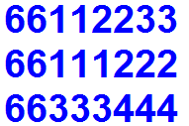
7. Print all phone numbers in the contact, one by one.
Output

Slide 8
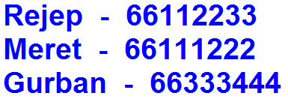
8. Print all items in the contact, one by one.
Output

Slide 9


9. Get a name from the user. If the name is in the contact, print its phone number, else print the message "phone number not found".
Output
Output

Slide 10
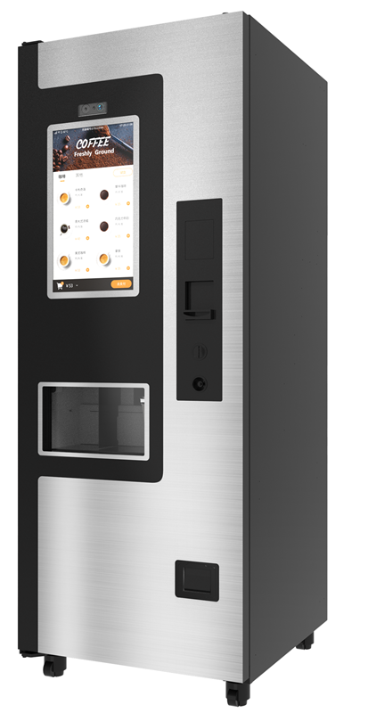
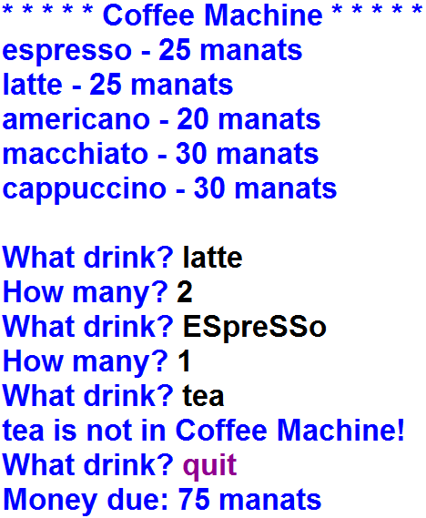
10. Write the code for the following application.
A = {"espresso" : 25,
"latte" : 25,
"americano" : 20,
"macchiato" : 30,
"cappuccino" : 30 }
Output

Slide 11
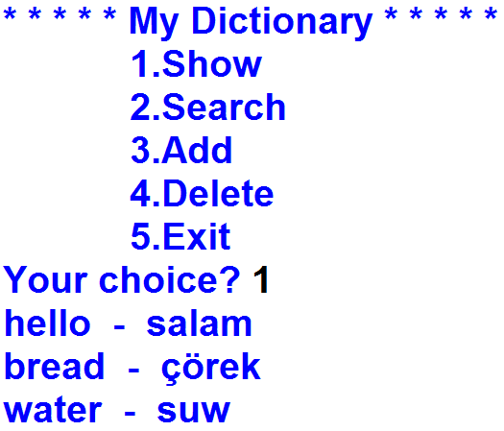

11. Write the code for the following application.
Output

Slide 12
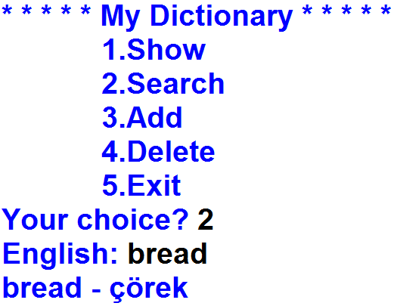
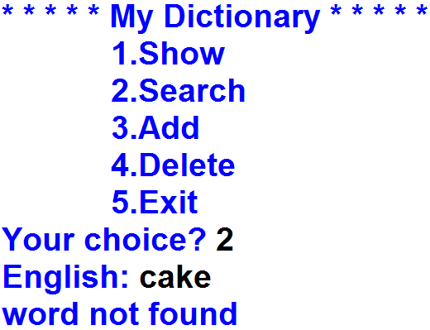
12. Write the code for the following application.
Output
Output

Slide 13
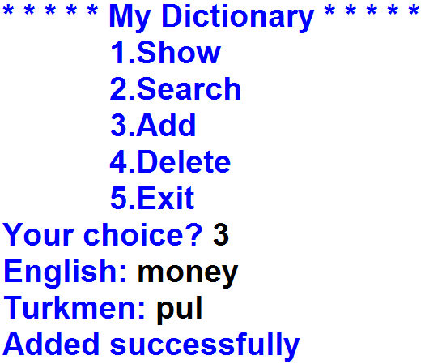
13. Write the code for the following application.
Output

Slide 14
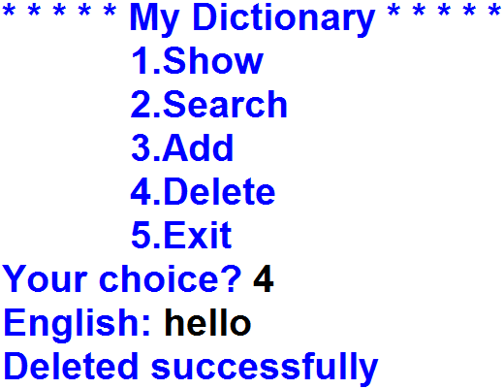
14. Write the code for the following application.
Output

Slide 15
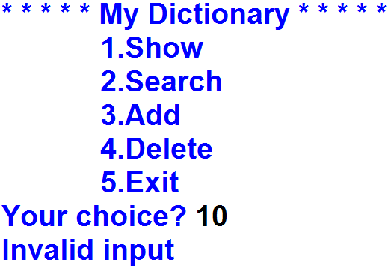
15. Write the code for the following application.
Output

Slide 16
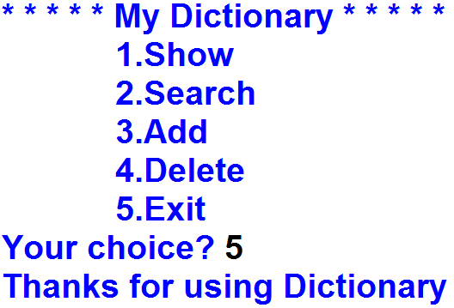
16. Write the code for the following application.
Output

