Slide 1
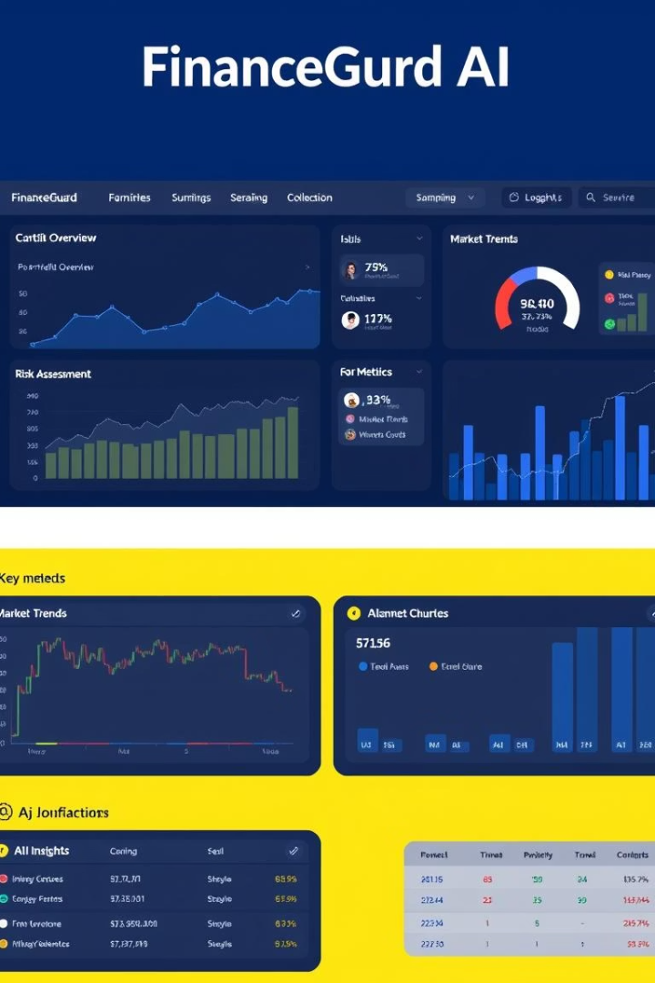
FinanceGuard AI
Retail Transaction Monitoring Dashboard
Open-source Python app for retail transaction analysis.

Slide 2
Core Functionality
Transaction Data
Metrics Calculated
Pattern Recognition
Real-time Monitoring
Processes CSV files like jordan_transactions.csv
Failure rates and key financial indicators
Identifies failed transaction patterns
Dashboard updates live transaction status
Natural Language Queries
Utilizes OpenAI for conversational data access

Slide 3
Implemented Features
AI Assistant
Analytics Dashboard
Chat interactively with transaction data
Interactive charts: heatmaps, trends
Real-time Monitoring
Smart Insights
Live status on transactions
Automated pattern recognition
Advanced AI
Gamification
Predictive failure scoring models
Branch performance rankings

Slide 4
Technical Architecture
Frontend
AI Engine
Streamlit web app for user interaction
OpenAI GPT-4 with LangChain integration
Visualizations
Data Processing
Plotly for dynamic charts and heatmaps
Pandas and NumPy for data manipulation
Notifications
Voice
Telegram, WhatsApp, Slack, Email
Arabic voice recognition support

Slide 5
AI-Powered Analysis
Natural Language Queries
Automated Insights
Failure Detection
Predictive Scoring
Generates key findings automatically
Detects patterns in transaction failures
Forecasts transaction failure risk
Ask data insights conversationally
Routing Recommendations
Anomaly DNA Matching
Guides smart transaction routing
Identifies unique failure signatures

Slide 6
Multi-Channel Alerts
Telegram Bot
WhatsApp Integration
Interactive commands and alerts
Via Twilio API
Slack Notifications
Email Alerts
Webhooks and bot messaging
Includes chart attachments
Configurable Thresholds
Priority Routing
User-defined alert criteria
Alerts routed by importance

Slide 7






Easy Installation
Clone Repository
git clone from GitHub
Install Dependencies
pip install -r requirements.txt
Set API Key
Add OpenAI key to .env file
Run Dashboard
streamlit run app.py
Configure Bots
Optional notification bot setup
Docker Support
Containerized deployment included

Slide 8
Available on GitHub
Source Code
Documentation
5000+ lines of Python code
Comprehensive setup and usage guides
Setup Scripts
Sample Data
Automation utilities for deployment
Data generator for testing and demos
Bot Configurations
Docker Files
Prebuilt configs for notifications
Container deployment manifests

