Slide 1

Statistics – an unreliable friend
Magnus ahlkvist
Twitter: @transmokopter
www.tsql.nu
Github.com/transmokopter

Slide 2
About Magnus
20+ years SQL Server experience
Transmokopter SQL AB
SQL Server consultant, Microsoft Certified Trainer, Microsoft Data Platform MVP
SQL Server Usergroup, SQL Friday, Data Weekender

Slide 3
"There are three kinds of lies: lies, damned lies, and statistics."
Not Mark twain

Slide 4
Why this presentation?
System for reporting financial statistics
Tight deadline for “crunching” numbers
Performance issues
Bad performance on reporting day
Reporting done late
Users unhappy
DBA yelled at
DBA unhappy ☹

Slide 5
Session scenario
Order system
Ship orders to warehouse system
OK Performance mostly, getting today’s orders however problematic
We will start in the age of SQL Server 2008

Slide 6
DEMO
Characteristics of our performance issue

Slide 7

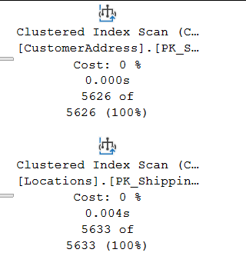
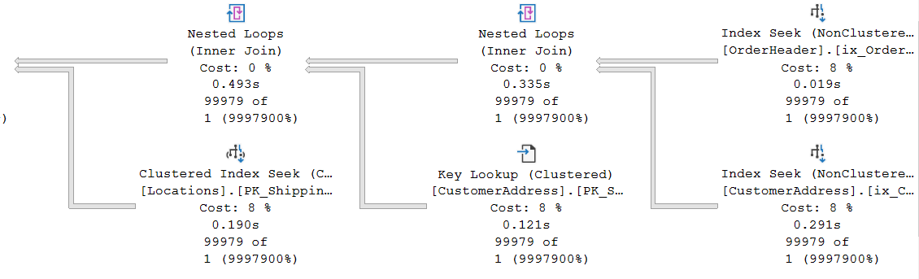
Plan characteristics

Slide 8
DEMO I know why it’s slow
It’s the statistics, it’s all lies.
Or fake news for a more modern reference

Slide 9
Statistics density vector
Density of leading column, then two leading columns in combination, then three leading columns…
Density = 1 / DistinctValuesCount
Gender = High density, SSN = Low density
Low Selectivity = High Density

Slide 10
Estimated rowcount
With histogram
OrderDate = 2016-08-24: 12496
OrderDate = 2016-08-25: 0 (Optimizer will estimate 1)
With density vector
D = Density for column(s) involved in equality predicate.
Example: OrderDate = 2020-08-25. Density for OrderDate = 0,004
RC = Total number of rows in the table
Estimated number of rows for equality predicate: D * RC
2020-08-24: 0,004 x 3 124 374 = 12497
2020-08-25: 0,004 x 3 124 374 = 12497
Then came New Cardinality Estimation. More on that later…

Slide 11
Ascending Key Problem
Can also be missing key-in-the-middle problem
Can also be bad estimates even with perfect statistics ☹

Slide 12
DEMO Suggested solutions
Parametrization, Hints, Trace flags, Upgrade, “Voldemort solution”

Slide 13
Other causes of bad guessing on Optimizer part
Statistics updated with low sample rate and skewed data
Bad cardinality estimation due to complex predicate and join logic
SQL 2014 and later addresses Ascending Key (with varying success)
But also introduce new cardinality estimator

Slide 14
DEMO Cardinality estimation
How will Sql Server generate Estimated Rowcount?
Simple predicates and more complex predicates

Slide 15
Thank you for participating in this event, donations will be used to help rebuild schools, homes and lives of people that were effected badly by earthquakes in Croatia 28.-29.12.2020.
Updates on donations: https://gogetfunding.com/sisakpetrinjastrasnik-earthquake-relief/ more info & organizer contact: https://mvps4croatia.com/

