Slide 1

Giant Eagle Checkout Area
Erik Wright, Eli Coyle, Aaron Noll, William Kurek

Slide 2
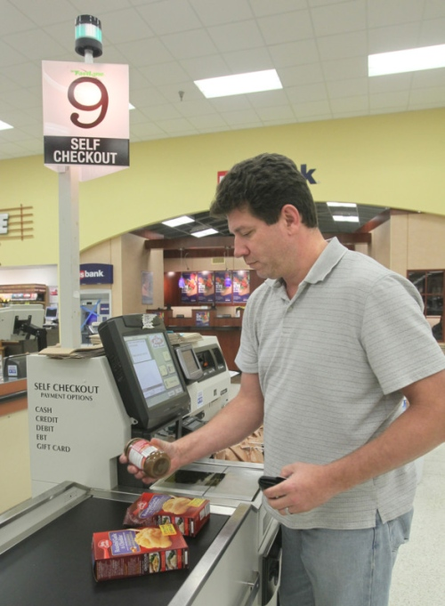
Introduction
Giant Eagle has two ways for customers to purchase items:
Checkout stations where an employee scans the customer’s items
Self-checkout stations where the customer scans their own items
Our project’s goal was to:
Analyze the differences between the two types of checkout stations
Determine if one is more useful than the other
The problems we chose to solve will help to:
Increase customer happiness by reducing the amount of time customers must wait in line
Improve company profits by decreasing the amount of time cashiers are idle

Slide 3
Problems to Solve
Which results in shorter wait times: cashier or self-checkout?
Lowers time spent waiting in line, making customers more happy. If it is found that self-checkout lanes are significantly faster, the store could save money by not hiring as many employees
What are the optimal number of lanes to have open on an average day?
This will find the optimal balance between maximizing speed of service and diminishing returns (extra lanes that do not get used as frequently)
How often does a customer at the self-service station require an employee’s help with a transaction?
The benefit of self-checkout lanes is that a single employee may manage multiple lanes; this benefit is lost if customers spend too much time waiting for an employee to assist them. If this is the case, improving the software in self-checkout lanes or making more lanes cashier-checkout may be necessary

Slide 4
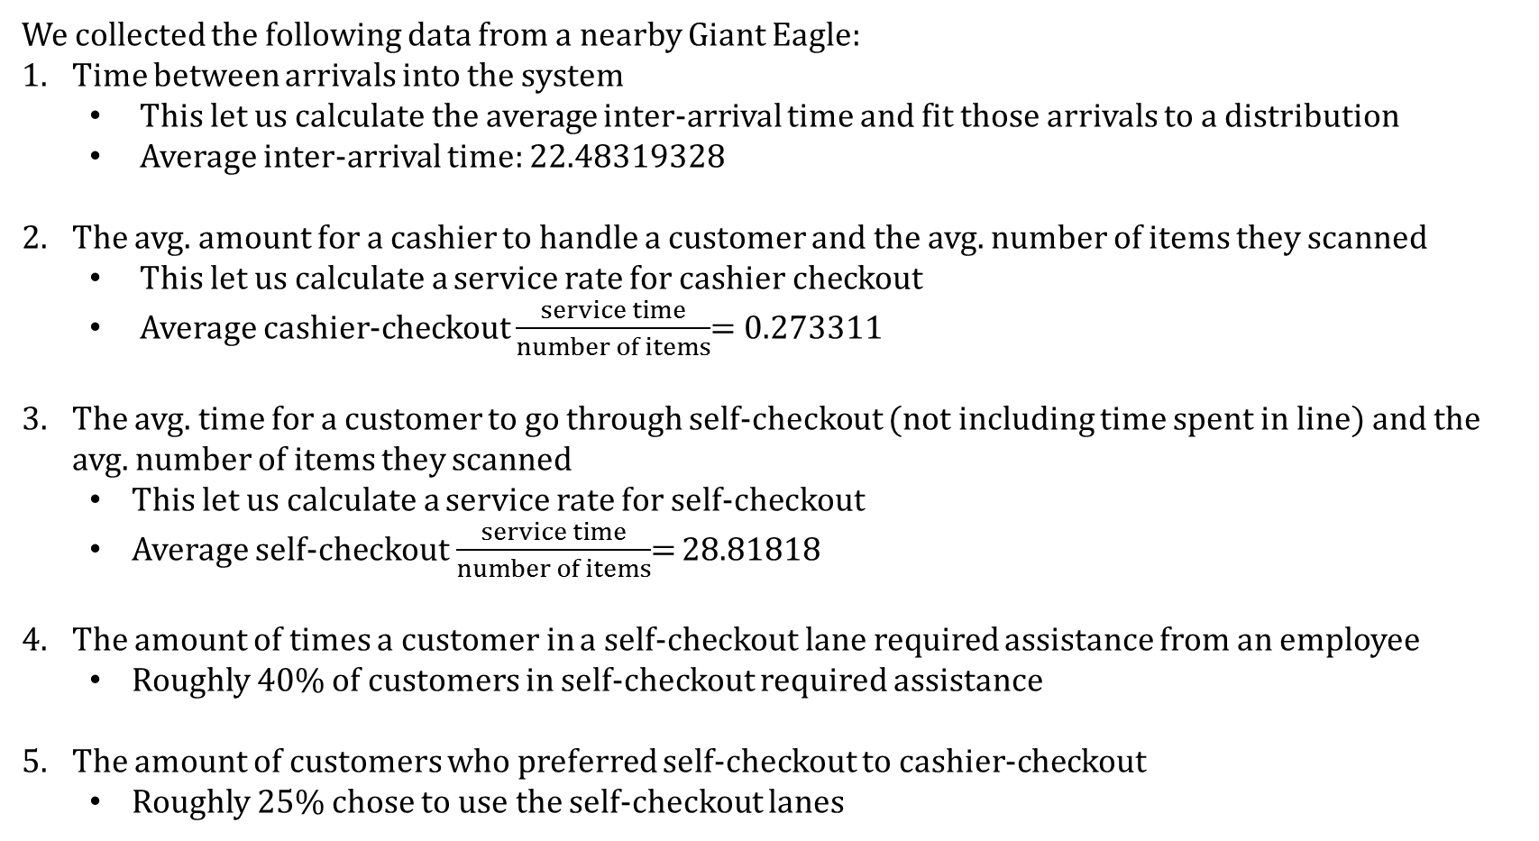
Data Collection
We collected the following data from a nearby Giant Eagle:
Time between arrivals into the system
This let us calculate the average inter-arrival time and fit those arrivals to a distribution
Average inter-arrival time: 22.48319328
The avg. amount for a cashier to handle a customer and the avg. number of items they scanned
This let us calculate a service rate for cashier checkout
Average cashier-checkout $\frac{service time}{number of items}$= 0.273311
The avg. time for a customer to go through self-checkout (not including time spent in line) and the avg. number of items they scanned
This let us calculate a service rate for self-checkout
Average self-checkout $\frac{service time}{number of items}$= 28.81818
The amount of times a customer in a self-checkout lane required assistance from an employee
Roughly 40% of customers in self-checkout required assistance
The amount of customers who preferred self-checkout to cashier-checkout
Roughly 25% chose to use the self-checkout lanes

Slide 5
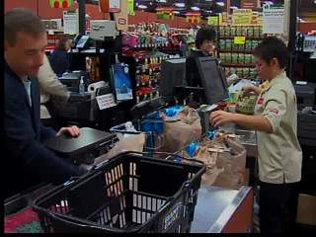
Modeling
Each checkout lane is modelled as a SimPy Resource object
Operates in the same way as a FIFO queue
Customers must be modeled as well
Customers will have a random amount of items
Customers will arrive according to a Exponential distribution
The speed at which a customer is serviced by a cashier is dependent on the speed of the cashier and the number of items
This can be calculated by giving each cashier a speed and multiplying by the number of items
This lets us determine when to remove a customer from the head of the queue
For the self-checkout lanes, each customer would have their own checkout speed
The service times for both cashier lanes and self-checkout lanes will fit an exponential distribution

Slide 6
Experimental Design
We wrote our program in Python, using the SimPy and SciPy.Stats libraries
Our program was designed as follows:
The amount of cashier-checkout lanes and self-checkout lanes are easily modifiable through command-line arguments
The number of 10-hour days the sim runs for can also be changed on the command line (default is 1)
Customers will arrive in a pseudo-random fashion following a Exponential distribution
Each customer will have a randomly generated number of items they are purchasing
Number of items is normally distributed
Customers will choose to go to either a self-checkout or cashier-checkout lane based on the number of items they have
Customers are much more likely to use the self-checkout lanes if they have few items (usually ≤10)

Slide 7
Experimental Design
Customers using self-checkout have a personal service rate (assigned when created) while cashier lanes have a constant rate throughout the day
Checkout speeds for cashiers and customers are exponentially distrubuted
The simulation runs for 10 “hours” (times the number of user-specified days) and outputs each customer’s checkout stats into a spreadsheet when they complete
ID, # items, type of kiosk, kiosk number, time spent in line, time spent checking out, whether or not an employee was involved (if self-checkout was used)
The simulation will be run multiple times with different combinations of self-checkout lanes and cashier lanes

Slide 8
Experiments (1)
Which results in shorter wait times: cashier or self-checkout?
The pseudo-random arrival will be the same for different combinations of checkout stations. For this problem we run the simulation for a “week” once with one cashier, once with one self-checkout, and do a paired t-test on the resulting wait times.
2. What is the optimal number of lanes (of each type) to have open on an average day?
Since there are multiple combinations of self-checkout and cashier kiosks, we can’t do a paired t-test. Instead, we will run the simulation for a “week” with each combination—the one with the lowest average wait time and highest number of customers served is the optimal combination

Slide 9
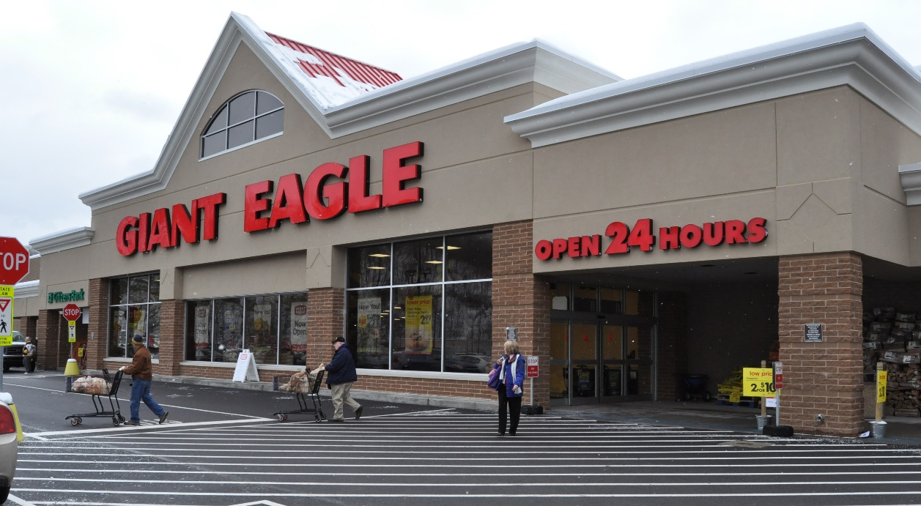
Experiments (2)
3. How often does a customer at the self-service station require an employee’s help with a transaction?
We can easily figure this out by running our simulation for several “days” with several self-checkout lanes and counting the average number of employee interactions/day

Slide 10



Question 1
Problem Solutions
(Run for 7 days each)

Slide 11
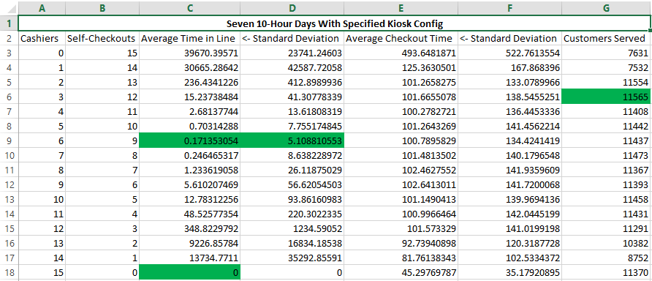
Question 2
Problem Solutions

Slide 12
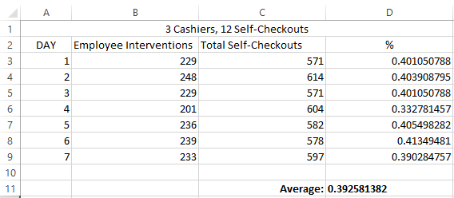
Problem Solutions
Question 3

Slide 13
Concluding Remarks
Overall, cashier checkout lines proved to be much more efficient
Some customers still prefer to have self-checkout
The most efficient setup is to have mostly cashier-run lanes and a few self-checkout lanes
Giant Eagle has this setup already, so they’re doing a pretty good job
A Giant Eagle advantage card is required at self checkout
Many first-time customers don’t realize at first and try to checkout without a card, causing a delay in the system
Customers take a long time to scan and bag their own items
Making it easier for the customer to go through self-checkout could help a lot
This could be done by making the software easier to understand for first-time users

