Slide 1
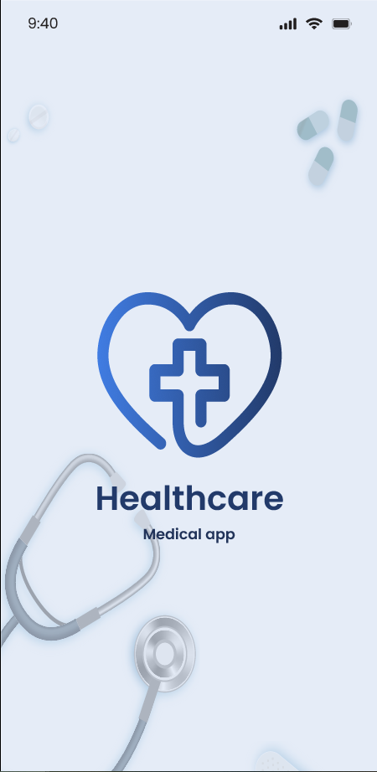
Final project
HEALTHCARE
MEDICAL APP

Slide 2
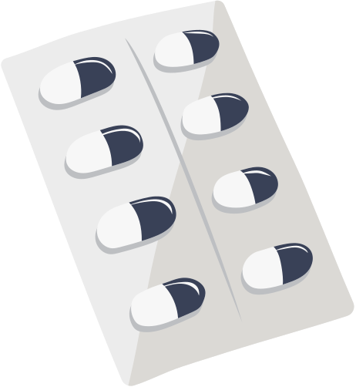
Concept

Slide 3

Identify symptoms and understand potential causes in simple terms,
Find over-the-counter (OTC) medicines available at local pharmacies,
Book appointments with medical professionals (including telehealth),
And quickly access emergency services with a single tap when needed.

Slide 4

Key Conceptual for Themes
Accessibility: Easy-to-use UI for all ages, including elderly users.
Integration: Combines symptom checking, pharmacy lookup, appointment booking, and emergency help in one app.
Proactive Health Support: Encourages early self-check and care rather than delaying until symptoms worsen.
Local Relevance: Leverages real-time location to show nearby medicine and clinics.
Simplicity: Designed for users with no medical background — clear language, intuitive navigation, no jargon.

Slide 5
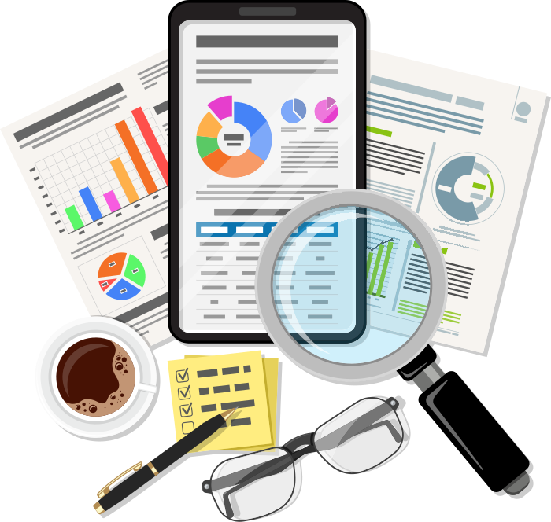
Research

Slide 6

Research for the HealthCare App
PROBLEM SPACE EXPLORATION
Many users rely on Google to self-diagnose but often end up misinformed or overwhelmed.
Booking doctors or finding nearby medicine requires using multiple apps/websites.
In emergencies, users may struggle to locate help quickly due to poor UI design or information overload.

Slide 7
Project process
PROBLEM
SOLUTION
Most users:
Felt frustrated with cluttered health websites.
Wanted quick, simple tools to understand symptoms.
Liked the idea of local pharmacy integration.
Demanded a clean UI with an emergency shortcut.
Focus on visual hierarchy and spacing to reduce cognitive overload.
Suggestions and explanations are shown in layperson’s terms with no medical terms.
Uses location-based services and map previews for clarity.
Streamlined UI with flat design, clear icons, and high-contrast elements.

Slide 8

Prototype

Slide 9
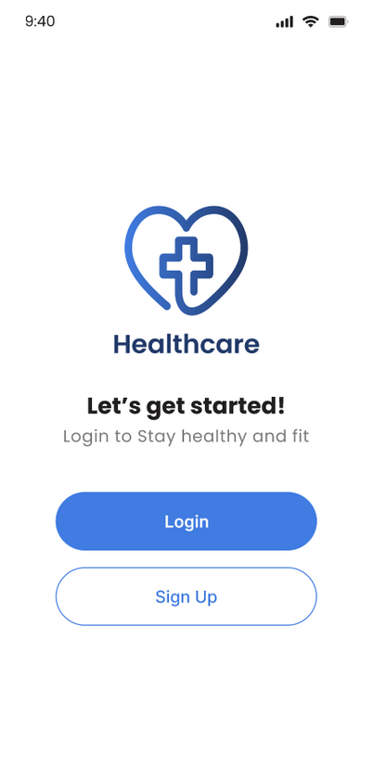
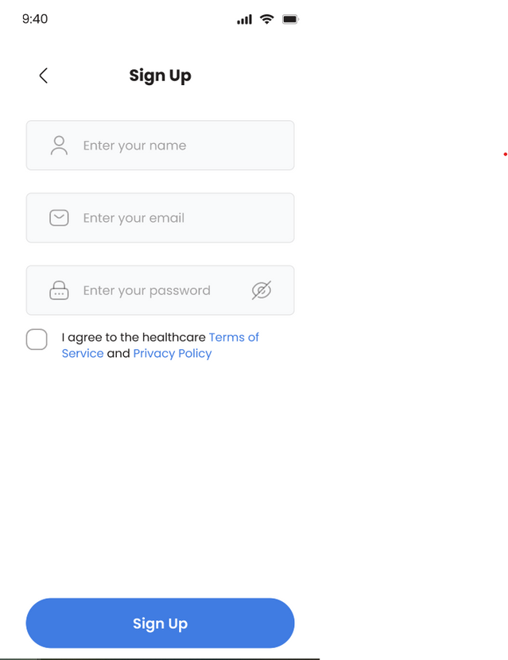
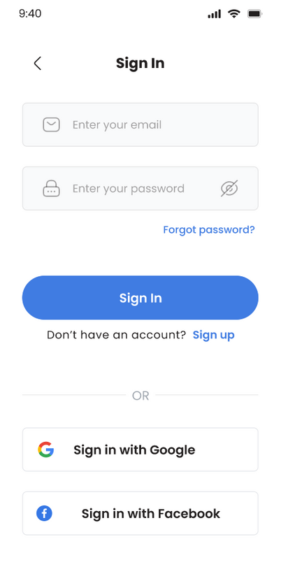

Slide 10
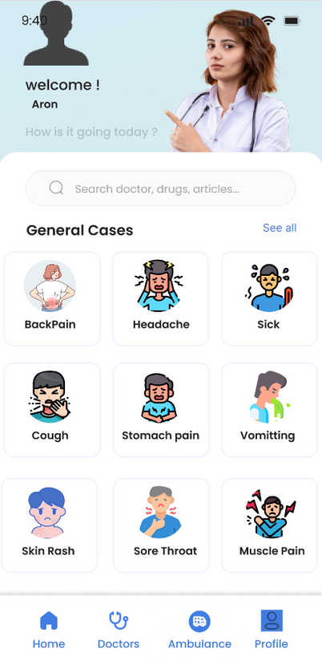
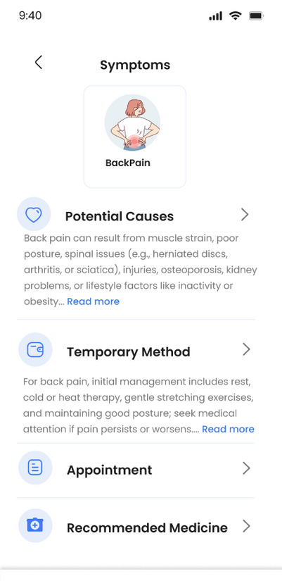
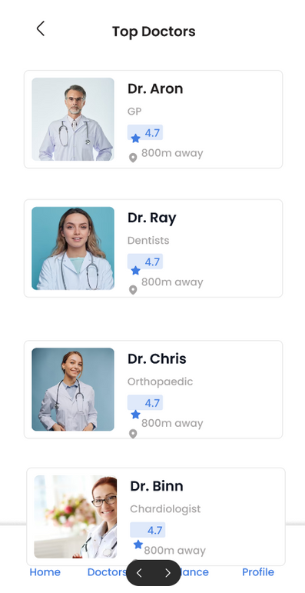
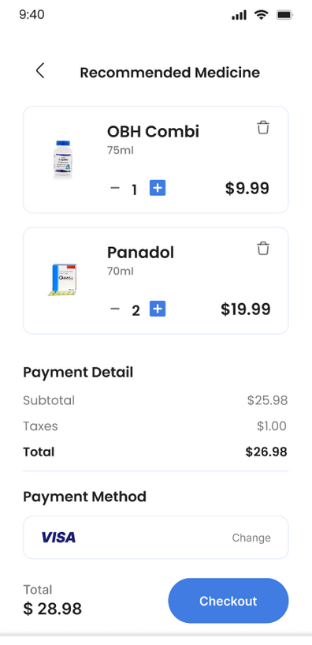


Slide 11
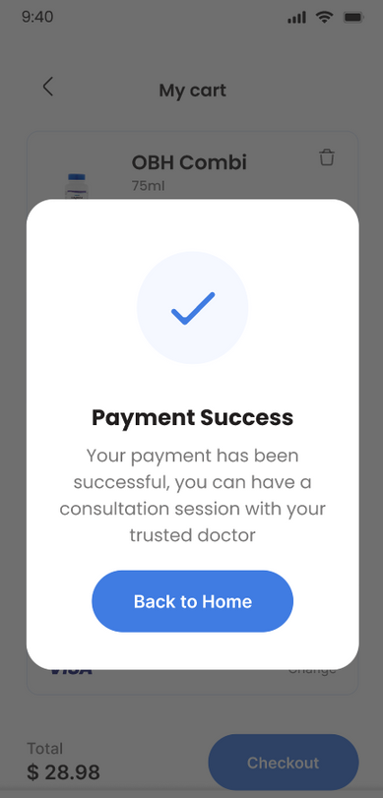

Slide 12
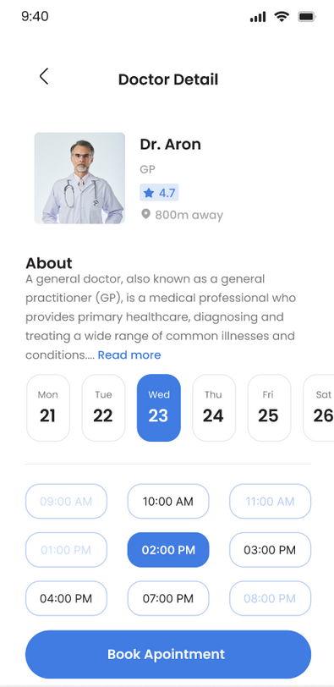
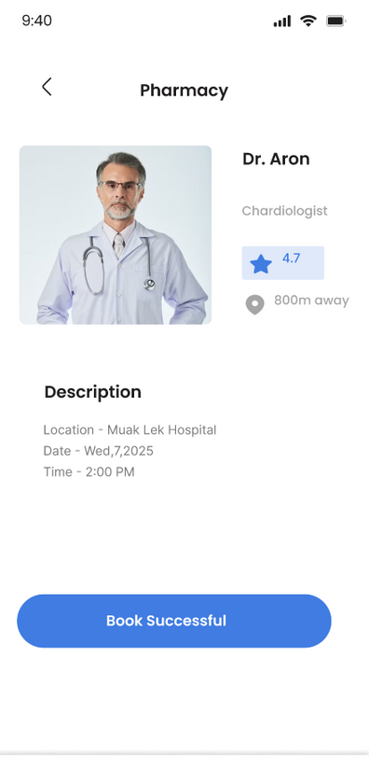

Slide 13
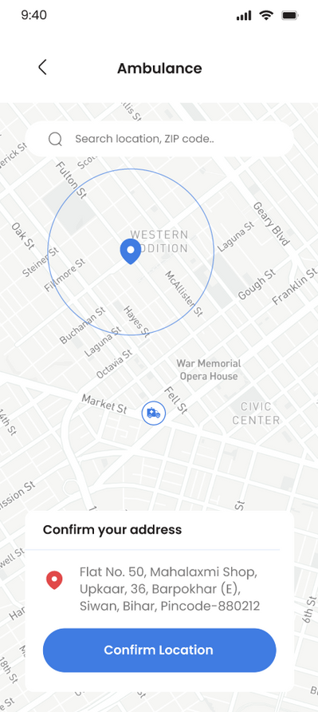

Slide 14
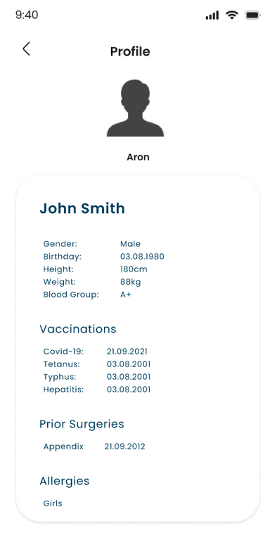

Slide 15

Reflection

Slide 16
ANALYSIS
APPROACH
AS WE WRAPPED UP THE DEVELOPMENT OF OUR HEALTHCARE APP, WE TOOK TIME TO REFLECT ON WHAT WE LEARNED AND HOW OUR DESIGN EVOLVED.
Evidence
APPLICATION

Slide 17

ANALYSIS
Many users feel overwhelmed by current health websites due to dense text and medical jargon.
Accessibility and clarity are critical, especially for older adults or non-technical users.
Emergency access and local relevance are often overlooked in existing health apps.

Slide 18

APPROACH
Applied user-centered design with iterative prototyping and testing cycles.
Prioritized simplicity, clarity, and speed in both interaction and visual design.
Focused on core tasks: symptom checking, medicine finding, and emergency access.
Incorporated HCI principles (e.g., visibility, feedback, error prevention).

Slide 19

EVIDENCE
Insights were drawn from secondary research, user personas, and design best practices.
Reflected common frustrations found in online health forums and app store reviews of similar apps (e.g., WebMD, Ada Health).
Personas helped simulate likely behaviors and guided the design of essential flows.
Decisions were grounded in HCI literature (e.g., Nielsen’s heuristics, Shneiderman’s principles) rather than empirical user data.
Wireframe evaluations and team reviews acted as a proxy for user testing, helping us identify usability gaps early.

Slide 20
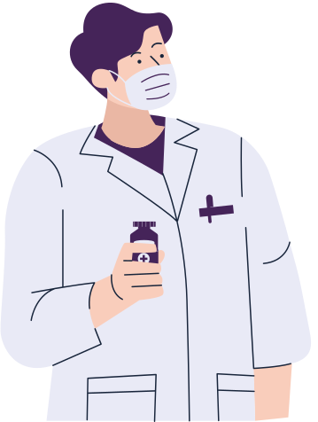
APPLICATION
Applied HCI principles to design wireframes and interactive prototypes that prioritize clarity, accessibility, and user flow.
The design is now positioned for future usability testing and potential integration with real-time APIs (e.g., local pharmacy databases, telehealth services).
Reflections from this project will inform future iterations with a stronger focus on inclusive design, mobile responsiveness, and data privacy standards.

Slide 21
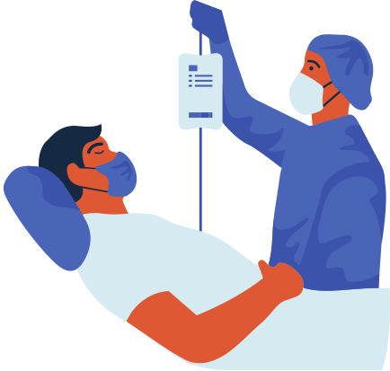
Thanks for your attention!

