Slide 1
VMR SYSTEM REQUIREMENTS AND LIMITS
System Minimum Requirements
VMR MAX LIMITS
VMR | CPU | RAM | Disk Size
10k | min of 4 | 4 | 10
100k | min of 8 | 12 | 20
VMR TYPE | VPN | CONNECTIONS | MSG RATE | INGRESS FLOW | EGRESS FLOW
VMR 100K | 7 (5 usable) | 100K | LINK | 100K | 100K
VMR 10K | 7 (5 usable) | 10K | LINK | 10K | 10K

Slide 2
VMR & MSG VPN CATALOGUE
VMR
MESSAGE VPN
VMR | CPU | RAM | Disk Size
10k | 4-8 | 4-8 | 100 GB
100k | 8-16 | 12-16 | 100 GB

Slide 3
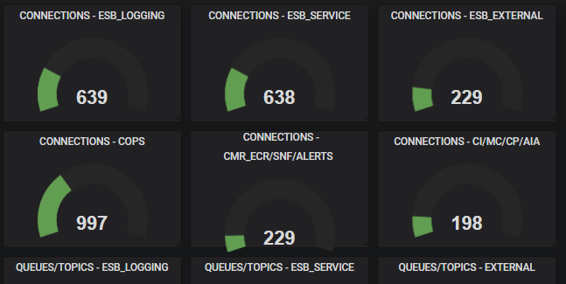
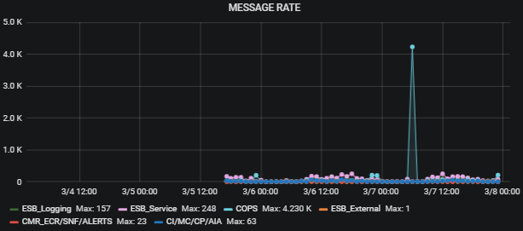
CHINA EMS STATISTICS

Slide 4
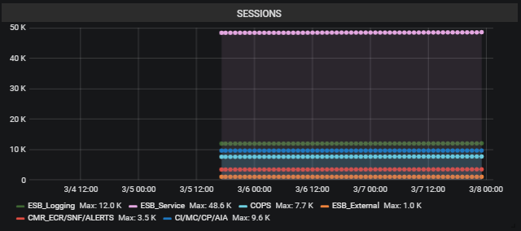
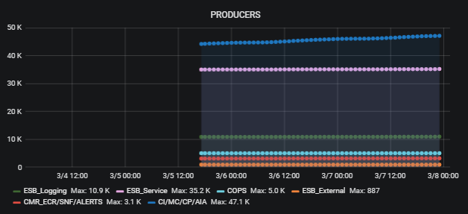
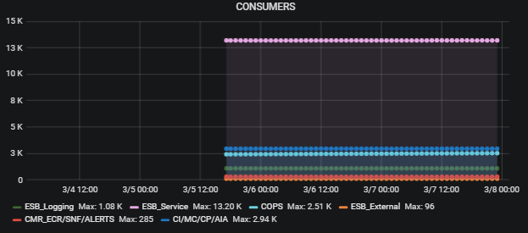
CHINA EMS STATISTICS

Slide 5
ARCHITECTURE
SINGAPORE DATACENTER
HONGKONG DATACENTER
VMR CONFIGURATION / SETTINGS:
Run in Docker container
Use Externalized Volumes
Load Balancer URL enabled

