Slide 1


FACTORS INFLUENCING UPTAKE OF SEASONAL FLU VACCINES
DSC-PT-03
Group 5
Waruchu Kuria, Catherine Gakii, Felix Awino, Michelle Mwendwa, Cleophas Opati, Steven Kalungu, & Tobias Ng’ongá
July, 2023

Slide 2
PROJECT OVERVIEW
Various factors impact seasonal flu vaccine uptake. Vaccination is crucial in preventing infectious diseases like flu.
Limited knowledge exists about how socio-economic, behavioral, and demographic factors, along with perceptions of vaccine effectiveness, influence uptake.
Policy makers can enhance vaccine uptake by understanding these influences and crafting effective policies.

Slide 3
RESEARCH QUESTIONS
This project is aimed at understanding the factors influencing the uptake of the seasonal flu vaccines:
How do individuals’ socio-economic factors influence the uptake of seasonal vaccines?
How do individual behavioral factors influence the uptake of seasonal vaccines?
How do individual demographic background factors influence the uptake of seasonal vaccines?
How do individual knowledge, attitudes, and beliefs about seasonal vaccines influence their uptake?

Slide 4
DATA USED
The data used for this project was collected over the phone between late 2009 and early 2020.
It was sourced from DRIVENDATA(CDC, NCRID and NCHS (2012), National 2009 H1N1 Flu Survey)
For purposes of this study, the data was split as follows:
Train feature dataset; 26707 rows and 36 columns.
Target dataset; 26707 rows and 3 columns

Slide 5
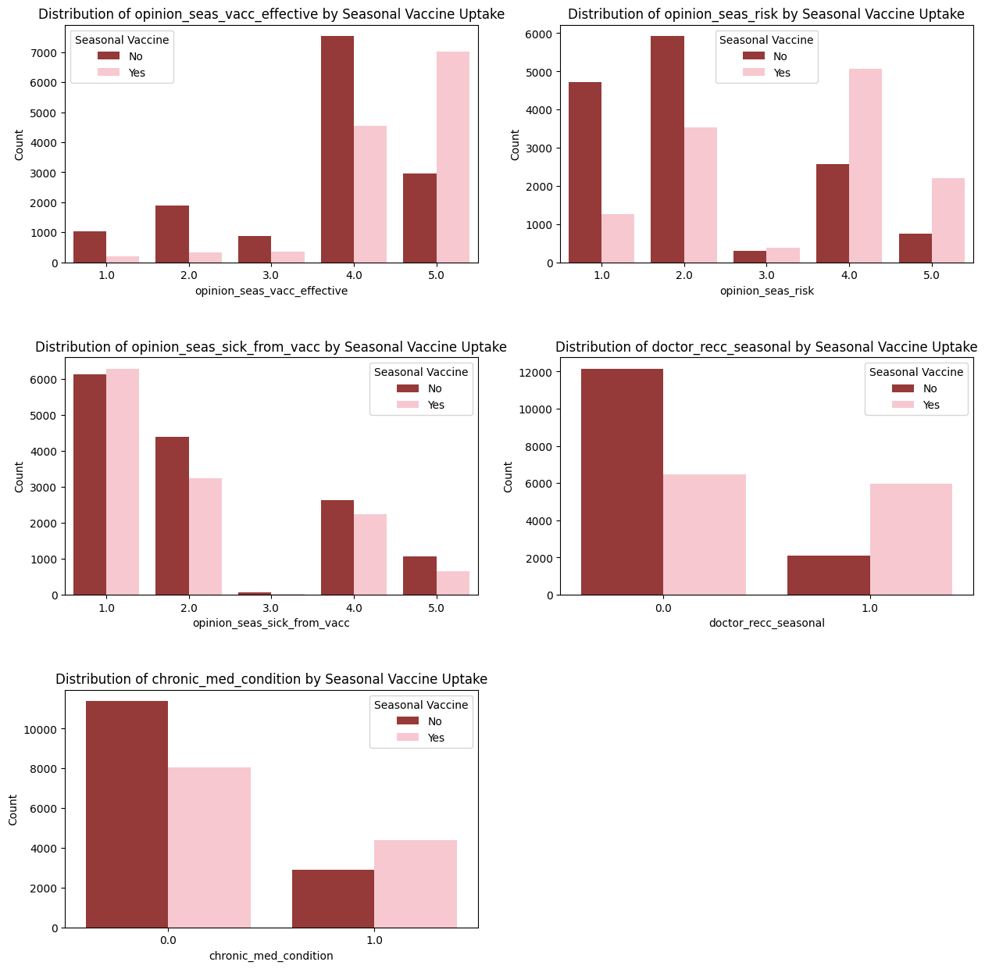
EDA
Bivariate Analysis:
KAP vs Seasonal Vaccine Uptake

Slide 6
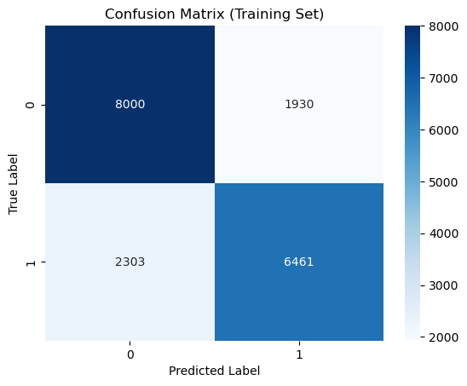
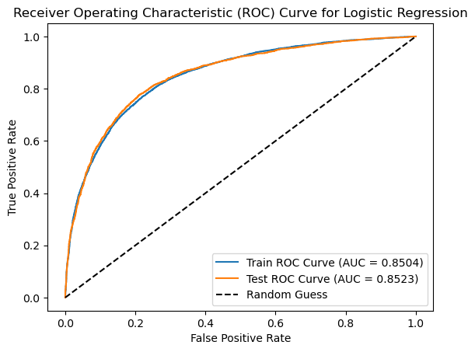
MODELLING
Logistic Regression Model(Baseline)
The ROC curve above shows a AUC score of 0.8523 on the test set, revealing that the model is quite good on distinguishing between those who received the seasonal flu vaccine or not (positives and negatives).
The score is close to 1, meaning that the predictive power of the model can be trusted.

Slide 7
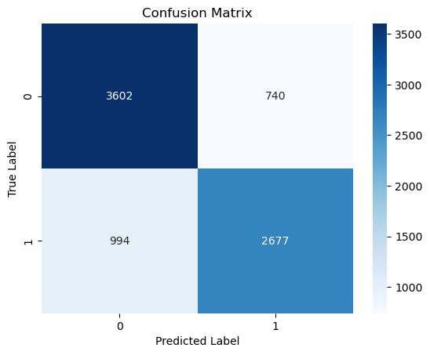
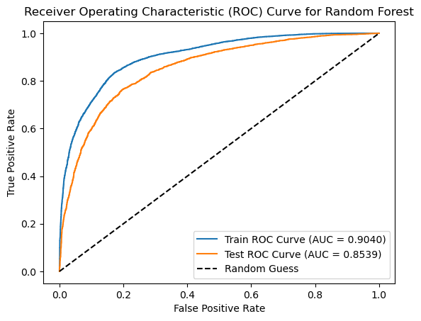
MODELLING
Random Forest Model
This model's ROC curve shows AUC of 0.8539, the highest so far. The model is more effective in predicting the seasonal vaccine uptake based on the provided features.It is able to differentiate between vaccine recipients and non-recipients effectively.

Slide 8
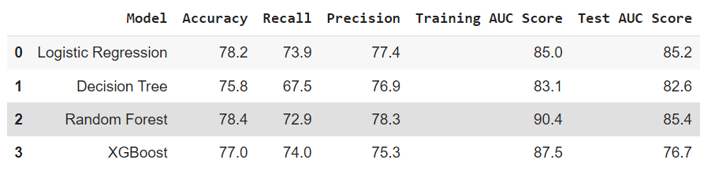
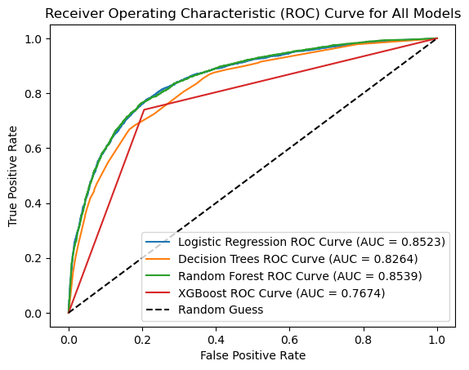
MODEL EVALUATION SUMMARY
The Random Forest Model (best_model3) has demonstrated commendable performance in predicting the uptake of the seasonal flu vaccine.
It has strong evaluation metrics and an ROC curve with strong discriminatory power.

Slide 9
CONCLUSION
The role of healthcare professionals can never be downplayed as evidenced by the fact that a doctor's recommendation to get the flu vaccine played a big role.
How people view and feel about vaccines is a big influence on vaccine uptake.
Older people tend to get the seasonal flu vaccine more than younger people.

Slide 10
RECOMMENDATIONS
Embrace personalized outreach as a campaign tool so as to target individuals and mould their perception towards immunization.
Public campaigns should be geared towards bringing onboard more younger people as it seems that they are less likely to get the seasonal flu vaccines.
The public health sector should continue encouraging doctors to recommend suitable vaccines to their clients. This modelling and analysis process has shown that people are highly likely to listen to their doctor's advice.

Slide 11
THANK YOU
Would you get the vaccine?

