Slide 1
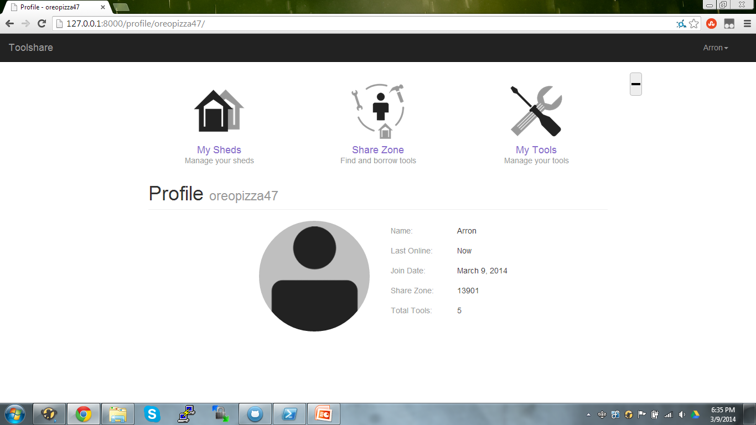
Group 4: Toolshare Project

Slide 2
Requirements Planning
User Registration
Create new user and add personal information
Add share zone if the zipcode is unknown
Add to previous share zone if zipcode is known
Tool Registration
Create new tool with details and description
Specify pickup arrangements in tool description
Share From Home Or Shed
Tool can be shared from owner or community shed
Tool cannot be in two places at once
User can change tool location

Slide 3
Technologies Used
Python
Django
Github
Replacement for SVN repository
Bootstrap
Web design

Slide 4
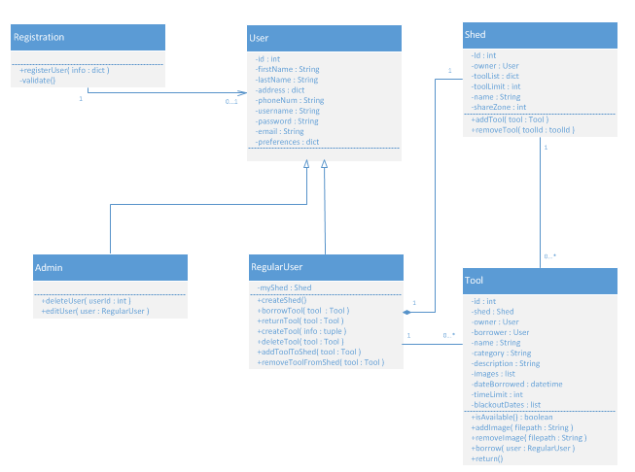
Design Documentation

Slide 5
Time for a site demo!

