Slide 1
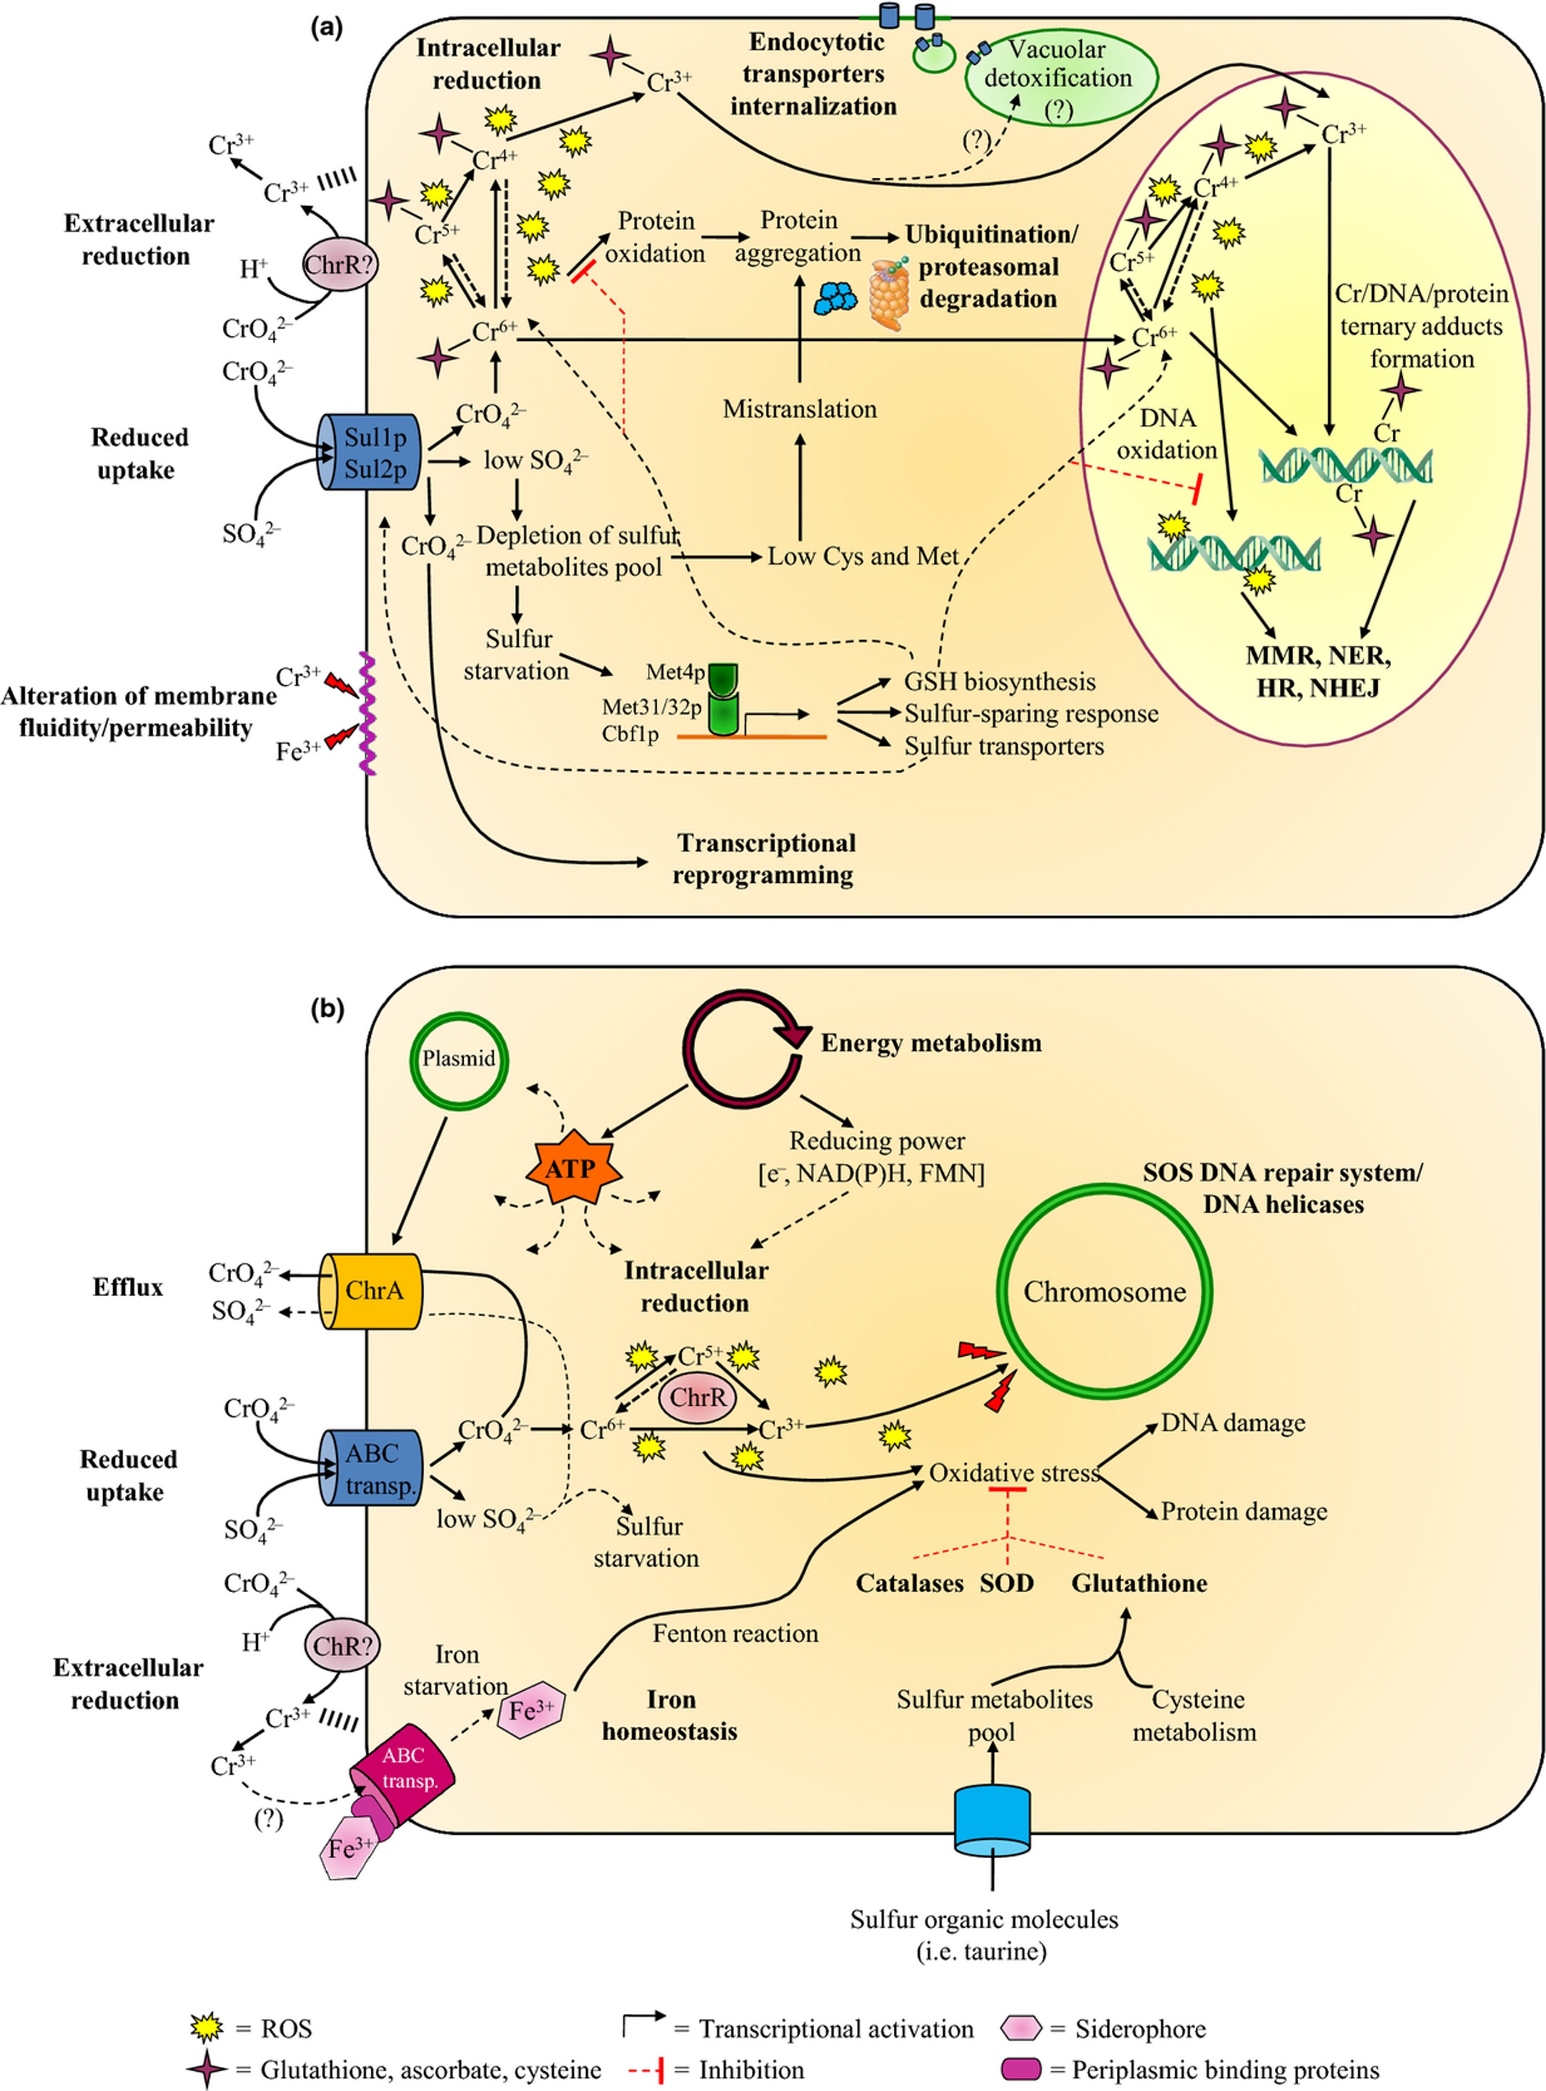

Figure 9 Interactions of Cr(VI) with the most important eukaryotic (a) and prokaryotic (b) model microorganisms.
Notes:
Figure 9 Interactions of Cr(VI) with the most important eukaryotic (a) and prokaryotic (b) model microorganisms.
Unless provided in the caption above, the following copyright applies to the content of this slide: © 2014 Federation of European Microbiological Societies.

Slide 2
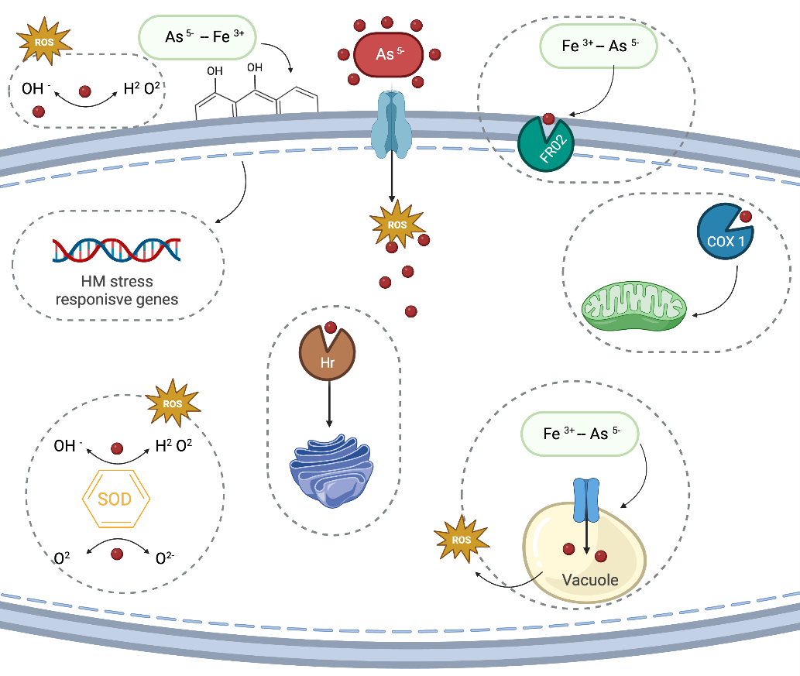
Binding
Melanin
Yor1
CRM1
Complex ion transport
Pmc1
PSMB7
Ca ²⁺
VCX
Endoplasmatic reticulum

Slide 3
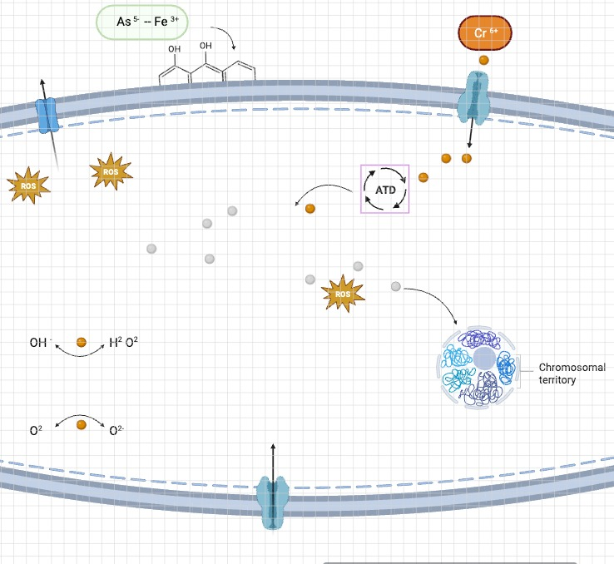
CrO₄²⁻
SO₄²⁻
ETC
Chr?
ETC
e⁻
ATP
CAP1
e⁻
e⁻
NADPH
e⁻
Iron homeostasis
ABC
Cu⁺
Cr³⁺
Fe³⁺ - Ca²⁺ - K⁺
Oxidative strees
ctpA
ROS
Cr³⁺
CAT
Reticulum
Cr³⁺
Glutathion
(GTH)
Chr?
Oxidation DNA
Cr/DNA/protein formation
CrO₄²⁻
Extracelular reduction
ENA1
H⁺

