Slide 1
Final project
Sumin Oh
Notes:
Good morning/afternoon. I would like to introduce my final project.

Slide 2
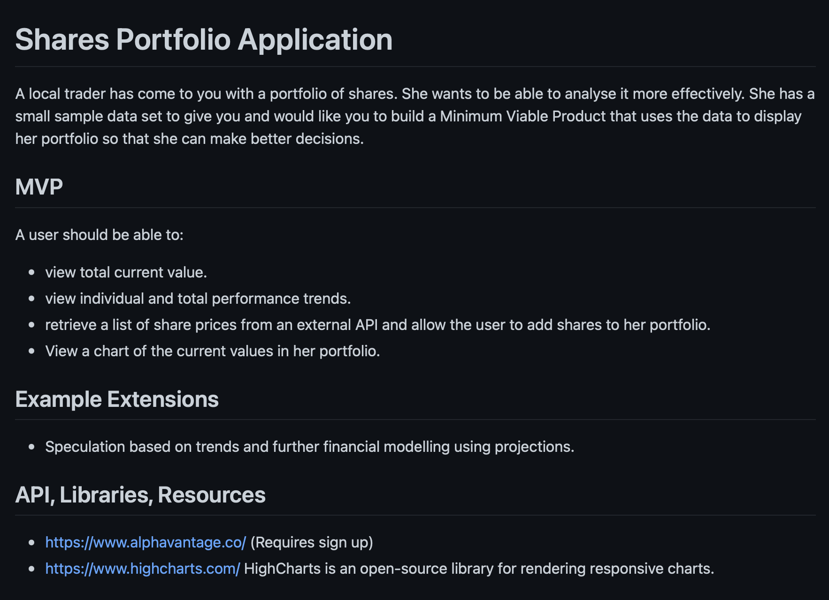
Initial project brief
Notes:
My initial project brief was shares portfolio application built by Python for the backend and Javascript for the frontend. However, I couldn't stick to follow this brief because

Slide 3

Notes:
I got another covid and it comes with severe brain fog. So, instead of building a new app from scratch, I decided to extend the previous project. So I created a new brief that helps to improve my weakest part during the course, which is CSS.

Slide 4
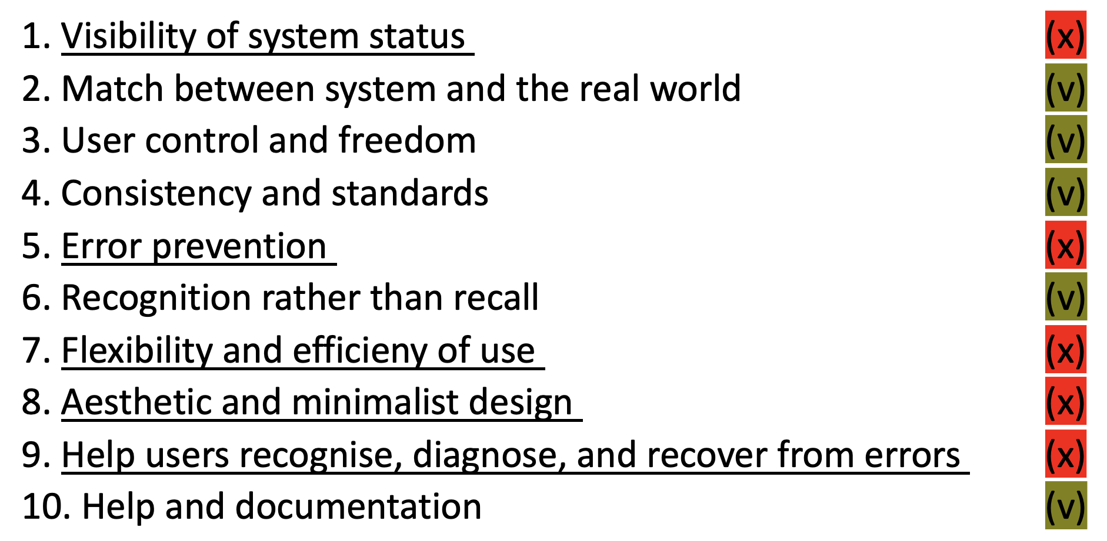
New project brief
Car salesperson using car inventory web app (from the first Python project) asks to improve the website design
Notes:
So, the new project brief is based on the scenario where carsales person asks to improve the design of car inventory app, which is from my first project. The screenshot is self-heruisitic evaluation for User interface design of the website, and it is from my previous presentation. This time, I decided to improve the visibility of system status and aesthetic and minmalist design. So what are those?

Slide 5
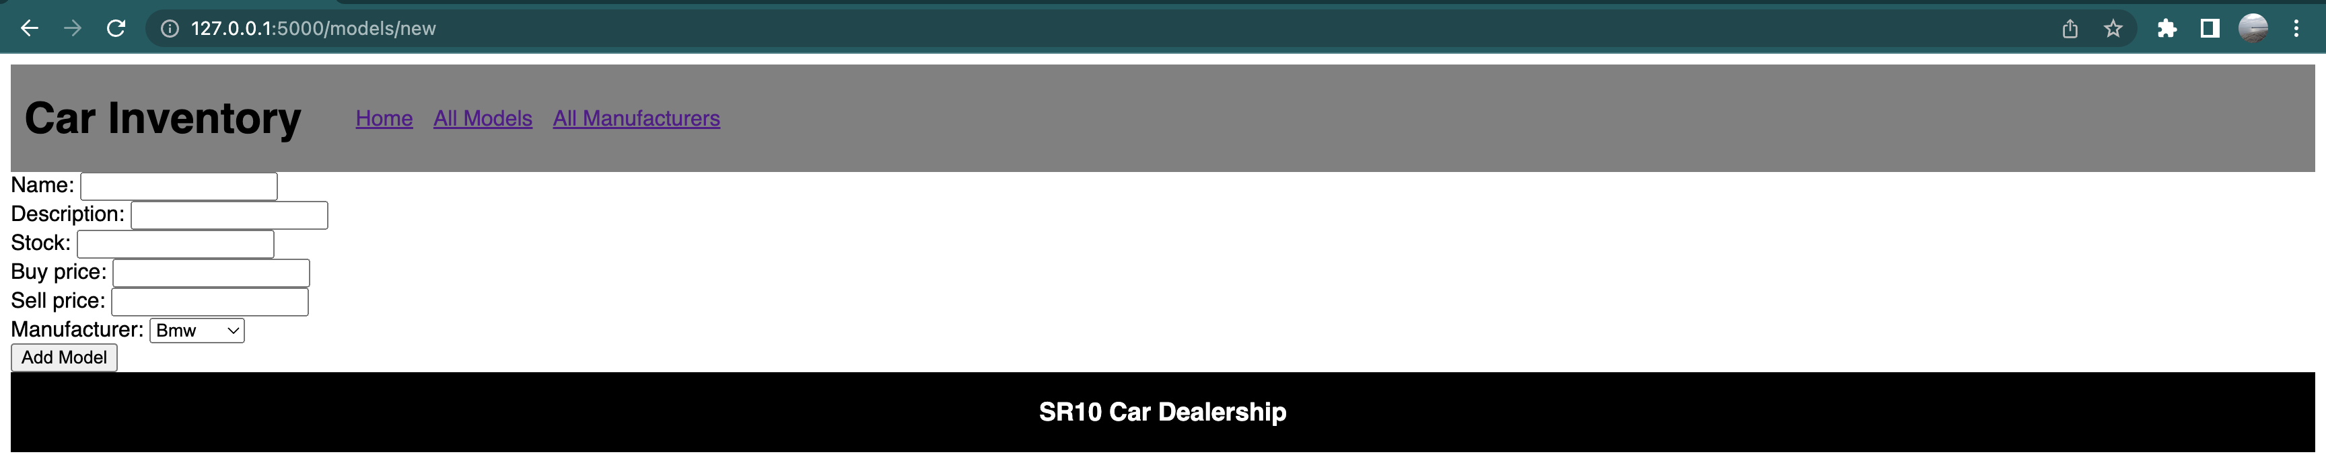
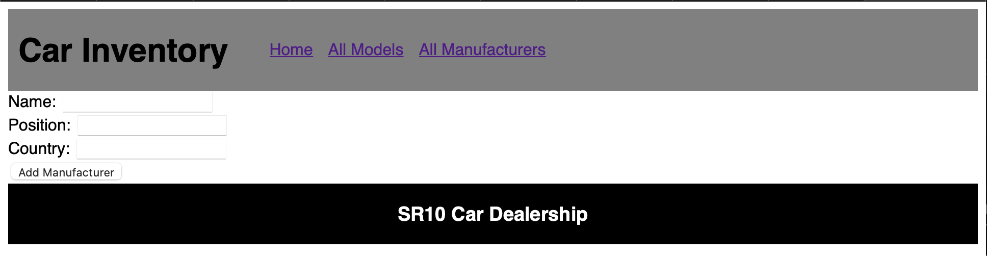
Visibility of system status
Notes:
Visibility of system status includes things like allowing user to go back to the previous page. My first project lacks this feature as you can see in these two screenshots. So the user had to tab back button on browser. What about aesthetic and minmialist design?

Slide 6
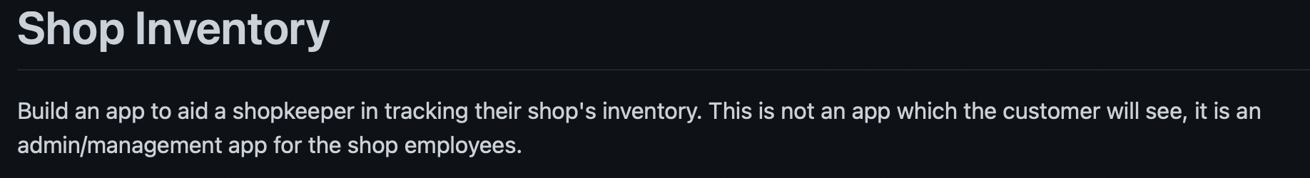
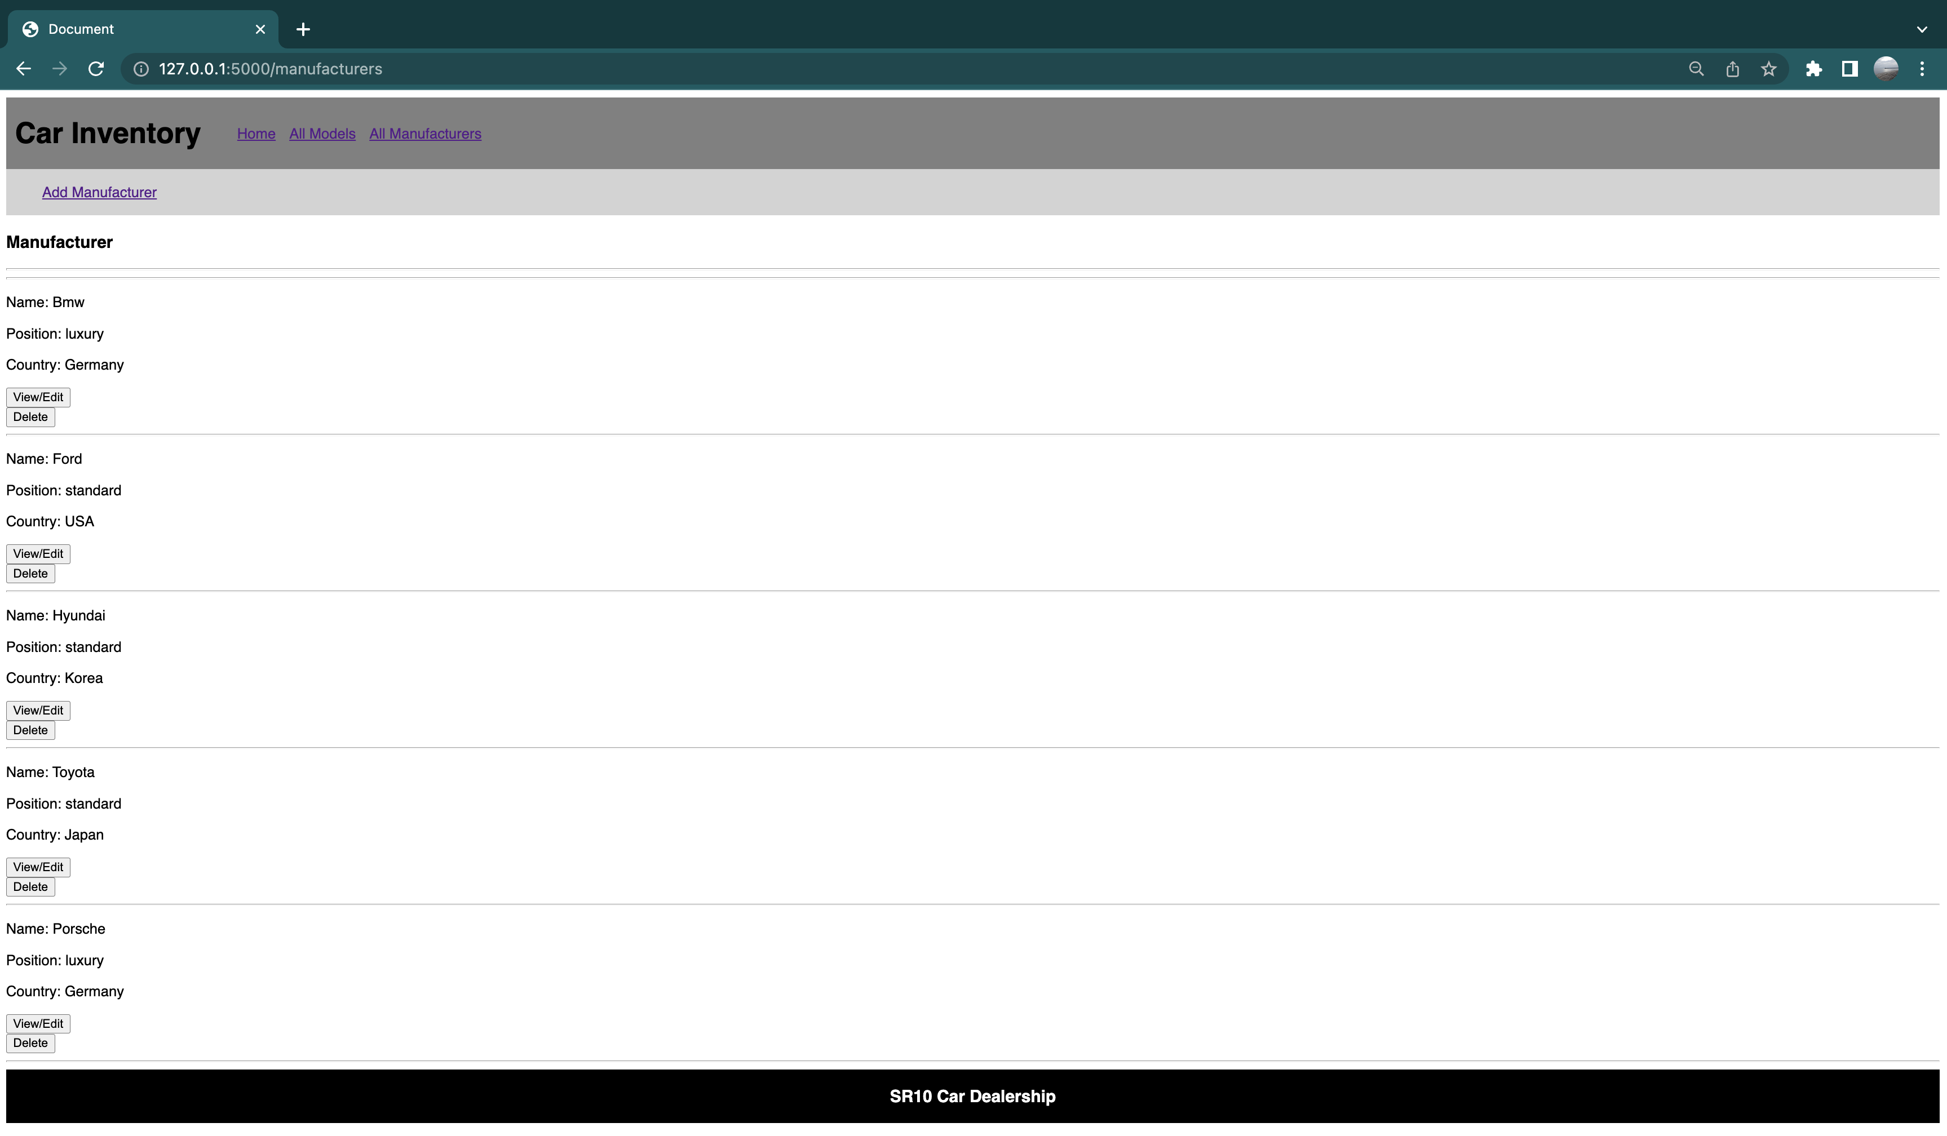
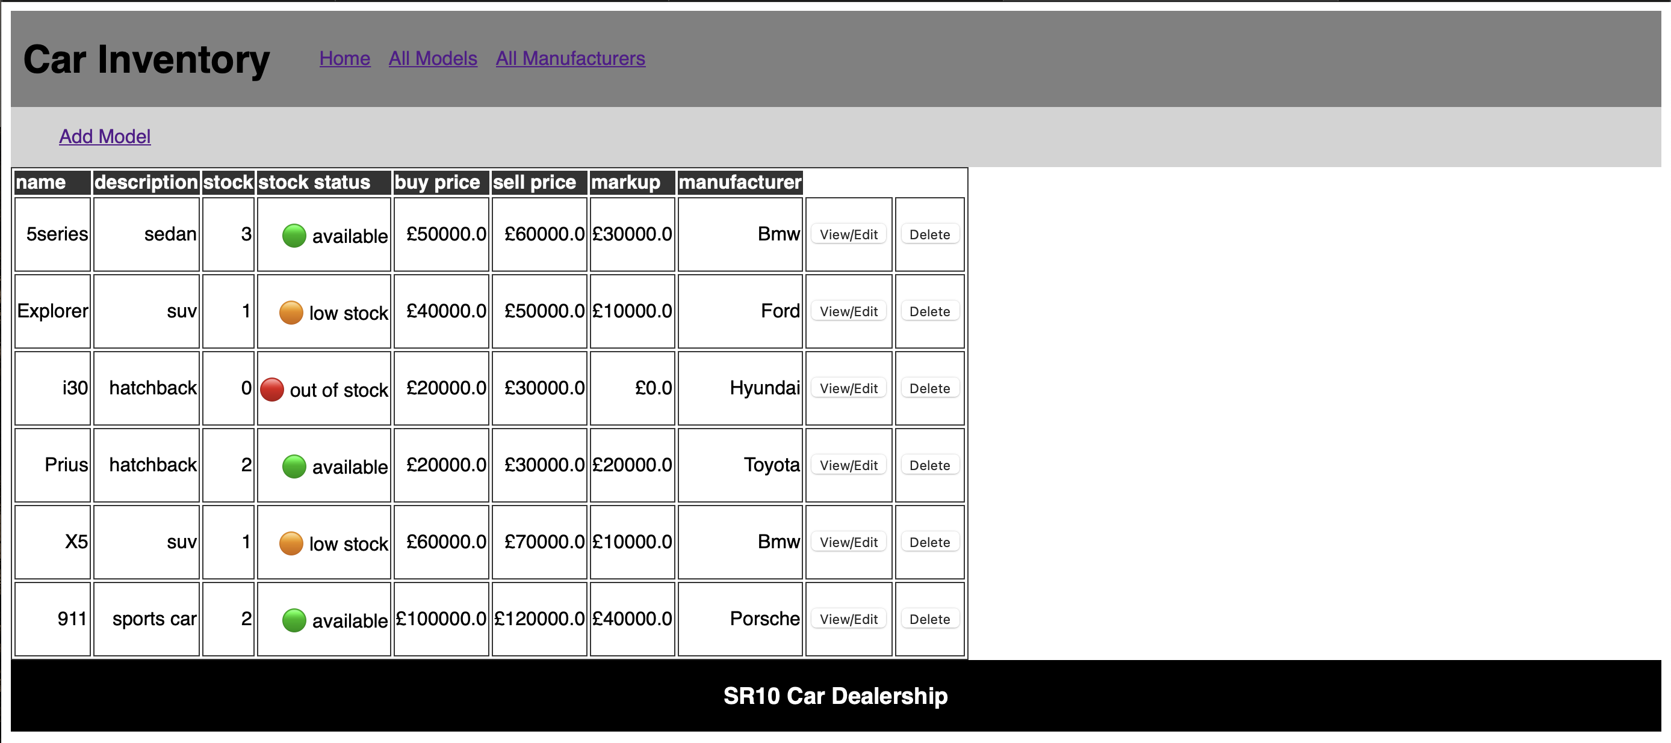
(Aesthetic) and minimalist design
Notes:
I actually put aesthetic is in brackets because i think car inventory app can't be aesthetic. However, my previous work wasn't minmalistic design as you can see. It has unnecessary empty spaces on the left. And also, if you look at the buttons here, it repeats view/edit and delete multiple times, which are also uncessary. So I worked mainly on css to improve these two aspects. Now I am gonna show you the demo of my app.

Slide 7
Demo

