Slide 1

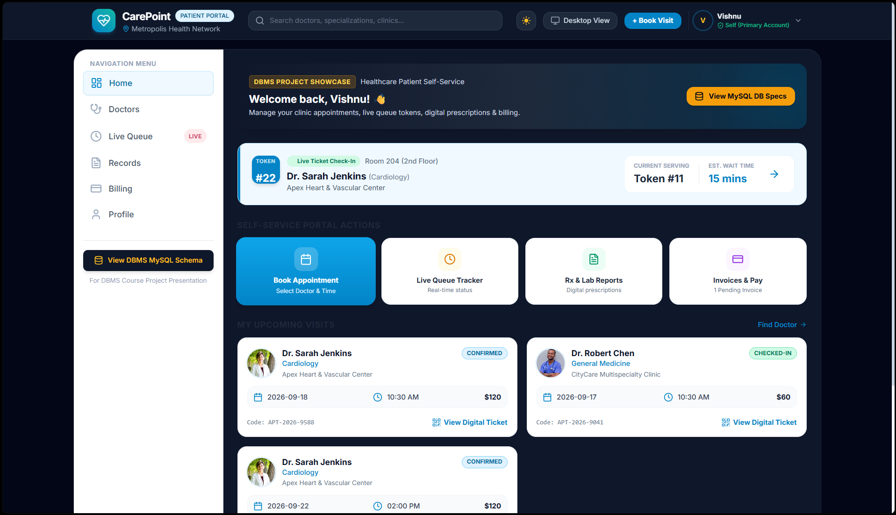
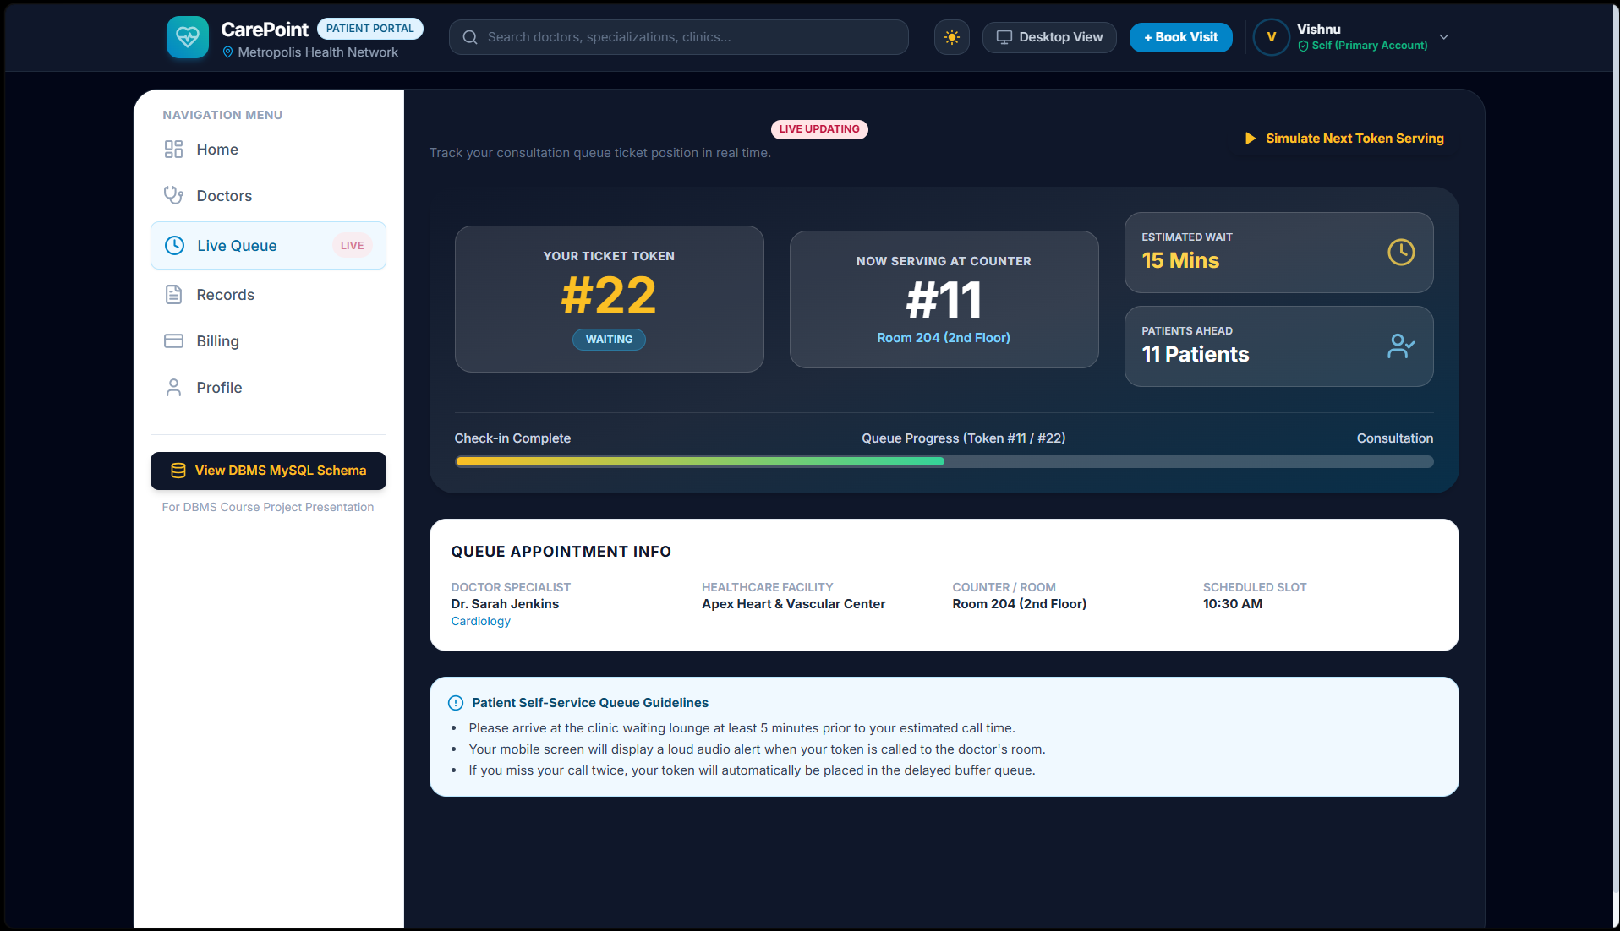
Healthcare & Clinics Mobile App for Patient Self Service
Team ID: 21 | Section: 03 | Members: K. Vishnu – 2520030199, U. Vidhath – 2520030597, K. Poojitha Sai – 2520030103 | Guide: Dr. Spandana.S
Database Systems Engineering and Distributed Backend Development (25CS1302E) | KLH Bachupally Campus, CSE | PBL 2026-27
Abstract
Tools & Technologies
A database-driven mobile self-service app for patients and clinics: book appointments, view medical history, get push alerts and file insurance claims.
Built with Android (Kotlin, Jetpack Compose), Node.js REST API, MySQL and Room DB offline cache, reducing paperwork and clinic admin workload.
Front-End: Android (Kotlin, Jetpack Compose)
Local Cache: Room DB (offline access)
Back-End: Node.js + REST APIs
Database: MySQL
Notifications: Firebase Cloud Messaging (FCM)
Tools: Android Studio, Git & GitHub, Postman
Problem Statement & Objectives
Problem: Manual, phone- and paper-based booking, records and claims cause long waits, low transparency and heavy staff workload.
Objective 1: Self-service app for appointments, profile and medical history.
Objective 2: Secure, scalable MySQL + REST data management with offline access.
Objective 3: Real-time FCM alerts and faster insurance claim handling.
Scope: Patients and doctors; profile, appointments, history, claims and billing, notifications, background sync.
System Architecture
Android Application
Kotlin + Jetpack Compose
Room DB offline cache
HTTPS/JSON
Node.js REST API
Auth, Appointments,
History, Claims
SQL
MySQL Database
Patients, Doctors,
Appointments, Claims
Existing vs Proposed System
push alerts
Firebase Cloud
Messaging (FCM)
Feature | Existing System | Proposed System
Appointments | Phone calls / walk-ins | In-app booking with offline cache
Medical history | Limited, paper-based access | Digital history and reports on demand
Notifications | No real-time updates | FCM push alerts
Insurance claims | Slow, paper-based | Integrated claim and billing module
Limitation / Gap | No unified platform; heavy staff dependency | One self-service platform: Android + Node.js + MySQL
ER Diagram & Database Design
PATIENT
PK patient_id
name, dob, phone
email, address
1 : N
APPOINTMENT
PK appt_id
FK patient_id, FK doctor_id
date_time, status
N : 1
DOCTOR
PK doctor_id
name
specialization
1 : N
1 : 1
1 : N
INSURANCE_CLAIM
PK claim_id
FK patient_id
amount, status
1 : N
BILLING
PK bill_id
FK appt_id, FK claim_id
amount, paid_status
MEDICAL_RECORD
PK record_id
FK patient_id, FK doctor_id
diagnosis, prescription
Feasibility Study
Technical: Kotlin, Jetpack Compose, Node.js and MySQL are well documented; Android Studio and Postman are freely available.
Economic: Open-source stack with free-tier Firebase Cloud Messaging, so no licence cost.
Operational: Simple self-service UI for patients; less routine work for clinic staff; easy to maintain.
Schedule: Planned for completion within the PBL trimester timeline.
Implementation Screenshots
Add app screenshot 1 here (e.g. Home / Appointments)
Add app screenshot 2 here (e.g. Medical History / Claims)
Results & Testing
Conclusion
Future Scope
Planned checks: CRUD, input validation and sync via Postman.
Indexed SQL queries for quick record retrieval.
Digital platform for appointments, history and claims.
Meets objectives: less paperwork, more transparency, faster claims.
AI-based health recommendations
Wearable (IoT) integration
Telemedicine consultations
Advanced health analytics
References: [1] Android Developers: Jetpack Compose & Room, developer.android.com [2] Firebase Cloud Messaging docs, firebase.google.com/docs/cloud-messaging [3] MySQL Reference Manual, dev.mysql.com/doc [4] Node.js Docs, nodejs.org/docs

