Slide 1
+
CareQueue™
Intelligent Healthcare Queue Management & Clinical AI Platform
Database Systems Engineering & Design (DBSE_DBD) — Project 36
VISHNU | UHID-2026-0016 | 2026
Notes:
Good morning respected professors. I present CareQueue, a distributed healthcare system that removes unpredictable clinic waits through ACID queue management, priority triage and AI wait-time prediction.

Slide 2
Problem & Objectives
The problem
Our objectives
• Unmanaged physical queues cause clinic bottlenecks
• FIFO ignores urgent cardiac, pediatric, geriatric cases
• No wait visibility raises patient anxiety
• Doctors lack load balancing and live patient history
• ACID-compliant token and appointment scheduling
• Dynamic triage priority scoring
• Little’s Law + Random Forest wait forecasting (R² 98.97%)
• Personalized patient portal with live tracking and vitals AI
Notes:
Flat FIFO queues and unpredictable waits compromise care. CareQueue moves from reactive queuing to predictive, patient-first orchestration.

Slide 3
Distributed Multi-Tier Architecture
React Client
Node API + Gateway
AI Microservice
Polyglot Storage
Port 3000
Port 5000
Port 8000
MySQL 8 + MongoDB
→
→
→
React 18, Vite, Tailwind, Socket.IO client
Express, Socket.IO server, mysql2 pool
FastAPI, Scikit-Learn Random Forest, Joblib
ACID core + event telemetry
Real-time WebSocket events (token:called, token:issued, doctor:status_changed) sync the TV display, doctor console and patient phone in under 15 ms.
Notes:
Node.js handles REST and WebSockets, a Python FastAPI service handles ML inference, MySQL 8 provides transactional guarantees.

Slide 4
Relational Design: 10 Tables, BCNF
departments
doctors
patients
appointments
queue_tokens
active_queues
consultation_sessions
queue_history
ml_telemetry
system_configs
1NF
2NF
3NF / BCNF
Atomic attributes, distinct keys, no repeating groups
No partial dependencies on composite keys
No transitive dependencies; doctors and departments isolated
Notes:
Schema is normalized to BCNF with foreign keys, cascading deletes, domain checks and unique composite constraints.

Slide 5
Advanced SQL: Procedures, Triggers, Indexes
Stored procedures
Triggers
Composite B-Tree indexes
sp_issue_token
sp_call_next_patient (SELECT … FOR UPDATE)
sp_complete_consultation
sp_reassign_queue
BEFORE INSERT: block duplicate active token
BEFORE UPDATE: wait/consult minutes
AFTER UPDATE: immutable audit log
(token_date, doctor_id, status)
(doctor_id, scheduled_date, time_slot)
history token+event
48.2 → 1.1 ms
1,000+ → <5
O(N) → O(log N)
Query latency (97.7% faster)
Rows examined (EXPLAIN)
Full scan eliminated
Notes:
Business logic lives in MySQL: row-level locks prevent race conditions, triggers keep an audit trail, and composite indexes cut latency by 97.7 percent.

Slide 6
Priority Triage & AI Wait-Time Engine
Priority score
Hybrid wait estimate
Score = TriageBase + Vulnerability + Appointment
Emergency +95 | Urgent +65 | Routine +20
Age ≥65, ≤12, pregnant, PWD: +15
On-time check-in: +10
Wait = 0.70 × Random Forest + 0.30 × Little’s Law
Trained on 5,000 encounters
Outputs point estimate + 95% CI
R² 0.9897
±5.07 min
~18 ms
Variance explained
Mean absolute error
AI inference latency
Notes:
Priority scoring protects emergencies and vulnerable groups. The hybrid estimator blends queuing theory with a Random Forest for an R-squared of 0.9897.

Slide 7
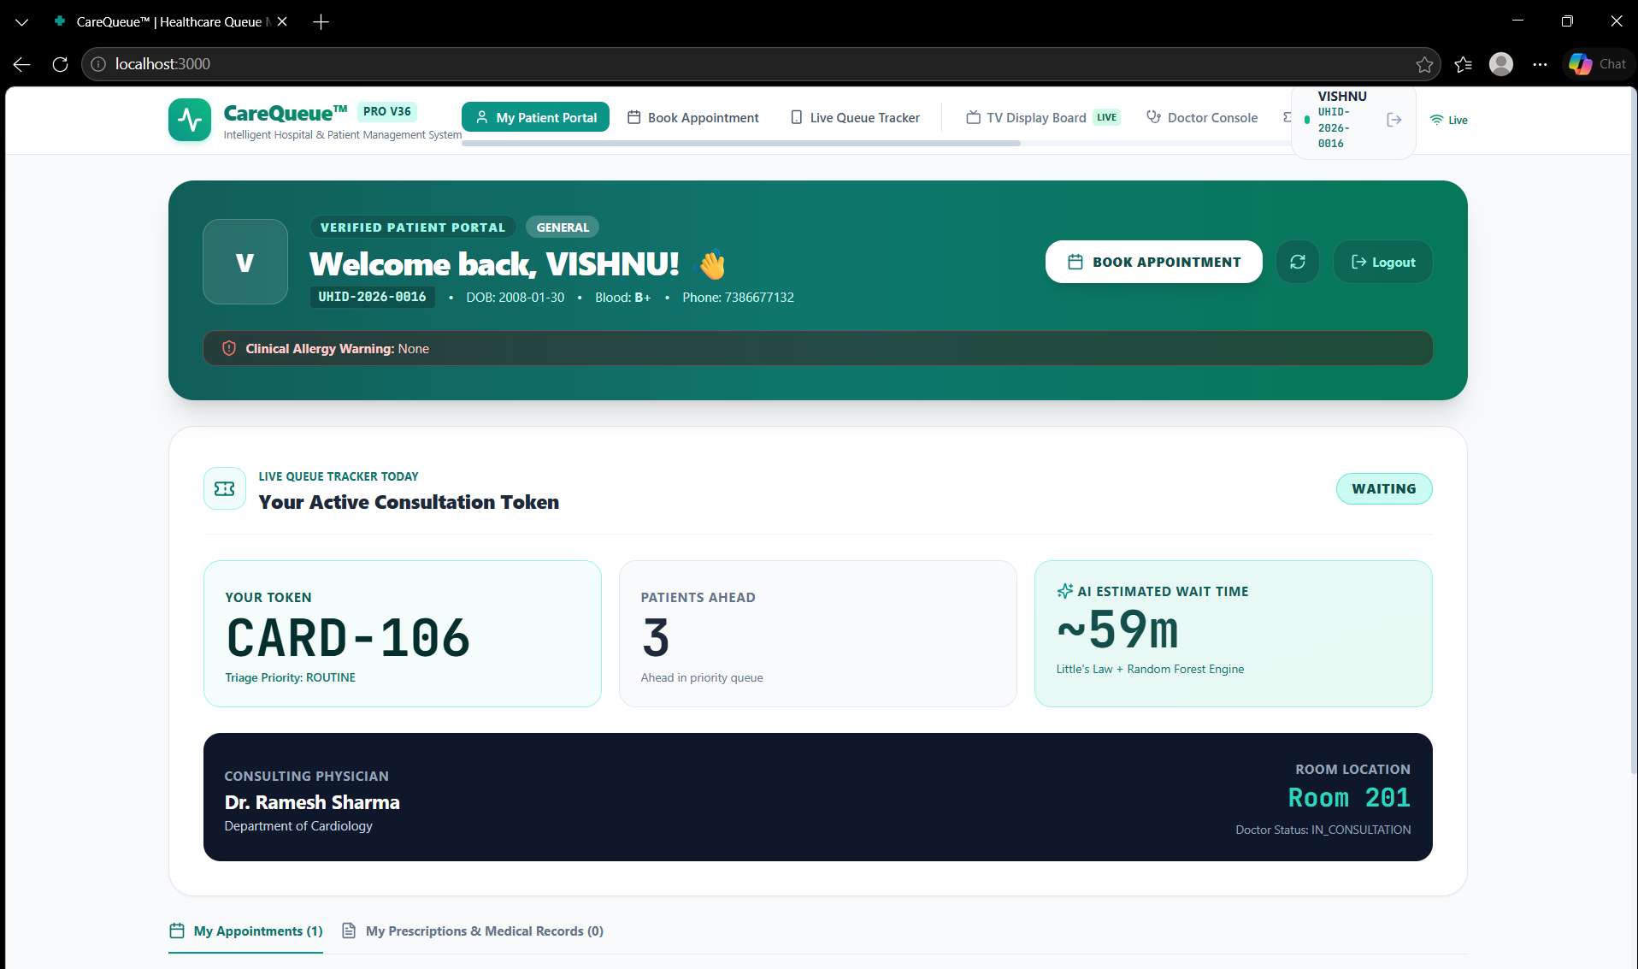
Patient Portal, Doctor Console & TV Board
Patient
4-step booking, live token tracker, Rx vault, vitals AI
Doctor
Call next, consultation timer, vitals + Rx entry
TV board
Now-calling cards, chime + text-to-speech
Live portal: patient VISHNU, token CARD-106, 3 patients ahead, AI wait ~59 min
Notes:
Three live interfaces share one WebSocket event stream: patient portal, doctor console, and waiting-room TV display.

Slide 8
Testing, Validation & Benchmarks
14 / 14
< 15 ms
< 45 ms
Automated tests passing
WebSocket delivery
Token issue to TV update
Validated
Reliability
Patient creation, UHID format, token generation, ACID rollbacks, slot conflicts, priority ordering
React ErrorBoundary prevents blank screens; auto-healing UHID fallback in booking
Notes:
The suite covers core endpoints and DB constraints; end-to-end latency is under 50 ms.

Slide 9
Conclusion
BCNF database with procedures, triggers and indexed queries
Ethical priority triage beyond FIFO
Hybrid AI wait engine, R² 98.97%
Real-time sync across patient, doctor and TV
Patient vitals AI with AHA blood-pressure classification
Thank you — questions are welcome!
Notes:
CareQueue turns outpatient management into an intelligent, data-driven, patient-centric experience. Thank you.

