Slide 1

Description
Basically the Matrimony and Matchmaking is very big industry and there are so many big players in market. But the demand of Matchmaking and Matrimony services is so high because the Industry targeting each and every Unmarried boy’s and Girl’s, to find match’s and get married.
Before stating this website I research the market and I found that there are some loop pols and from that I started my own platform Kurmaian.com.

Slide 2

Introduction
The website Kurmaian.com is a start-up from Punjab and the name of this website has comes from a Punjabi word Kurmai ( Engagement ) it’s the combination of kurmai+ian+.com and this combination becomes Kurmaian.com.
Actually our core market is Punjab and Punjabis those are settled in Other countries across the world so we select the name so that they can easily remember our name and it’s attachment with a emotion and Culture of Punjab.
But we are also serving our services in Pan India and to every community in the same way.

Slide 3

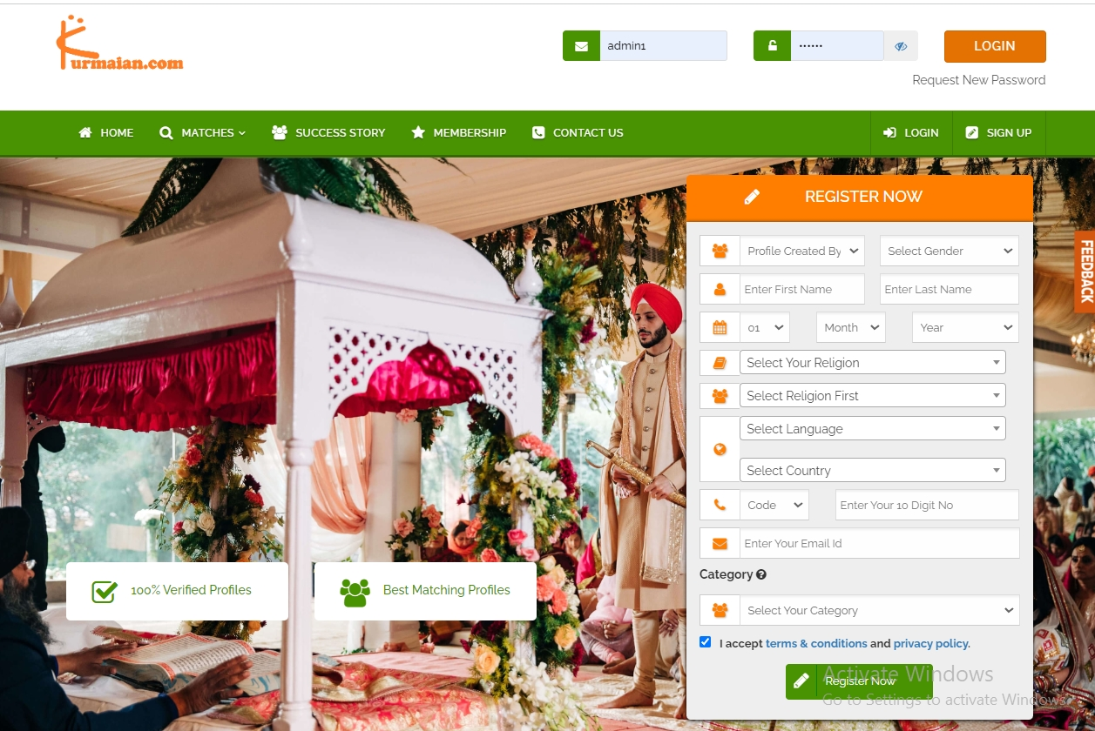
Home Page

Slide 4

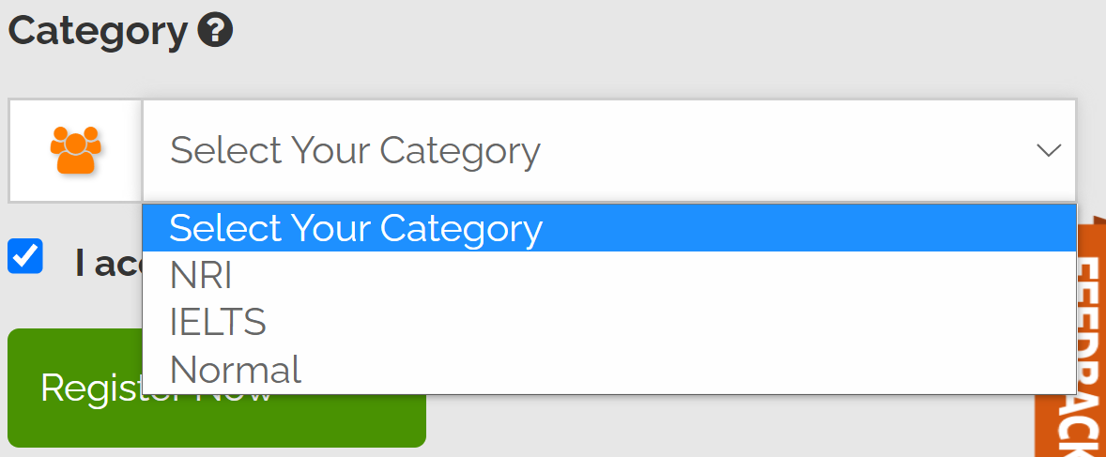
Our Different Matrimony Categories
We have 3 different categories according to deferent Interests so that user can easily find their match’s.
We also give a description for Category section at Category ?
We believe and aim to provide a user friendly interface to users.

Slide 5

Description of 3 Matrimony categories
NRI Matrimony
IELTS Matrimony
NORMAL Matrimony
When I analyze some popular match making and Matrimony website I found some loop poles I found so many users are wasting moony at the plat forms.
I realize that they are finding something else and these websites and apps are not providing the same match as per users request.
After research in Punjab I found that so many youngsters are going to abroad and before going to abroad they are getting married.
6 from 10 youngsters are doing IELTS (International English Language Testing System) and almost 75% youth is getting married.
But the thing is market demand is high to find match’s but they do not have any digital platform, they are using Newspaper classified to check match’s.
So we have launched IELTS Matrimony we are the first in the whole matchmaking and matrimony industry

Slide 6

NRI Matrimony
NRI matrimony If we briefly talk about our first product NRI matrimony. It's solving a big gap between user and website. Let suppose someone is from Canada and finding a match from India so sign up he/she sign-up with xyz.com website and Start finding their match and they also paid for service to contact matches. But when they talk to some of matches they are not interested for NRI's and package balance getting low. When the same user use Kurmaian.com firstly they select the matrimony category in the mentioned section NRI Matrimony and after they paid for service and start contact to match's all the matches are interested to get married with NRI.
So this is the big game changer in market and it's really easy to use and user friendly.
Also in the other hands. If someone from India finding a match from other countries they can easily find Match in the same Matrimony category.

Slide 7

IELTS Matrimony
IELTS Matrimony is the first matrimony product that we have launched in the Market. No one is providing this service right now. If we talk about north India youngsters are doing IELTS and after that they getting married and go to abroad. This Trend is common in North Indian and people are finding Matches only through newspaper classified. No one digitally providing this service at the online platform. So we have launched this IELTS Matrimony. If someone have completed IELTS or any other English test and finding a match for them, they can select IELTS Matrimony in category section and we have specially mentioned score option so that they can mention the score of test, and which country they wanted to apply. It's kind of immigration process but if a user is finding a match they can check everything like test score and which country they wanted to apply after that. So user can consume their paid services to get worthy results not to waste their balance.

Slide 8

Normal Matrimony
If we talk about other competitors in the market they are following this process Normal matrimony If someone is finding a match they filled the details and website will show them matches according to age height religion. But we are going to some upgraded features in Normal Matrimony in a few months. The changes are mentioned below. We are going to use Google maps to find match. Like if user sign-up with Kurmaian.com they select home city from where they are with help of maps we are going to set an algorithm that website will show nearby matches from the location like within 40-50 kilometers. Matches will show with the algorithm we are going to set it will find out the best and perfect match for user according to age height religion caste and also nearby locations. Because we have research that most of the Indian people are preferred to get married in nearby locations.

Slide 9

Employment Generation
I believe that if I want to become wealthy and grow up in business i have to make a strong team because a leader is nothing without a team and a team is nothing without a true leader. So we are going to generate maximum to maximum employment. First of all we are going to hire some members for website and app development engineers to make our website upto date and bug free so we can complete our promise to user that we our platform is user friendly and easy-to-use. After that we are going to hire some customers service executives so they can contact each and every user for verification process and interaction with them and ask them if they are facing any problem or any suggestions for website. Customer service executives will also contact user for paid services. In future we are planning to open our center's in big cities like Chandigarh Delhi Chennai and also out of country to built trust and we are also going to introduce some new matrimony products like love marriage. We will need a big team to handle this much of audience to provide our services.

Slide 10

Revenue
I talk about everything and now I'm going to share my revenue generating process. First of all we will charge a certain amount for users if anyone wants to contact match's. Second we will start advertisement, we are going to advertise worthy ads so that user's can attract and advertiser can also generate revenue from our user. Like immigrations, marriage lawyers can advertise at our platform and these ad's will run at our IELTS Matrimony because this category is relating to the advertisement and it'll help advertiser's get more and genuine leads. We are planning collaborating with travel industry so that we can advertise and sale honeymoon packages also. We'll take our commission from every package. So these are revenue generating program's we are planning for. But now we are generating our revenue from our paid services.

