Slide 1

CVR COLLEGE OF ENGINEERING
Department of CSE
B.Tech CSE III Year II Semester
Industrial Oriented Mini Project Review-1, March. 2026
23B81A05GN-M.Sanath Kumar
23B81A05GV-B.Shiva
23B81A05GX-K.Siddartha
Under the Guidance Of:
Mr. Singam Chandra Sekhar

Slide 2
Topic: TaskMaster Productivity and Task Management Web Application

Slide 3
ABSTRACT
TaskMaster will be a productivity and task management web application designed to help individuals and teams organize, prioritize, and track their work efficiently. The system will allow users to create projects, assign tasks, set deadlines, and monitor progress through interactive dashboards and visual workflows.
The platform will include features such as customizable project boards, drag-and-drop task organization, priority labels, deadline reminders, and progress tracking. Role-based access control will enable team leads to manage tasks and permissions while team members collaborate and update task statuses in real time.
TaskMaster will be developed using the MERN stack, incorporating secure authentication, RESTful APIs, and real-time updates. The system will also support future enhancements such as AI-based task suggestions, calendar integration, time tracking, and advanced reporting.

Slide 4
INTRODUCTION
Need for the system: In today's fast-paced work environment, individuals and teams struggle with managing multiple tasks simultaneously. Without a centralized system, critical tasks get missed, deadlines are overlooked, and productivity suffers due to disorganized workflows.
Purpose of the system: . TaskMaster is designed to provide users with a smart, organized platform to plan, assign, and monitor tasks effectively. It replaces fragmented to-do lists and spreadsheets with an integrated, real-time collaborative task management solution.
Benefits: The system improves team productivity, ensures timely task completion, reduces missed deadlines, enables clear role assignments, and provides actionable insights through progress reports and analytics for smarter decision-making.

Slide 5
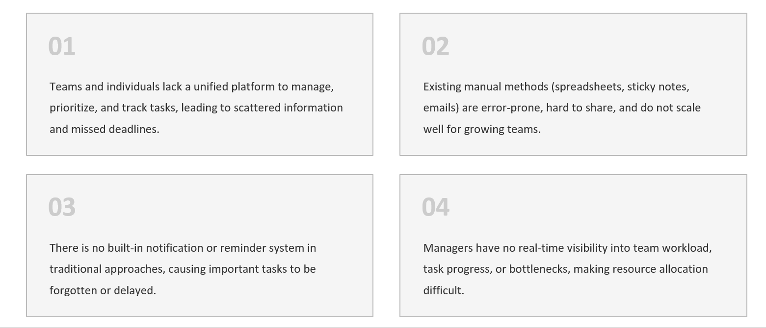
PROBLEM STATEMENT
Many vehicle owners fail to maintain regular service schedules due to lack of reminders and proper tracking systems.
Traditional service booking methods require physical visits or phone calls, which are time-consuming and inconvenient.
Service centers often face difficulties in managing appointments, customer records, and service history efficiently.
There is no centralized system that allows customers to track maintenance history and book services easily in one platform.

Slide 6
LITERATURE SURVEY
System / Tool | Key Features | Limitations
Trello | Uses Kanban boards for visual task organization, drag-and-drop task management, and collaboration features for teams. | Limited advanced analytics and lacks integrated personal productivity tools such as habit tracking.
Asana | Provides project planning, task assignment, workflow automation, and deadline tracking for teams. | Can become complex for small teams and individuals; limited personalization for daily productivity.
Jira | Widely used for software project management, supports issue tracking, sprint planning, and agile workflows. | Primarily designed for development teams; complex interface for general productivity use.
Notion | Combines note-taking, databases, and project tracking with flexible workspace customization. | Requires manual setup for structured task workflows and lacks built-in advanced task automation.

Slide 7
PROJECT OBJECTIVES
1. Productivity Enable users to create, prioritize, and manage tasks with clear deadlines and status tracking.
2. Collaboration Support team-based task assignment with role-based access control and shared workspaces.
3. Transparency Provide real-time visibility into task status, workload, and overall project progress.
4. Smart Reminders Deliver automated notifications and deadline alerts to ensure tasks are completed on time.
5. Analytics Generate reports and dashboards to analyze productivity trends and team performance.
6. Accessibility Ensure a responsive, mobile-friendly system accessible from any device, anywhere.

Slide 8
FUNCTIONAL AND NON-FUNCTIONAL REQUIREMENTS
Functional Requirements
• User registration and authentication
• Profile and workspace management
• Project creation and management
• Task creation, editing, and deletion
• Task assignment to team members
• Priority and deadline setting
• Task status updates (To-Do/In-Progress/
Done)
• Comment threads and collaboration on tasks
• Notification and reminder system for deadlines
• Admin panel for project and user management
Non-Functional Requirements
• Support multiple concurrent users
• Real-time updates with low latency
• Secure login and session management
• Data encryption using HTTPS and JWT authentication
• Role-based access control (RBAC)
• Responsive and mobile-friendly user interface Minimal system load time (<2 seconds)
• Cross-browser compatibility
• Scalable backend architechture for future
expansion
• Reliable data storage and backup

Slide 9
HARDWARE AND SOFTWARE REQUIREMENTS
Hardware Requirements
Processor: Intel Core i3 or higher
RAM: Minimum 4 GB (8 GB recommended)
Storage: At least 10 GB free disk space
Internet Connection: Required for development and testing
Display: Standard monitor with 1366 × 768 resolution or higher
Software Requirements
Operating System: Windows / Linux / macOS
Frontend: HTML, CSS, JavaScript, React.js
Backend: Node.js, Express.js
Database: MongoDB
Development Tools: VS Code or any modern code editor
Package Manager: npm or yarn
Browser: Google Chrome / Mozilla Firefox / Edge
Version Control: Git and GitHub

Slide 10
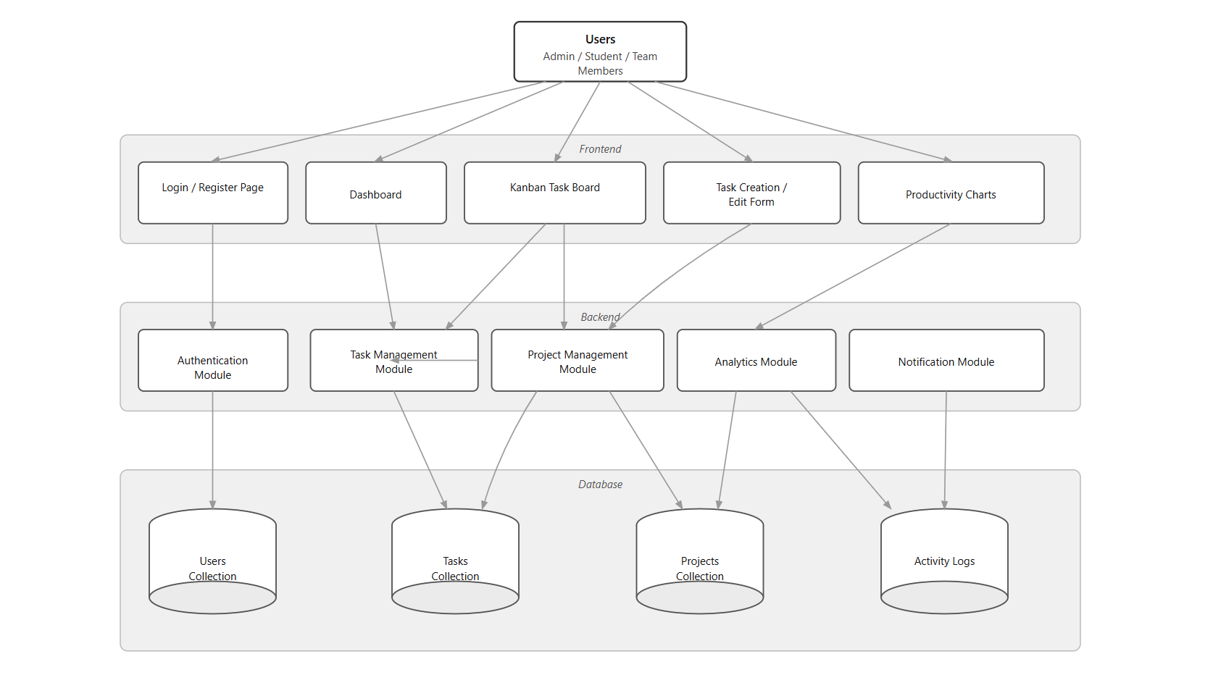
Architecture Diagram

Slide 11
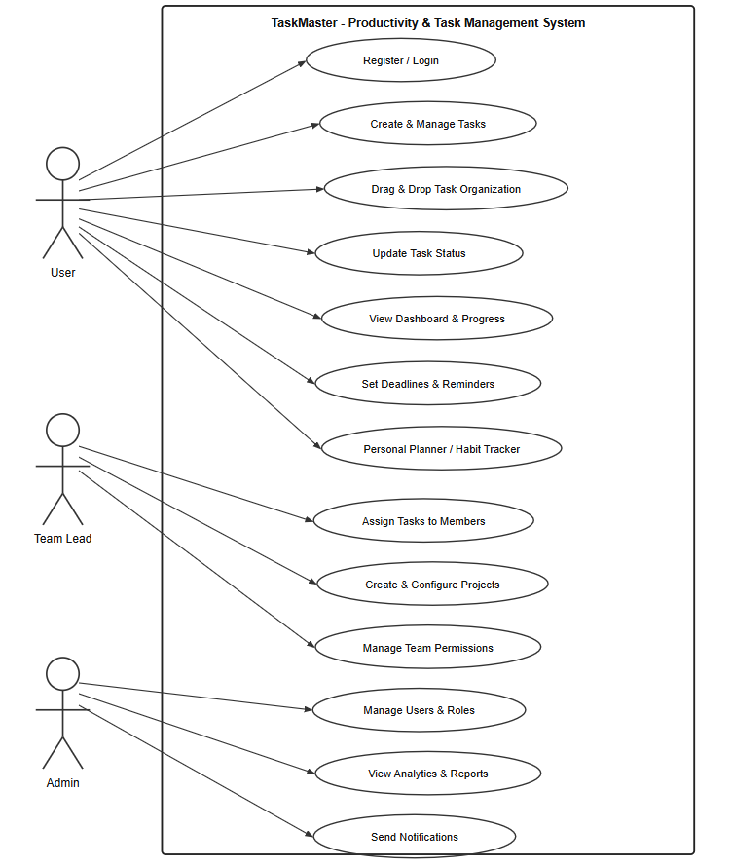
Use Case Diagram

Slide 12
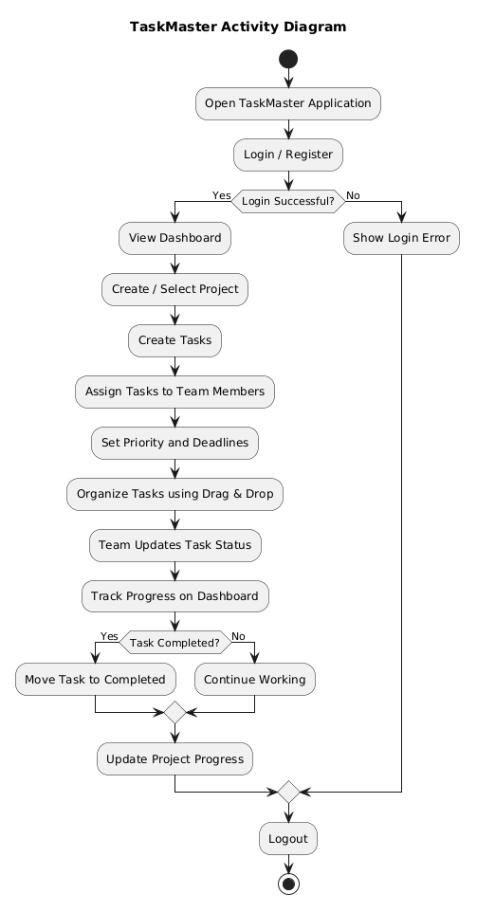
Activity Diagram

Slide 13
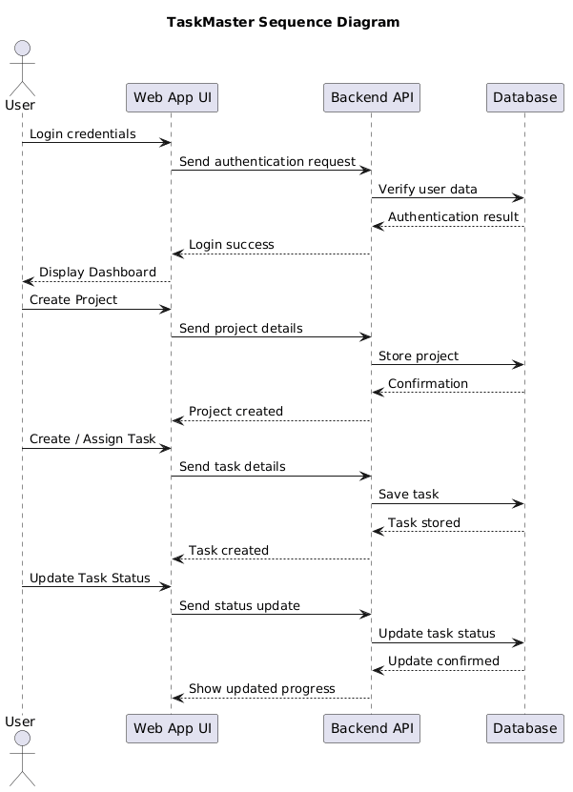
Sequence Diagram

Slide 14
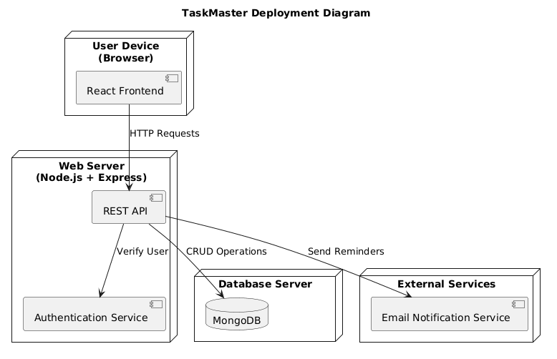
Deployment Diagram

Slide 15
THANK YOU

