Slide 1
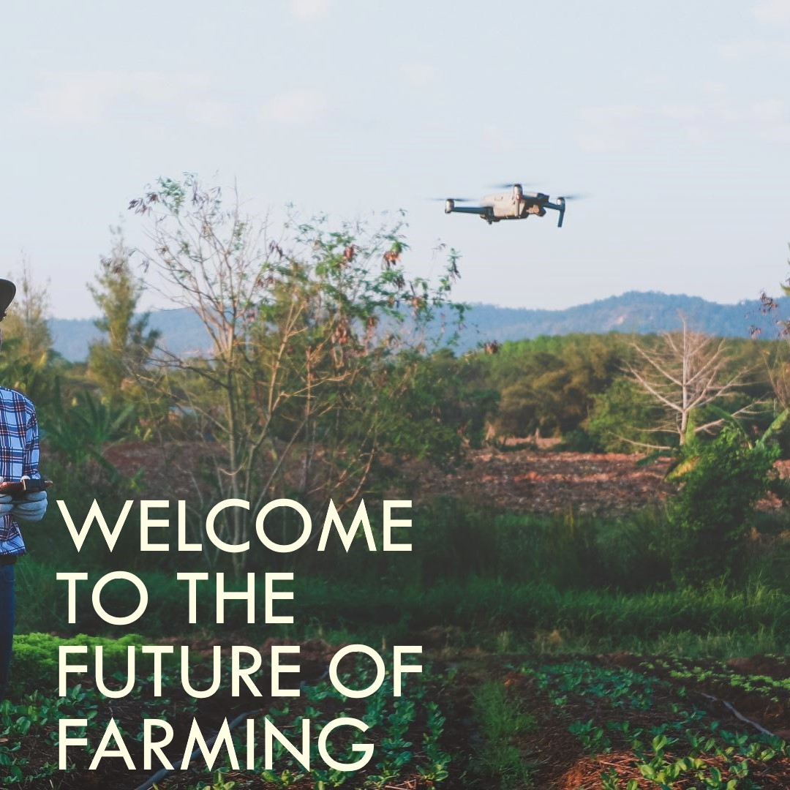

Slide 2
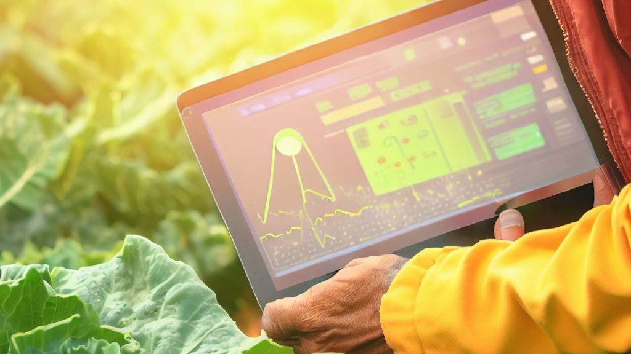
FarmConnect: Empowering Farmers

Slide 3


AGENDA:
Introduction
Key Features
Benefits
Innovative Features
Feasibility and Profitability
Challenges to Consider
Call to Action
Contact Information

Slide 4

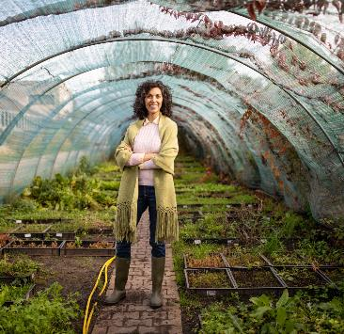
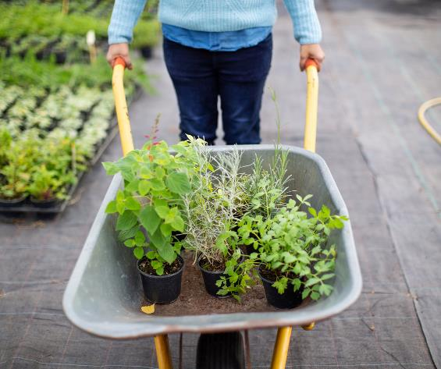
Introduction
Welcome to FarmConnect: Empowering Farmers
It's purpose is to provide farmers with comprehensive tools for optmizing farming operations and improving productivity.

Slide 5
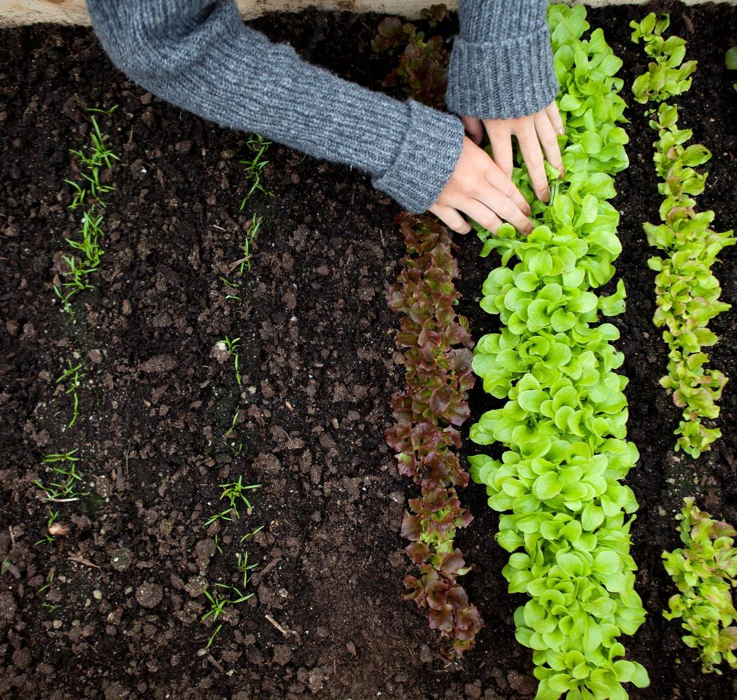
Key Features:
Real-time Weather Updates
Crop Management
Market Insights
Knowledge Hub
Financial Management
Community and Networking

Slide 6


Benefits:
Increase productivity and yield
Improve decision-making
Enhance financial management
Access valuable knowledge and resources
Foster community and networking
Save time, reduce costs, and maximize profitability

Slide 7
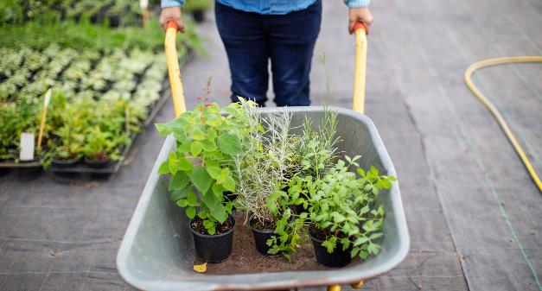
Innovative Features:
Soil Health Analysis
Crop Disease Recognition
Assess soil composition, fertility, and nutrient deficiencies to inform soil management decisions.
Identify and diagnose crop diseases from images uploaded by farmers for timely treatment.

Slide 8
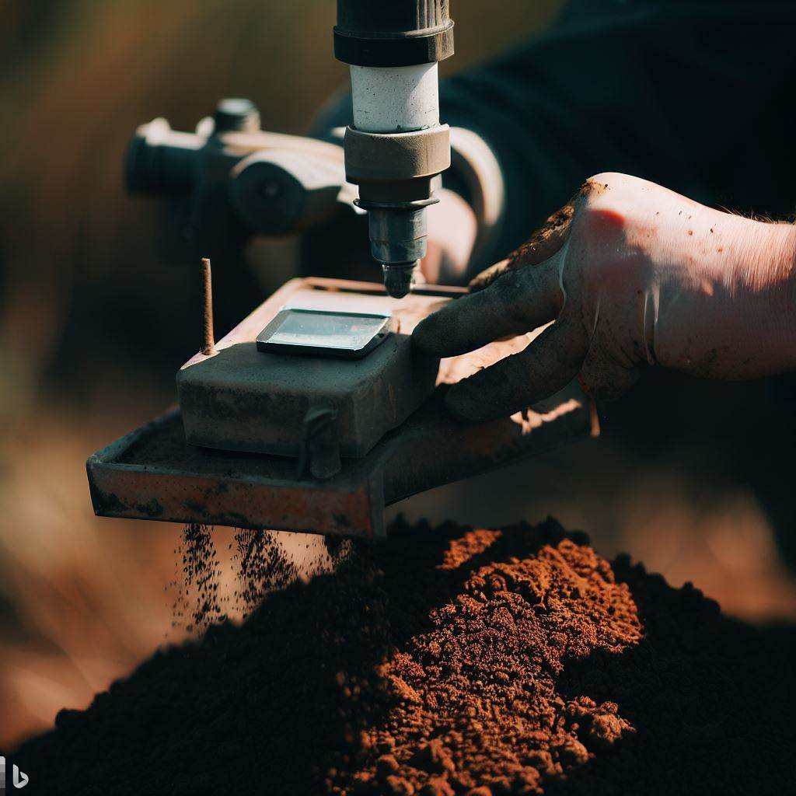
Innovative Features (cont.):
Predictive Analytics
Farm Equipment Sharing
Livestock Management
Generate personalized recommendations on planting, irrigation, and harvesting for optimized resource allocation.
Enable farmers to share and rent farm equipment for cost-effective resource utilization.
Track health records, vaccinations, and market trends for efficient livestock management.

Slide 9

Innovative Features (cont.):
Farm-to-Consumer Traceability
Smart Irrigation Management
Knowledge Exchange Platform
Use blockchain for transparent tracking of product origin, practices, and quality.
Optimize irrigation schedules based on crop needs and weather conditions for water efficiency.
Facilitate information sharing and collaboration among farmers, experts, and researchers.

Slide 10

"To forget how to dig the earth and to tend the soil is to forget ourselves."
-Mahatma Gandhi

Slide 11
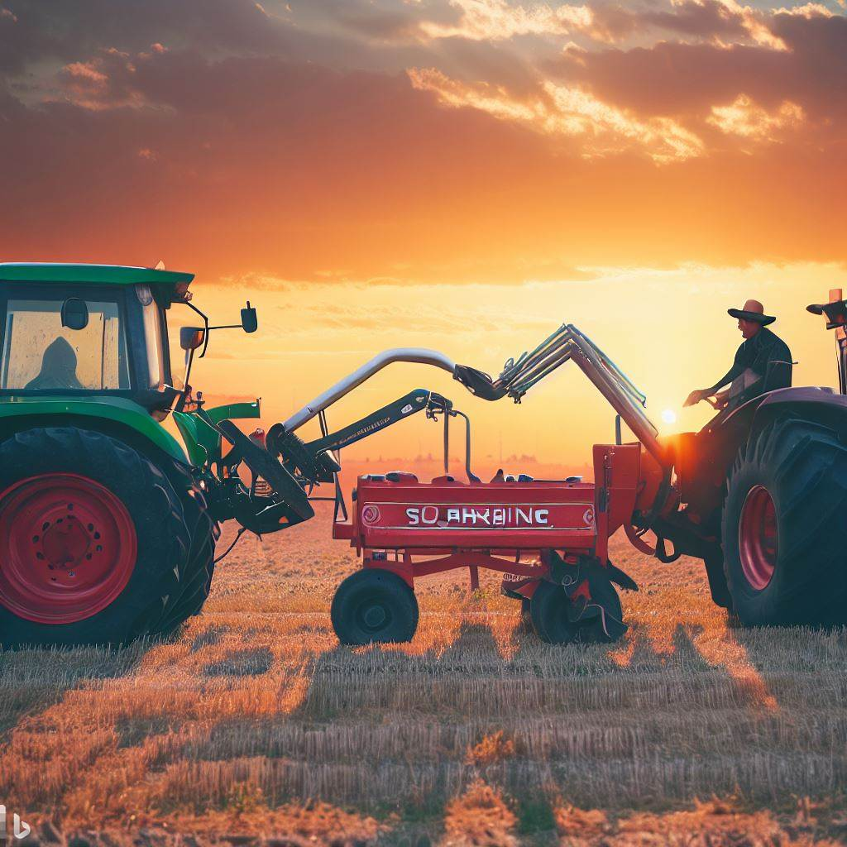
Feasibility and Productivity:
Growing demand
Connectivity
Precision farming
Market access
Knowledge sharing
Sustainability and traceability

Slide 12
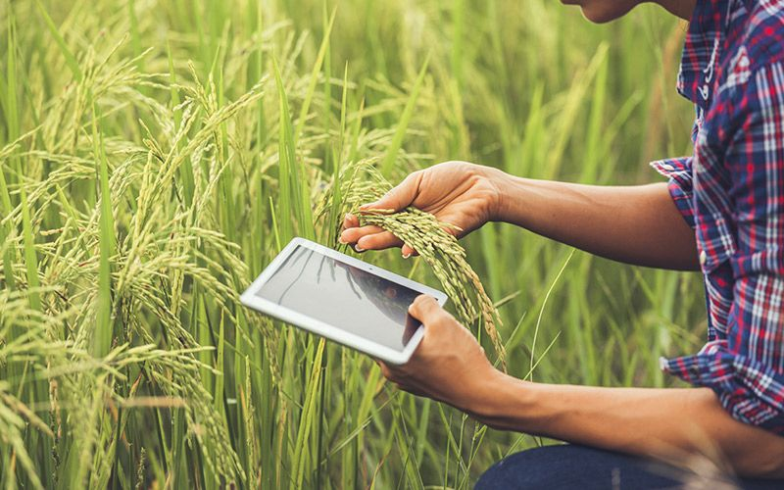
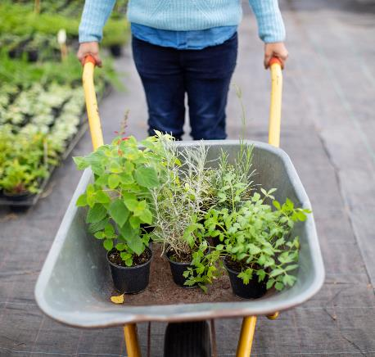
Challenges to Consider
• Varying technological adoption
• Connectivity limitations
• User-friendly interface

Slide 13

Call to Action
• Download FarmConnect app today
• Join the FarmConnect community
Contact Information:
• Website: www.farmconnect1.netlify.app
• Email: info@farmconnectapp.com
• Phone: +91 8840036840

Slide 14
References:
1. Smith, J., & Johnson, A. (2022). "The Impact of Digital Solutions on Agriculture: A Literature Review." Journal of Agricultural Technology, 18(3), 45-67.
2. Johnson, M. (2021). "Leveraging Technology for Sustainable Agriculture." International Conference on Sustainable Agriculture Proceedings, 223-235.
3. Food and Agriculture Organization of the United Nations. (2022). "The State of Food and Agriculture 2022: Digital Transformation for Rural Prosperity." Rome: FAO.
4. Wang, L., & Kim, S. (2021). "Predictive Analytics in Agriculture: A Case Study of Crop Yield Prediction." International Journal of Data Science and Agriculture, 12(1), 78-91.
5. World Bank. (2022). "Digital Solutions for Agricultural Development: Promoting Inclusive Growth." Washington, DC: World Bank.

Slide 15


