Slide 1


Cloud deployment
Muhammed KURNASAN

Slide 2


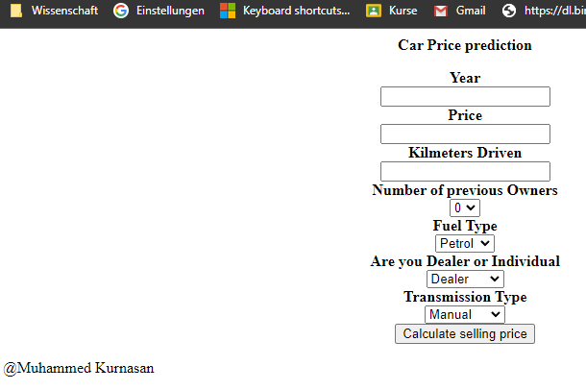
Model selection
Selected model from week 4

Slide 3
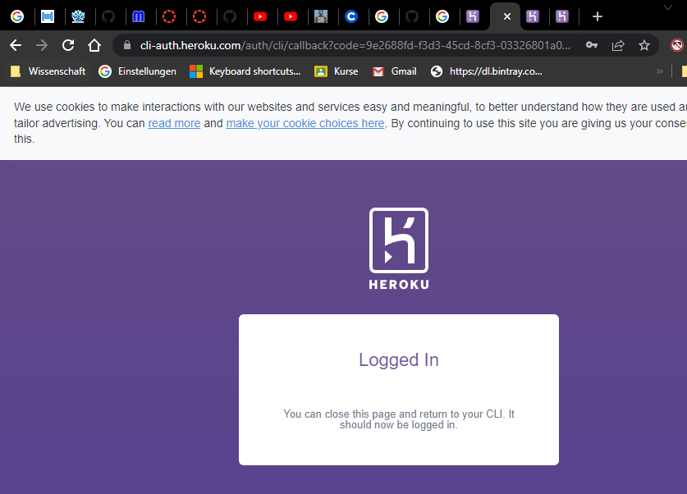
Model selection
Selected model from week 4

Slide 4
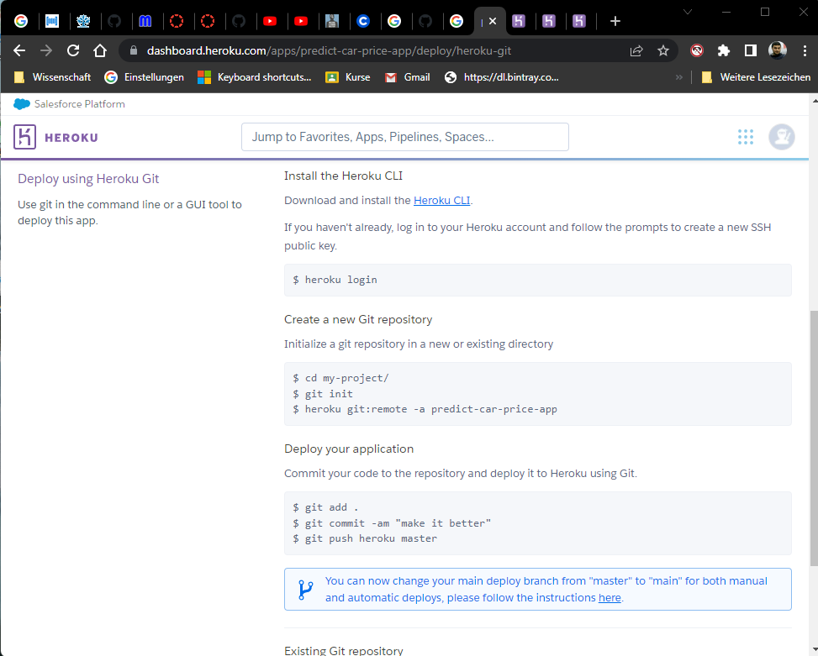
Following instructions
Initialing a git
Setting remote
Adding files
Committing and puyshing

Slide 5
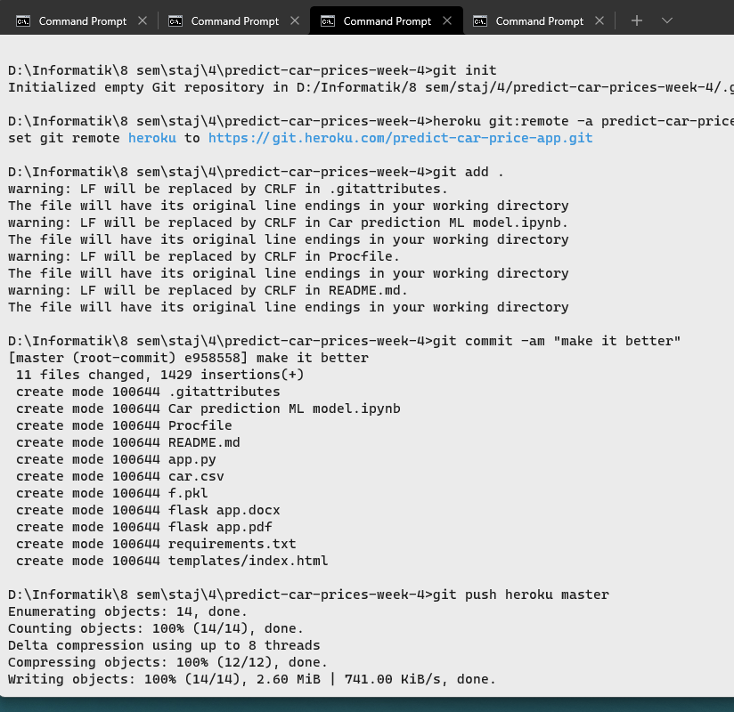
Following instructions

Slide 6
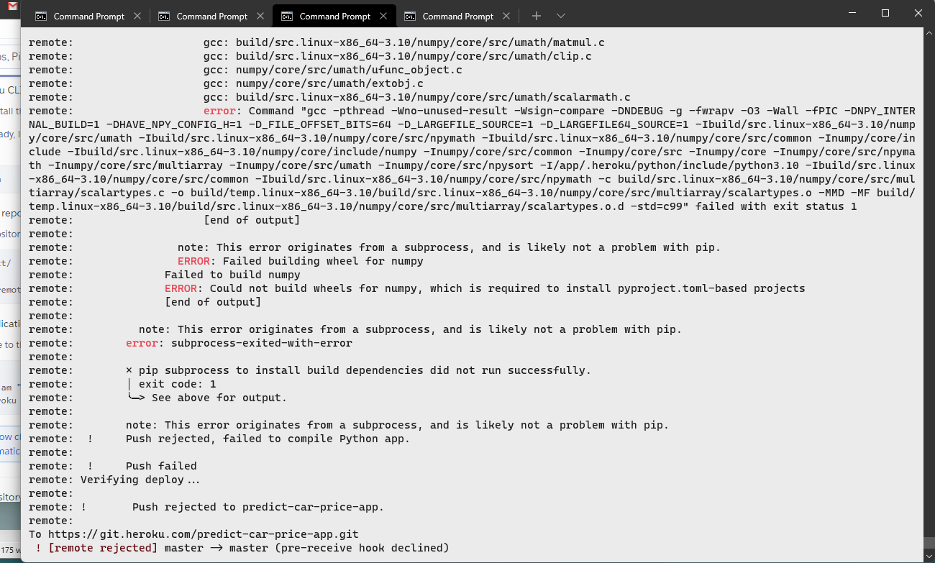
failure
Most probably internal error. Couldn’t resolve the issue

