Slide 1
Organic Food
7th floor’s proposal

Slide 2
Why 7th floor?
The reason why our group choose “Seventh Floor” as a name is because some people believe seven is a lucky number, in society we know about “seven” wonders, not eight nor nine wonders. Moreover, and the most important thing that all of our members are living in the seventh floor. The same places somehow give us the advantages and become one of our strategies to make the coordination and collaboration easier.

Slide 3
Why organic?
Organic foods’ market have been growing in the global market for the past years and it is taking more and more market shares in the food market. Because food market could be considered the largest market in all markets in the world, we choose to study this particular market and choose it as our project’s theme.

Slide 4
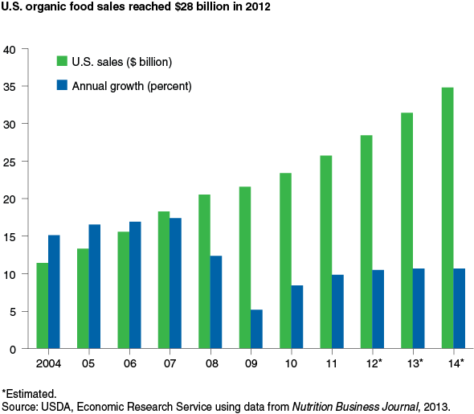
Market growth in America
Have it reached its market saturation?
How about global market?

Slide 5
Project’s outline
- History/development of organic food industry
- Advantages of organic food compared to regular food
- Governments’ policies and regulations in organic food industries
- Technology involved in organic foods’ industries
- Market analysis and market growth of organic food

Slide 6
Logic Model

Slide 7
Participant
Students
Teachers
Classmates

Slide 8
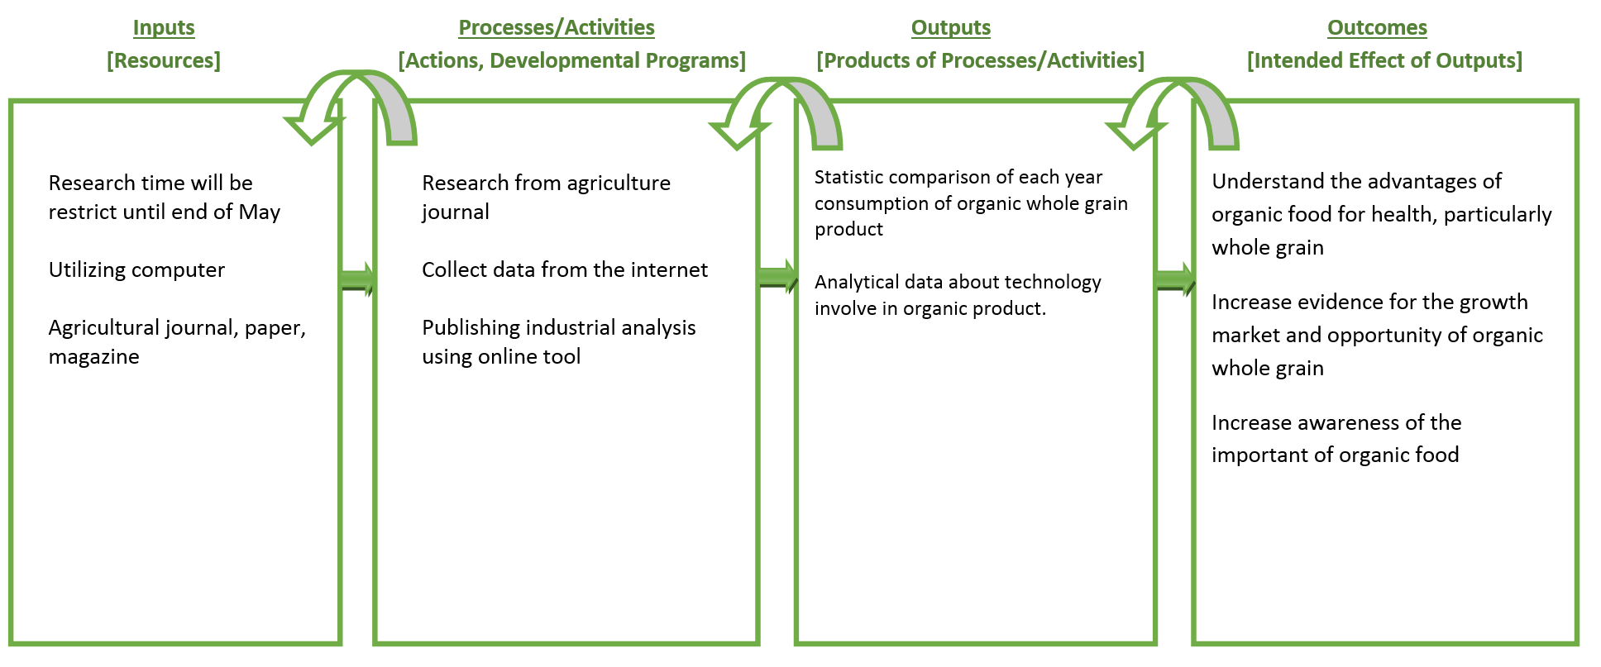
Logic Model

Slide 9
progress
7th Floor Team

Slide 10

Progress
Research from agriculture journal
Collect data from the internet
Publishing industrial analysis using online tool

Slide 11
Research from scratch
What is Organic?
What is Whole Grain?

Slide 12
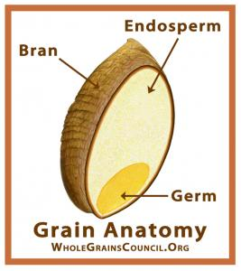
What is Whole Grain?
Any kind of edible plant seeds (aka. Kernel) that contains bran, endosperm and germ
Bran outer layer of a grain; protects the grain from diseases, pests, etc.
Endosperm, food that the germ was fed on
Germ, it is the embryo that will sprout in to new plant.

Slide 13
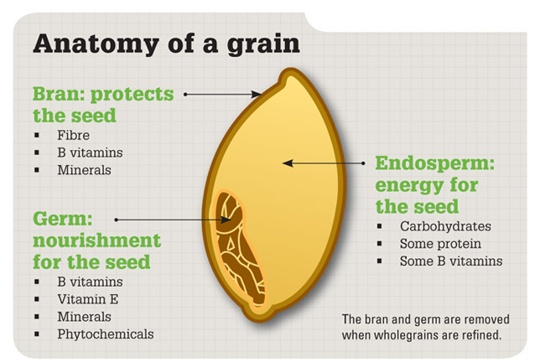
Grain Anatomy

Slide 14
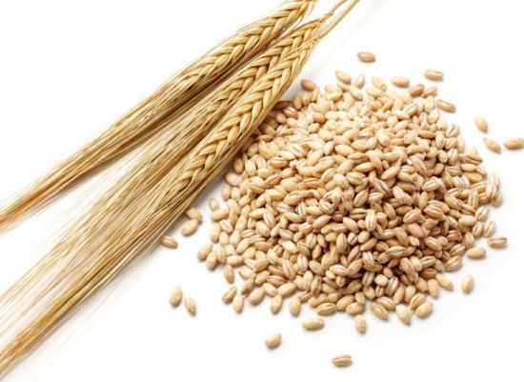
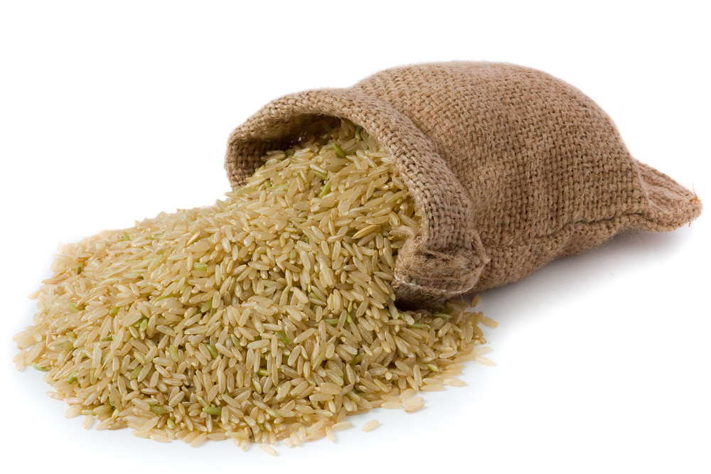
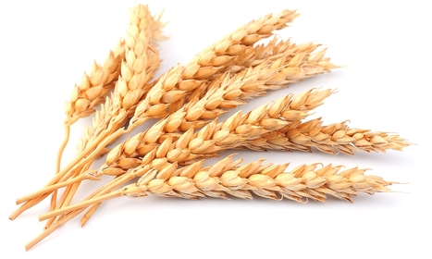
Example of whole grain
Wheat
Barley
Brown Rice

Slide 15
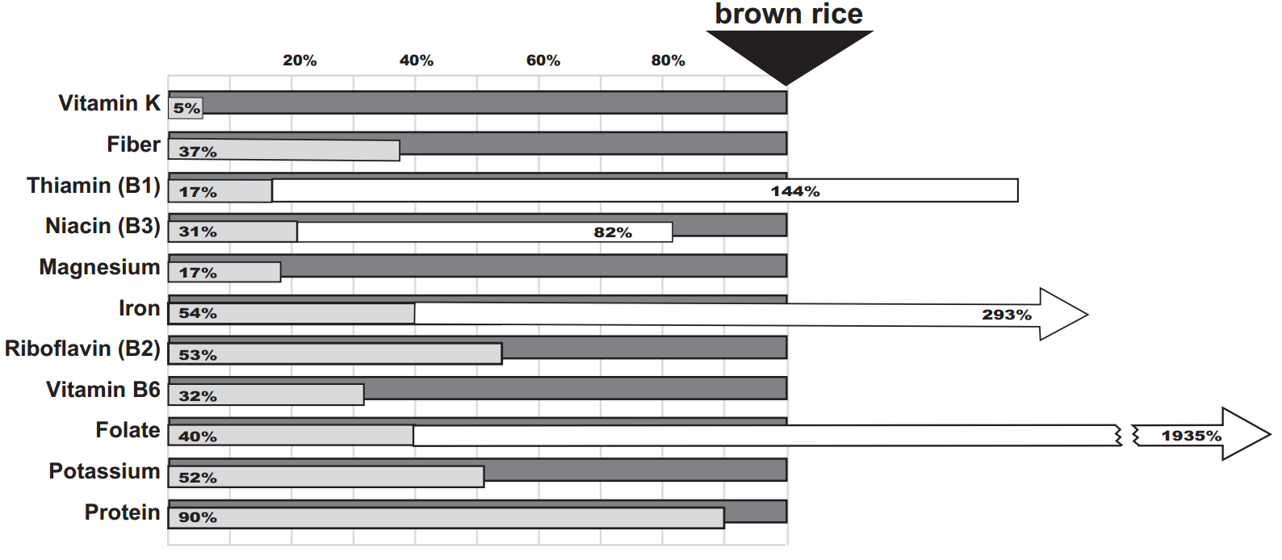
Brown Rice

Slide 16

7th Floor
Bobby Kurniawan 2014280194
Seetala Ummaralikit 2014280195
Muanphet Charnratanavisan 2014280199

