Slide 1
Organic Food

Slide 2
What is Organic Food?
Organic is a labeling term that indicates that the food or other agricultural product has been produced through approved methods that integrate cultural, biological, and mechanical practices that foster cycling of resources, promote ecological balance, and conserve biodiversity
(usda, United State Department of Agriculture)

Slide 3
Characteristic Organic
Avoid chemicals input
Crop rotation
Overall system health is emphasized

Slide 4
Why Organic Food
Conventional farming leeches nutrients from the soil, puts a strain on our water supplies, and relies heavily on fossil fuels to make it work;
Organic farming builds better, more self-sufficient land, creates cleaner water, recycles nutrients, and leaves us with a cleaner atmosphere.

Slide 5
Benefit of Organic Product
Replenish soil fertility
Environment friendly

Slide 6
Regulation
Based on Electronic Code of Federal Regulations (http://www.ecfr.gov)
Organic Production and Handling Requirements
Labels, Labeling
Certification and Certification Agent

Slide 7
Regulation (http://www.ecfr.gov)
Organic Production and Handling Requirements
Organic production and handling system plan
Land requirements
Crop rotation standard
Livestock health care standard

Slide 8
Regulation (http://www.ecfr.gov)
Labels, Labeling
Product composition
How to can get label “organic”

Slide 9
Regulation (http://www.ecfr.gov)
Certification and Accreditation of Certifying Agent
Application for certification and mechanism of certification
Requirement for accreditation and applying for accreditation

Slide 10
History of Organic Product
Year
1920s – 1940s | Writers in the U.S. and Great Britain published influential works introducing the basic idea of organics
1940's | Synthetic pesticides and herbicides were introduced to American agriculture
1940's to 1950's | A loose network of farmers, shunned chemical agriculture by farming organically and writing about their experiences.
1953 | Natural Food Associates (NFA) was formed in Atlanta, Texas, to help connect scattered organic growers with fledgling markets for organically grown foods.
1962 | Rachel Carlson's Silent Spring was published, documenting some of the negative consequences associated with chemical use in agriculture.

Slide 11
History of Organic Product
Year
1970s | Activists across the U.S. to form regional groups and create organic standards by which to certify farmers and their crops. Some point to the United States' ban of the pesticide DDT in this year as the start of the modern environmental movement.
1980s | The National Resources Defense Council (NRDC) released their report on the carcinogenic growth regulator Alar, which was used on apples.
1990s | The organic industry had estimated sales of more than $1 billion and Congress passed the Organic Foods Production Act of 1990, which established the framework to create National Organic Standards.

Slide 12
History of Organic Product
Year
1995 | Margaret Wittenberg, Vice President of Government and Public Affairs for Whole Foods Market, appointed as the sole retail representative on the 14-member National Organic Standards Board (NOSB).
2000 | Organic industry members and consumers, sent over 275,000 comments to the USDA on their proposed National Organic Standards, which included provisions not recommended by the NOSB. The USDA's Economic Research Service released a major study on the status of organics in the U.S.
2001 | USDA passes the Final Organic Rule after reinstating prohibitions on irradiation, sewage sludge and genetically engineered seed.

Slide 13
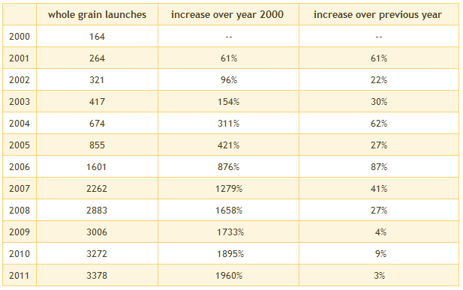
Whole grain growth market
Source: Mintel Global New Products Database

Slide 14
Discussion
Organic Product Related to Energy
Organic product can preserve more energy because we avoid to use chemical substance which consume more energy
Organic Product Related to Workforce
Organic Product
Organic Product Related to Transportation
Organic product need to control the humidity while shipped

