Slide 1
Organic Food
7th floor’s proposal

Slide 2
Why 7th floor?
The reason why our group choose “Seventh Floor” as a name is because some people believe seven is a lucky number, in society we know about “seven” wonders, not eight nor nine wonders. Moreover, and the most important thing that all of our members are living in the seventh floor. The same places somehow give us the advantages and become one of our strategies to make the coordination and collaboration easier.

Slide 3
Why organic as our topic?
Organic foods’ market have been growing in the global market for the past years and it is taking more and more market shares in the food market. Because food market could be considered the largest market in all markets in the world, we choose to study this particular market and choose it as our project’s theme.

Slide 4
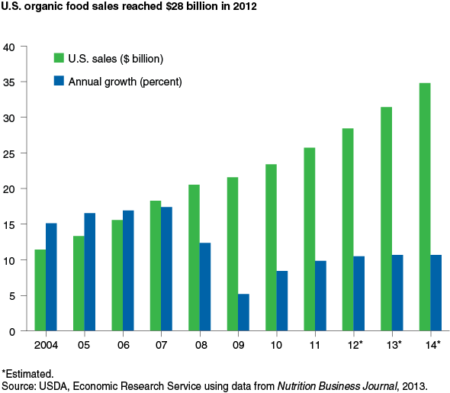
Market growth in America
Have it reached its market saturation?
How about global market?

Slide 5
Project’s outline
- History/development of organic food industry
- Advantages of organic food compared to regular food
- Governments’ policies and regulations in organic food industries
- Technology involved in organic foods’ industries
- Market analysis and market growth of organic food

Slide 6
Logic Model

Slide 7
Participant
Students
Teachers
Classmates

Slide 8
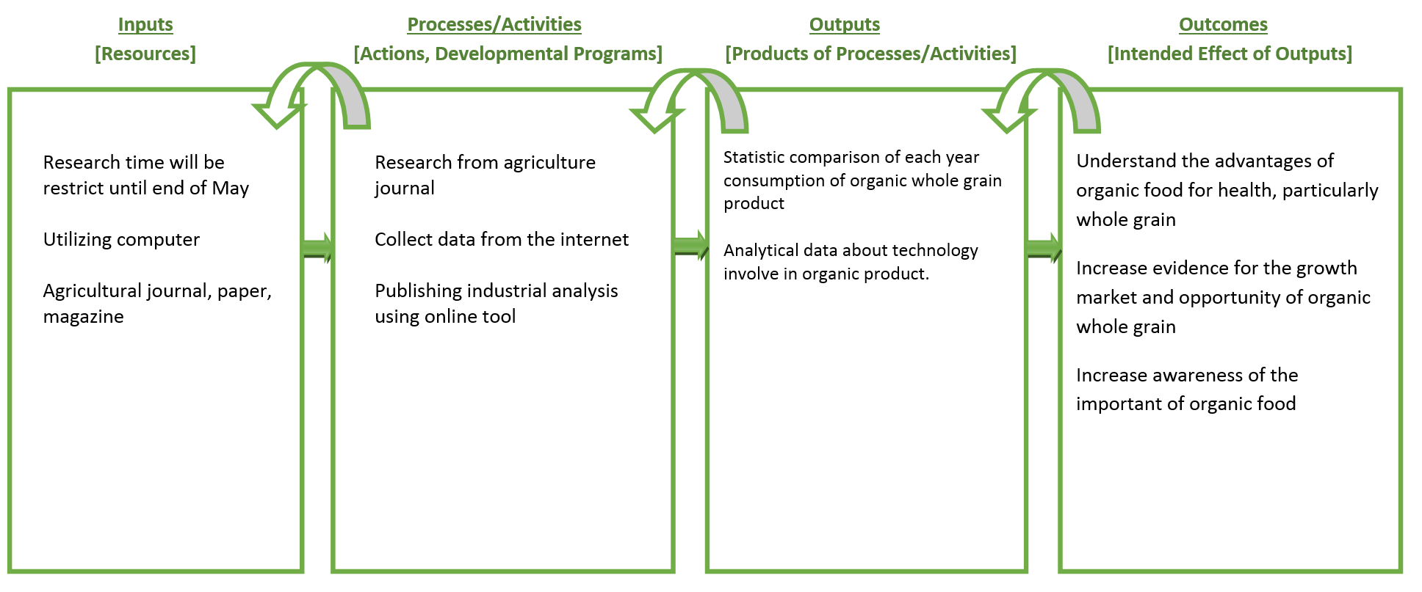
Logic Model

Slide 9
progress
7th Floor Team

Slide 10

Recall our logic model
Research from agriculture journal
Collect data from the internet
Publishing industrial analysis using online tool

Slide 11
Recall our Project’s outline
History/development of organic food industry
Advantages of organic food compared to regular food
Governments’ policies and regulations in organic food industries
Technology involved in organic foods’ industries
Market analysis and market growth of organic food

Slide 12
What is organic ?
Organic is a labeling term that indicates that the food or other agricultural product has been produced through approved methods that integrate cultural, biological, and mechanical practices that foster cycling of resources, promote ecological balance, and conserve biodiversity
(usda, United State Department of Agriculture)

Slide 13
Characteristic Organic food
Avoid chemicals input
Crop rotation
Overall system health is emphasized

Slide 14
Why Organic Food?
Conventional farming leeches nutrients from the soil, puts a strain on our water supplies, and relies heavily on fossil fuels to make it work;
Organic farming builds better, more self-sufficient land, creates cleaner water, recycles nutrients, and leaves us with a cleaner atmosphere.

Slide 15
Regulation
Based on Electronic Code of Federal Regulations (http://www.ecfr.gov)
(1) Organic Production and Handling Requirements
(2) Labels, Labeling
(3) Certification and Certification Agent

Slide 16
(1) Organic Production and Handling Requirements
Organic production and handling system plan
Land requirements
Crop rotation standard
Livestock health care standard
Notes:
(a) The producer must select and implement tillage and cultivation practices that maintain or improve the physical, chemical, and biological condition of soil and minimize soil erosion.
(b) The producer must manage crop nutrients and soil fertility through rotations, cover crops, and the application of plant and animal materials.
(c) The producer must manage plant and animal materials to maintain or improve soil organic matter content in a manner that does not contribute to contamination of crops, soil, or water by plant nutrients, pathogenic organisms, heavy metals, or residues of prohibited substances. Animal and plant materials include:
(1) Raw animal manure, which must be composted unless it is:
(i) Applied to land used for a crop not intended for human consumption;
(ii) Incorporated into the soil not less than 120 days prior to the harvest of a product whose edible portion has direct contact with the soil surface or soil particles; or
(iii) Incorporated into the soil not less than 90 days prior to the harvest of a product whose edible portion does not have direct contact with the soil surface or soil particles;
(2) Composted plant and animal materials produced though a process that:
(i) Established an initial C:N ratio of between 25:1 and 40:1; and
(ii) Maintained a temperature of between 131 °F and 170 °F for 3 days using an in-vessel or static aerated pile system; or
(iii) Maintained a temperature of between 131 °F and 170 °F for 15 days using a windrow composting system, during which period, the materials must be turned a minimum of five times.
(3) Uncomposted plant materials.
(d) A producer may manage crop nutrients and soil fertility to maintain or improve soil organic matter content in a manner that does not contribute to contamination of crops, soil, or water by plant nutrients, pathogenic organisms, heavy metals, or residues of prohibited substances by applying:
(1) A crop nutrient or soil amendment included on the National List of synthetic substances allowed for use in organic crop production;
(2) A mined substance of low solubility;
(3) A mined substance of high solubility: Provided, That, the substance is used in compliance with the conditions established on the National List of nonsynthetic materials prohibited for crop production;
(4) Ash obtained from the burning of a plant or animal material, except as prohibited in paragraph (e) of this section: Provided, That, the material burned has not been treated or combined with a prohibited substance or the ash is not included on the National List of nonsynthetic substances prohibited for use in organic crop production; and
(5) A plant or animal material that has been chemically altered by a manufacturing process: Provided, That, the material is included on the National List of synthetic substances allowed for use in organic crop production established in §205.601.
(e) The producer must not use:
(1) Any fertilizer or composted plant and animal material that contains a synthetic substance not included on the National List of synthetic substances allowed for use in organic crop production;
(2) Sewage sludge (biosolids) as defined in 40 CFR part 503; and (3) Burning as a means of disposal for crop residues produced on the operation: Except, That, burning may be used to suppress the spread of disease or to stimulate seed germination.

Slide 17
(2) Labels, Labeling
Product composition
How to can get label “organic”

Slide 18
Certification and accreditation of certifying agent
Application for certification and mechanism of certification
Requirement for accreditation and applying for accreditation

Slide 19
Discussion
Organic Product Related to Energy
- Organic product can preserve more energy because we avoid to use chemical substance which consume more energy
Organic Product Related to Workforce
- Organic Product
Organic Product Related to Transportation
- Organic product

Slide 20
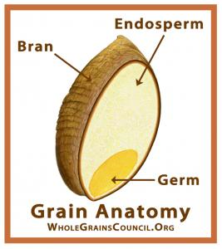
What is Whole Grain?
Any kind of edible plant seeds (aka. Kernel) that contains bran, endosperm and germ
Bran outer layer of a grain; protects the grain from diseases, pests, etc.
Endosperm, food that the germ was fed on
Germ, it is the embryo that will sprout in to new plant.

Slide 21
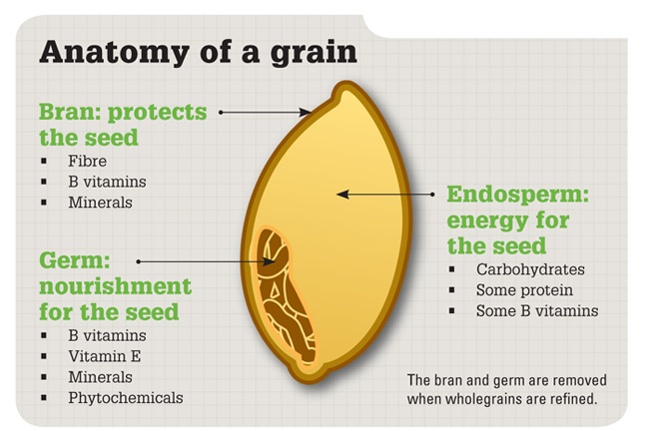
Grain Anatomy

Slide 22
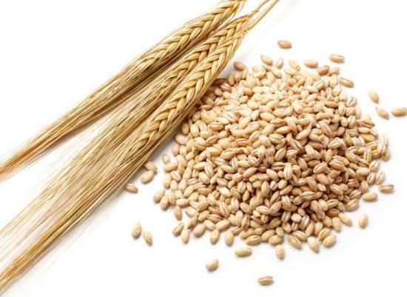
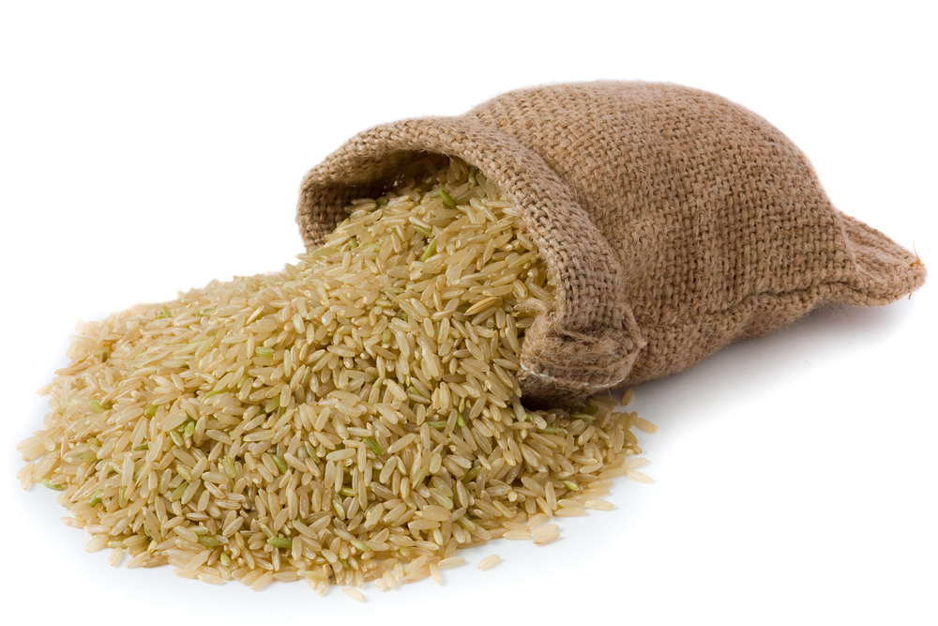
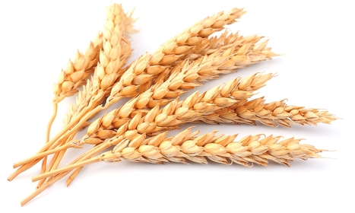
Example of whole grain
Wheat
Barley
Brown Rice

Slide 23
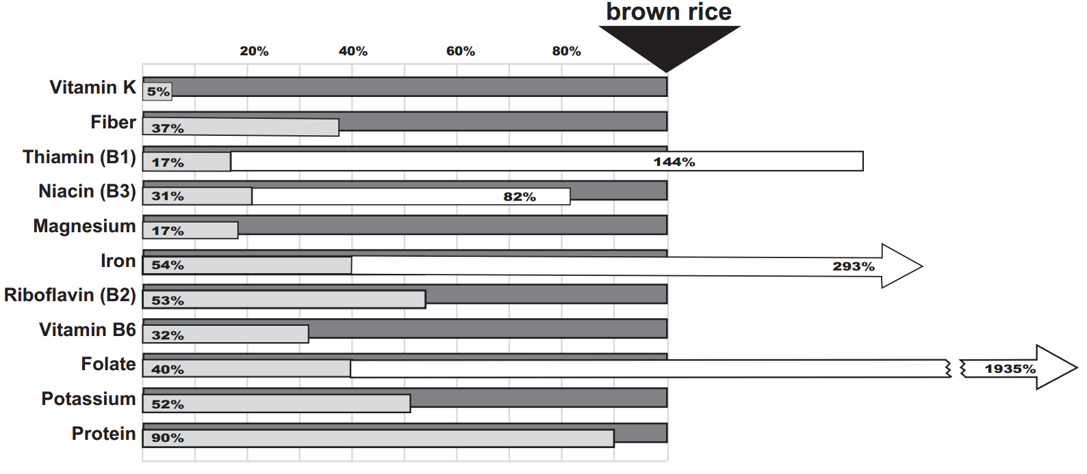
Brown Rice

Slide 24
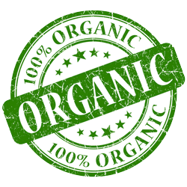
7th Floor
Bobby Kurniawan 2014280194
Seetala Ummaralikit 2014280195
Muanphet Charnratanavisan 2014280199

