Slide 1
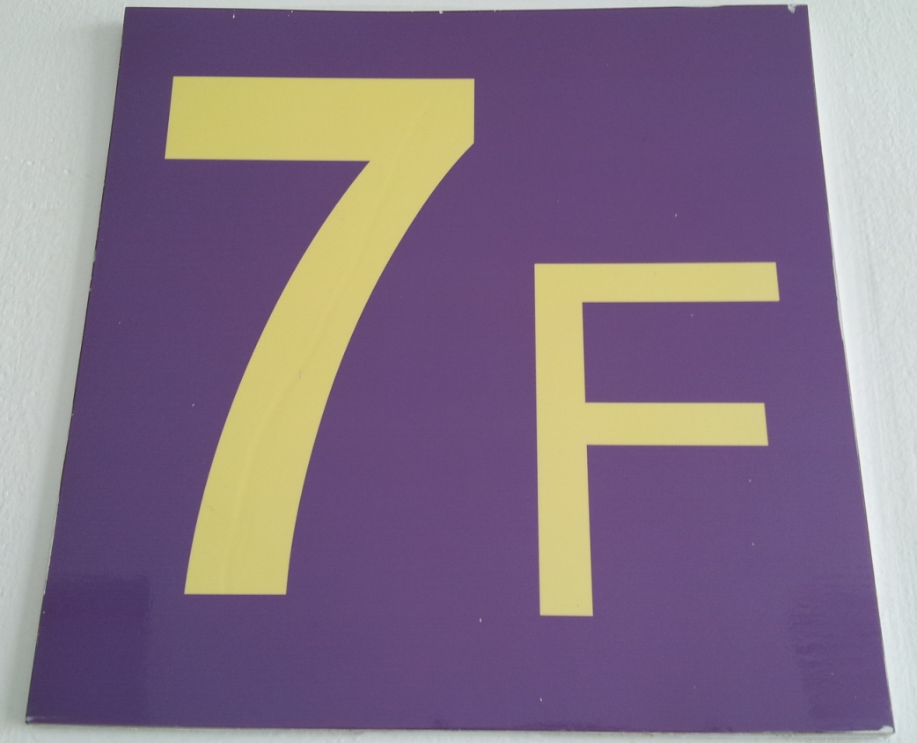

7th Floor Group
Member:
1 . Bobby Kurniawan / 2014280194
2. Seetala Ummaralikit/2014280195
3. Muanphet Charnratanavisan/2014280199

Slide 2
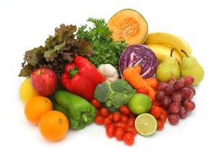
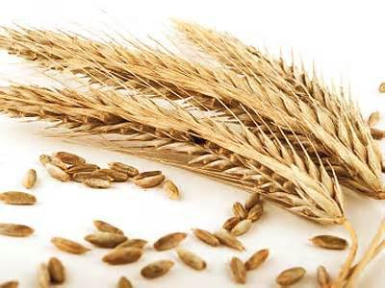
Product theme
Organic food

Slide 3
Outline
History/development of organic food industry
Advantages of organic food compared to regular food
Governments’ policies and regulations in organic food industries
Technology involved in organic foods’ industries
Market analysis and market growth of organic food

Slide 4
Logic Model
Participant
- Students
- Teachers
- Classmates

Slide 5
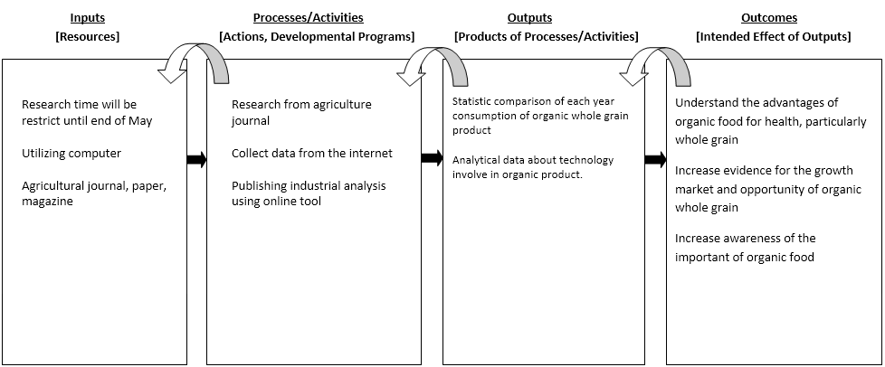
Logic Model

Slide 6
Thanks

