Slide 1
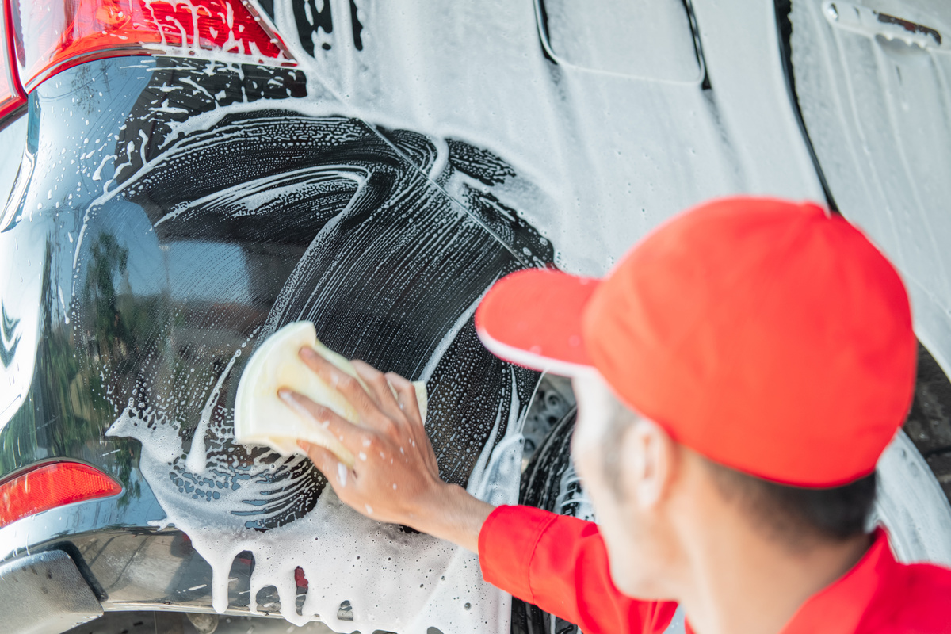
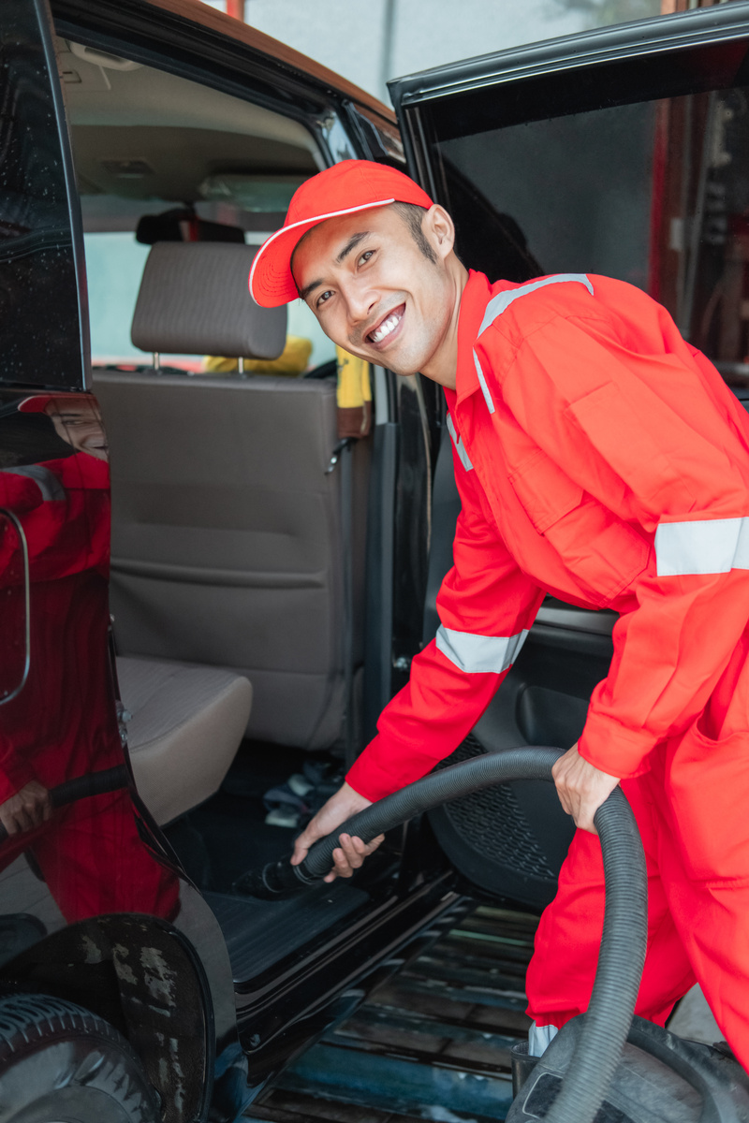

Cantumkan
Logo
disini
Car Wash
Buka Senin - Jumat
09.00 - 16.00
Pelayanan :
Cuci salju
Pembersihan
interior
kit
Pesan sekarang, HUB +6287-000
@Cantumkan_sosmed_kalian

