Slide 1
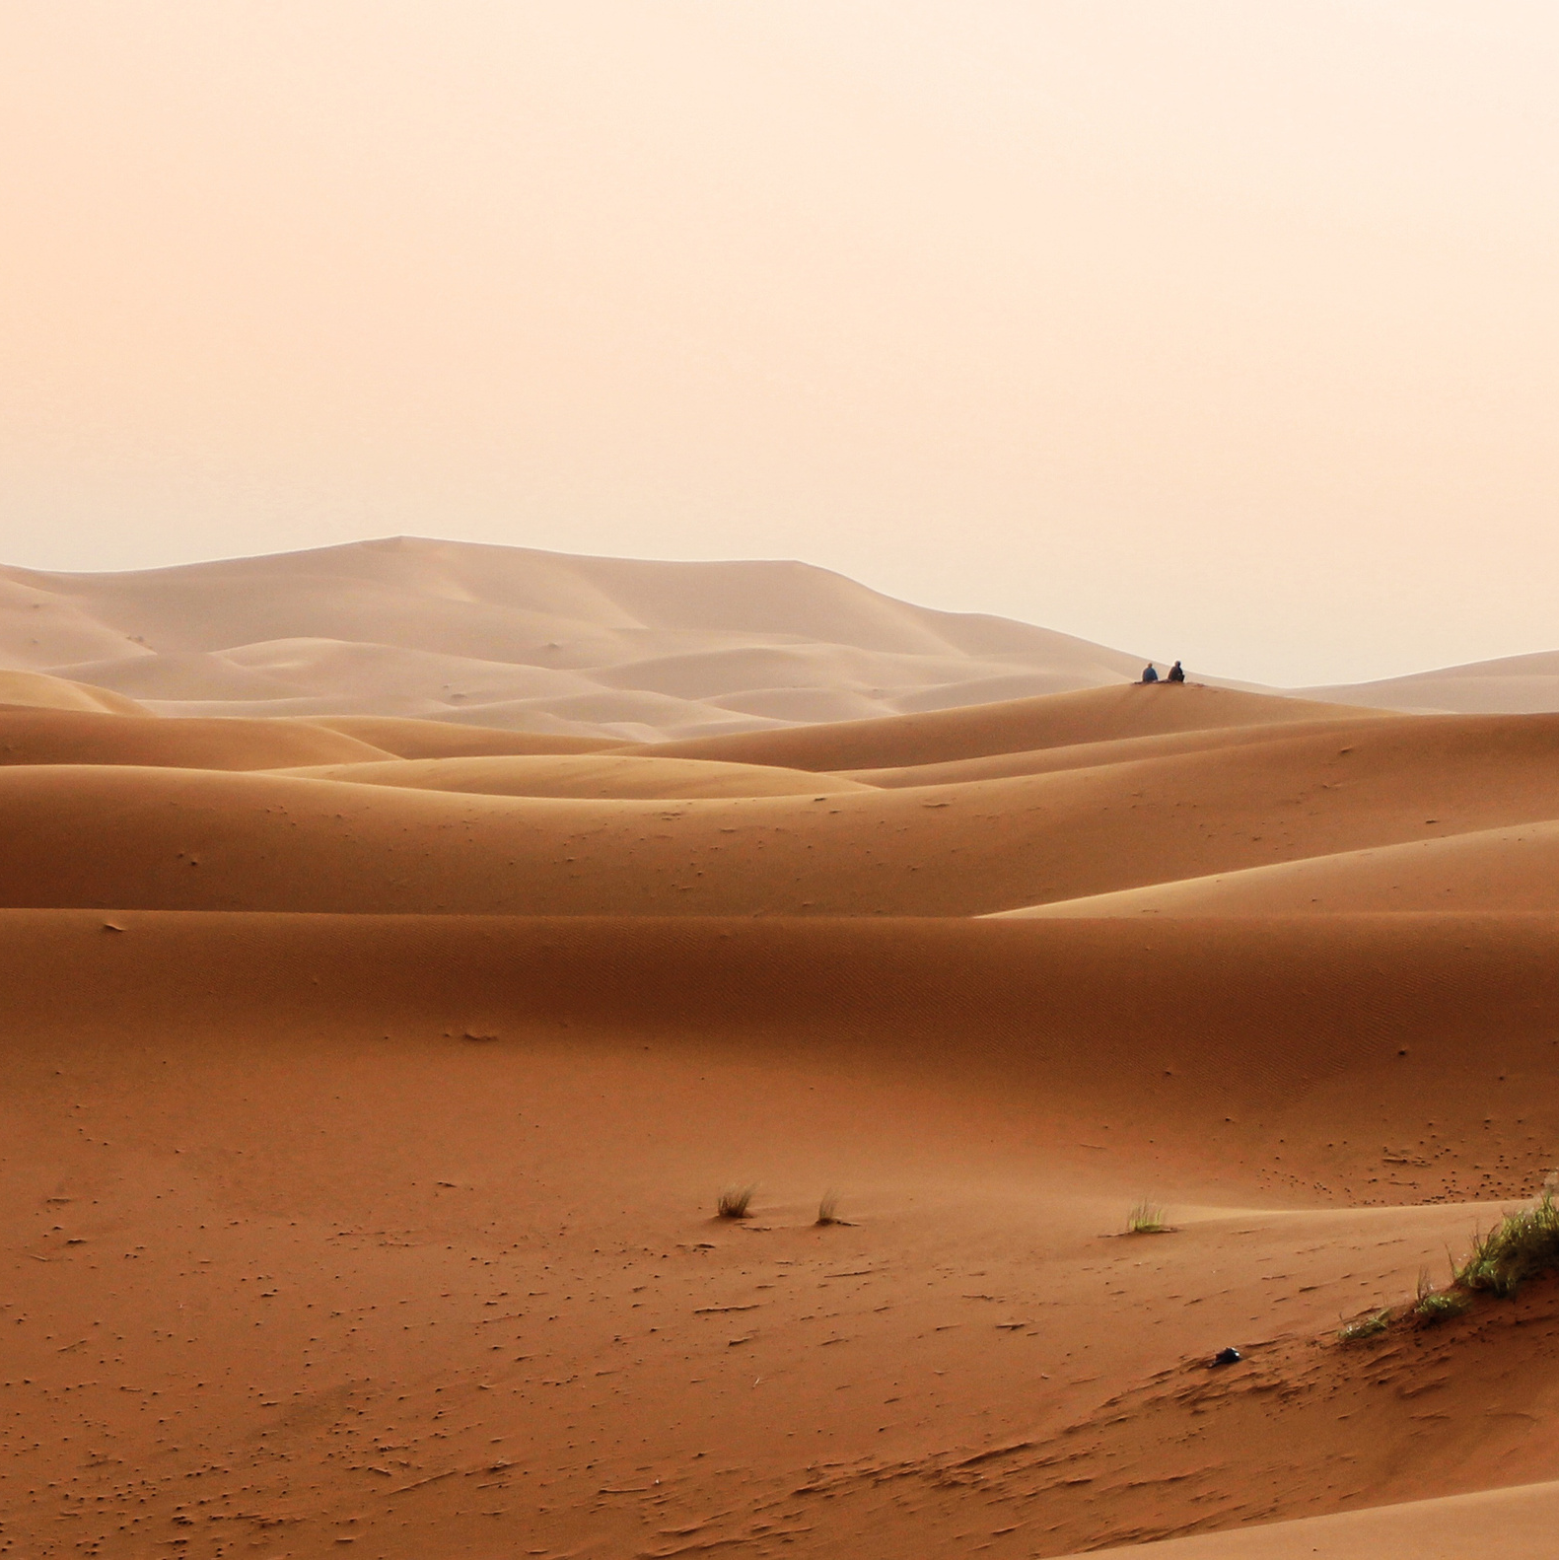

Cantumkan
Logo
disini
There is no end to the adventures that we can have if only we seek them with our eyes open.
OH YEAH!
LET'S GO!
@cantumkan_sosmed_disini

