Slide 1

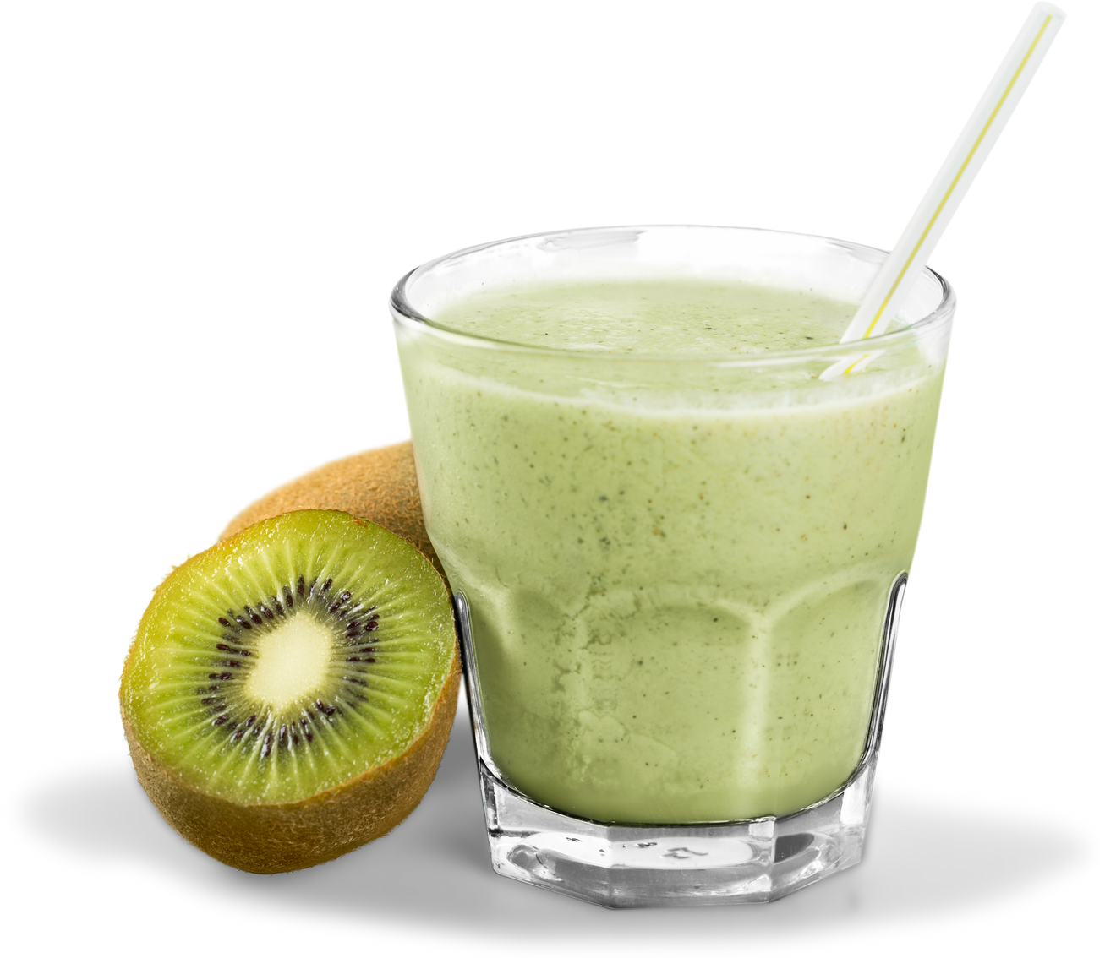

Cantumkan
Logo
disini
@social_media kalian
KIWI
NATURAL JUICE
Rp3
000

