Slide 1

CABALMESH
INVESTOR PITCH · 2026
THE NOBODY NETWORK
CabalMesh
A wallet whose payments survive with no internet — sign an intent on your phone, relay it through the phones around you, settle it on Avalanche the moment any of them finds a signal.
CABALMESH · AVALANCHE FUJI · github.com/kurodenjiro/Cabal-Mesh

Slide 2
CABALMESH
PITCH · 2026
THE PROBLEM
Every payment rail on earth assumes a live connection — so when the network drops, value stops moving.
2.2B
3.1B
300M
PEOPLE
THE USAGE GAP
THE COVERAGE GAP
are still offline in 2025 — 96% of them in low- and middle-income countries.
live under mobile coverage they do not use — 38% of the world’s population.
have no mobile internet coverage available to them at all.
ITU, Facts and Figures 2025
GSMA, State of Mobile Internet Connectivity 2025
GSMA, State of Mobile Internet Connectivity 2025
And coverage is not availability: outages, disasters, borders, crowds and dead zones take the network away from everyone else, exactly when local coordination matters most.
02

Slide 3




CABALMESH
PITCH · 2026
THE SOLUTION
CabalMesh is a zero-identity wallet that settles offline transactions through the people around you.
01
02
03
04
SIGN
RELAY
GATEWAY
SETTLE
Compose and sign on-device. No account, no server, no session.
Nearby phones carry the encrypted payload over Bluetooth and mesh.
The first peer with internet drains the queue toward the chain.
Escrow confirms on Avalanche. The proof lands; the identity never does.
IT ALREADY WORKS
PRIVACY BY SUBTRACTION
THE NETWORK IS THE MOAT
The offline path is built and demonstrated end to end — 470 automated tests, escrow live on Fuji, verified with the radio off.
No account, no server, no stored history. There is nothing to leak because nothing is kept — only a proof settles on-chain.
Every user is a relay, and relaying earns. Density is the product: the more users in a place, the better it works there.
None of this loop is a roadmap item — it runs today on iOS, Android and macOS, and the demo is the app, not a mock.
03

Slide 4
CABALMESH
PITCH · 2026
MARKET
A large, structural need — and two compounding markets already paying for pieces of it.
WHO NEEDS IT
2.2B
3.1B
300M
WHY THE NEED IS URGENT
Coverage keeps growing while use does not — the gap is behaviour, price and trust, not towers. An offline-first rail does not wait for either curve.
offline today
in the usage gap
with no coverage
ITU 2025
GSMA 2025
GSMA 2025
MARKETS ALREADY BEING PAID FOR
WIRELESS MESH NETWORKING
8.8% CAGR
Mordor Intelligence, 2025 → 2030
OUR BEACHHEAD
$10.4B
$15.8B
Avalanche builders, privacy-hardware buyers, and off-grid trade communities. We size it with the Phase 2 pre-order waitlist rather than asserting a number here — the waitlist is the KPI.
CRYPTO HARDWARE WALLETS
~26% CAGR
Grand View / Mordor, 2025 → 2030
$0.6B
$1.5B
Sources — ITU Measuring Digital Development: Facts and Figures 2025 · GSMA State of Mobile Internet Connectivity 2025 · Mordor Intelligence · Grand View Research.
04

Slide 5
CABALMESH
PITCH · 2026
GO TO MARKET · WHAT WE BUILT
Start where the mesh is already dense, then sell the hardware that makes it denser.
WHO USES IT FIRST
BUILT AND RUNNING TODAY
01
Avalanche builders & grant circles
Offline signing, relay queue, auto-confirm on reconnect
They already see the demo and read the code. Cheapest audience to reach, hardest to fool.
BLE offline plane on iOS and Android
02
Privacy & crypto-hardware buyers
Escrow live on Avalanche Fuji — real deployed address
A category that already buys a physical security device — ShadowBox and the Nobody Box are pre-order units.
Vault (AES-256-GCM) + guardian social recovery
03
Off-grid, disaster & local trade
470 automated tests · desktop and mobile app shipping
The people the offline path was written for. Slowest to reach, highest retention once it works.
MOTION — mesh missions verified on-chain (not just posts) → Kaito mindshare campaign → waitlist → pre-order. Every user is a relay, so growth densifies the network instead of only adding accounts.
05

Slide 6
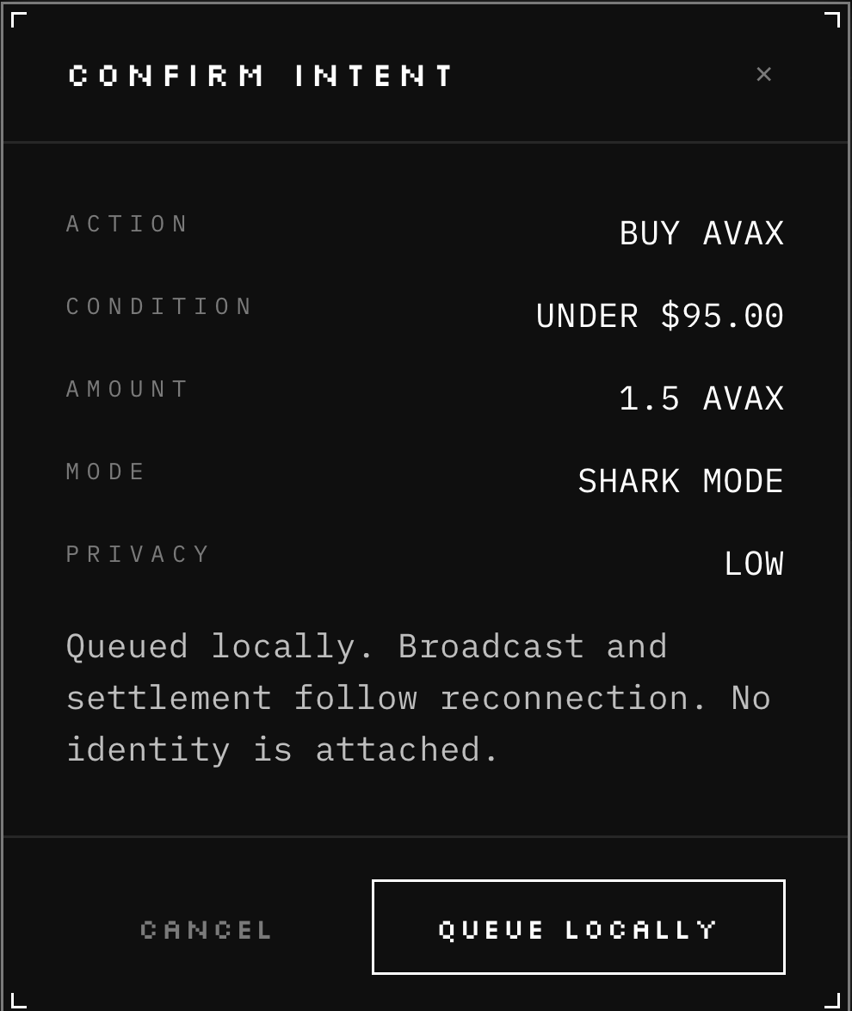
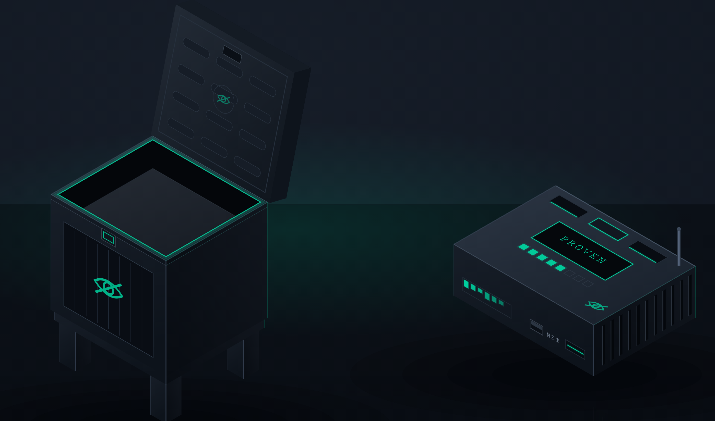
CABALMESH
PITCH · 2026
WHAT IS BUILT · WHAT EACH PIECE IS FOR
Three pieces are built. Each removes one reason people cannot transact.
ENROL — 5 shares, none a key
REQUEST — over BLE, unlinkable
APPROVE — a human, every time
VETO — 24h window to block
RESTORE — 3 of 5 rebuild it
LIVE
LIVE
CONCEPT · PHASE 2
OFFLINE INTENT
GUARDIAN RECOVERY
THE TWO BOXES
WHAT IT IS FOR
WHAT IT IS FOR
WHAT THEY ARE FOR
A payment that survives the moment the network does not: signed and queued with the radio off, then broadcast and settled after reconnection — no identity attached.
Losing the phone stops being fatal. Three of five guardians rebuild the vault over Bluetooth, each approving by hand — and no server ever holds a key.
A node and a locker — the first things we can sell. The ShadowBox relays for the neighbourhood, runs the local model and generates the proof; the Nobody Box is escrow at the front door, a parcel locker whose bolt turns when the deal settles.
ALL OF IT CHECKABLE — 61 automated tests · escrow live on Fuji 0xCaFF53657191d75Aa4f5C2182210302656d8B392 · demo youtu.be/Z3ooub-mnCw · code github.com/kurodenjiro/Cabal-Mesh
06

Slide 7
CABALMESH
PITCH · 2026
TEAM
Who is building it — and how they decide what ships.
HOW THIS TEAM WORKS
FOUNDER · ENGINEERING
01
The audit ships with the pitch
kurodenjiro
A code-read status document lists what does not work, feature by feature, with the file to check.
Wrote the mesh, the BLE offline plane, the vault, guardian recovery and the on-chain settlement path — 74 commits in the first 30 days.
docs/product-status.md
02
The model proposes, Rust signs
AI only produces validated fields. Rust still validates, previews and signs — the safety property holds by construction.
parse_intent_chat · commands.rs
03
One true story over three half-built ones
Core team of two to three. Full bios on request.
Controls that imply capability we do not have get hidden rather than demoed. The offline path is the one we stake the pitch on.
CabalMesh-Project-Plan.md §4
Every claim in this deck points at a file, a contract address or a video. Nothing on these seven slides is a projection.
07

