Slide 1
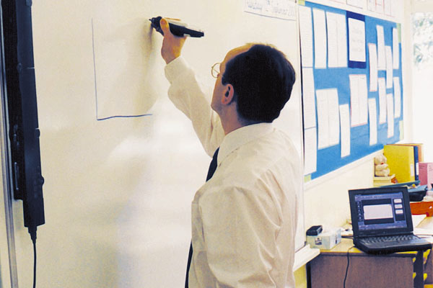
Chapter 3
Objectives
Input devices and their roles in getting different types of information into the computer
Output devices and the ways they make computers more useful
The functionality of different types of storage devices
The ways the components of a computer system fit together

Slide 2
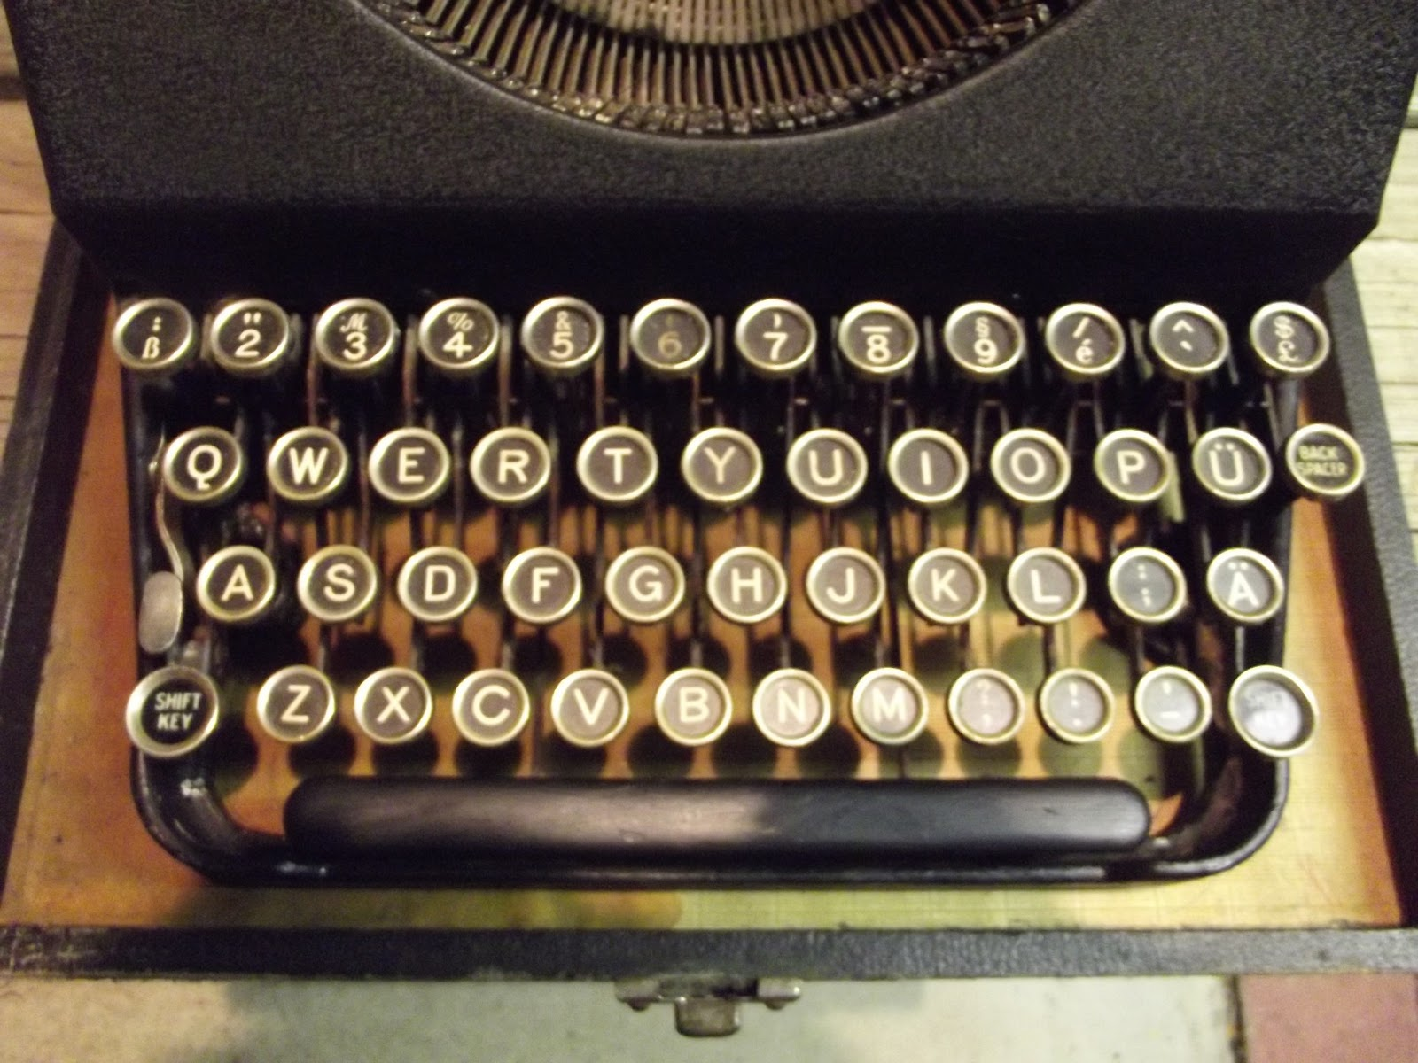
Input devices – qwerty keyboard
invented in 1872
  Intentionally slow -Keys stick if typed quickly
  Designed a keyboard to minimize the stuck keys.
  Where’s the 1? The Zero?
QWERTY
  Keys located so move hands a lot.
  keys following each other often on same hand.

Slide 3
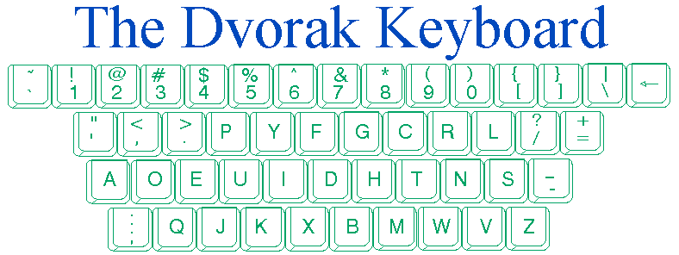
Input devices – dvorak keyboard
developed 1936 to improve efficiency
hands don't have to move as much

Slide 4
Instructor’s Note: the Forgotten Characters
| - Vertical Bar, or Pipe (above the Enter key)
  Used widely in UNIX and as a mathematical symbol.
\ - Forward-slash (sometimes mistaken for /, the Back-slash)
  Typing in a URL? Use the Backslash. The one that shares the key with the question mark.
~ - Tilde (top left of the keyboard, above Tab)
  (In different places on laptop keyboards)
  In writing, indicates approximation.
    We “expect ~10 people to show up” (“we expect about 10 people to show up”)
  In mathmatics and logic, indicates negation. ~x = not x.
  Used to indicate a “home directory” in UNIX filesystems (and subsequently shows up in many URLs)

Slide 5
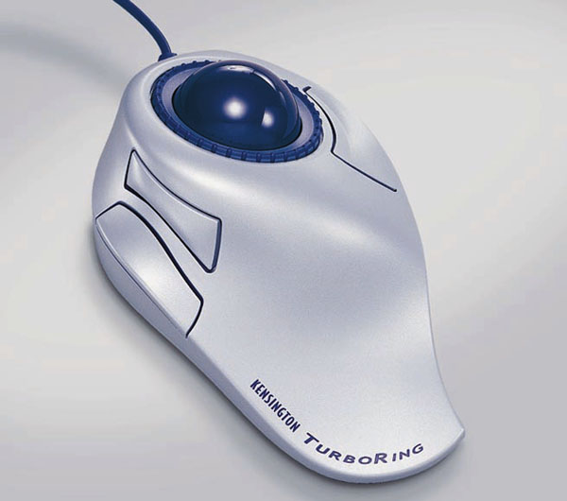
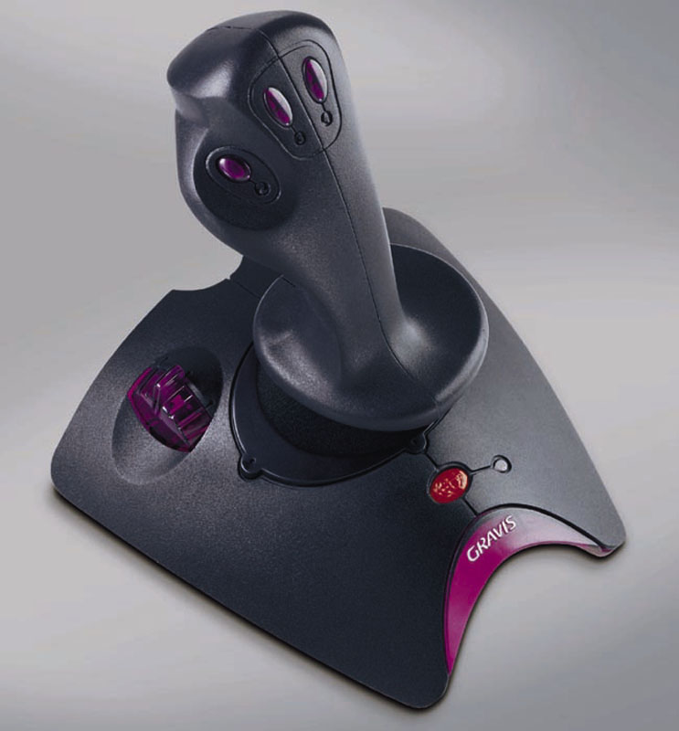
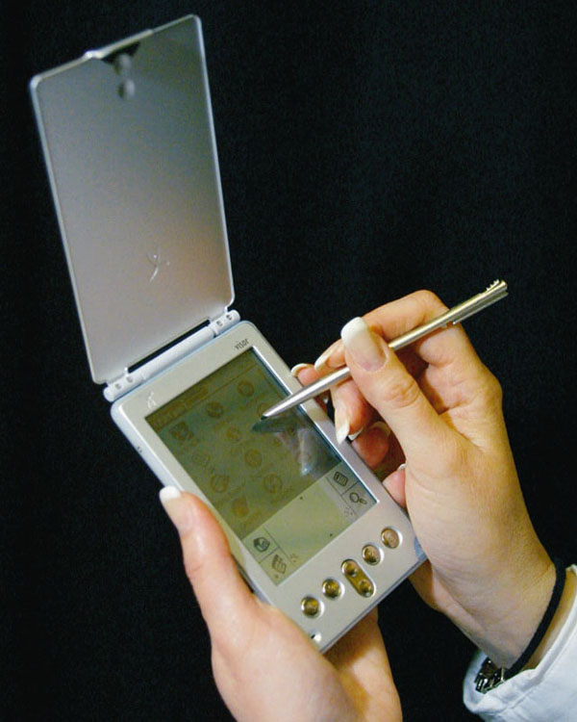
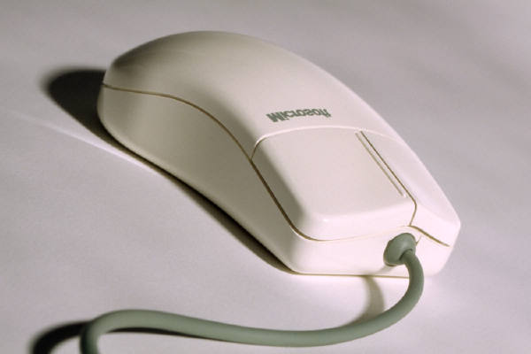
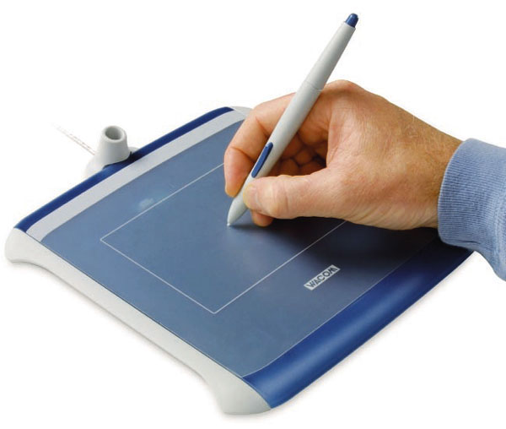
Pointing Devices
Mouse
Touchpad
Trackball
Joystick
Graphics tablet
Touch screen
  Stylus

Slide 6
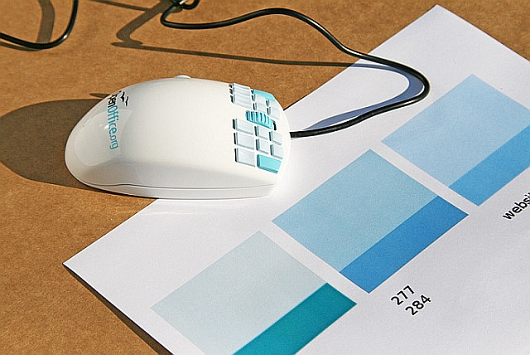
Other mice
  Optical mouse
    Reads movement on X-Y axis
    More accurate
    Fewer moving parts to break
    Is now the standard mouse type

Slide 7


Slide 8
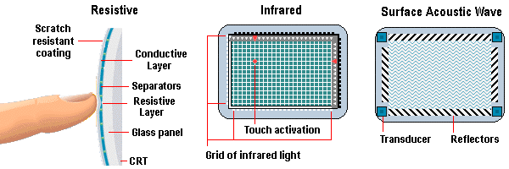
Input devices – touch screen
touch screens
  Resistive screens: edges emit horizontal and vertical light beams
  Capacitive screens create electromagnetic field, blocked by the electromagnetic field of your skin.
    Also allows for multi-touch input
  Input and output from the same device
  Good for systems where a keyboard would be cumbersome
  Now common on smartphones, tablets, Nintendo DS, and many new laptop and desktop screens.

Slide 9
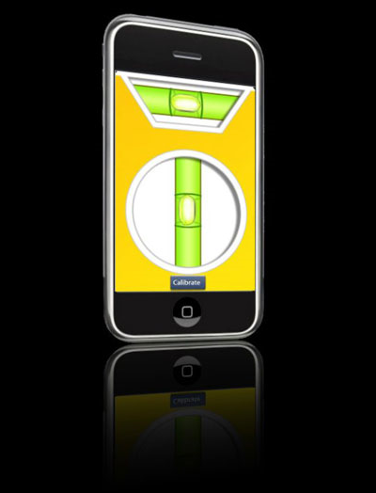
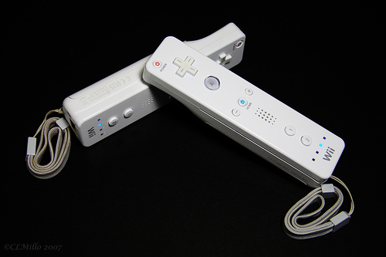
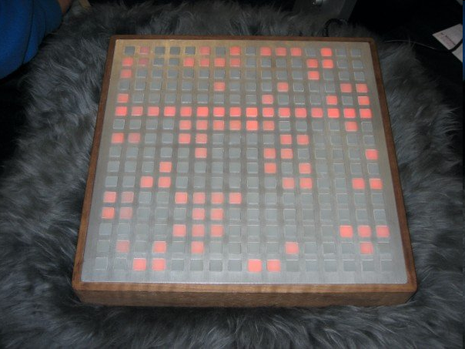
Accelerometer
Detects vertical or lateral motion, converts to a digital signal.
  Apple iPhone
  Nintendo Wii-mote
  Monome

Slide 10
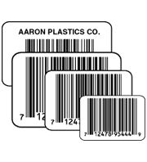
Optical input methods
Bar codes:
Universal Product Code (UPC)
  pattern of vertical marks
bar code reader
  reads code by reflected light
    no price information in bars
grocery store
  reads bar code
  looks up item in computer
  prints receipt, adjusts inventory
Federal express
  tracks shipments
    each package uniquely identified

Slide 11
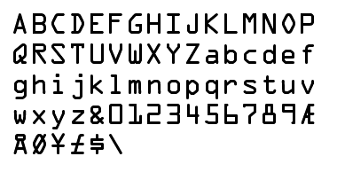
Optical recognition – other ways
OMR - optical mark recognition
  machine senses marks on paper
  fill-in sheets
  Pink scantron
OCR - optical character recognition
  recognizes individual letters of text otherwise just copying dots
  MICR fonts
    readable by humans and machines
    typeface developed by American National Standards Institute

Slide 12
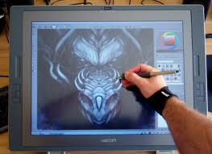
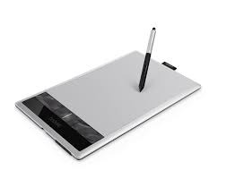
Graphical input
digitizing tablet
  draw or trace images on touchpad or screen
  Artist's tablet

Slide 13
Magnetic Card Readers and
RFID transponders
RFID = Radio Frequency Identification
Commonly used in employee/Student ID badges
Becoming more common for purchases
  PayPass™ on Credit cards
Potential for misuse, invasion of privacy

Slide 14
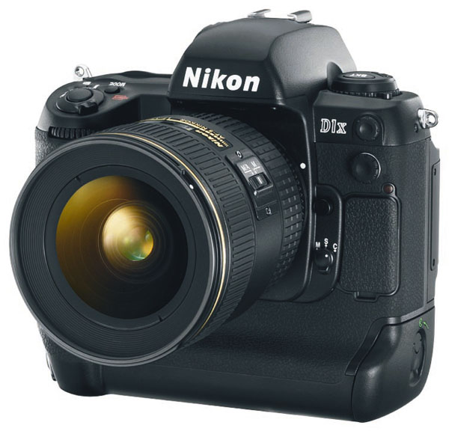
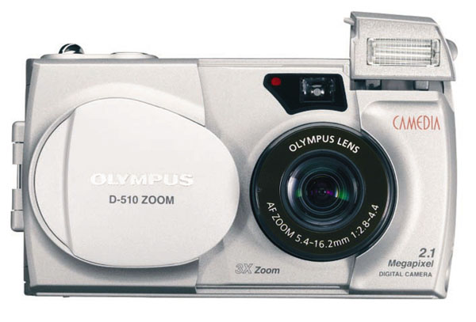
Chapter 3
Input: From Person to Processor
Digital camera
  Snapshots captured as digital images
  Digital images stored as bit patterns on disks or other digital storage media

Slide 15
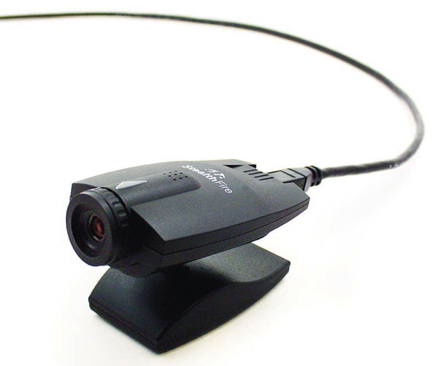
Chapter 3
Input: From Person to Processor
Video digitizer
  Capture input from a:
    Video camera
    Video recorder or television
  Convert it to a digital signal
    Stored in memory and displayed on computer screens
Videoconferencing
  People in diverse locations can see and hear each other
    Used to conduct long-distance meetings
  Video images transmitted through networks

Slide 16
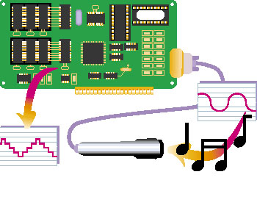
Chapter 3
Input: From Person to Processor
Audio digitizers
  Digitize sounds from
    Microphones
    Other input devices
  Digital signals can be
    Stored
    Further processed with specialized software
    A digital signal processing chip compresses the stream of bits before it is transmitted to the CPU

Slide 17
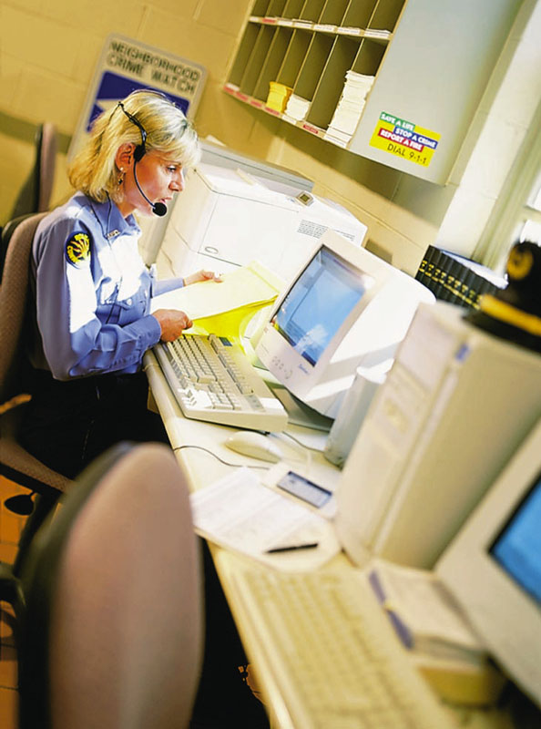
Chapter 3
Input: From Person to Processor
Speech recognition software
  Converts voice data into words that can be edited, printed or acted upon.

Slide 18

Voice recognition types
discrete word systems
  pause in between words
  I.. am.. now.. speaking..
continuous word systems
  able to interpret sustained speech
  Best currently available commercial software for this: Dragon Naturally Speaking
  Siri is exceptionally good (but not perfect).

Slide 19
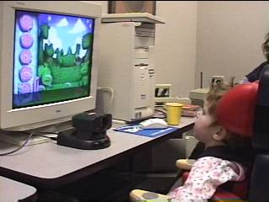
Input devices – visual tracking
mostly for disabled persons
electrodes connected around eye
The Camera Mouse
  developed at Boston College
  uses a video camera located above or below the user's monitor to replace a mouse
  allows people who have very limited voluntary muscle control –to control the computer.
    controlled movement of the head, fingers, or toes.

Slide 20
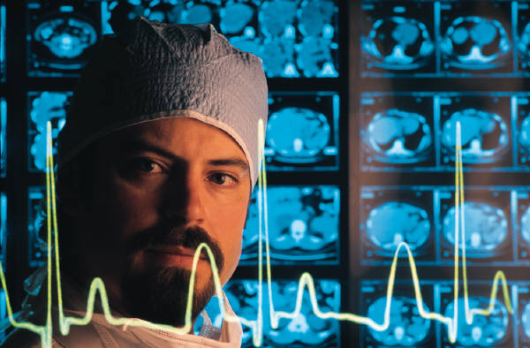
Chapter 3
Input: From Person to Processor
Sensors
  Designed to monitor physical conditions
    Temperature, humidity, pressure
  Provide data used in:
    Robotics
    Environmental climate control
    Weather forecasting
    Medical monitoring
    Scientific research

