Slide 1
Chapter 3
Hardware Basics: Peripherals
Slide <number>

Slide 2
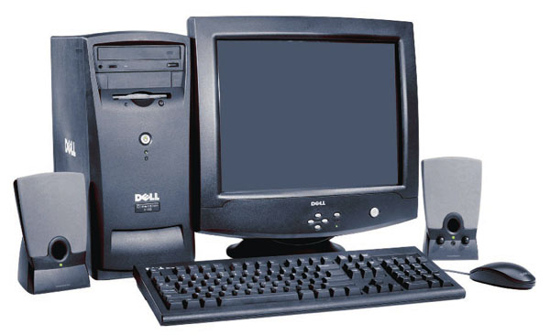
Chapter 3
Output: From Pulses to People
Screen Output
A monitor or video display terminal (VDT) displays characters, graphics, photographic images, animation and video
  Video adapter—connects the monitor to the computer
  VRAM or video memory—a special type of RAM to hold video images
    the more video memory, the more picture detail is displayed
    Also affects the resolution and frame-rate of moving images
Slide <number>

Slide 3
Chapter 3
Output: From Pulses to People
Monitor size: Measured as a diagonal line across the screen
Resolution: The number of pixels displayed on the screen
  Pixels (or picture elements): tiny dots that compose a picture
  The higher the resolution, the closer together the dots
Image quality is affected by resolution and color depth (or bit depth)
  Color depth refers to the number of different colors a monitor displays at one time
Slide <number>

Slide 4
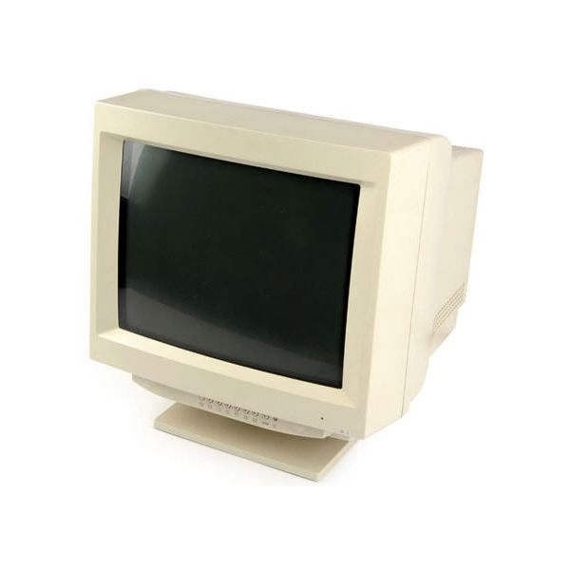
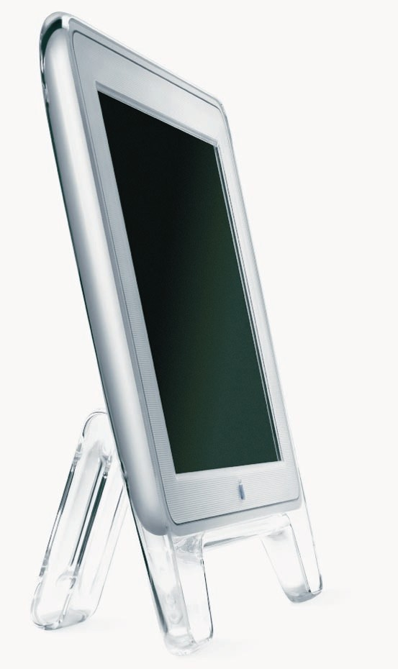
Chapter 3
Output: From Pulses to People
Monitor classes
  CRTs (cathode-ray tubes)
    Bulky, heavy, take up large amounts of desk space.
  LCDs (liquid crystal displays) are now more popular
    Video projectors
    Laptops
Slide <number>

Slide 5
Monitor Characteristics
pixel – all images made up of pixels
  addressable dots, each with an x/y coordinate
  usually about 72dpi (dots per inch)
  resolution = how many pixels on the screen?
dot pitch
  space between dots
  Smaller number = better quality image
response time
  2ms-5ms typical
  Shorter response times mean quicker transitions between images, less blur
  Relevant for LCD screens, but not a factor with CRT screens
Examples
  CRT – 21 in screen - 1600 x 1280 Pixels Resolution, .22 mm Pitch - $25
  22" Widescreen LCD Monitor - 1680 x 1050 resolution .282mm Pitch, 4ms response time - $75
Slide <number>

Slide 6
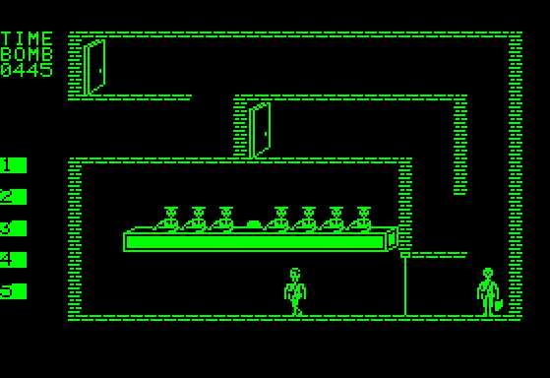
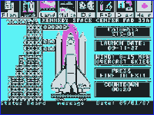
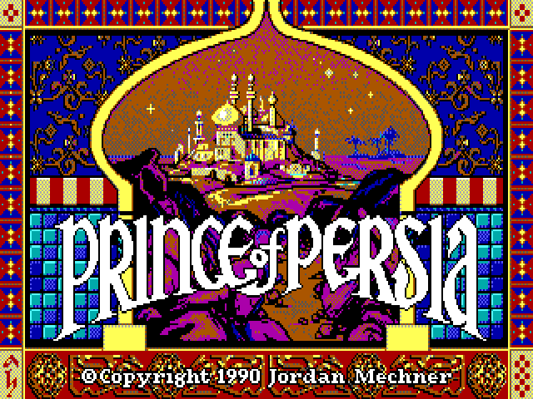
display types – a brief history
Monochrome – one color
  (white on black, green on black, etc.)
CGA - color graphics adapter
  320x200 pixels, 16 colors
EGA - enhanced graphics adapter
  640x350 pixels – 64 colors

Slide 7
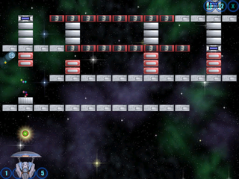
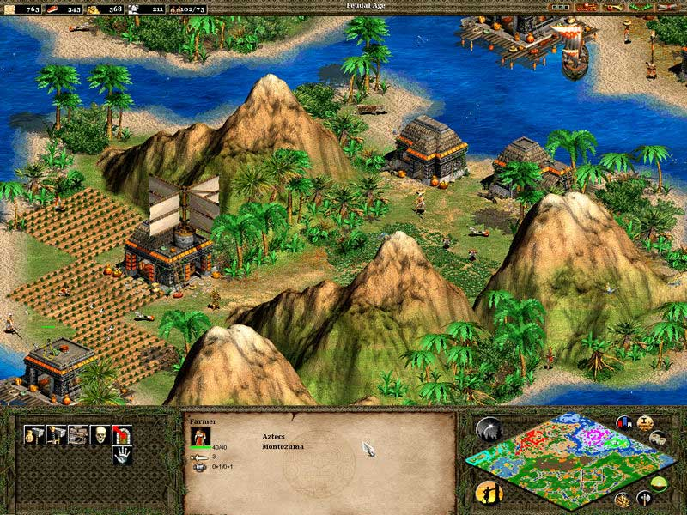
VGA - video graphics array
  640x480 pixels
  256 colors
SVGA - Super video graphics array
  800x600 pixels minimum
  1600x1200 normally possible
  16 million colors at once with enough video memory
Slide <number>

Slide 8
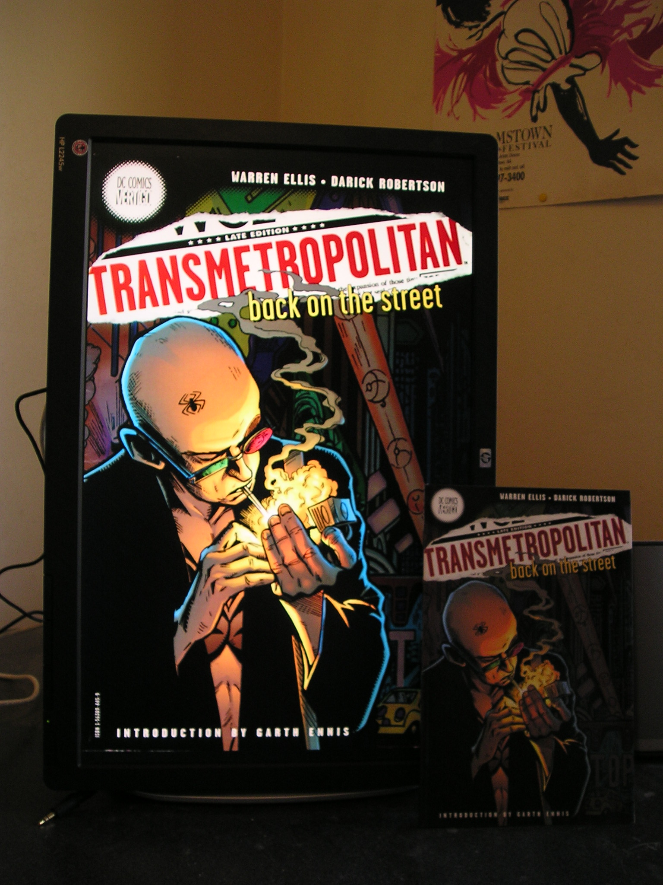
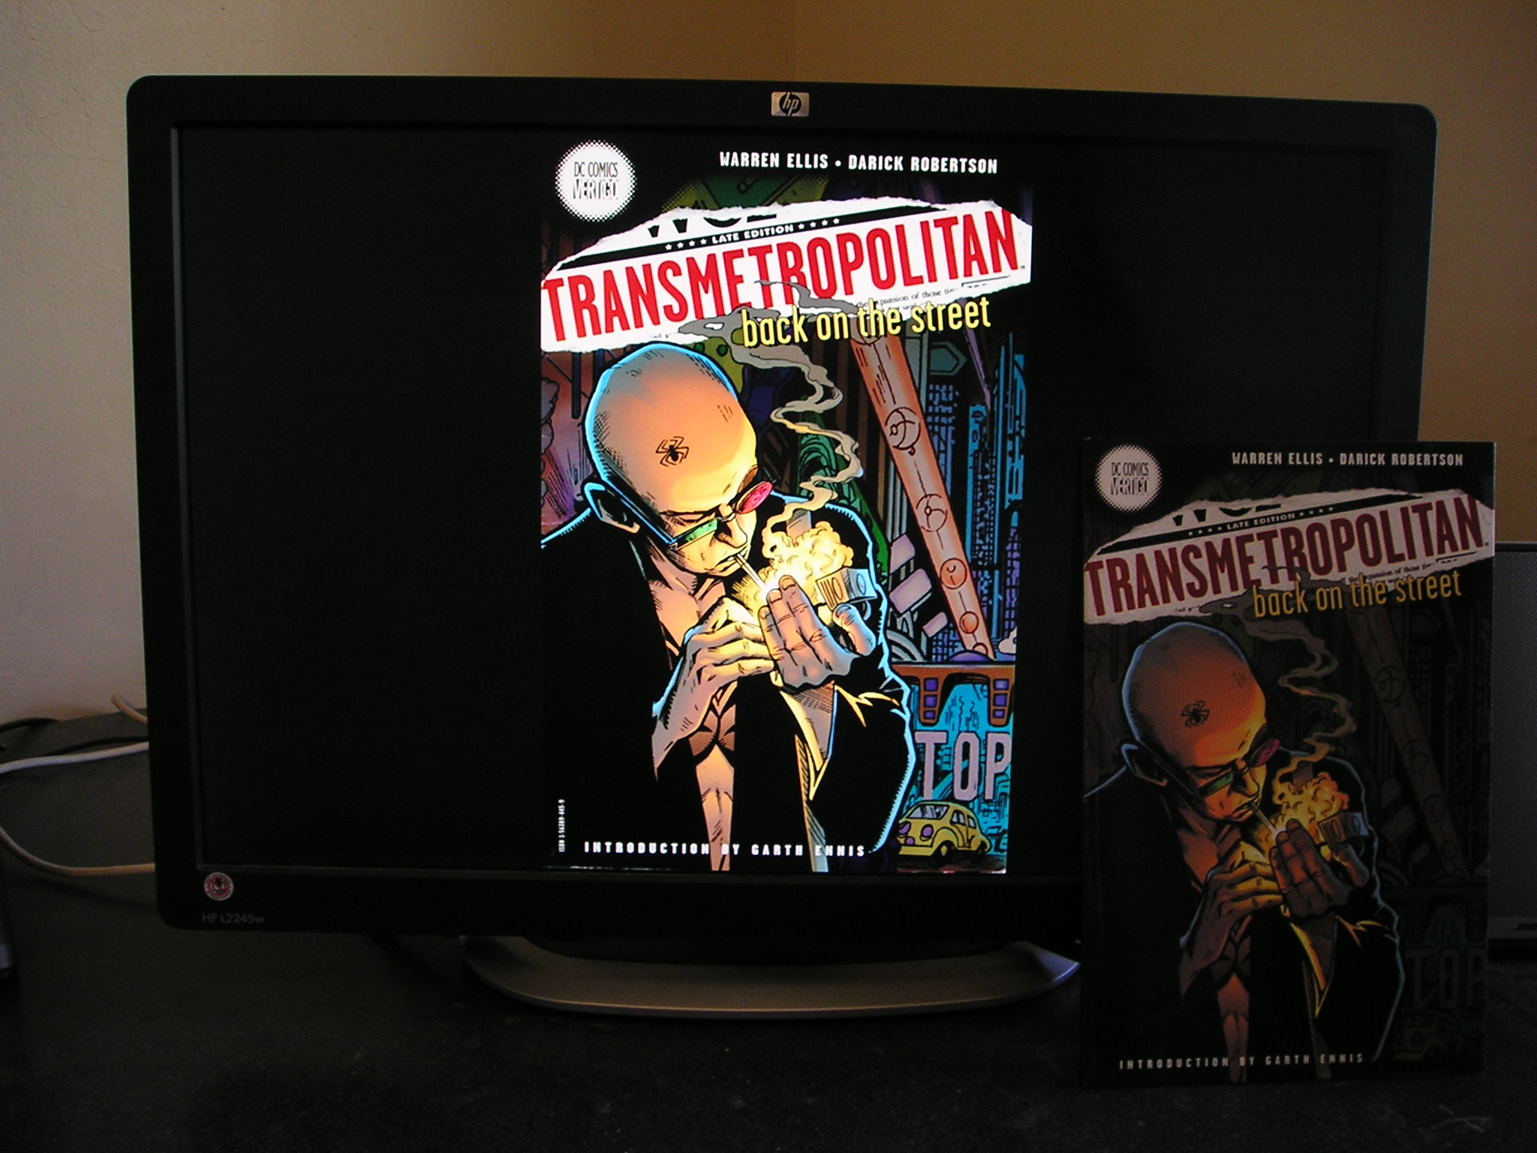
Rotating Widescreen Monitors
Slide <number>

Slide 9
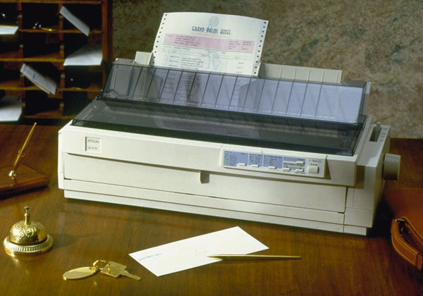
Computer Confluence 7/e
Chapter 3
Output: From Pulses to People
Paper Output
Printers produce paper output or hard copy
Two basic groups of printers:
  Non-Impact printers
    Inkjet
    Laser
  Impact printers
    Line printers
    Dot-matrix printers
Slide <number>

Slide 10
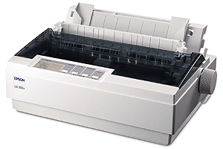
Impact Printers
impact printer
  Example: dot matrix
    handles both text and graphics
  physically strikes paper with hammer and ribbon
Slide <number>

Slide 11
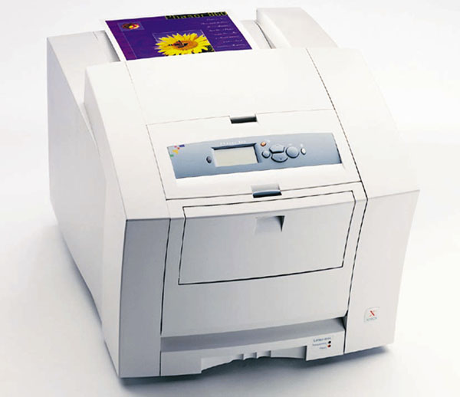
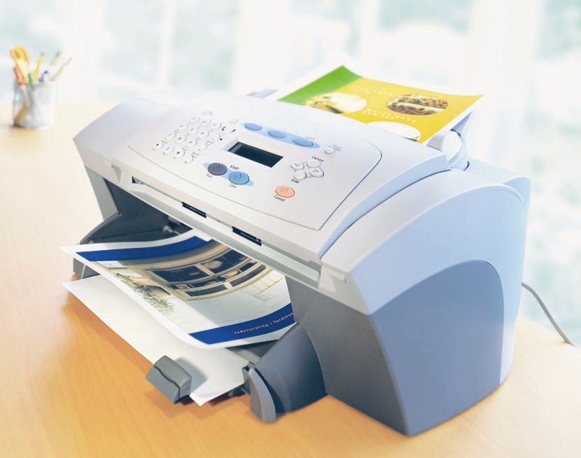
Computer Confluence 7/e
Chapter 3
Output: From Pulses to People
  Non-impact printers
    Laser printers
      Laser beam reflected off a rotating drum to create patterns of electrical charges
      These electrical charges attract toner, a fine colored powder, which is then heated to fuse to the paper
      Faster and more expensive than inkjet printers
      High-resolution print output
    Inkjet printers
      Sprays ink onto paper to produce printed text and graphic images
      Prints fewer pages/minute than laser printer
      Higher-quality color for less $ than a color laser printer
        Liquid ink creates more vivid and accurate color than combinations of different colored toner
Slide <number>

Slide 12
Ink Prices in Perspective
Liquid | Unit price/size | Price per gallon
Gasoline | $2.59/gallon (as of 4/14/16) | $2.59
Dom Perignon 2015 | $149.99 for 750ml bottle | $958.92
Human Blood | $200 processing fee per 500ml unit | $1,514.79
HP Black Ink Cartridge | $13.59 for 16ml | $3215.24
Dom Perignon 1955 | $1086.85 for 750ml | $5485.56

Slide 13
voice output
speech synthesis
  voice synthesizers
  converts data to vocalized sounds understandable by humans
synthesis by analysis
    actual human words, recorded individually
    “John…Smith…is…not…available."
    sounds somewhat natural
    limited vocabulary
synthesis by rule
    uses linguistic rules to generate artificial speech
    generates each word by rules of pronunciation
    can synthesize an extensive vocabulary
Slide <number>

Slide 14
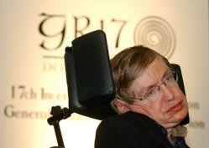
Stephen Hawking
Amyotropic lateral sclerosis
  (severe motor neurone disease)
Uses voice synthesizer
  Same synthesizer
  he used in 1985
Slide <number>

Slide 15
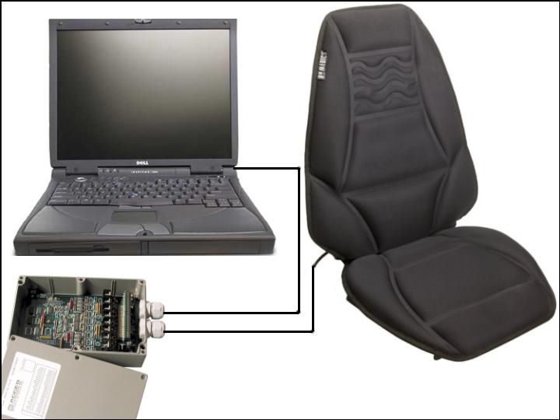
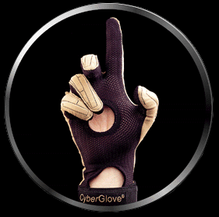
Haptics = convert touch to/from data
VisPad, Doanna Weisgerber
Slide <number>

Slide 16
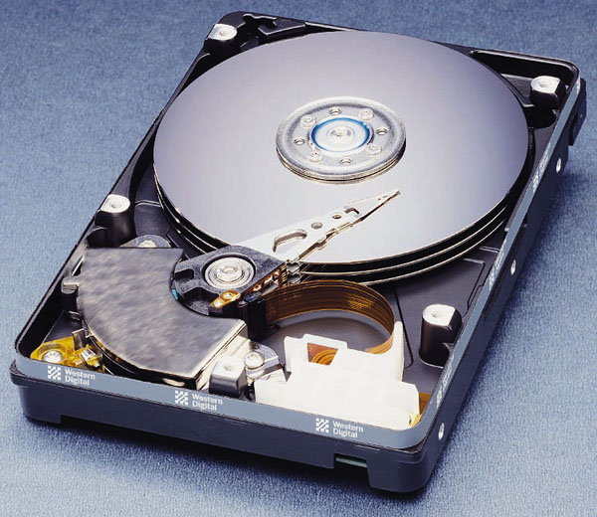
Chapter 3
Secondary Storage Devices: Input Meets Output
Magnetic Disks
Random data access
Secondary Storage
Floppy disks
  Provide inexpensive, portable storage
  Hold too little data for modern purposes
Hard disks
  Non-removable, rigid disks that spin continuously and rapidly
Slide <number>

Slide 17
Slide <number>

Slide 18
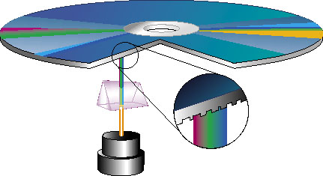
Chapter 3
Storage Devices: Input Meets Output
Optical Disks
Use laser beams to read and write bits of information on the disk surface
  Not as fast as magnetic hard disks
  Large storage capacity
  Very reliable
    May degrade over long periods of time (5-10 years+, depending on quality of manufacture.
    Home-burned CDs and DVDs likely have a shorter lifespan than professional manufactured disks.
Slide <number>

Slide 19
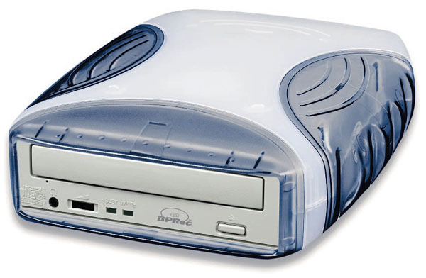
Chapter 3
Optical Storage Devices
DVD (Digital Versatile Disks)
  Store & distribute all kinds of data
  Typically hold either 4.7 or 8.5gigabytes of information
    Single (4.7gb) vs. dual (8.5gb) layer
    Dual layer has a semi-transparent layer, allowing
    both layers to be read
DVD-RW Drives (Digital Versatile Disks – ReWritable)
  Can read and write data to DVD disks
    Rewritable disks often only last 2-3 years, not reliable
    Are being phased out on newer laptops
Slide <number>

Slide 20
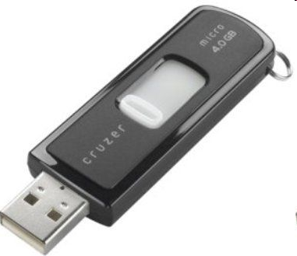
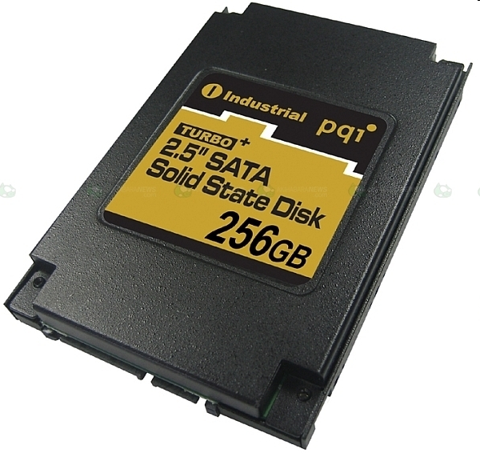
Chapter 3
Solid-State Storage Devices
Flash memory is an erasable memory chip
  Sizes range from 256MB to 64+ GB
  Compact alternative to disk storage
  Contains no moving parts
  Designed for specific applications such as storing pictures in digital cameras
SSDs (Solid State Drives) are quickly replacing hard drives.
  SSDs are much faster, silent, more reliable
  But currently 5-6 times more expensive per gigabyte
  Downsides can be mitigated if set up as a boot drive, with secondary drives for larger data storage.
Slide <number>

Slide 21
Chapter 3
Computer Systems: The Sum of Its Parts
USB: Expansion Made Easy
With the PC open architecture and the introduction of new interfaces, you can hot swap devices. USB (Universal Serial Bus) transmits a hundred times faster than a PC serial port
  Platform independent: designed to work across a wide variety of devices
  Hot swap: To plug in/unplug devices with the computer power still on
  A single USB port can be used to connect to a maximum of 127 devices.
Slide <number>

Slide 22
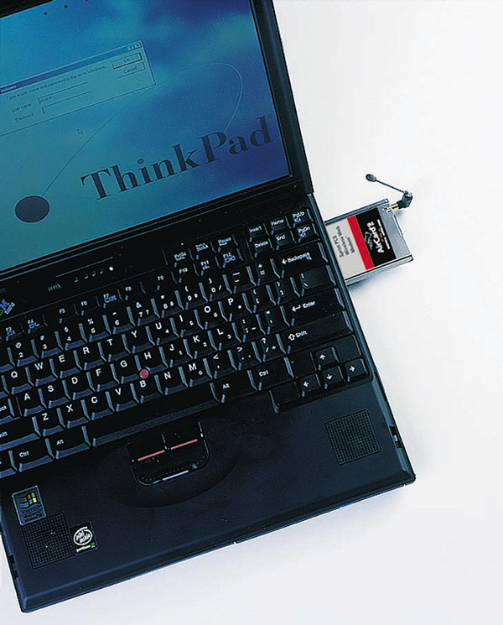
Chapter 3
Computer Systems: The Sum of Its Parts
Other ports typically included on a the system board or its expansion cards:
  Video Port used to plug a color monitor into
  the video board
  Microphone, speaker, headphone, MIDI ports used to attach sound equipment
  Ethernet port used to connect to the internet or a local area network (LAN)
  Basic port vocabulary: female vs. male ports and cables
Slide <number>

Slide 23
Any questions?
Slide <number>

