Slide 1
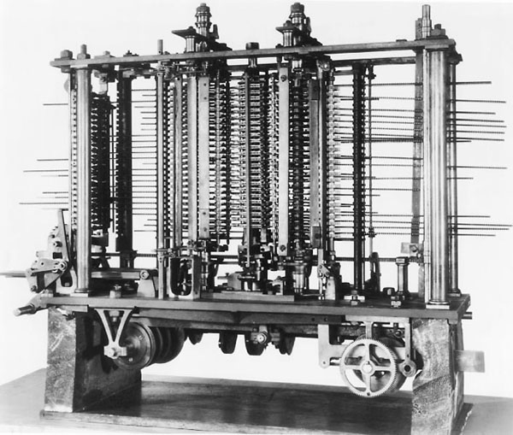
Chapter 1
Computing Before Computers
Charles Babbage (1791-1871)
  19th-century mathematics professor at Cambridge
  Difference engine required 25,000 parts, weighed 15 tons
  Never finished it
The Analytical Engine (1843)
  Mother of all computers, conceived of by Charles Babbage
  Could (theoretically) be programmed with punched cards
  Could carry out any calculation to 20 digits of accuracy
Slide <number>

Slide 2
Chapter 1
Computers in Perspective: An Evolving Idea (continued)
  At about the same time, the British government was assembling a top-secret team of mathematicians and engineers to crack Nazi military codes
    1943: The team, led by mathematician Alan Turing and others, completed Colossus, considered by many to be the first electronic digital computer
    Turing was key in breaking Enigma – the German military’s chief cipher machine.
      Turing is also known for the Turing Test – a basic test for artificial intelligence
Slide <number>

Slide 3
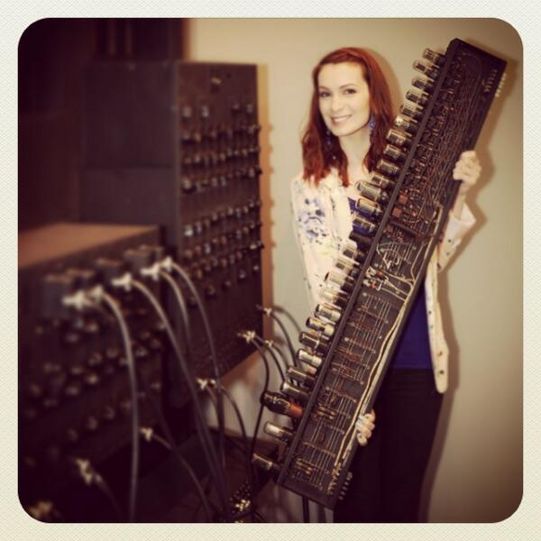
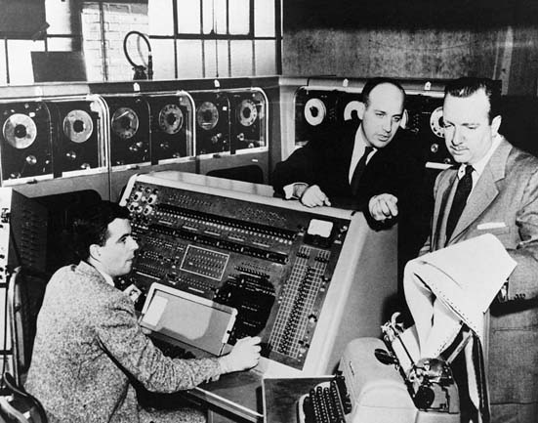
Chapter 1
Computers in Perspective: An Evolving Idea (continued)
John Mauchly and J. Presper Eckert helped the U.S. effort in World War II by constructing a machine to calculate trajectory tables for new guns
  called ENIAC (Electronic Numerical Integrator and Computer)
After the war, Mauchly and Eckert started a private company called Sperry and created UNIVAC I, the first general-purpose commercial computer
Slide <number>
Notes:
ENIAC was a 30-ton behemoth with 18,000 vacuum tubes that broke down, on average, once every seven minutes. It wasn’t completed until two months after the end of the war, but it convinced its creators that large-scale computers were commercially feasible.

Slide 4
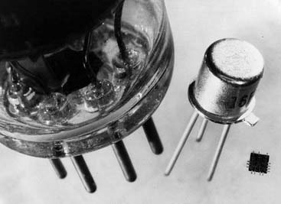
Chapter 1
Computers in Perspective: An Evolving Idea (continued)
Evolution and Acceleration
  Vacuum tubes were used in early computers
  Transistors replaced vacuum tubes starting in 1956
  By the mid-1960s transistors were replaced by integrated circuits
Slide <number>

Slide 5
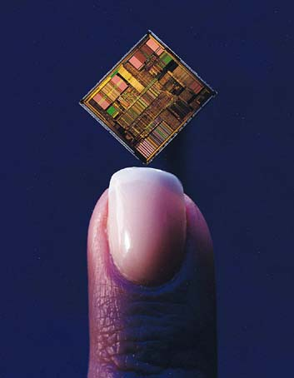
Chapter 1
Computers in Perspective: An Evolving Idea
(continued)
The Microcomputer Revolution
  1971: The first microprocessor was invented
  by Intel engineers
  The microcomputer revolution began in the 1970s:
    Apple
    Commodore
    Tandy (Radio Shack)
Slide <number>

Slide 6
Free Books
Project Gutenberg – www.gutenberg.org
  Repository of 42,000+ texts
    Public domain
    Out of copyright
  Mostly an English-language phenomenon
    Many translated works
      But the translation has to be in the public domain
  Can be downloaded directly to most computers, e-readers, and smartphones.

Slide 7
Freeware and Open Source
Freeware
  Actually Free – no strings attached
  Often unsophisticated, but sometimes what you need
  Often quite sophisticated: Firefox, VLC Media Player, etc.
Open Source: Not just free software, free source code
  Free download
  Free to modify
  Free to improve

Slide 8
PC Basics
  System unit includes built-in memory (RAM) and a hard disk
  CPU uses RAM memory for instant access to information
  Hard disk serves as a longer-term storage device
    Stores large quantities of information
    A permanent fixture in the system unit
Slide <number>

Slide 9
Chapter 2
A Bit About Bits
Bits, Bytes, and Buzzwords
Bit-related terminology
  Byte
  Kilobyte (KB)
  Megabytes (MB)
  Gigabytes (GB)
  Terabytes (TB)
= 8 bits
= 1 Thousand Bytes
= 1 Million Bytes
= 1 Billion Bytes
= 1 Trillion Bytes
(Note: not exact figures. 1kb=1024 bytes, 1mb=1024kb,etc)
Slide <number>

Slide 10
GHz
Speed often expressed in megahertz (MHz) or gigahertz (GHz)
  Typical Desktop PC processors: 1.5 GHz – 3.0 GHz per core
  Modern desktops typically have dual-core or quad-core processors
Analogous to clock ticks
1 GHz - capable of handling 1 billion machine cycles per second
Note:
  Intel still uses the GHz rating,
  AMD (the primary non-intel CPU manufacturer) has switched to more complex rating systems.
Slide <number>

Slide 11
Moore’s Law
Gordon Moore’s real version:
  The number of transistors that can be inexpensively placed on an integrated circuit doubles every two years.
Popular variants include:
  Transistors will double every 18 months.
  Processing speed and storage capacity will double every 18 months.
Frequently ignored addendum (by Gordon Moore):
  The exponential growth can’t continue forever. Miniaturization will eventually approach atomic sizes.
In any case, it’s a description of a modern trend, not a true physical law.
Slide <number>

Slide 12
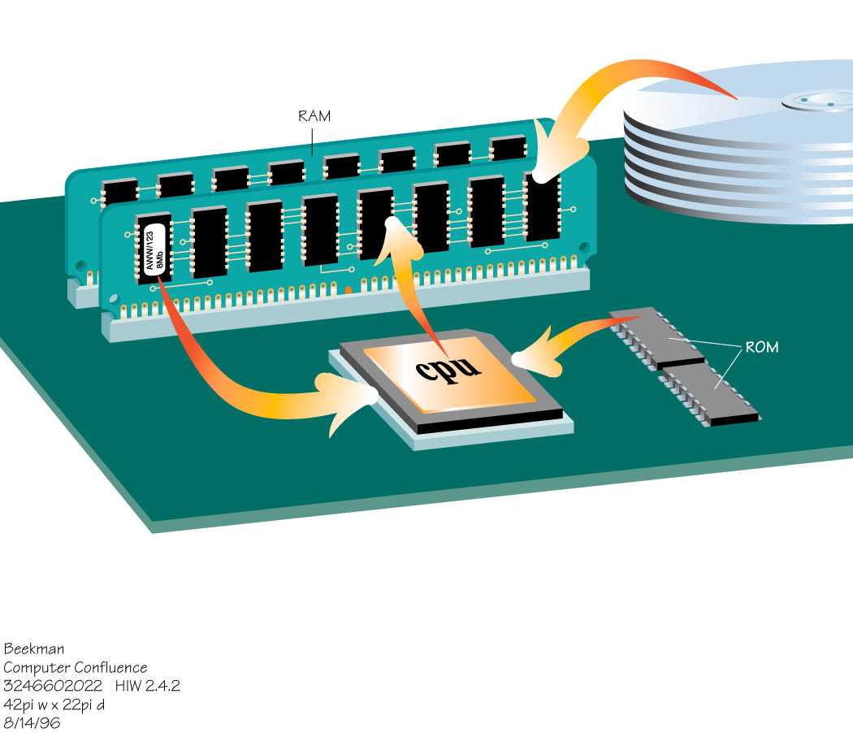
Chapter 2
The Computer’s Memory
RAM (random access memory)
  Used to store program instructions and data temporarily
  Unique addresses and data can be stored in any location
  Can quickly retrieve information
  Will not remain if power goes off (volatile)
Slide <number>

Slide 13
Chapter 2
The Computer’s Memory (continued)
ROM (read-only memory)
  Information is stored permanently on a chip
  Contains startup instructions and other permanent data
Flash memory
  Used for phones, cameras, flash drives, and solid-state drives.
  Non-volatile
  On track to replace current hard drive technology
Slide <number>
Notes:
When you turn on the computer, the CPU automatically begins executing instructions stored in read-only memory (ROM). On most computer systems, ROM also contains parts of the operating system. The firmware programs in ROM are sometimes called the BIOS (basic input/output system).
The executing instructions help the system start up and tell it how to load the operating system—copy it from disk into memory.
Once executing instructions are loaded into memory, the CPU is able to execute them.

Slide 14
What is a Cache?
Small block of very fast memory
  Size is typically 512 Kb to 2 Mb.
Speed up data transfer
  Holds instructions and data used most frequently or most recently
Processor requests data or instructions
  The first request goes to RAM
    Main memory
  Following requests - looks to cache first
    transfer speeds from cache are much higher
Slide <number>

Slide 15


Chapter 2
A Bit About Bits (continued)
Using two symbols all numbers can be represented or calculated
  A calculator translates the touch on
  the numeric keypad into series of 0s and 1s
  Each number then is looked at as a component
  of its positional values (each a power of 2)
  19 will be represented as 00010011
19
0 0 0 1 0 0 1 1
128 64 32 16 8 4 2 1
Slide <number>

Slide 16
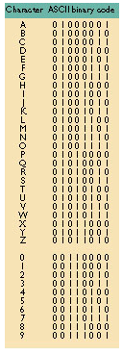
Chapter 2
A Bit About Bits (continued)
Bits as codes
ASCII
  The most widely used code
  An abbreviation of American Standard Code for Information Interchange
Unicode
  A coding scheme supporting 65,000 unique characters
Slide <number>

Slide 17
ALU – Arithmetic/logic unit
electronic circuitry executes arithmetic and logical operations
  arithmetic operations
    addition
    subtraction
    multiplication
    division
+
/
*
-
Slide <number>

Slide 18
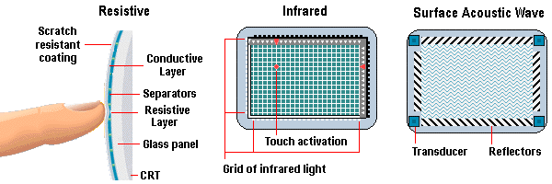
Input devices – touch screen
touch screens
  Resistive screens: edges emit horizontal and vertical light beams
  Capacitive screens create electromagnetic field, blocked by the electromagnetic field of your skin.
    Also allows for multi-touch input
  Input and output from the same device
  Good for systems where a keyboard would be cumbersome
  Now common on smartphones, tablets, Nintendo DS, and many new laptop and desktop screens.

Slide 19
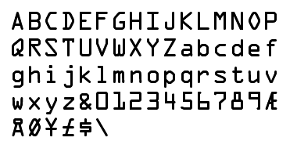
Optical recognition – other ways
OMR - optical mark recognition
  machine senses marks on paper
  fill-in sheets
  Pink scantron
OCR - optical character recognition
  recognizes individual letters of text otherwise just copying dots
  MICR fonts
    readable by humans and machines
    typeface developed by American National Standards Institute

Slide 20
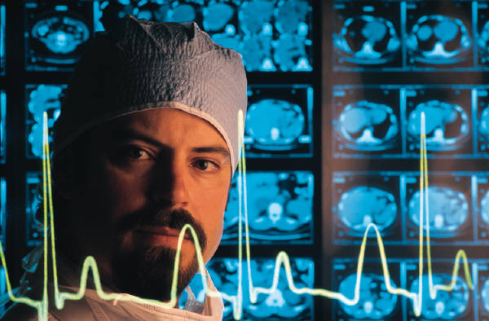
Chapter 3
Input: From Person to Processor
Sensors
  Designed to monitor physical conditions
    Temperature, humidity, pressure
  Provide data used in:
    Robotics
    Environmental climate control
    Weather forecasting
    Medical monitoring
    Scientific research

Slide 21
Chapter 3
Output: From Pulses to People
Monitor size: Measured as a diagonal line across the screen
Resolution: The number of pixels displayed on the screen
  Pixels (or picture elements): tiny dots that compose a picture
  The higher the resolution, the closer together the dots
Image quality is affected by resolution and color depth (or bit depth)
  Color depth refers to the number of different colors a monitor displays at one time
Slide <number>

Slide 22
Monitor Characteristics
pixel – all images made up of pixels
  addressable dots, each with an x/y coordinate
  usually about 72dpi (dots per inch)
  resolution = how many pixels on the screen?
dot pitch
  space between dots
  Smaller number = better quality image
response time
  2ms-5ms typical
  Shorter response times mean quicker transitions between images, less blur
  Relevant for LCD screens, but not a factor with CRT screens
Examples
  CRT – 21 in screen - 1600 x 1280 Pixels Resolution, .22 mm Pitch - $25
  22" Widescreen LCD Monitor - 1680 x 1050 resolution .282mm Pitch, 4ms response time - $75
Slide <number>

Slide 23
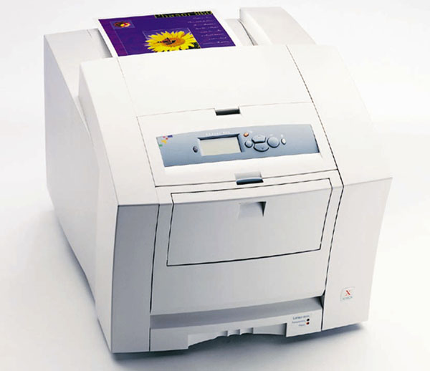
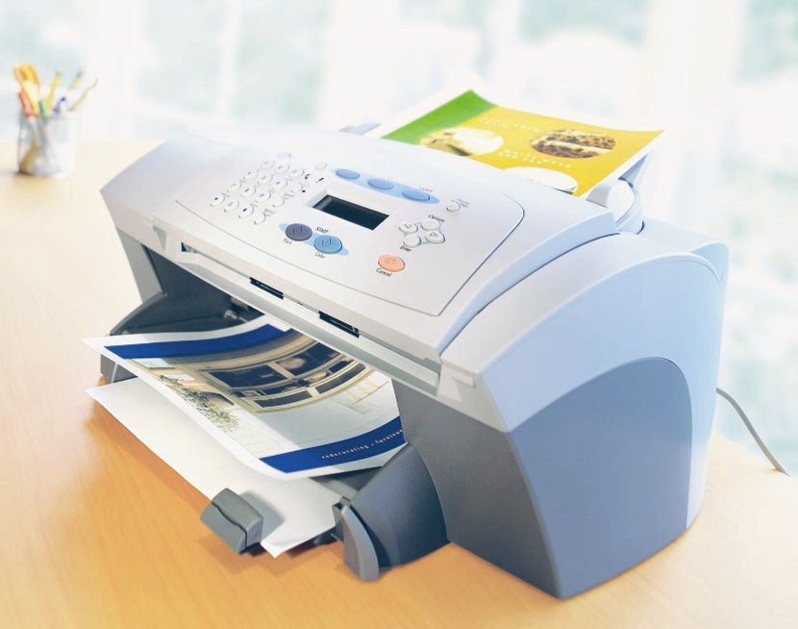
Computer Confluence 7/e
Chapter 3
Output: From Pulses to People
  Non-impact printers
    Laser printers
      Laser beam reflected off a rotating drum to create patterns of electrical charges
      These electrical charges attract toner, a fine colored powder, which is then heated to fuse to the paper
      Faster and more expensive than inkjet printers
      High-resolution print output
    Inkjet printers
      Sprays ink onto paper to produce printed text and graphic images
      Prints fewer pages/minute than laser printer
      Higher-quality color for less $ than a color laser printer
        Liquid ink creates more vivid and accurate color than combinations of different colored toner
Slide <number>

Slide 24
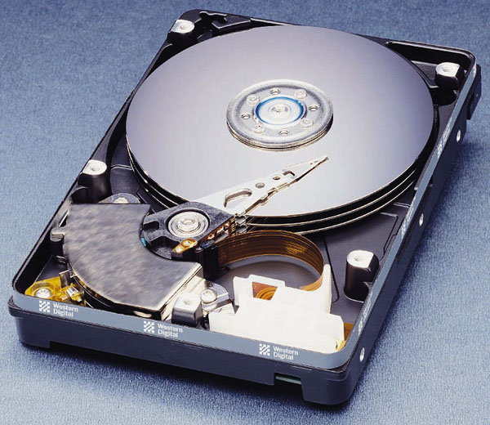
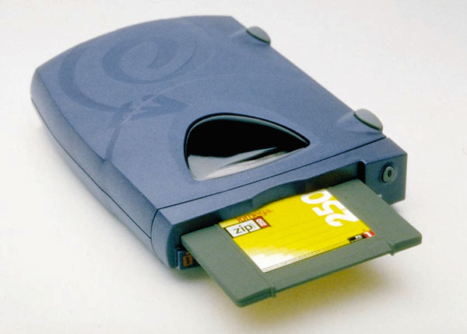
Chapter 3
Secondary Storage Devices: Input Meets Output
Magnetic Disks
Random data access
Secondary Storage
Floppy disks
  Provide inexpensive, portable storage
  Hold too little data for modern purposes
Hard disks
  Non-removable, rigid disks that spin continuously and rapidly
  Provide much faster access than a floppy disk
Slide <number>

Slide 25
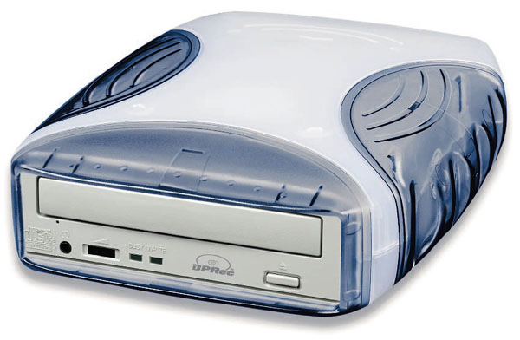
Chapter 3
Storage Devices: Input Meets Output
DVD (Digital Versatile Disks)
  Store & distribute all kinds of data
  Typically hold either 4.7 or 8.5gigabytes of information
    Single (4.7gb) vs. dual (8.5gb) layer
    Dual layer has a semi-transparent layer, allowing
    both layers to be read
DVD-RW Drives (Digital Versatile Disks – ReWritable)
  Can read and write data to DVD disks
    Rewritable disks often only last 2-3 years, not reliable
    Are being phased out on newer laptops
Slide <number>

Slide 26
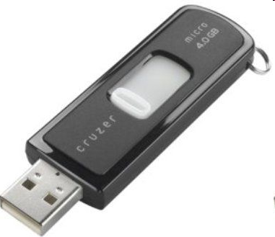
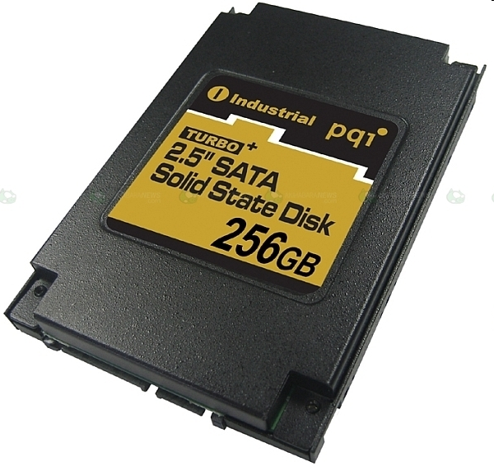
Chapter 3
Solid-State Storage Devices
Flash memory is an erasable memory chip
  Sizes range from 256MB to 64+ GB
  Compact alternative to disk storage
  Contains no moving parts
  Designed for specific applications such as storing pictures in digital cameras
SSDs (Solid State Drives) are quickly replacing hard drives.
  SSDs are much faster, silent, more reliable
  But currently 5-10x more expensive per gigabyte
  Downsides can be mitigated if set up as a boot drive, with secondary drives for larger data storage.
Slide <number>

Slide 27
Chapter 3
Computer Systems: The Sum of Its Parts
USB: Expansion Made Easy
With the PC open architecture and the introduction of new interfaces, you can hot swap devices. USB (Universal Serial Bus) transmits a hundred times faster than a PC serial port
  Platform independent: designed to work across a wide variety of devices
  Hot swap: To plug in/unplug devices with the computer power still on
  A single USB port can be used to connect to a maximum of 127 devices.
Slide <number>

