Slide 1
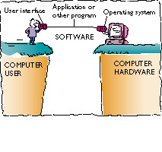
Chapter 4
Types of Software
The three major categories of software:
  Compilers and other translator programs: enable programmers to create other software
  Software applications: serve as productivity tools to help computer users solve problems
  System software: coordinates hardware operations and does behind-the-scenes work the computer user seldom sees
OS vs. Application software
Slide <number>

Slide 2
Chapter 4
Processing with Programs
A Fast, Stupid Machine
  Programmers begin with an algorithm: a set of step-by-step instructions
    Process begins in a natural language, e.g., English
    English has ambiguous, error-prone generalities
  Programmers then figure out how to translate this algorithm into the vocabulary of a programming language
Slide <number>

Slide 3
Chapter 4
Processing with Programs
The Language of Computers
  Natural Languages: resemble languages spoken by humans
  Programming language: falls between machine language and natural human language
    Compilers translate programming language into machine language
    Examples: C++, JavaScript, Perl, PHP
  Machine Language: numeric codes that represent data
Slide <number>

Slide 4
Software revisions, upgrades, and patches
Upgrading: users can upgrade a program to the new version, often by paying an upgrade fee to the software manufacturer
    Version Numbers indicate how up-to-date a program is.
    Version 2.7 will likely have fixed some problems from Version 2.5
    Version 1.9b will have likely fixed some very minor problems with Version 1.9a.
  Once Marketing gets involved, confusion begins:
    MS Windows 3.1 became Windows 95, then Windows 98, which became Windows XP, which became Windows Vista… and now Windows 7.
    See also: Macintosh OS X Cheetah, Tiger, Puma, Leopard, and Lion.
    Ubuntu Linux: versions Feisty Fawn, Gutsy Gibbon, Hardy Heron (7.04, 7.10, 8.04)
      Current: Precise Pangolin 12.04
  Newer releases often have additional features, with fixes to previous bugs
    … but major updates often come with new problems of their own
    Minor fixes, called “patches” are usually available for free.
Software insiders’ advice: Never buy version 1.0 of anything.
Slide <number>

Slide 5
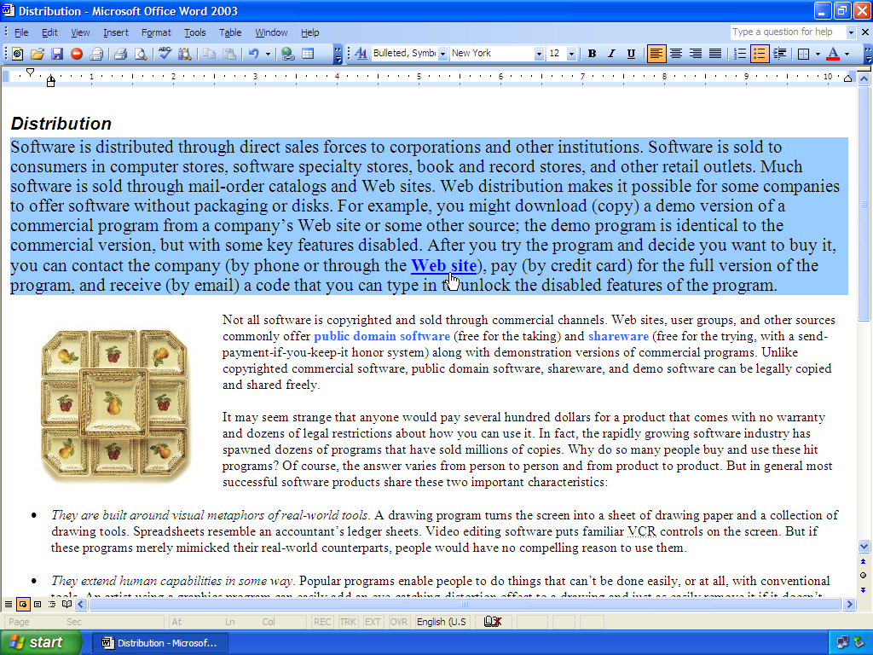
Chapter 4
Software Applications: Tools for Users
  Licensing: commercial software is copyrighted so it can’t be legally duplicated for distribution to others
    Software license
    Volume licenses
  Distribution: software is distributed via
    Direct sale
    Retail stores
    Mail-order catalogs
    Web sites
  EULA – End-User License Agreement
Slide <number>

Slide 6
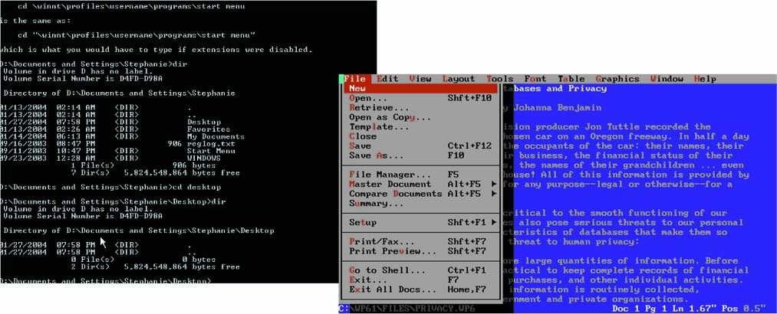
Chapter 4
The User Interface: The Human–Machine Connection
  DOS features include:
    Command-line interface (commands are typed)
    Menu-driven interface (commands are chosen from on-screen lists)
Slide <number>

Slide 7
System Software: The Hardware-Software Connection
Device drivers
  Small programs that enable Input/Output (I/O) devices—keyboard, mouse, printer, and others—to communicate with the computer
  Included with the operating system or bundled with peripherals
    Simpler devices (mice and keyboards) work without the full manufacturer’s driver package installed.
  If a device doesn’t work, there’s a good chance you need to replace the drivers – look at the manufacturer’s website
    Most troublesome: Video Drivers, Printer Drivers
  Many new PCs include hardware compatible with Windows Vista or 7, but not Windows XP
    This is not an accident.
Slide <number>
Slide <number>

Slide 8
Chapter 4
The User Interface: The Human–Machine Connection
User Interface
The look and feel of the computing experience from a human point of view
Desktop Operating Systems
  MS-DOS is a disk operating system in which the user interacts using characters
    Letters
    Numbers
    Symbols
Slide <number>

Slide 9
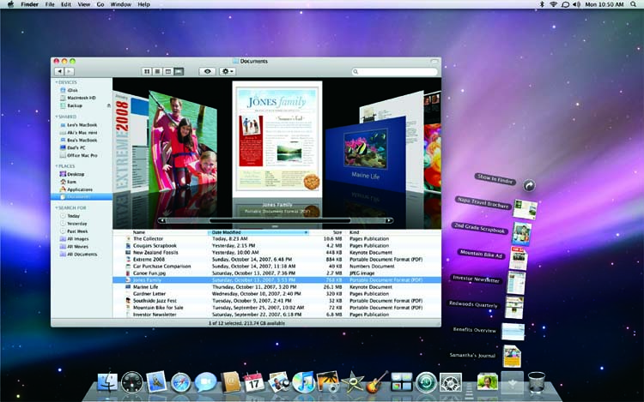
Chapter 4
The User Interface: The Human–Machine Connection
  Graphical User Interface – GUI
    Pronounced “Gooey”
    Mac OS
      First operating system in which the user interacted with the computer primarily by using a pointing device (typically, a mouse)
Slide <number>

Slide 10
Emulator Programs
Can “pretend” to be another operating system or hardware device.
  Can run programs written for that system
  Not all applications work perfectly
  Can cause a drop in system performance, especially with resource/graphics intensive applications
  Older systems are easier to emulate
Slide <number>

Slide 11
US Copyright Law
US Constitution, Article I, Section 8, gives Congress the power to enact statutes:
  “To promote the Progress of Science and useful Arts, by securing for limited Times to Authors and Inventors the exclusive Right to their respective Writings and Discoveries.”
  Copyrights – ideas, creative works
    70 years + life of author (or up to 120 years for works of corporate authorship)
    (Was 50 years + life of author, until Bono Act of 1998)
  Patents - inventions
    Typically 20 years from application date
Slide <number>

Slide 12
Sony vs. Universal Studios
Landmark 1984 copyright case
The Motion Picture industry tried to prevent the sale of video recording technology for home use.
  Arguments:
    Home recording of televised movies would hurt box office returns and ad revenue from future broadcasts.
    Claimed Sony should be liable for potential misuse by its products’ owners.
Slide <number>

Slide 13
Supreme Court Decision (5-4):
  Because the device has substantial legitimate, legal uses, the producers can not be held liable for misuse.
  Personal use of the machines to record video for later viewing constitutes fair use.
Slide <number>

Slide 14
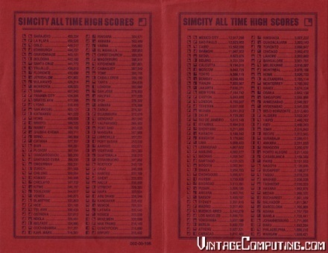
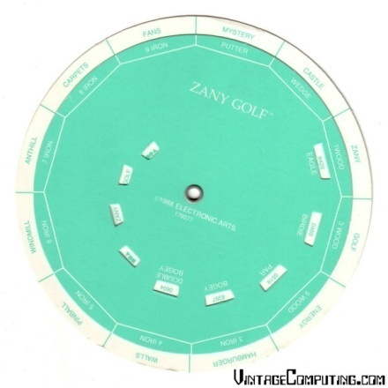
Software Copy Protection
Early years:
  Operation required codes from printed manuals.
  Code wheels
  “Fingerprinting” disks by damaging sectors
Recent years:
  Unique serial numbers with online verification
  Automated updates check for known cracks.
  CD Keys (CD must be in drive to operate)
  Subscription-based software
Slide <number>

Slide 15
Music – Jammie Thomas Case
October 4, 2007: Capital Records et al v. Jammie Thomas
Jammie Thomas sued for $222,000 for making 24 songs available for download on Kazaa
  $9,250 per song.
  The plaintiff was unable to prove that anyone had downloaded the songs, only that they were made available.
Sony’s position in the trial:
  “When an individual makes a copy of a song for himself, I suppose we can say he stole a song. Making ‘a copy’ of a purchased song is just a nice way of saying ‘steals just one copy’.” -Jennifer Pariser, the head of litigation for Sony BMG
Retrial
  The trial judge vacated the award and ordered a retrial, under doubt that simply making copyrighted material “available” is sufficient to prove infringement.

Slide 16
June 15, 2009 Re-trial
Jury awarded $1.92 million
  $80,000 per song
  Allowable legal damages: $750-$150,000
  Song list:
    “Welcome to the Jungle”; “November Rain” By Guns N Roses
    “Let’s What Awhile” By Janet Jackson
    “Iris” by The Goo Goo Dolls
    “Save the Best for Last” by “Vanessa Williams”
    “Cryin” by “Aerosmith”
    “Here We Are”; “Coming Out of the Heart”; “Rhythm is Gonna Get You” by “Gloria Estefan”
    “Basket Case” by “Green Day”
    “Faithfully”; “Don’t Stop Believing” by “Journey”
    “Bills, Bills, Bills” by “Destinys Child”
    “Possession”; “Building a Mystery” by “Sara McLachlan”
    “Now and Forever” by “Richard Marx”
    “One Step Closer” by “Linkin Park”
    “Run Baby Run” by “Sheryl Crow”
    “Pour Some Sugar on Me” by “Def Leppard”
    “Bathwater”; “Hella Good”; “Different People” by “No Doubt”
    “One Honest Heart” by “Reba McEntire”
    “Somebody” B y “Bryan Adams”

Slide 17
Ways the RIAA and MPAA fight back:
Adding “white noise” or flaws to their own songs and making them available to filesharing systems.
Audio watermarking
  Useless for CDs available for purchase, but can identify the origins of pre-release copies
Video watermarking
  Individual film frames are altered slightly for release to different theaters, to narrow the search for cam operators
  (Also done by video pirates to identify their own handiwork.)
Direct legal means, lawsuits
  Threats and lawsuits to users
  Prosecution and lawsuits against torrent trackers

Slide 18
Fair Use
Generally, exceptions are made for duplicating copyrighted content:
  For criticism or commentary
    This includes parody, even for commercial gain.
  For teaching, scholarship, or research
These exceptions are not absolute
    Courts can consider the amount of the work you duplicate, and the effect on the use’s effect on its market.
Fair Use is a defense you can bring up in court.
    But it is not a guarantee that you can’t be sued in the first place.

Slide 19
Grey Areas: Abandonware
The product has been off the shelves for years.
The company that made it has gone out of business.
The computer system it runs on has been obsolete since 1991.
Who is this hurting?
  Typically, no one.
  But it can discourage nostalgia releases of old software (mostly games).
  Rights purchased by other companies.
    e.g. mobile phone companies buy rights to older, simple games that can run on a phone

Slide 20
PIPA and SOPA – Shelved in Jan 2012, but not permanently defeated.
Would allow a nationwide block of internet domains that provide access to copyrighted materials
  Would remove infringing websites from search results
  Would require service providers to block certain IP addresses
  Would hinder financial support to websites through ads or donations
  Also allows for civil litigation against any website that facilitates communication about infringement
    This could create a huge restriction on freedom of speech online

Slide 21
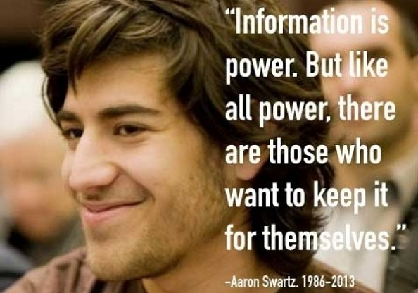
Aaron Swartz
Helped develop:
  RSS (Really Simple Syndication)
  Reddit
  Creative Commons
Founded Demand Progress
  Instrumental in halting SOPA
Legal troubles:
  PACER in 2008
  JSTOR in 2010

Slide 22
Font Connotations
Serif: Good for body text.
Times New Roman
  Formal, Traditional, Cold.
Garamond
  Casual, Traditional, Warm.
Goudy Old Style
  Formal, Traditional, Warm.
Sans-serif: Good for display text
Arial
  Formal, but unprofessional.
  Considered somewhat generic
Calibri
  Formal, Modern
  First sans-serif font chosen as a default for Microsoft (in Office 2007)
Comic Sans
  Informal, Unprofessional, Friendly
  Comic Sans Criminal!
Slide <number>

Slide 23
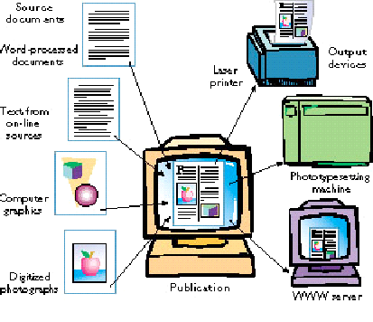
Desktop Publishing
Used to produce books, magazines, other publications.
Includes several steps:
  Writing text
  Editing text
  Producing graphics
  Format design
  Arranging text and graphics
Slide <number>

Slide 24
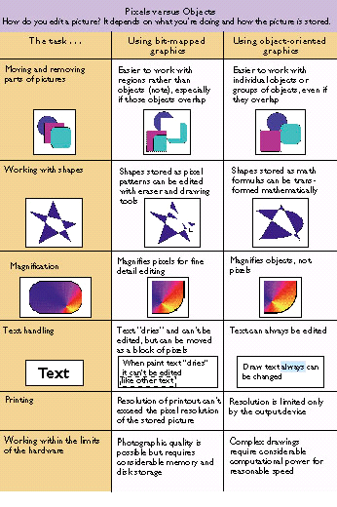
Desktop publishing software:
  Image editing software
  Page-layout software combines the various source documents into a coherent, visually appealing publication
    Quark X-Press
    Pagemaker
    Adobe In-Design
    Microsoft Publisher
Slide <number>

Slide 25
calibre
http://calibre-ebook.com/
Free, open souce software
Can read almost any ebook file format
Can convert files to almost any other ebook file format
Can be used to remove DRM from eBooks
Slide <number>

Slide 26
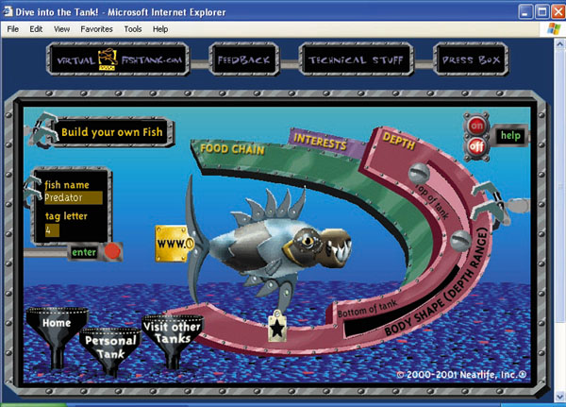
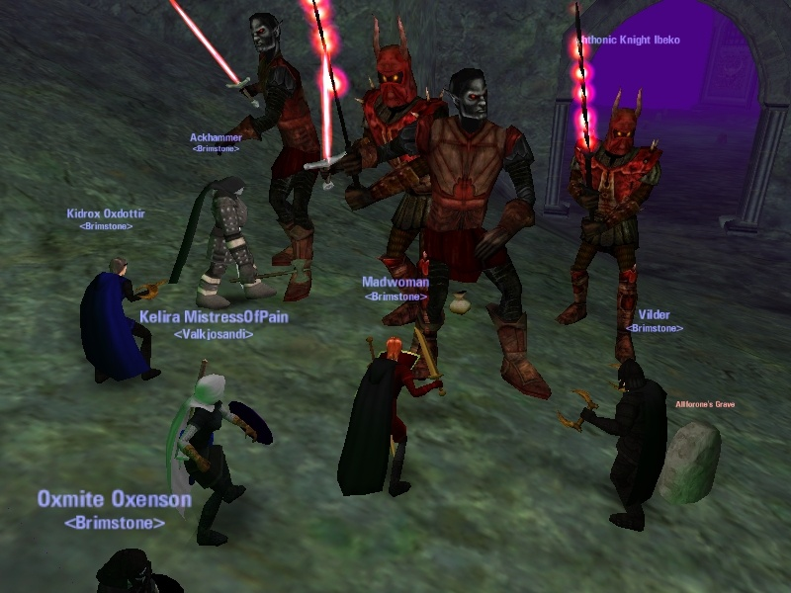
Computer Modeling
Computer modeling uses computers to create abstract models of objects, organisms, organizations, and processes
Examples of popular computer models:
  Games (chess boards, sports arenas, and fictional societies)
  Models of organisms, objects, and organizations
  Flight simulators and simulations of science lab activities
  Business, city, or nation management simulations
Slide <number>

Slide 27
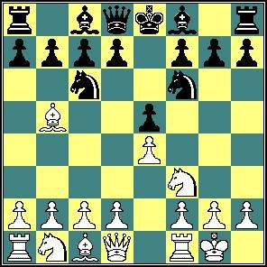
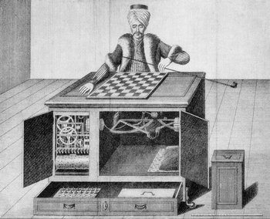
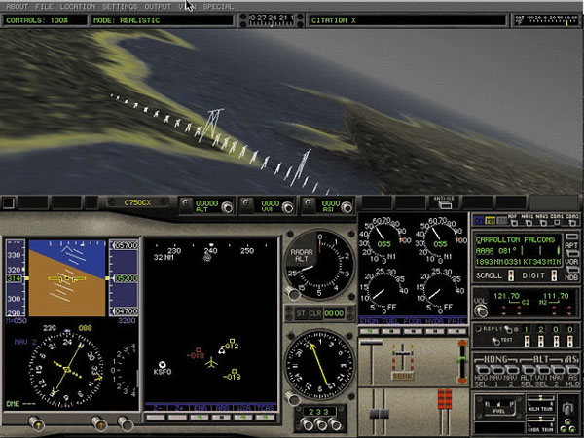
Computer Simulations
Chess
  Among the earliest attempts at AI.
  Limited possibilities, clear rules = excellent simulation.
MS Flight simulator
  Clear physical rules
  Much safer than real-world flight
Slide <number>

Slide 28
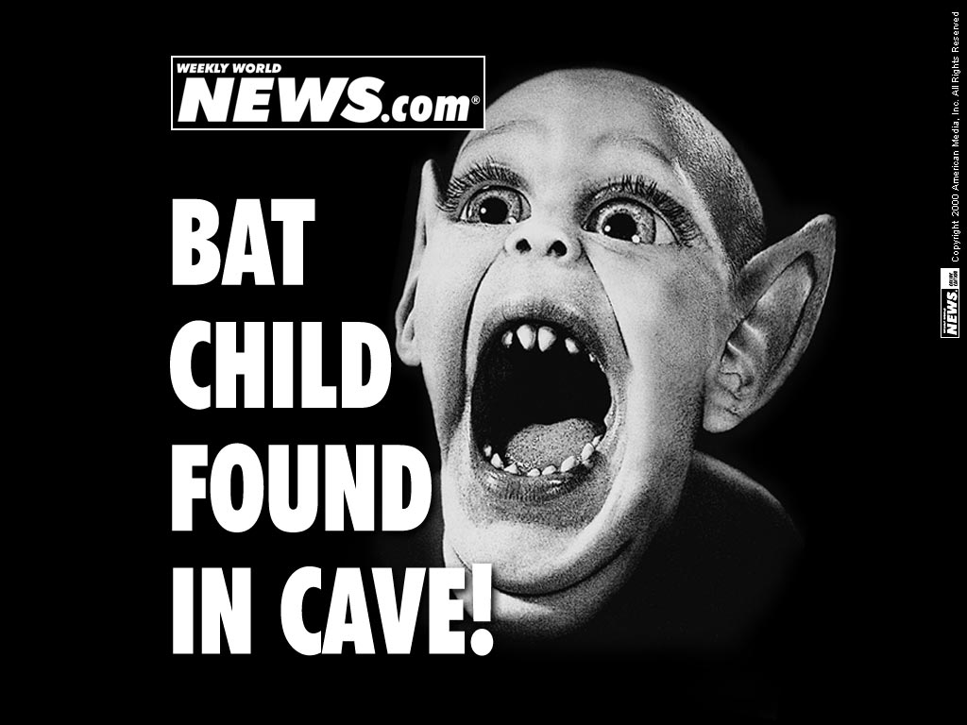
Image Processing: Photographic Editing by Computer
Allows the user to manipulate photographs and other high-resolution images with tools such as Adobe Photoshop
  Photoshop now requires a monthly subscription
  Free alternative: GIMP (Gnu Image Manipulation Program)
Non-subscription option: Photoshop elements
  Has simple, but useful features: cropping, tone correction, red-eye removal, etc.
Slide <number>

Slide 29

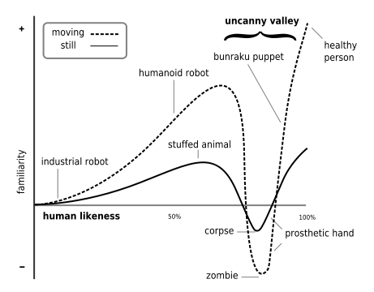
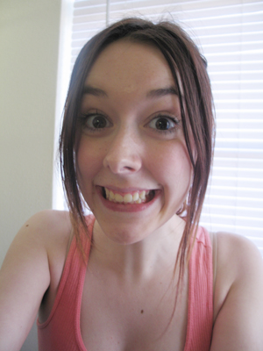
The Uncanny Valley: Realism vs. Familiarity
Slide <number>

Slide 30
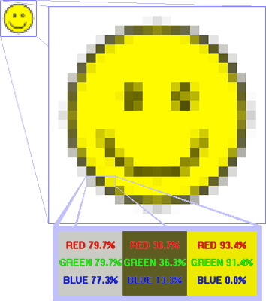
Graphics Terminology
Pixels: tiny dots of white, black, or color that make up images on the screen
The palette of painting tools mimics real-world painting tools
Bitmapped graphics (or raster graphics): pictures that show how the pixels are mapped on the screen
Color depth: the number of bits devoted to each pixel
Resolution: the density of the pixels
Slide <number>

Slide 31
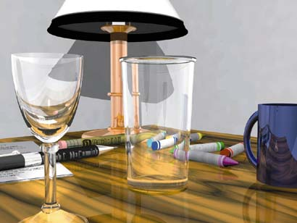
Bit-mapped painting (pixels) gives you these advantages:
  More control over textures, shading and fine detail
  Appropriate for screen displays, simulating natural paint media and embellishing photographs
  (All digital photos are bit-mapped)
Slide <number>

Slide 32


Vector Graphics
Object-oriented drawing gives you these advantages:
  Better for creating printed graphs, charts, and illustrations
  Lines are cleaner and shapes are smoother
  Can be resized repeatedly without pixelization
Slide <number>

Slide 33
Concept: Data Compression
Shrinking a file, usually for easier storage or faster transmission over a network.
  Used for photos, video, audio, text, programs – almost anything stored on a computer.
Removes redundant information: repeated text, sounds, images, etc.
Removes unnecessary information: sounds beyond the human hearing range, images too detailed to see at a given resolution
Lossy compression: Some information is lost permanently.
Lossless compression: All information can be restored on decompression.
Slide <number>

Slide 34
Graphics File Formats
MOST COMMON:
.GIF – max 255 colors per frame, supports animation, lossless compression
.JPG or .JPEG – mostly used for photos, offers continuous tone image, lossy compression
.PNG – Portable Network Graphic (lossless)
FREQUENTLY FRUSTRATING:
.TIF or .TIFF – Tagged Image File Format (used for scanned docs and Photoshop images – often requires Photoshop software to open)
OTHERS:
.BMP – Windows bitmap (older file format, not much used now)
.PBM – Portable bitmap (for portable devices)
.ICO – Icon image for MS Windows
.PCT or .PICT – Macintosh PICT image (older file format, pre-OSX)
.PSD or .PDD – Adobe Photoshop Drawing
.PSP – Paintshop Pro
.TGA – Truevision image (usually screenshots of animation)
Slide <number>

Slide 35
3-D Modeling Software
Used to create three-dimensional objects with tools similar to those in drawing software
Goal for some applications: to create an animated presentation on a computer screen or videotape
Flexible: can create a 3-D model, rotate it, view it from different angles
Can “walk-through” a 3-D environment that exists only in the computer’s memory
Slide <number>

Slide 36
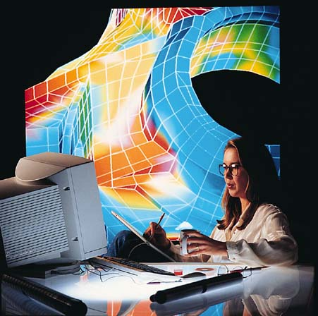
Computer Aided Design (CAD) software:
  Allows engineers, designers, and architects to create designs on screen for products ranging from computer chips to public buildings
  Can test product prototypes
  Cheaper, faster, and more accurate than traditional design-by-hand techniques
Slide <number>

Slide 37
Video Production
  Video Production Goes Digital
Today most video editing is done using nonlinear editing technology
Video editing software, such as Adobe Premiere and Final Cut, makes it easy to eliminate extraneous footage, combine clips from multiple takes, splice together scenes, create specific effects and other activities
Morphs are video clips in which one image metamorphoses into another
Slide <number>

Slide 38
Digital Audio
  Rule of Thumb: Digital Audio Dos and Don’ts
Understand streaming and downloading
Know your file formats: mp3, wav, ra, others
Data-compression – shrinking files by removing unnecessary or redundant information
  Over-compression can significantly degrade quality
DRM: Digital rights management. Not a file format, but a set of restrictions on a file designed to limit its use.
  Wal-Mart Music Downloads used DRM until Feb 2008, limiting their play to “Windows PlaysForSure” products and some other players.
    If you bought DRM protected music before 2008, Wal-Mart no longer runs the servers supporting the music.
  Apple’s iTunes now allows customers to purchase files without DRM
  Argument: DRM hurts only legal users, doesn’t have much effect on illegal users
Slide <number>
Slide <number>

Slide 39
Digital Audio Formats
Format | Description
WAV, AIFF | Standard formats for uncompressed audio for Windows and the Mac OS, respectively. Both formats are supported on Windows, Mac OS, and Linux. Both create large files. Both are lossless – a CD track encoded with WAV or AIFF sounds identical to the original.
MP3 | A popular format for transmitting audio on the Internet. A CD track converted to MP3 format can be 1/10 the size of the original – or smaller – but still sound very similar.
WMA | An alternative to MP3 developed by Microsoft for Windows. WMA compression can result in smaller files of higher fidelity. WMA files may be protected by DRM.
AAC | Apple’s alternative to MP3 and WMA is used primarily by iTunes and iTunes Music Store. AAC compression is sonically superior to MP3 compression. AAC files may be protected by DRM.
OGG | Similar to WMA and AAC in sound quality and compression, OGG Vorbis is open source and freely available – not controlled by any company.
FLAC | Free Lossless Audio Codec: Open Source format, compresses audio files by about 40-50%, losing no information along the way. The broadcast format of choice for many audiophiles and the European Broadcasting Union.
Popular Digital Audio Formats
Slide <number>

Slide 40
What are your questions?
Slide <number>

