Slide 1
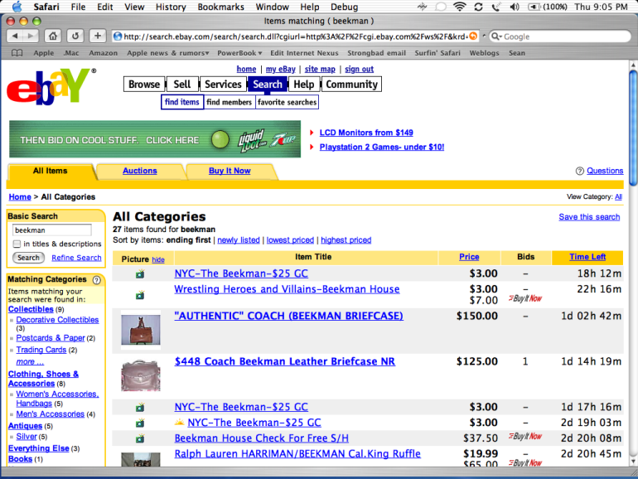
Chapter 7
Database Basics
What Good Is a Database?
A database:
  A collection of information
  stored on computer disks
Database software:
  Application software
  (like word processing and
  spreadsheet software)
  Designed to maintain databases
  (collections of information)
Slide <number>

Slide 2
Chapter 7
The Electronic File Cabinet: Database Basics
The type of information a field can hold is determined by its:
  Field type
  Sometimes called Data type or Field Data type
  Data type can be text or numeric.
  Numeric data type: date, GPA, Account balance
  Text data type: Name, Major, Outstanding Arrest Warrants
Database programs provide you with more than one way to view data:
  Form views
    Show one record at a time
  List views
    Display several records in lists similar to the way a spreadsheet displays data
Slide <number>

Slide 3
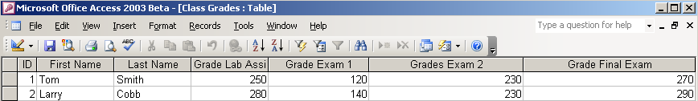
Chapter 7
The Electronic File Cabinet: Database Basics
A record is the information relating to one person, product, or event
Each discrete piece of information in a record is a field
Field
Record
Table
Slide <number>

Slide 4
Chapter 7
The Electronic File Cabinet: Database Basics
Most modern database management programs support a standard language for programming complex queries called SQL (Structured Query Language)
  Available for many database management systems
  Programmers and sophisticated users don’t need to learn new languages when they work with new systems
  Graphical user interfaces allow point-and-click queries
    Insulates users from the complexities of the query language
Slide <number>

Slide 5
Chapter 7
Beyond the Basics:
Database Management Systems
Data Mining:
  The discovery and extraction of hidden predictive information from large databases
  Uses statistical methods and artificial intelligence technology
    Locates trends and patterns in data that would have been overlooked by normal database queries
Slide <number>

Slide 6
Amendment IV to the Constitution of the United States
The right of the people to be secure in their persons, houses, papers, and effects, against unreasonable searches and seizures, shall not be violated, and no warrants shall issue, but upon probable cause, supported by oath or affirmation, and particularly describing the place to be searched, and the persons or things to be seized.
Slide <number>

Slide 7
Smartphone data
In 2014, Apple and Google begin encrypting their smartphone data.
  Major selling point: user data is made so it’s accessible to the customer, but even Apple and Google can’t access it.
  Government agencies reacted negatively:
    “Apple will become the phone of choice for the pedophile” – Chicago Police Chief
    California and New York legislatures have proposed laws making such phones illegal in their states.

Slide 8
The All Writs Act
Following the December 2015 workplace shooting in San Bernadino, the FBI ordered Apple to write software that would break its iPhones’ encryption
Not a subpoena, a court order under the All Writs Act of 1789

Slide 9
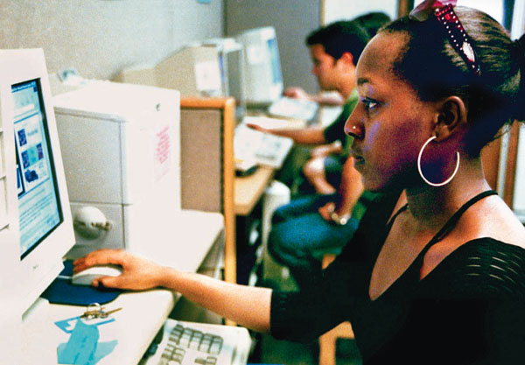
Chapter 8
Basic Network Anatomy
A computer network is any system of two or more computers that are linked together
How is networking important?
  People share computer hardware, thus reducing costs
  People share data and software programs, thus increasing efficiency and production
  People work together in ways that are otherwise difficult or impossible
Slide <number>

Slide 10
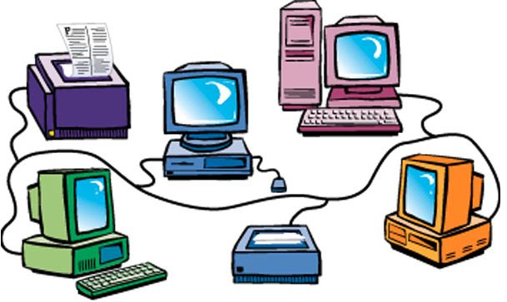
Chapter 8
Basic Network Anatomy
Networks Near and Far
A local area network (LAN): computers are physically close to each other, usually in the same building
In a wireless network each node has a tiny radio (or, less commonly, infrared) transmitter connected to its network port
  Sends and receives data through the air rather than through cables
  Computers are linked within a
  building or cluster of buildings
  Each computer and peripheral is
  an individual node on the network
  Open vs. Closed Wireless Networks
    Con: Security risks
    Pro: “To me, it's basic politeness. Providing internet access to guests is kind of like providing heat and electricity, or a hot cup of tea.” – Bruce Schneier , Wired.
Slide <number>

Slide 11
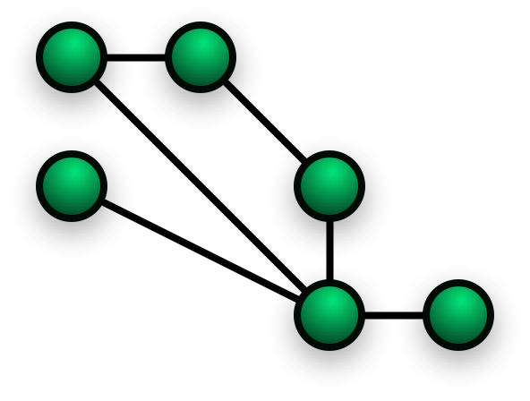
Chapter 8
Basic Network Anatomy
Communication frequently happens between LANs and WANs
  Bandwidth: the quantity of information that can pass through a communications medium in a given amount of time
  Bridges and gateways: hardware devices that can pass messages between networks
    Often translate messages so they can be understood by networks that obey different software protocols
  Routers: hardware devices or software programs that route messages as they travel between networks
  Mesh networks: an alternative to traditional networks, creates individual nodes for communication.
    Used to set up small, temporary communication systems
    Example: emergency personnel use at fire scenes to coordinate actions
Slide <number>

Slide 12
Chapter 8
Basic Network Anatomy
Broadband connection—a connection with much greater bandwidth than modems have
  DSL uses standard phone lines and is provided by phone companies in many areas
  Cable modems provide fast network connections through cable television networks in many areas
  High-speed wireless connections can connect computers to networks using radio waves rather than wires
  Satellite dishes can deliver fast computer network connections as well as television programs
Slide <number>

Slide 13
Chapter 8
Basic Network Anatomy
Fiber Optic Connections
  DSL and cable modems have nowhere near the bandwidth of the fiber optic cables that are replacing copper wires in the worldwide telephone network
  A fiber optic network can rapidly and reliably transmit masses of multimedia data at the same time that it’s handling voice messages
NETWORKS ARE BUILT ON PHYSICAL MEDIA
Type | Uses | Maximum Operating Principal Distance (without amplification) | Cost
Twisted pair | Small LANs | 300 feet | Low
Coaxial cable | Large LANs | 600–2,500 feet | Medium
Fiber optic | Network backbones; WANs | 1–25 miles | High
Wireless/infrared | LANs | 3–1,000 feet (line of sight) | Medium
Wireless/radio | Connecting things that move | Varies considerably | High
Slide <number>

Slide 14
Chapter 8
Email, Instant Messaging, and Teleconferencing:
  Computer Telephony
  Voice mail: a messaging system with the ability to store, organize, and forward messages
    An example of a growing trend toward computer telephony integration (CTI)—the linking of computers and telephones to gain productivity
  VOIP – Voice Over Internet Protocol:
    Sending voice signals through the Internet, bypassing the phone companies (and their charges) altogether
    Still working out some bugs:
      Caller-ID can be faked
      Calling 911 doesn’t always show caller’s location
      Outside the US, some countries tax or criminalize VOIP, because the state makes so much money on traditional telephone service.
      VOIP is not as legally secure against wiretapping
Slide <number>

Slide 15
Email, Instant Messaging, and Teleconferencing: Interpersonal Computing
  Private browsing – available on most web browsers, disables your browser history to keep it private from others with access to that computer
    This does NOT delete any records kept by other networks you are connected to
  TOR Browser – much more private browsing, connects to an anonymizing network that doesn’t reveal your true IP address to any site you connect to
    Can be slow, is not completely invulnerable to dedicated investigation
  An IP address is not a person
    If a legal offense is tied to a particular IP address, additional verification is necessary to prove what person committed that offense
Slide <number>

Slide 16
Chapter 9
ARPANET Pioneers Build an Unreliable Network ... on Purpose
The Advanced Research Projects Agency NETwork (ARPANET) is the predecessor to the Internet:
  Developed at the request of the Department of Defense by a team of visionary computer scientists
  Launched in 1969
  Its peer-to-peer networking philosophy and protocols were copied in other networks in the 1980s
  Disbanded in 1990, having fulfilled its research mission, but its technology spawned the Internet
Slide <number>

Slide 17
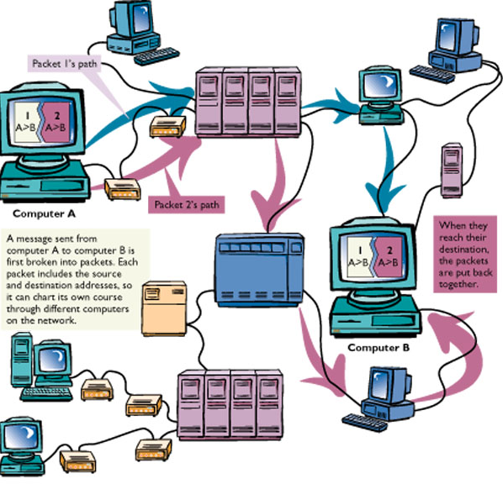
Chapter 9
Inside the Internet
Internet Protocols
Transmission Control Protocol/Internet Protocol, TCP/IP…
  At the heart of the Internet
  Allows cross-network communication
Slide <number>

Slide 18
Chapter 9
Inside the Internet
TCP breaks messages into packets
  Each packet has all the information needed to travel from network to network
  Host systems called routers determine how to route transmissions
IP is the address for the packets
  Each Internet host computer has a unique IP address
  Each address is comprised of four sets of numbers between 0 and 255 separated by periods, such as 128.114.113.19
Slide <number>

Slide 19
Chapter 9
Inside the Internet
Internet Addresses
The host is named using DNS (domain name system), which translates IP addresses into a string of names
Has led to legal fights over rights to certain domain names
  Cyber-squatting – grabbing domain names to resell later
Top-level domains include:
  .edu - educational sites
  .com - commercial sites
  .gov - government sites
  .mil - military sites
  .org - nonprofit organizations
Slide <number>

Slide 20
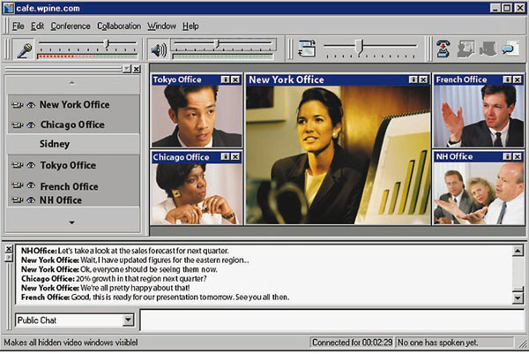
Chapter 9
Inside Web Applications
Push Technology: Notifications and Alerts
The Web was built with pull technology
  Browsers on client computers “pull”
  information from server machines
  Browser asks for information
With push technology, information is
delivered automatically to the client
computer
  New product descriptions
  Automatic software upgrades
  Updated news
RSS Feeds
  Open standard for subscription feeds
  Instead of regularly visiting a dozen web pages. Look for the Feed Icon:
  Google Reader abandoned July 1, 2013
  Feedly still works
Slide <number>

Slide 21
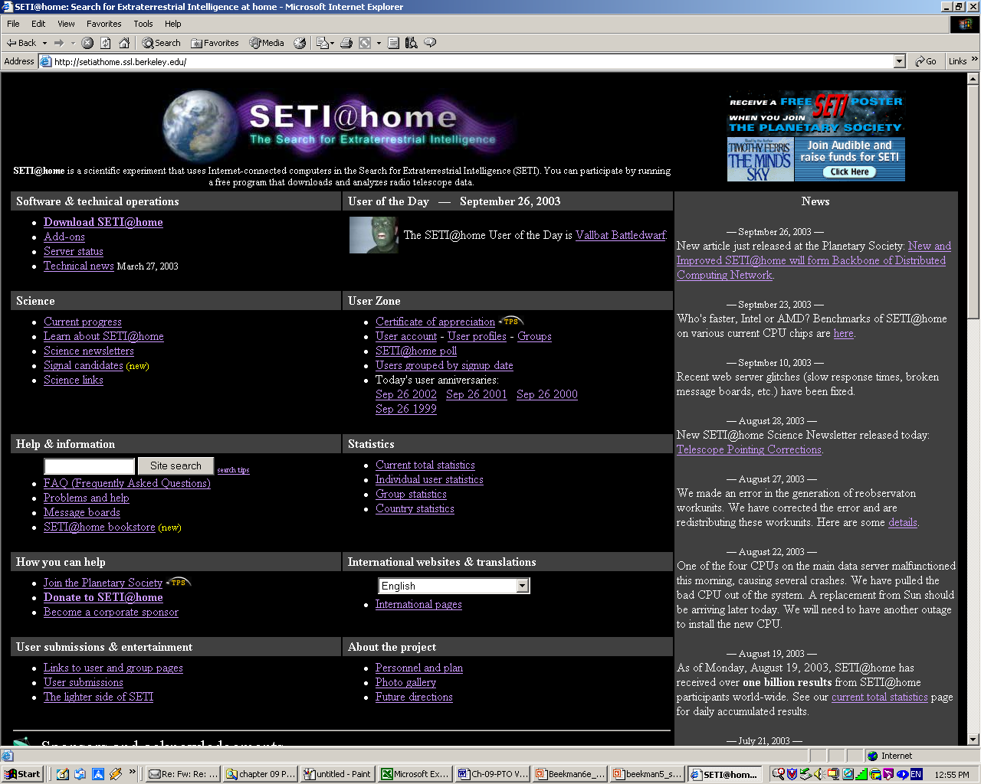
Chapter 9
Inside Web Applications
Peer-to-Peer and Grid Computing
Peer-to-Peer (P2P) Computing
  Users share music, movies,
  and other files without going
  through a central directory
Grid Computing
  Anyone can plug in from
  anywhere and rent processing
  power and software from anywhere
  on the Net
  Example: SETI@Home, Folding@Home
Slide <number>

Slide 22
Chapter 10
Online Outlaws: Computer Crime
Common types of computer crime:
  Spoofing: presenting a false identity to trick others into divulging passwords and other private information
  Identity theft: the use of computers and other tools to steal whole identities
  Phishing: users “fish” for sensitive information under false pretenses
    Take this online quiz! What’s your birthday? Your mother’s maiden name?
  Online fraud
    Most related to online auctions – while auctions are statistically safe, check user feedback
    Also, spam-based work-at-home schemes – selling “business opportunities” that cost money to get involved in
Slide <number>

Slide 23
Chapter 10
Software Sabotage: Viruses and Other Malware
Malware: malicious software, or any type of intentionally invasive, unwanted software.
Malware can include:
  Trojan horse: performs a useful task while also running undesired, unrequested, or actively harmful routines
    Examples: A screen saver displaying a waterfall while erasing your hard drive.
  Virus: spreads by making copies of itself from program to program or disk to disk
    Can corrupt data, damage systems, spread malware/spyware - or often do nothing at all, created only as an intellectual challenge.
    Examples: Macro viruses and email viruses
Slide <number>

Slide 24
Chapter 10
Software Sabotage: Viruses and Other Malware
Antivirus programs are designed to search for viruses, notify users when they’re found, and remove them from infected disks or files
  Common commercial software: McAfee, Norton Anti-Virus
    Note: Commercial anti-virus software tends to be bloated, consuming unnecessary system resources. Can be very hard to completely uninstall.
  Recommended Freeware anti-virus:
    AVG Free, Avast!, MS Security Essentials (Windows 7), or MS Defender (Windows 8)
  Good all-purpose scanning program: Malwarebytes
  Beware of ransomware or any anti-virus program suggested via pop-up ad.
  Programs need to be frequently revised to combat new viruses as they appear
  Most can automatically download new virus-fighting code from the Web as new virus strains appear
    It can take several days to develop and distribute patches for new viruses
Slide <number>

Slide 25
Chapter 10
Software Sabotage: Viruses and Other Malware
Spyware is technology that collects information from computer users without their knowledge or consent
    Also called: Tracking software or Spybot
  Information is gathered and shared with outsiders via Internet
    Your keystrokes could be monitored
    Web sites which you visit are recorded
    Snapshots of your screen are taken
    Cause pop-ups to appear
  61% of PC users have spyware on their computers
    In drive-by downloads just visiting a Web site can cause a download
    (Mozilla Firefox is somewhat more secure than Internet Explorer)
Slide <number>

Slide 26
Chapter 10
Software Sabotage: Viruses and Other Malware
Hacking and Electronic Trespassing
Hacker (or cracker) refers to people who break into computer systems
Webjackers hijack Web pages and redirect users to other sites
Denial of Service (DOS) attacks bombard servers and Web sites with traffic that shuts down networks
Slide <number>

Slide 27
Chapter 10
Computer Security: Reducing Risks
Depending on the security system, you might be granted access to a computer based on:
  Token ID - Something you have
    A key, an ID card with a photo, or a smart card containing digitally encoded identification in a built-in memory chip
  Passcode ID - Something you know
    A password, an ID number, a lock combination, or a piece of personal history, such as your mother’s maiden name
  Signature ID - Something you do
    Your signature or your typing speed and error patterns
  Biometric ID - Something about you
    A voice print, fingerprint, retinal scan, facial feature scan, or other measurement of individual body characteristics; these measurements are collectively called biometrics
Slide <number>

Slide 28
Chapter 10
Computer Security: Reducing Risks
Passwords
Passwords are the most common tool for restricting access to a computer system
Effective passwords are:
  Not real words
  Not names
  Changed frequently
  Kept secret
  A combination of letters and numbers
  Not shared across multiple accounts
Choosing a real word or name for your password leaves it susceptible to a dictionary attack – a comparison of your password to every word in the dictionary, which can be accomplished quickly
Beware of Keyloggers – usually running on other people’s computers
  Keyloggers log all keystrokes
  Often USB devices placed between external keyboards and desktop computers.
  Keylogger hardware often can’t be detected by software
Slide <number>

Slide 29
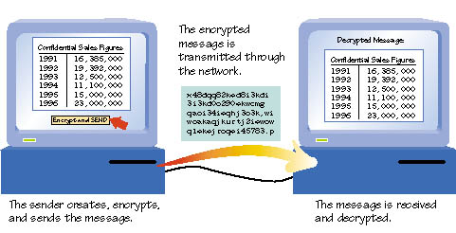
Chapter 10
Computer Security: Reducing Risks
Making a message secure from outsiders requires encryption software
  Encryption software scrambles the sent message using a key
  A different key is needed to unscramble the received message
Slide <number>

