Slide 1
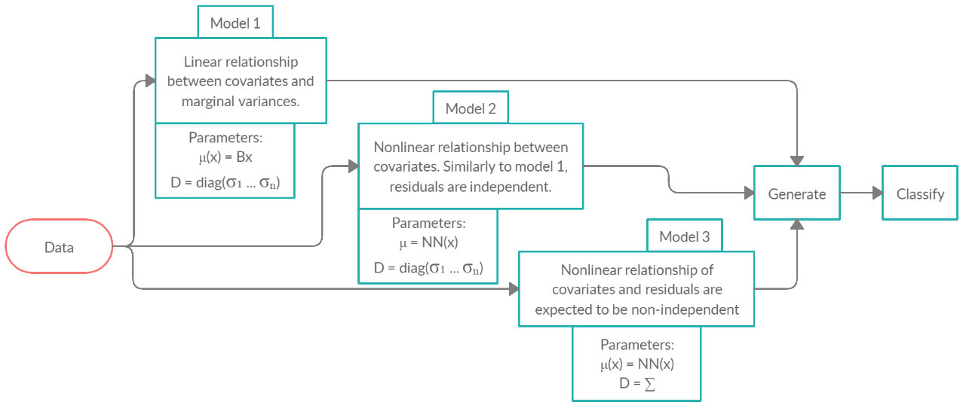
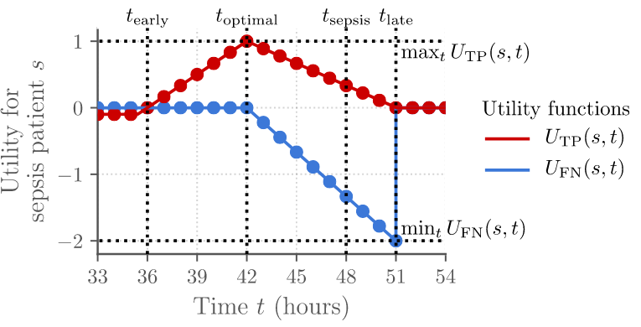




Sepsis identification and prediction using machine learning:
Performance of the generative modelling approach compared to a neural network implementation
Jonne Kurokallio, Vesa Vahermaa
Department of Computer Science, School of Science, Aalto University, Finland
Introduction
Machine learning can be used to identify and predict critical medical conditions including sepsis with varying rates of success (Desautels et al., 2016; Mao et al., 2018)
Sepsis is a life-threatening condition with a high mortality rate, requiring immediate care in the Intensive Care Unit (ICU)
ICU patients have their vital signs constantly monitored, as well as regular blood tests that provide various laboratory values
We compare the prediction accuracies of the Bayesian classifier based on linear and non-linear generative models and compare them to a discriminative LSTM neural network model
Figure 1. Workflow diagram for the project
Figure 2. Utility functions for true positives (TP) and false negatives (FN)
Dataset
Methods
Results
Conclusions
The dataset was acquired from the PhysioNet2019 Challenge
We employed both linear and non-linear generative models in the pipeline, together with simple Bayes classifier
Predictive utility score of the tested models ranged from -0.0004 to 0.0534. Details in Table 1 below.
Multivariate data in medical events has rarely linear relationships. Therefore the model that expected non-linearity and non-independent residuals performed better than the simpler models.
The dataset was split into two parts, each from one hospital
Performance was graded using a utility score. Predictions up to 12 hours before, and identification up to 3 hours after sepsis onset was rewarded; false negatives were heavily penalized.
Highest score was achieved by a Bayes classifier based on generative model, using model 3. The utility score of this method reached 0.0534.
The top scores of the PhysioNet 2019 challenge ranged from 0.425 to 0.433 for the top 10, meaning that our implementation performed significantly worse than the top models trained for the same dataset.
Put together, the dataset included data from 40336 ICU patients,
2932 of whom developed sepsis at some point.
For training purposes, the dataset was divided into equal amounts of sepsis and non-sepsis patients to mitigate sample size bias
Utility functions were chosen over traditional measures like AUROC, as correctly timed predictions are crucial for successful clinical care, while false negatives can be lethal for patients.
Model | Model attributes (N_nodes) | Avg of 5 runs
Model 1 | Regression Coeff.: 7x34 | 0.0284
Model 2 | 2 hidden layers (14,28) | 0.04
 | 4 hidden layers (14,28,56,28) | -0.0004
 | 1 hidden layer (17) | 0.0458
Model 3 | 2 hidden layers (14,28) | 0.047
 | 1 hidden layer (17) | 0.0534
LSTM | 2 LSTM layers | 0.0076
The dataset included 1.550.000 rows of data, each representing
one hour of data of one patient in the ICU
The generative models are easy to implement and perform well against the discriminative models, where the data imputation for missing data needs to be taken care of separately.
Data included vital sign data such as hourly temperature, heart rate and respiratory rate, as well as laboratory and demographic data
For models 1-3 in figure 1, it is assumed that the data is normally distributed Y~N(μ(X), D).
References
Vital signs were recorded every hour, laboratory results generally every 12 hours, which meant 90+% of data points lacked lab data
We used a Recurrent Neural Network (RNN) architecture called Long Short Term Memory (LSTM) for predicting sepsis for future time points.
Desautels, T. et al. (2016) ”Prediction of Sepsis in the Intensive Care Unit With Minimal Electronic Health Record Data: A Machine Learning Approach” JMIR Medical Informatics, 4(3), e28. doi: 10.2196/medinform.5909
For the LSTM model, laboratory features with 80+% of missing values were discarded completely
LSTM was selected for its capability of successfully processing data sequences instead of only individual time points
Mao, Q. et al. (2018) ”Multicentre validation of a sepsis prediction algorithm using only vital sign data in the emergency department, general ward and ICU” BMJ Open, 8(1), e017833. doi: 10.1136/bmjopen-2017-017833
Table 1. Classification accuracies by model and parameters.
Department of Computer Science
Download the poster!
Contact Information:
jonne.kurokallio@aalto.fi
vesa.vahermaa@aalto.fi

