Slide 1
Jonne Kurokallio
Python case / Pre-assignment

Slide 2
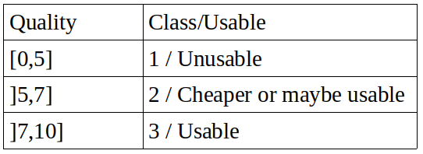
Data
This dataset is public available for research. The details are described in [Cortez et al., 2009]. Please include this citation if you plan to use this database:
    P. Cortez, A. Cerdeira, F. Almeida, T. Matos and J. Reis. Modeling wine preferences by data mining from physicochemical properties. In Decision Support Systems, Elsevier, 47(4):547-553. ISSN: 0167-9236.
Wine database with thousands of wine samples with 11 features such as pH and acidity.
Qualities evaluated by tree experts
Problem: determine usability of future samples.
It is unnecessary to divide the wine into 10 categories, so I divide it into three classes based on it’s usability.

Slide 3
Preprocessing the data
Processed with Pandas
Scaling the features
  Scaling subtracts the mean value of the observation and then divides it by the unit variance of the observation
  This eliminates the dominating (if exist) feature values
Checking linearity
Feature selection
  1. with Lasso before trying models
  2. with ExtraTreeClassifier before trying the models
  3. with Recursive Feature Elimination after training the model to see if this makes any difference

Slide 4
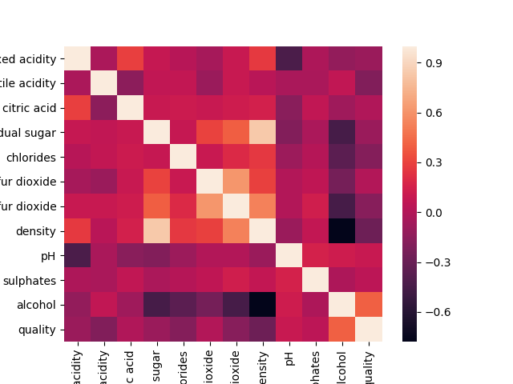
Linear equivalence

Slide 5
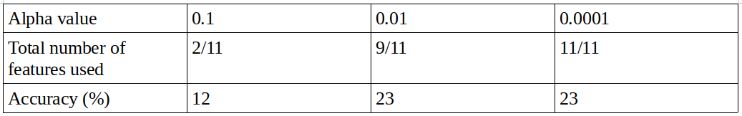
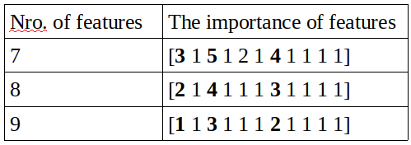
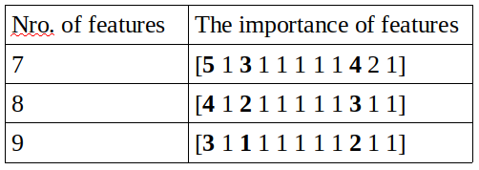
Feature selection
Lasso
ExtraTreeClassifier
[0.07217551 0.10953069 0.0845641 0.08082555 0.0829807 0.09360738 0.08148188 0.07966577 0.07944639 0.07345181 0.16227022]
Recursive Feature Elimination
  SVM- linear
  Random Forest

Slide 6
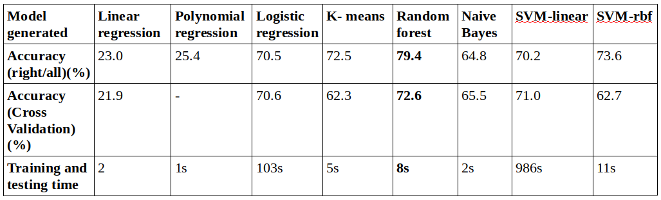
Trained models without feature selection

Slide 7
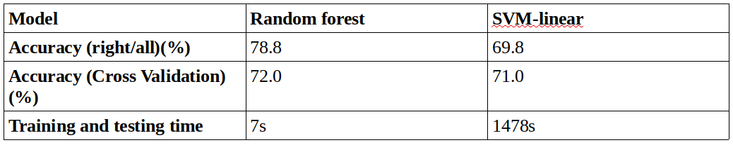
RF and SVM-linear with feature selection

Slide 8
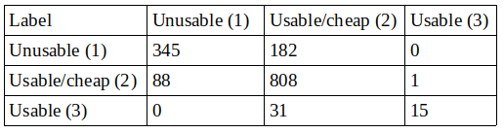
Analysis of the results
Confusion matrix (Random Forest with out Feature selection)

Slide 9
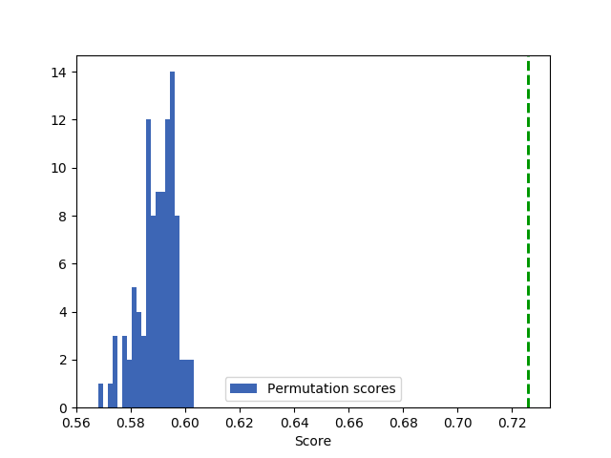
Permutation analysis
Random Forest without feature selection
p.value = 0.009

Slide 10
Future work
More study on the feature selection
  Better and more accurate results with fewer features
Try different scaling method
Tune in more parameters

