Slide 1


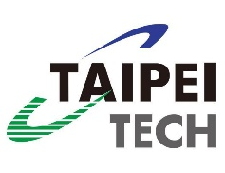

A Secure and IoT-Enabled Data Sharing System Based on IPFS and IOTA Blockchain
Tse-Yang Huang (Yuan Ze U.)
Joint work with Yu-Chi Chen, Tsung-Chen Hsieh, Huan-Chi Chang (Taipei Tech), Chih-Chieh Chang (Taiwan Tech)
Notes:
Good afternoon everyone, and thank you for being here today. My name is Tse-Yang Huang, and I'm here to talk about “A Secure and IoT-Enabled Data Sharing System Based on IPFS and IOTA Blockchain.”

Slide 2
Outline
Introduction
Preliminaries
Proposed system
Discussions
Conclusions
Notes:
This is the outline of my presentation. In this slide, I will provide a brief overview of the outline, I will be covering in my presentation, including the Introduction, preliminaries, the proposed system, discussions, and conclusions.

Slide 3
Outline
Introduction
Preliminaries
Proposed system
Discussions
Conclusions
Notes:
Now, let's dive into the introduction

Slide 4
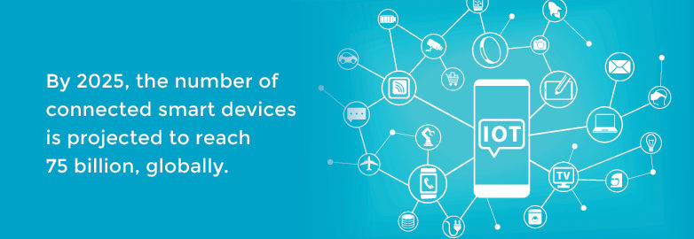
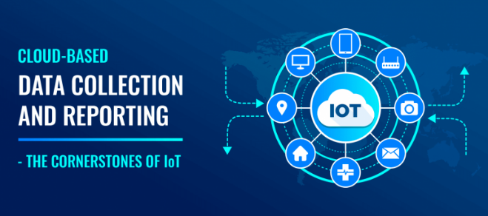
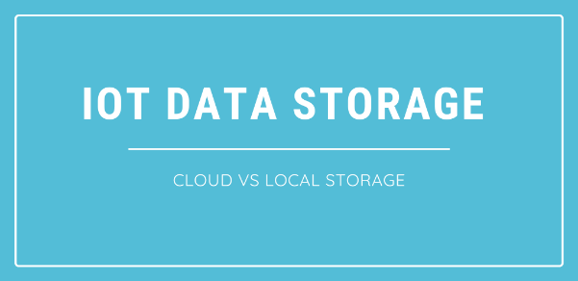
Challenge - IoT Data Growth
The explosion of IoT :
Rapid data growth
Issues in data collection and sharing
Difficulty in data locating
Need for secure and untrusted cloud storage
Source: https://logicsimplified.com/newgames/cloud-based-data-collection-and-reporting/
Source: https://www.endtoend.com/the-new-office-and-the-internet-of-things/
Source: https://essencesoftwares.com/blog/the-solution-to-data-storage-problems-of-iot-devices-cloud/
Notes:
With the explosive growth of the Internet of Things (IoT) in recent years, the number of IoT devices and the amount of data they collect has significantly increased. However, This great amount of data presents several challenges. Firstly, how do we collect such a massive volume of data? There are two approaches: setting up our own IoT devices to gather the required data or requesting data-sharing or purchasing from potential data owners who already collect the data we need.
In such a scenario, we need a data-sharing platform to facilitate this process. Our goal is to develop such a platform.
There is a issue called data isolation in current IoT landscape, where large amounts of data are underutilized or redundantly collected. Therefore, we need a search system in our platform to help data users to find potential IoT devices that collect the desired data efficiently.
To create such a search system, the data must be stored in cloud storage. This raises a crucial concern: if we rely on traditional centralized cloud service providers, we must trust that they will not invade our data privacy or misuse our data. This gives rise to privacy and trust issues.

Slide 5
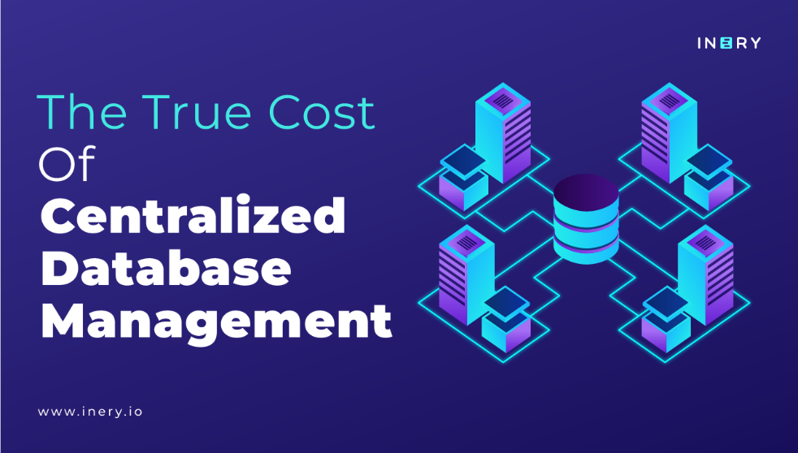
Decentralized data-sharing platform
Essential Features:
Searching mechanism
Decentralized and untrusted cloud storage
Decentralized and untrusted fine-grained access control
One-to-many encrypted data sharing ability
Notes:
Hence, we believe that our data-sharing platform should have the following functionalities or capabilities.
Firstly, to address the data isolation issue as we told above we need a data searching mechanism.Secondly, the cloud storage we choose should be decentralized and untrusted.
Moreover, data owner may have a lot of IoT devices and need to share the IoT data with a lot of DUs, and it is difficult to manage such a large number of devices, and it can bear a burden for IoT devices or DO to encrypt the IoT data for several times for every single DU. So that we need a decentralized and untrusted fine-grained access control management mechanism and one-to-many encrypted data sharing ability.

Slide 6
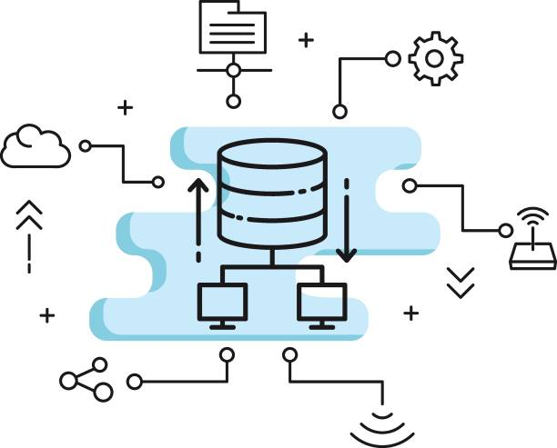
Technique Highlight
Access Control and one-to-many encrypted data sharing ability:
Fuzzy Identity-Based Encryption (FIBE) and IOTA smart contract for access control
Decentralized cloud storage:
InterPlanetary File System (IPFS)
Decentralized searching mechanism:
IOTA smart contract and IPFS
Source: https://www.istockphoto.com/photos/centralized-server
Notes:
Consequently, we use Fuzzy Identity-Based Encryption (FIBE) and IOTA smart contracts to achieve fine-grained access control and management, as well as one-to-many sharing. We also use IPFS as our decentralized cloud storage and IOTA smart contracts to complete our search system.

Slide 7
Outline
Introduction
Preliminaries
Proposed system
Discussions
Conclusions

Slide 8
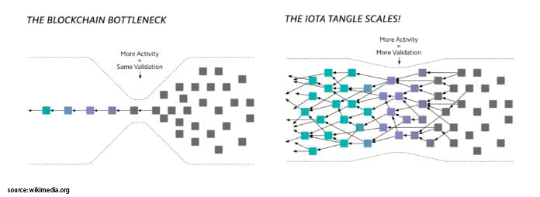
IOTA Tangle
Decentralized searching mechanism & FIBE Re-Encryption:
Handles FIBE re-encryption through smart contracts
Supports hashtag-based searches and queries through smart contracts
Note: The smart contract functionality of IOTA Tangle is crucial to our system.
Source: wikimedia.org
Notes:
IOTA Tangle is a blockchain liked architecture, and it is suitable for IoT landscape. And we leverage the SC of it to handle the FIBE Re-Encryption and to support the hashtag-based searching mechanism in our system.

Slide 9
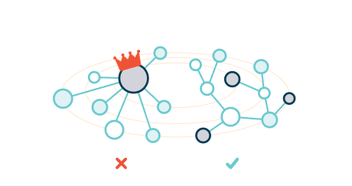
IPFS and IPNS
Decentralized cloud storage:
Stores all IoT data and Access Control Policies
Provides integrity, non-repudiation, and verifiability
All stored data is public
Note: To ensure data privacy, we encrypt all sensitive data using Fuzzy IBE or Public Key Encryption before storage.
Source: https://ipfs.tech/#why
Notes:
This is IPFS and IPNS, and we skip this slide.

Slide 10
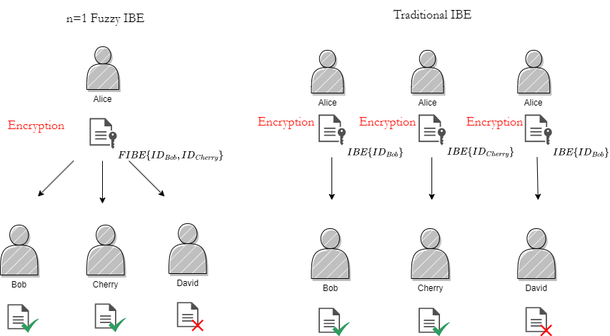
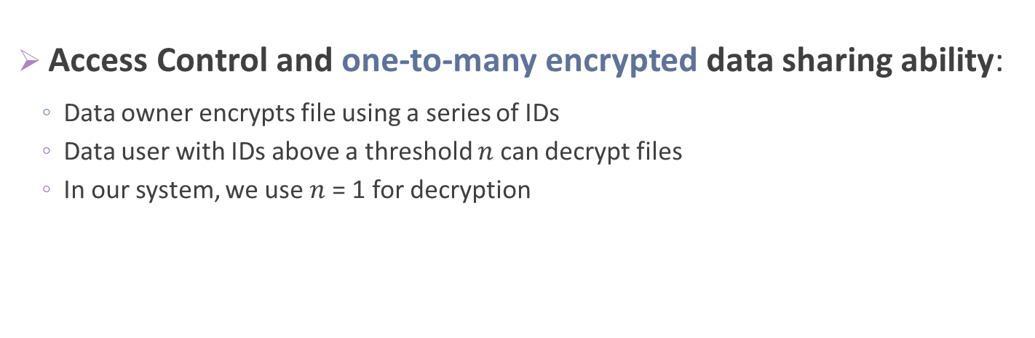
Fuzzy Identity-Based Encryption (FIBE)
Access Control and one-to-many encrypted data sharing ability:
Data owner encrypts file using a series of IDs
Data user with IDs above a threshold $n$ can decrypt files
In our system, we use $n$= 1 for decryption
Note: This ensures that any data user whose ID is included among the encrypting IDs can use their private key to decrypt the data.
Notes:
This is FIBE, and the use case of our system is n=1 Fuzzy IBE. n is the threshold of FIBE. And a DO can encrypt the data file with FIBE and a set of IDs. We can call this ID set as an Access Control Policy. And n=1 means that the DU whose ID has been included in the Access Control Policy can decrypt the file. Thus, we can achieve one-to-many encrypted data-sharing ability in our system.
And we can compare the n=1 FIBE to the Traditional IBE. If we use the traditional IBE to do that, the DO needs to encrypt the data file for several times for every single DU. And it can bear a burden on DO or their IoT devices.

Slide 11
Outline
Introduction
Preliminaries
Proposed system
Discussions
Conclusions
Notes:
Our system mainly has these three roles.

Slide 12
System Model
Data Owner (DO)
Data User (DU)
IOTA Smart Contract (SC)

Slide 13
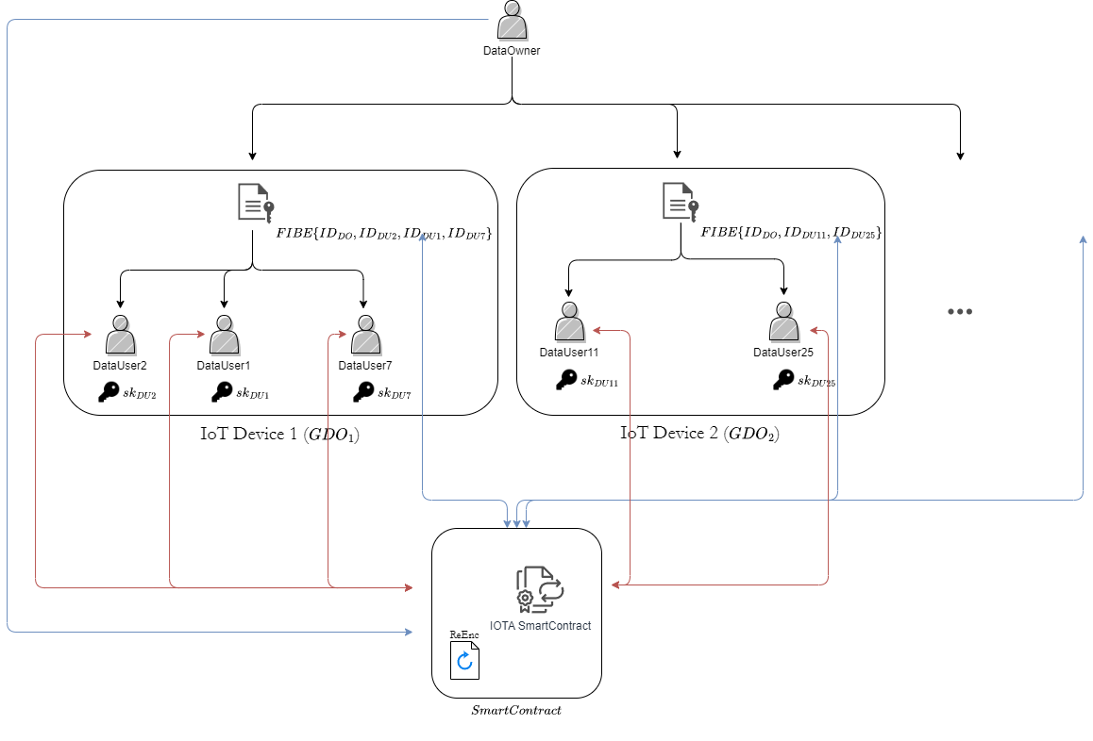
System Model
Re-Encryption
Hashtag-Based Searching
Notes:
This is the way how they interact with each other. and the rectangle represents the IoT devices. And the DU can interact with the IOTA SC to do hashtag-based searching to search for the data they want. And DO can also interact with the IOTA SC to do FIBE Re-Encryption to modify the Access control policy of their IoT devices.

Slide 14
System Protocols
Registering
IoT Device Registering.
IoT Data Uploading or Updating
Hashtag-based Search Mechanism
Hashtag-based Searching
Access Control Management
Asking Access Rights
Permission Updating
IoT Data Accessing
Notes:
And Because of the time limit, we won’t show all of our protocols.

Slide 15
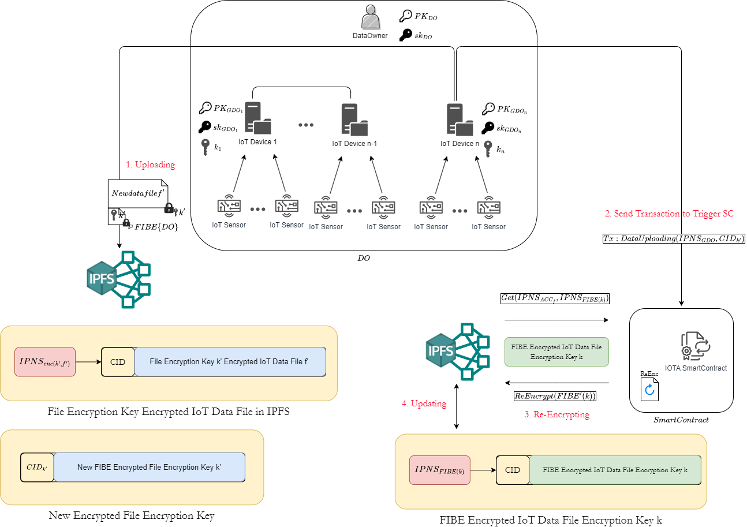





IoT Data Uploading or Updating
1. Uploading
2. Sending Transaction to Trigger SC
Aspect | Farahani et al. (2022) [Farahani22] | Zheng et al. (2020) [Zheng20] | Our System
Access Control Management
Decentralized Data Storage
Data Searching
Reducing Local Storage Overhead
Decentralized Key Management
1-to-Many Encrypted Data Sharing
3. Getting
5. Updating
4. Re-Encrypting
[Farahani22] Hadi Farahani and Hamid Reza Shahriari. 2022. A Privacy Preserving IoT Data Marketplace Using IOTA Smart Contracts. arXiv preprint arXiv:2210.04733 (2022).
[Zheng20] Xiaochen Zheng, Jinzhi Lu, Shengjing Sun, and Dimitris Kiritsis. 2020. Decentralized industrial IoT data management based on blockchain and IPFS. In Advances in Production Management Systems. Towards Smart and Digital Manufacturing: IFIP WG 5.7 International Conference, APMS 2020, Novi Sad, Serbia, August 30– September 3, 2020, Proceedings, Part II. Springer, 222–229.
Notes:
Farahani et al. proposed an IoT data trading platform, and Zheng et al. proposed an Industrial IoT data management system. in Farahani’s work, their data owner encrypts their IoT data with the public key of the data user and stores it in IPFS. So that, they can trade it with the data user. In this way, we can observe that they only treat the IPFS as a transmission channel but a Decentralized Data Storage and their IoT Data is still stored in local storage. This can bear a local storage and backup burden. In contrast, both our system and Zheng’s system have leveraged IPFS as a Decentralized Data Storage. Therefore, we can reduce the local storage and backup burden. We need to note that both Farahani’s and Zheng’s Systems have leveraged the IPFS and IOTA Tangle to complete their system like ours.
--------------------------------------------------------------------------------------------------------------------------------------------------------------------
Our system uploads and updates IoT data using IPFS and IOTA for secure, decentralized storage. Comparatively, both Farahani et al.'s IoT trading platform and Zheng et al.'s industrial IoT system also employ IPFS and IOTA.
Farahani et al.'s platform limits IPFS usage to only data transmission during transactions, neglecting its potential for decentralized storage. In contrast, both Zheng's and our systems maximize the use of IPFS for decentralized storage, securely storing all IoT data. This strategy promotes integrity, availability, redundancy, and reduces local storage and backup requirements.
Consequently, our system, like Zheng et al.'s, fully leverages IPFS for efficient and decentralized IoT data storage.
------ Let's look into how IoT data is uploaded and updated in our system. We use IPFS and IOTA to ensure secure and decentralized data storage. To make a clear comparison, we'll examine the systems proposed by Zheng et al. (2020) and Farahani et al. (2022), which also use IPFS and IOTA in their solutions.
Farahani et al. proposed an IoT data trading platform. In their system, IPFS is mainly used as a transmission channel, with IoT data being uploaded to IPFS only during the transaction process. This approach limits the usage of IPFS for data transfer and doesn't take full advantage of its potential for decentralized storage.
Zheng et al. proposed an Industrial IoT data management system. In contrast, both Zheng’s system and our system fully utilize IPFS for decentralized data storage. All IoT data is securely stored in IPFS, ensuring integrity, availability, and redundancy. This approach not only provides a robust and scalable storage solution but also minimizes the burden of local storage and backups.
As a result, our system, along with Zheng et al.'s, offers a more comprehensive use of IPFS, enabling efficient and decentralized data storage for IoT applications.

Slide 16
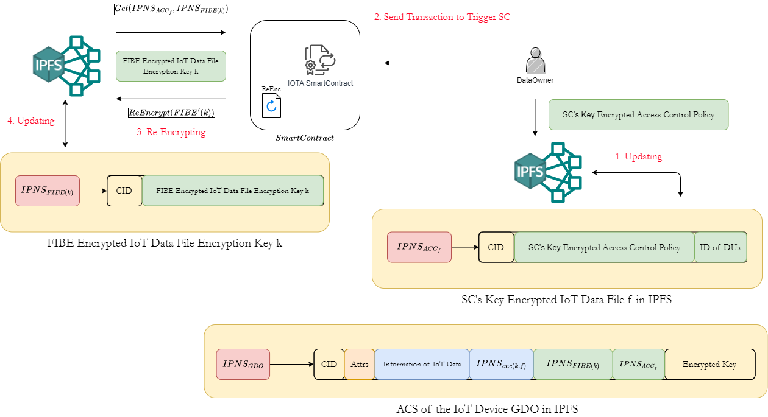

Permission Updating
3. Getting
2. Sending Transaction to Trigger SC
5. Updating
4. Re-Encrypting
1. Updating
Aspect | Farahani et al. (2022) [Farahani22] | Zheng et al. (2020) [Zheng20] | Our System
Access Control Management
Decentralized Data Storage
Data Searching
Reducing Local Storage Overhead
Decentralized Key Management
1-to-Many Encrypted Data Sharing
[Farahani22] Hadi Farahani and Hamid Reza Shahriari. 2022. A Privacy Preserving IoT Data Marketplace Using IOTA Smart Contracts. arXiv preprint arXiv:2210.04733 (2022).
[Zheng20] Xiaochen Zheng, Jinzhi Lu, Shengjing Sun, and Dimitris Kiritsis. 2020. Decentralized industrial IoT data management based on blockchain and IPFS. In Advances in Production Management Systems. Towards Smart and Digital Manufacturing: IFIP WG 5.7 International Conference, APMS 2020, Novi Sad, Serbia, August 30– September 3, 2020, Proceedings, Part II. Springer, 222–229.
Notes:
As we told above these two aspects are important and necessary in such a IoT data trading, management, or sharing system.
---------------------------------------------------------------------------------------------------------------------------------------------------------
Our system, as shown in the flowchart, efficiently manages and updates IoT data access rights. In contrast to systems proposed by Zheng et al. and Farahani et al., ours includes Access Control Management and Decentralized Key Management, both absent in their solutions.
Access Control Management allows data owners to control access rights, granting data access to authorized individuals only. This bolsters security and privacy. Decentralized Key Management, meanwhile, controls encryption key distribution, ensuring only authorized decryption and enhancing system security.
These crucial features, lacking in Zheng et al. and Farahani et al.'s systems, are integral to our system, providing a secure, controlled framework for IoT data sharing.
---
Let's take a closer look at the process of Permission Updating in our system. The visual flowchart demonstrates how we can efficiently manage and update access rights for IoT data. When comparing our system to those proposed by Zheng et al. (2020) and Farahani et al. (2022), it's important to note that they lack Access Control Management and Decentralized Key Management. These components are crucial for ensuring secure and controlled access to IoT data.
Access Control Management allows data owners to define and manage access rights, ensuring that only authorized individuals or entities can access the data. This feature provides an additional layer of security and privacy. Similarly, Decentralized Key Management enables the secure distribution and management of encryption keys. It ensures that data can only be decrypted by authorized parties, enhancing the overall security of the system.
Unfortunately, these vital aspects are absent in the systems proposed by Zheng et al. (2020) and Farahani et al. (2022). In contrast, our system incorporates Access Control Management and Decentralized Key Management, providing a robust framework for secure and controlled data sharing in the IoT ecosystem.

Slide 17
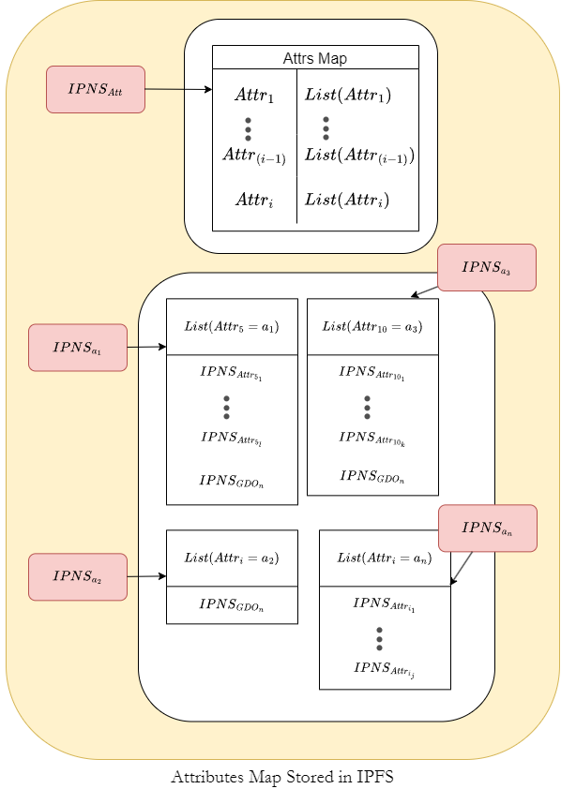
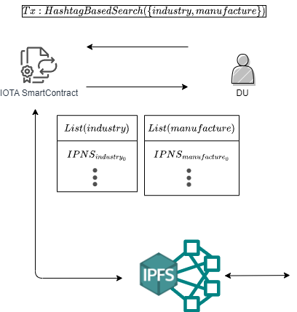
Hashtag-Based Searching
1. Sending Transaction to Trigger SC
4. Returning
Aspect | Farahani et al. (2022) [Farahani22] | Zheng et al. (2020) [Zheng20] | Our System
Access Control Management
Decentralized Data Storage
Data Searching
Reducing Local Storage Overhead
Decentralized Key Management
1-to-Many Encrypted Data Sharing
2. Searching
3. Getting
[Farahani22] Hadi Farahani and Hamid Reza Shahriari. 2022. A Privacy Preserving IoT Data Marketplace Using IOTA Smart Contracts. arXiv preprint arXiv:2210.04733 (2022).
[Zheng20] Xiaochen Zheng, Jinzhi Lu, Shengjing Sun, and Dimitris Kiritsis. 2020. Decentralized industrial IoT data management based on blockchain and IPFS. In Advances in Production Management Systems. Towards Smart and Digital Manufacturing: IFIP WG 5.7 International Conference, APMS 2020, Novi Sad, Serbia, August 30– September 3, 2020, Proceedings, Part II. Springer, 222–229.
Notes:
In Zheng’s System they have already provide a searching mechanism, however there are some limitations and this method is risky. They store the IoT data in IPFS, and then they wrap the CID and the metadata of it into a transaction and send it to the IOTA Tangle. After that DU can search for this transaction by IOTA Tangle explorer, and find out the IoT Data in IPFS with CID. However, IOTA Tangle explorer only has two ways to search for the transactions. First one is to search the transaction by the transaction ID of it. Second one is we can subscribe the knowing peers to follow up their transactions. However, we can observed that in this two ways, we can only find the knowing DO but the DO that potentially have the IoT devices that collecting the data we need. Therefore, their method fail to address the data isolation issue we told above.
Moreover, this method is risky. Because, IOTA Tangle has a mechanism called ”Snapshot”. And it will clean all the zero fee transactions. The CIDs and the metadata of the IoT data in there method will also be wiped out.
In contrast, Our Hashtag-based Searching mechanism doesn’t has such a risk, and also we can address the data isolation issue we told above.

Slide 18
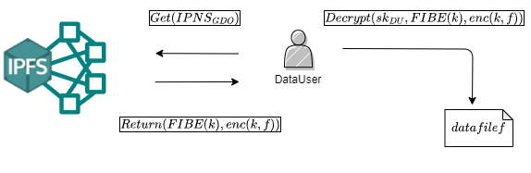
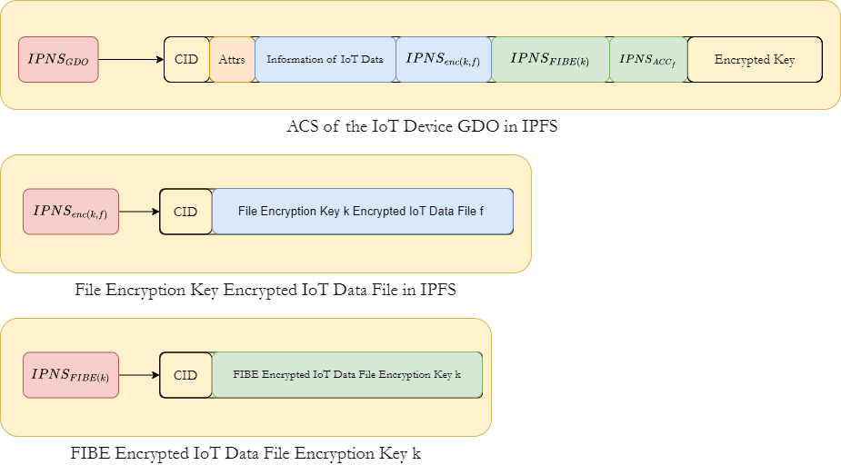
IoT Data Accessing
1. Getting
3. Decrypting
Get
Aspect | Farahani et al. (2022)[Farahani22] | Zheng et al. (2020) [Zheng20] | Our System
Access Control Management
Decentralized Data Storage
Data Searching
Reducing Local Storage Overhead
Decentralized Key Management
1-to-Many Encrypted Data Sharing
2. Returning
Get
[Farahani22] Hadi Farahani and Hamid Reza Shahriari. 2022. A Privacy Preserving IoT Data Marketplace Using IOTA Smart Contracts. arXiv preprint arXiv:2210.04733 (2022).
[Zheng20] Xiaochen Zheng, Jinzhi Lu, Shengjing Sun, and Dimitris Kiritsis. 2020. Decentralized industrial IoT data management based on blockchain and IPFS. In Advances in Production Management Systems. Towards Smart and Digital Manufacturing: IFIP WG 5.7 International Conference, APMS 2020, Novi Sad, Serbia, August 30– September 3, 2020, Proceedings, Part II. Springer, 222–229.
Notes:
In Farahani’s system, as we told above, they only achieve the one-to-one encrypted data-sharing ability in their system. And also as we told above, this will bear a burden on the DOs or their IoT devices.
And in Zheng’s system, they only provide a public mode in their system and didn’t provide a private mode in their system. Therefore, their system doesn’t have any encrypted data-sharing ability.
In contrast, as we told above, we provide the 1-to-Many Encrypted data-sharing ability. So that we can reduce the burden of the DO or their IoT devices.

Slide 19
Outline
Introduction
Preliminaries
Proposed system
Discussions
Conclusions

Slide 20
Security Goals
Data Confidentiality
IoT Data and Permissions Integrity
Authentication
Non-Repudiation
Notes:
This is the Security Goals that we set for our system.

Slide 21
Threat Model
In our threat model, DU may be dishonest.
Unauthorized access to data.
Unauthorized tampering of access control policy or IoT data.
Disputes over data ownership.
Premise: The underlying IOTA and IPFS infrastructure is secure
Notes:
And This is the threat model of our system.
------------------------------------------------------------------------------
Now, let's discuss the threat model and how our system addresses these threats. In our threat model, we take into account the possibility of dishonest Data Users. We have three main threats to consider:
The first threat is unauthorized access to data. To mitigate this, we ensure all private data is encrypted with either Public Key Encryption or Fuzzy Identity-Based Encryption before it is uploaded to the IPFS.
The second threat involves unauthorized tampering with our Access Control Policy or IoT Data. Our solution is to store all Access Control Policies and IoT Data on IPFS, leveraging its content-addressing feature to ensure that neither the Access Control Policy nor the IoT Data can be tampered with without authorization.
Lastly, we face potential disputes over data ownership. To counter this, all files uploaded by Data Owners are referenced using the InterPlanetary Name System, which contains a verifiable node private key signature and a verifiable file modification history. Additionally, although the IOTA Tangle may undergo Snapshots and wipe out 0-fee transactions, all transaction histories remain verifiable, ensuring non-repudiation and authentication.
I want to note that our system's security is based on the premise that the underlying IOTA and IPFS infrastructure is secure.

Slide 22
Countermeasures
Threat 1: Unauthorized access to data.
Encrypt all private data with PKE or FIBE before uploading to IPFS.
Threat 2: Unauthorized tampering of access control policy or IoT data
Store all Access Control Policies and IoT Data on IPFS to prevent unauthorized tampering.
Threat 3: Disputes over data ownership
Use IPNS for all uploaded files, and IOTA Tangle‘s verifiable transaction histories to ensure non-repudiation and authentication.
Notes:
This is the countermeasures to this three threats that we showed in our threat model above.

Slide 23


Comparisons with the Other Works
Aspect | Farahani et al. (2022) [Farahani22] | Zheng et al. (2020) [Zheng20] | Our System
Purpose | Data trading platform | Industrial IoT data management | Enhanced IoT data management and sharing platform
Access Control Management | No | No | Yes
Decentralized Data Storage | local storage | Encrypted in IPFS and Iota | Encrypted in IPFS and On-chain storage
Data Searching | No | Transaction searching based on IOTA Tangle | Enhanced Hashtag-based searching
Decentralized Key Management | No | No | Yes
Local storage and backup burden | High | Very Low | Very Low
Encrypted Data Sharing | One to One | No | One to Many
[Farahani22] Hadi Farahani and Hamid Reza Shahriari. 2022. A Privacy Preserving IoT Data Marketplace Using IOTA Smart Contracts. arXiv preprint arXiv:2210.04733 (2022).
[Zheng20] Xiaochen Zheng, Jinzhi Lu, Shengjing Sun, and Dimitris Kiritsis. 2020. Decentralized industrial IoT data management based on blockchain and IPFS. In Advances in Production Management Systems. Towards Smart and Digital Manufacturing: IFIP WG 5.7 International Conference, APMS 2020, Novi Sad, Serbia, August 30– September 3, 2020, Proceedings, Part II. Springer, 222–229.
Notes:
This is the detail version of the comparison table that we showed above.

Slide 24
Outline
Introduction
Preliminaries
Proposed system
Discussions
Conclusions

Slide 25
Conclusions
We proposed a secure and efficient platform for IoT data sharing.
Our system ensures that all private data remains inaccessible to any unauthorized entities.
We have successfully achieved all the security goals we set for our system.
Contributed to the data security in the IoT field and set implications for other areas requiring secure and efficient data-sharing.
Notes:
In conclusions,…

Slide 26

Thanks for listening!
A Secure and IoT-Enabled Data Sharing System Based on IPFS and IOTA Blockchain
Tse-Yang Huang, Yu-Chi Chen, Tsung-Chen Hsieh, Huan-Chi Chang, Chih-Chieh Chang
Notes:
Thanks for listening!

