Slide 1
BBS: A Blockchain Big-Data Sharing System
Shan Wang, Ming Yang, Tingjian Ge , Yan Luo , Xinwen Fu

Slide 2
Blockchain
Ledger :
world state :
stores the current system state such as the user cryptocurrency balance in Bitcoin.
blockchain :
saves all transaction history(contains operations on the world state and/or the data used to update the world state.)
Smart contract :
controls operations on the world state.
The ledger is synchronized across all blockchain nodes.

Slide 3
Challenges
Challenge 1—storage space limitation
Challenge 2—privacy requirement
Challenge 3—security requirement

Slide 4




Permissioned Blockchain( ) Settings
由organizations 共同建立
In Fabric organization 可以擁有多個users
The peer node set
The user set
所有的organizations共同開發並部屬 來實現各種如big data sharing 等目的。

Slide 5

Off-state
store at blockchain nodes 但不儲存在ledgers上
A smart contract C can directly operate on the off-state for read, write, encryption/decryption and other operations including data sharing.

Slide 6
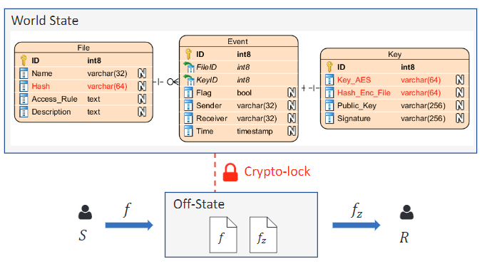

Slide 7
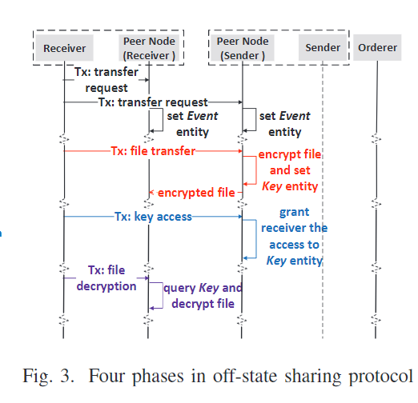
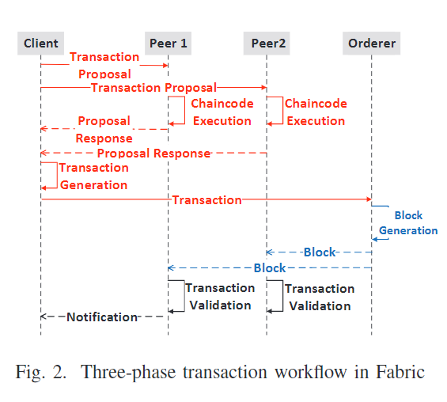

Slide 8
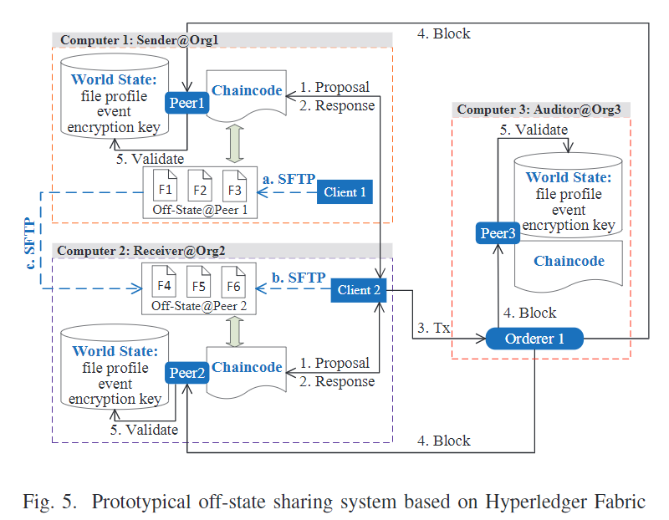

Slide 9
Blockchain off-state sharing
Stage 1, sender S prepares the big data f to be shared.
Stage 2, blockchain system B takes over the whole off-state sharing process

Slide 10
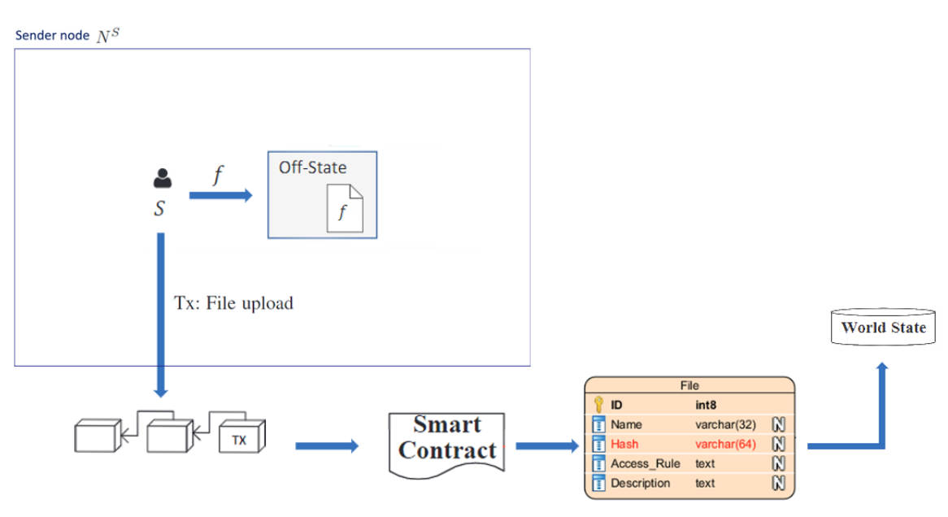
Stage 1: Preparing Off-State Data

Slide 11




Stage 2: Sharing Off-State Data
Phase 1 : File Transfer Request
Phase 2 : Encrypted File Transfer
Phase 3 : Key Retrieval
Phase 4 : File Decryption
User Sender
User Receiver
Sender node
Receiver node
Receiver Organization
Sender Organization
Smart contract
Big data file
Encrypted big data file
Symmetric encryption key

Slide 12
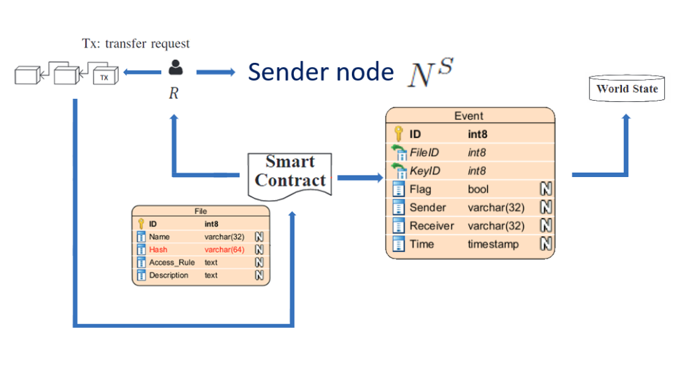
Phase 1: File Transfer Request:

Slide 13
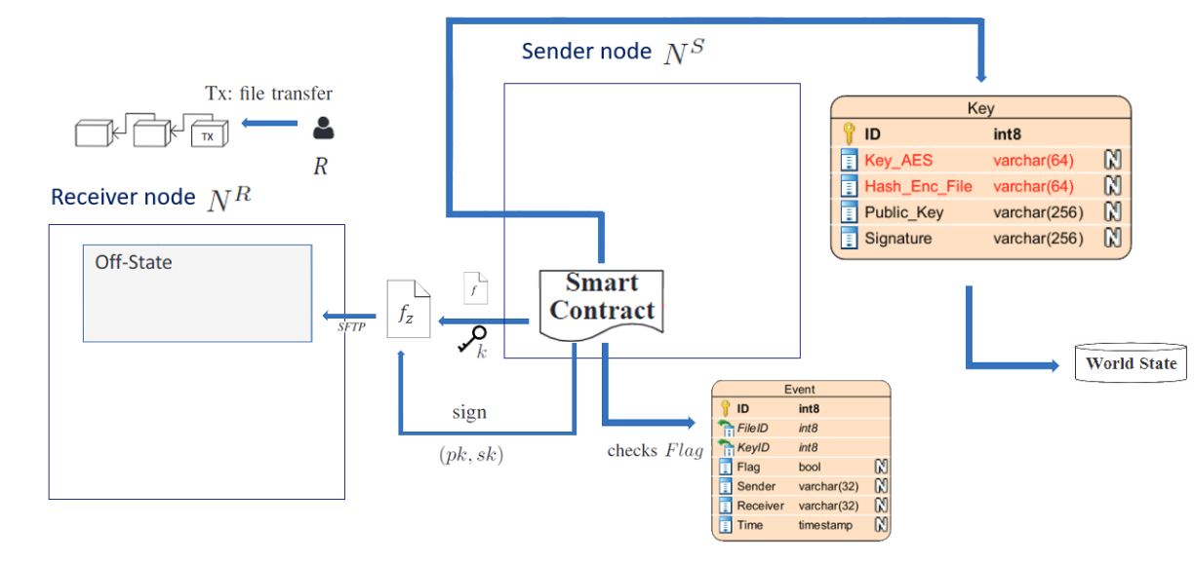
Phase 2: Encrypted File Transfer

Slide 14
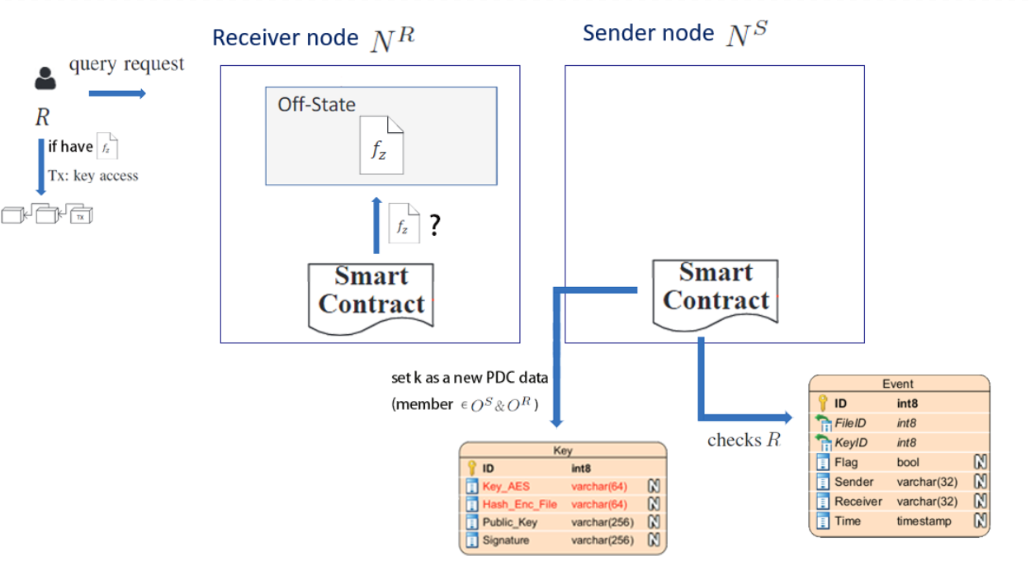
Phase 3: Key Retrieval

Slide 15
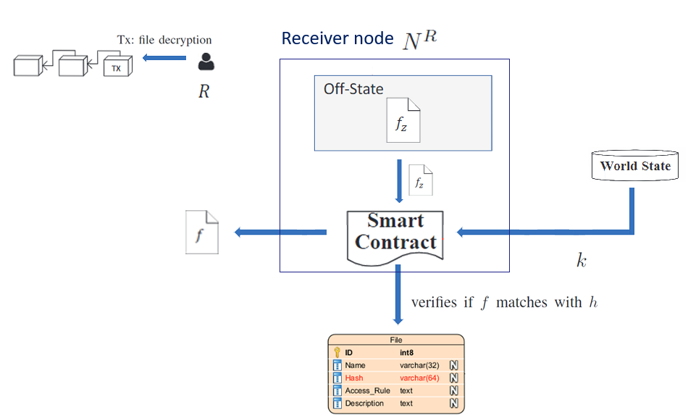
Phase 4: File Decryption

Slide 16
Conclusion
They solve a novel problem how to share sensitive big data within a blockchain system autonomously and with no charge. Such a data sharing application is critical for protecting intellectual property (IP).They also denote data such as a big file stored at a blockchain node but outside of the ledger as off-state. Finally, they implement BBS over Hyperledger Fabric and conduct extensive experiments to evaluate its feasibility and performance.

