Slide 1



Video Moment Retrieval
Interpretability and Failure Analysis
CS585 — Image and Video Computing
Assylkhan Geniyat · Pablo Bello · Jaime Bernal · Zukhriddin Fakhriddinov · Aidan Perez
Boston University

Slide 2
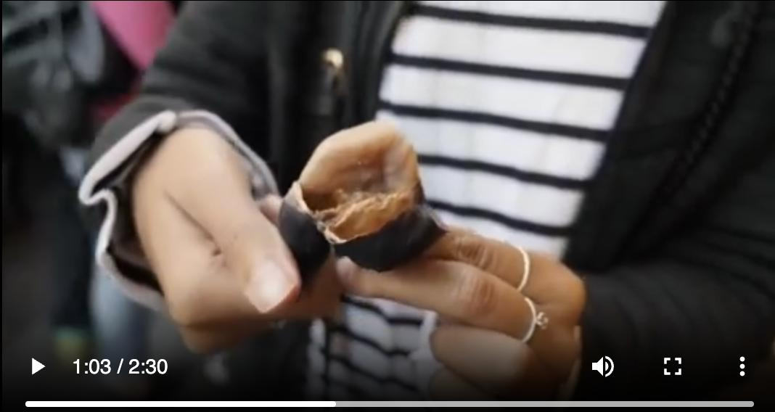
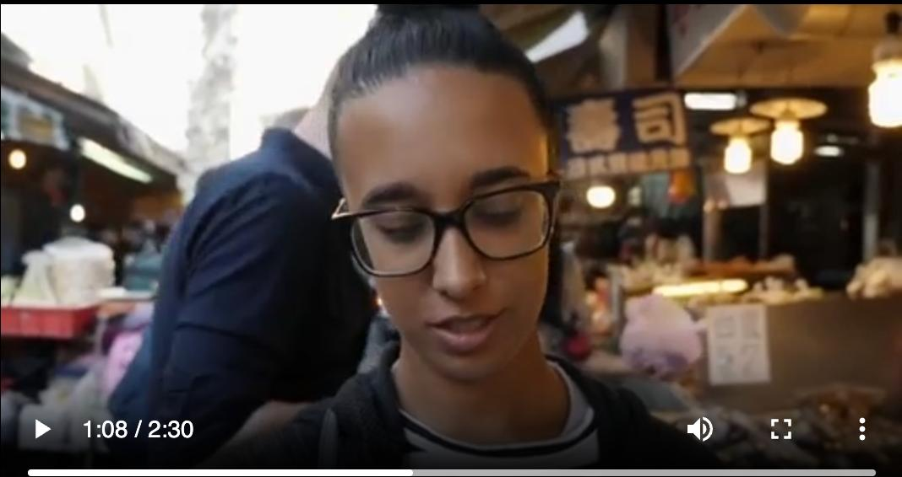
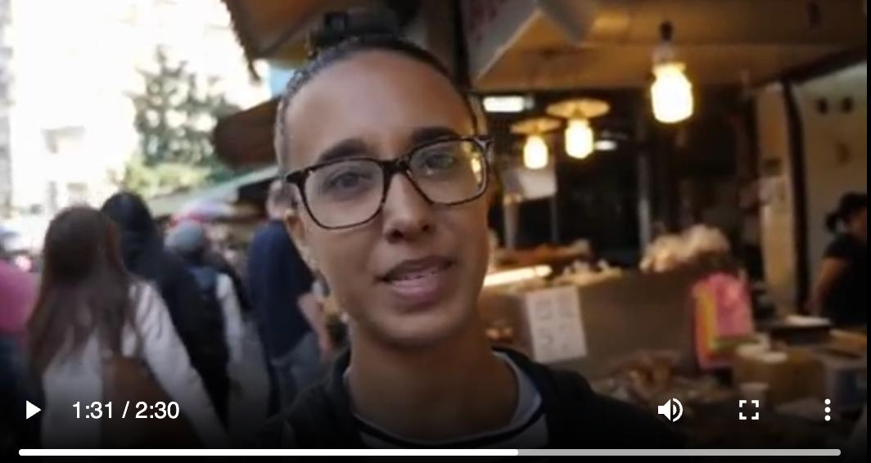
How It Works — A Live Example
QD-DETR retrieves a moment from a 2:30 video given a natural language query.
Query: “A woman wearing a glass is speaking in front of the camera”
Top-1 result: [63.2s — 91.8s] confidence 0.9837
1:03 · start of window
1:08 · inside window
1:31 · end of window
0s
retrieved window
2:30 (150s)
CS585 · Image and Video Computing · Boston University
2 / 21

Slide 3
What is Video Moment Retrieval?
0s
[34.2s, 41.7s]
150s
Query: “the person adds salt to the pan”
Given An untrimmed video + a natural language query
Task Predict [start, end] time of the matching segment
Requires Visual + language understanding + cross-modal alignment
CS585 · Image and Video Computing · Boston University
3 / 21

Slide 4
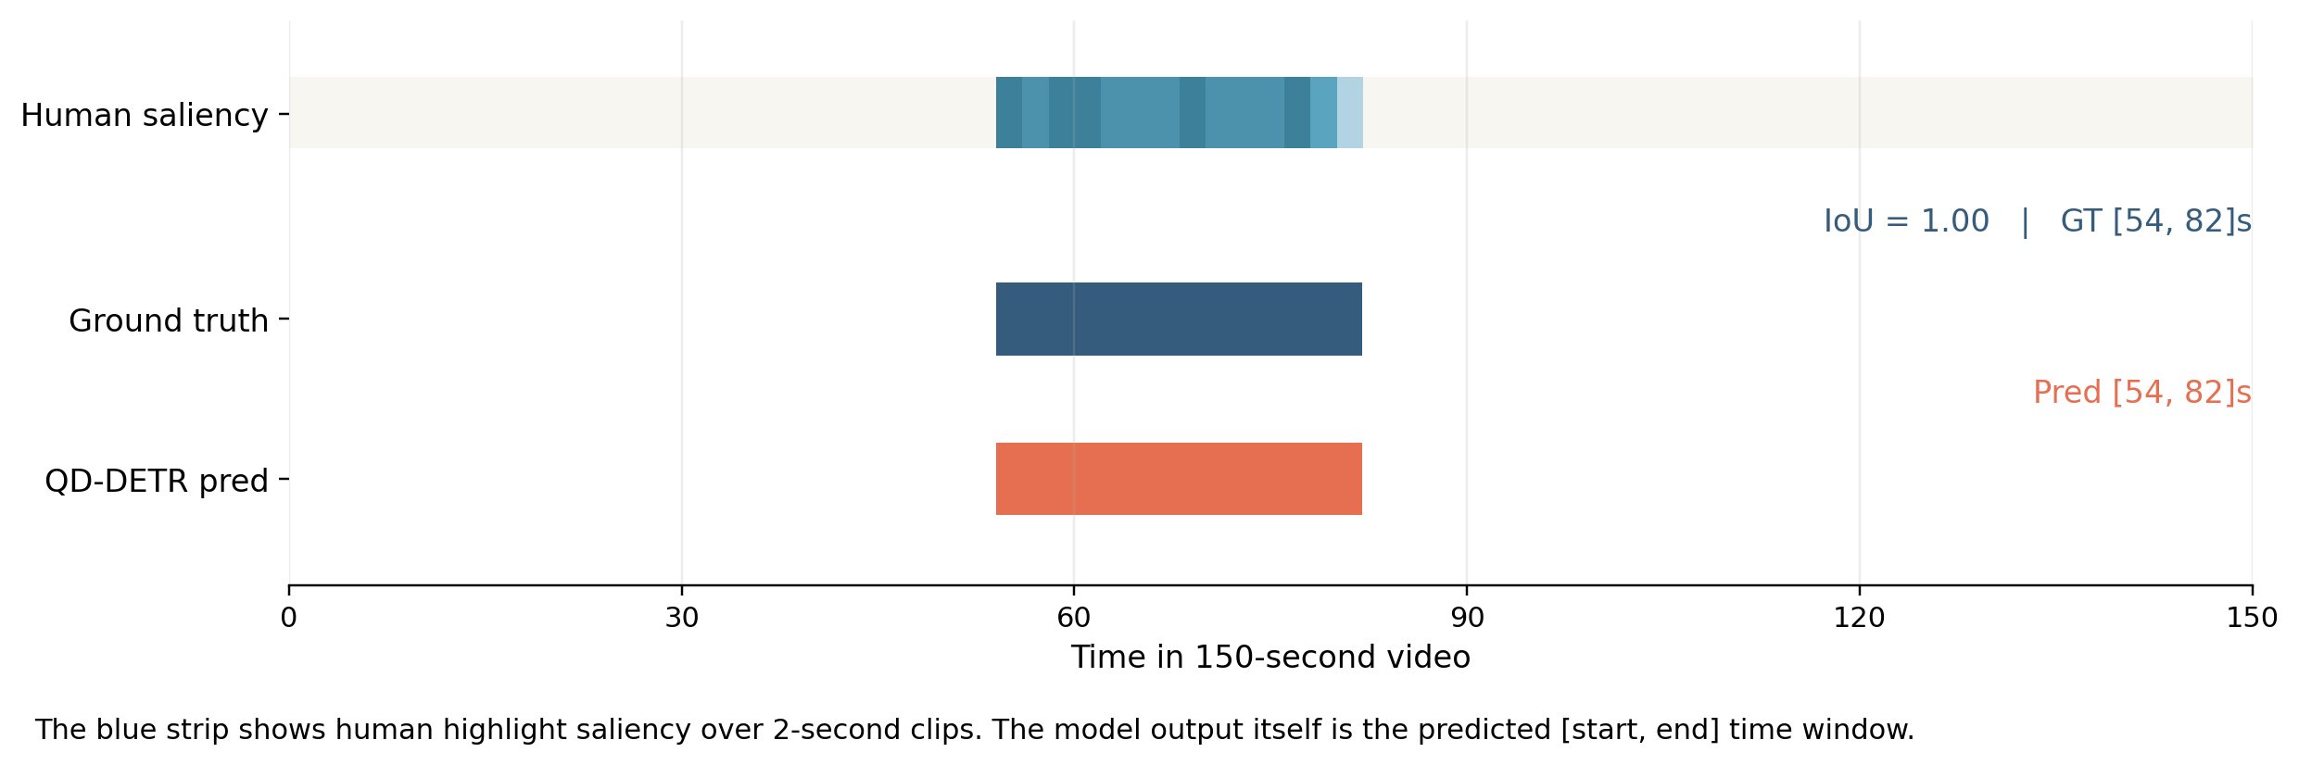
What the Model Actually Outputs
A query-conditioned prediction is a start/end time window over the full video, not a class label.
Saved QD-DETR Validation Examples
Example query: “Man talks to the camera under candlelight.”
This gives the audience the exact mental model: the system reads a query and returns a time window over the video timeline.
CS585 · Image and Video Computing · Boston University
4 / 21

Slide 5


Dataset & Experimental Setup
Dataset
Experimental Setup
QVHighlights benchmark
(Lei et al., 2021)
10,000+ queries
150-second videos
Moment retrieval + highlight detection
Pre-extracted features:
CLIP + SlowFast (visual)
CLIP (text)
PANN (audio)
Training Infrastructure
BU SCC cluster (GPU: L40S/A100)
HDF5-packed features for I/O
Framework
Lighthouse (Nishimura et al., 2024)
Three DETR-style baselines
Evaluation Metrics
Recall@1 at IoU 0.5 / 0.7
mAP, Highlight mAP (Fair/Good)
CS585 · Image and Video Computing · Boston University
5 / 21

Slide 6
Three DETR-Style Baselines
Moment-DETR
QD-DETR
CG-DETR
Lei et al., 2021
Moon et al., 2023
Moon et al., 2023
Set-prediction via Transformer encoder-decoder. Query-agnostic video features.
Conditions video representations on the query. Better discrimination for similar events.
Calibrates word-to-moment relevance. Strongest fine-grained alignment.
Increasing query awareness →
CS585 · Image and Video Computing · Boston University
6 / 21

Slide 7
Baseline Performance on QVHighlights
Model | R1@0.5 | R1@0.7 | mAP | HL-Fair | HL-Good
Moment-DETR | 54.06 | 36.52 | 32.80 | 68.18 | 58.29
QD-DETR | 62.06 | 45.48 | 40.56 | 74.14 | 63.30
CG-DETR | 62.84 | 46.84 | 42.00 | 76.05 | 64.88
QD-DETR jumps +8 R1@0.5 points over Moment-DETR through query-dependent representations.
CG-DETR is slightly strongest overall with calibrated grounding.
CS585 · Image and Video Computing · Boston University
7 / 21

Slide 8
Our Three Analysis Directions
Temporal Bias Analysis
1
Do models just predict “near the center”? How does performance vary by moment length and position?
Verb vs. Noun Sensitivity
2
Does the model rely on action words or object words for grounding? Which part of speech drives retrieval?
Head Ablation (Mechanistic)
3
Are there specific attention heads responsible for boundary prediction? Is temporal grounding localized or distributed?
CS585 · Image and Video Computing · Boston University
8 / 21

Slide 9
Temporal Bias Analysis
Bias Baselines: Models Do Real Work
Short Moments Are the Main Failure
Method | R1@0.5
Random guess | 8.89
Center of video | 8.65
Train distribution | 8.26
QD-DETR | 62.06
Length | R1@0.5 | Mean pred
Short (<10s) | 50.00 | 32.0s
Medium (10-30s) | 64.68 | 30.0s
Long (30-150s) | 62.98 | 56.9s
7x above trivial baselines
Mild center bias: pred center 0.49 vs GT 0.43
Models predict 32s for 4.6s actual moments!
Center bias does not explain performance — short-moment over-prediction is the dominant failure mode
CS585 · Image and Video Computing · Boston University
9 / 21

Slide 10
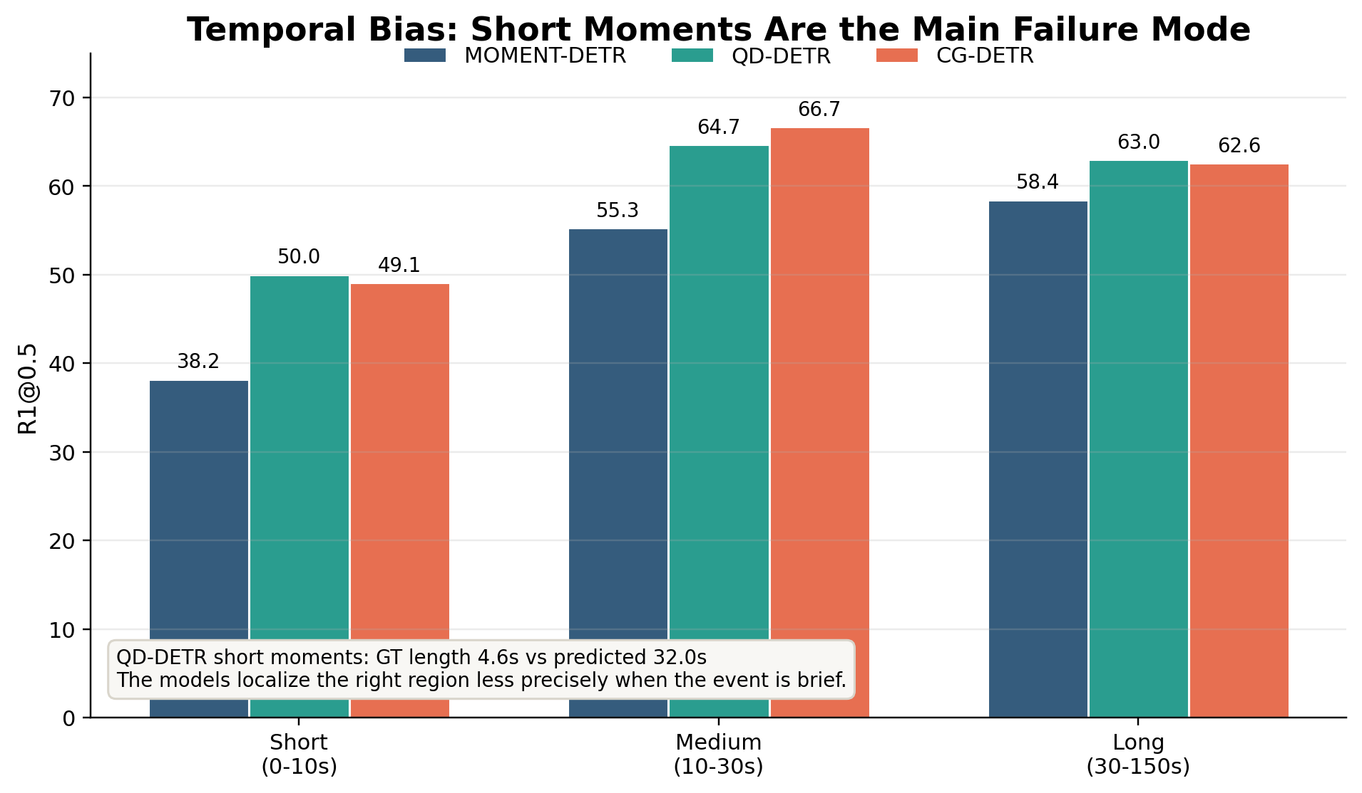
Temporal Bias — Result Summary
All three models are well above bias-only baselines, but they systematically over-predict short moments.
Key message: the models are far above bias-only baselines, but they systematically over-predict short moments.
CS585 · Image and Video Computing · Boston University
10 / 21

Slide 11
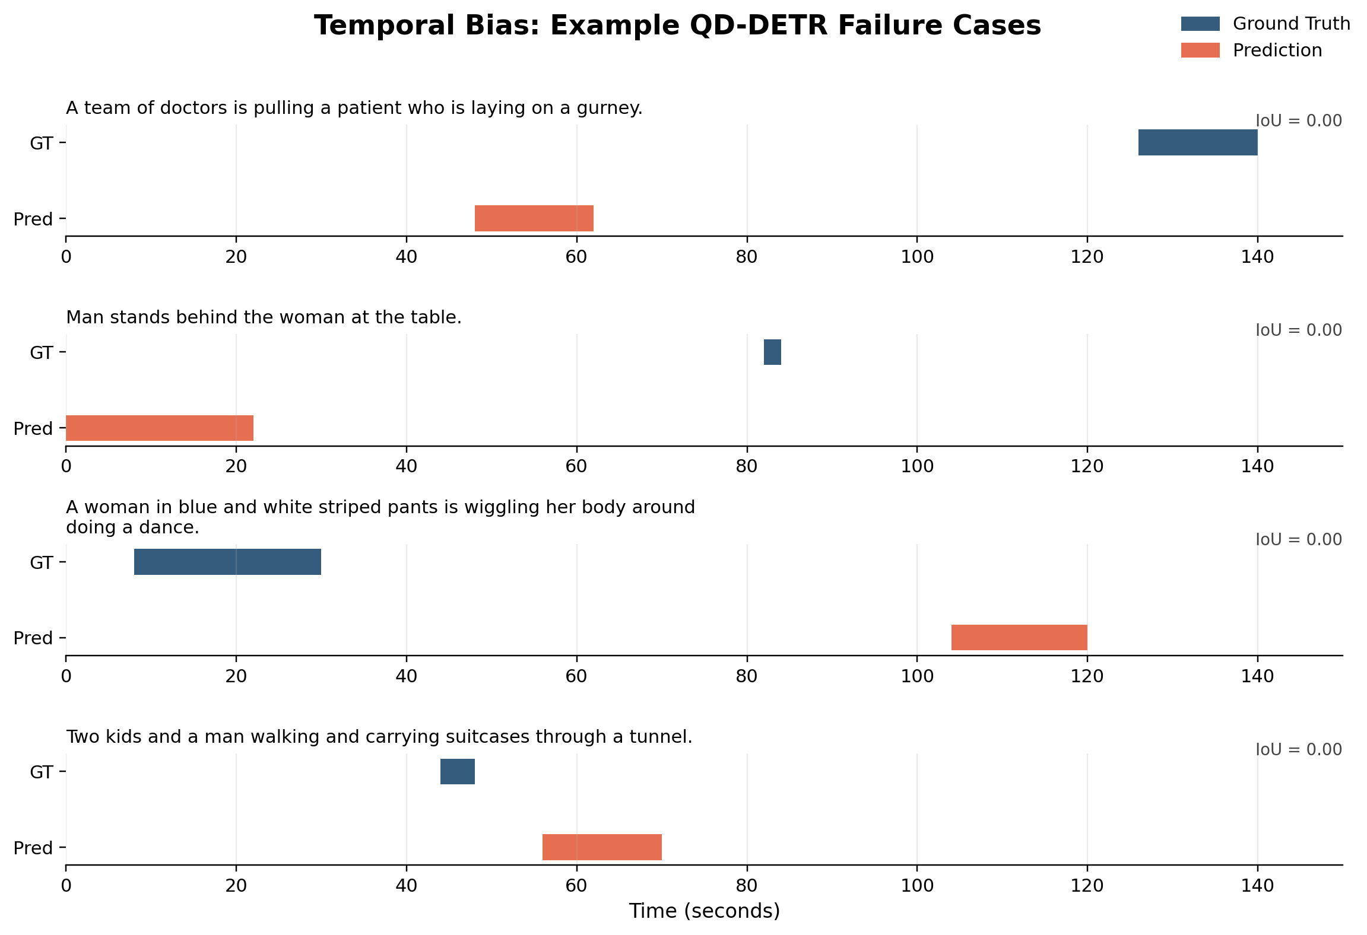
Temporal Bias — Example Failure Cases
Predicted windows drift too early or too wide, especially when the ground-truth moment is short.
These cases are useful live because the audience can literally see the predicted window drifting too early or too wide.
CS585 · Image and Video Computing · Boston University
11 / 21

Slide 12
Verb vs. Noun Sensitivity Ablation
Ablation Pipeline
1
Use spaCy to POS-tag all queries — identify verbs and nouns
2
Use CLIP tokenizer to align words to subword token positions
3
Zero out verb (or noun) token features in CLIP text hidden states
4
Re-run QD-DETR evaluation with masked features
5
Compare R1@0.5 drop: which POS category matters more?
Per query average:
Total tokens zeroed:
1.33 verbs | 3.75 nouns
12,405 verb | 39,548 noun tokens
CS585 · Image and Video Computing · Boston University
12 / 21

Slide 13
Nouns Matter 2.6x More Than Verbs
Condition | R1@0.5 | R1@0.7 | mAP | Drop R1@0.5
Original | 61.29 | 44.19 | 39.93 | —
Verb-masked | 60.39 | 44.13 | 39.14 | -0.90
Noun-masked | 58.97 | 42.90 | 37.91 | -2.32
2.6x
Interpretation
QD-DETR grounds moments primarily by entity/object mentions, not action semantics. This reveals a vulnerability for action-heavy queries.
more impact from nouns vs verbs
CS585 · Image and Video Computing · Boston University
13 / 21

Slide 14
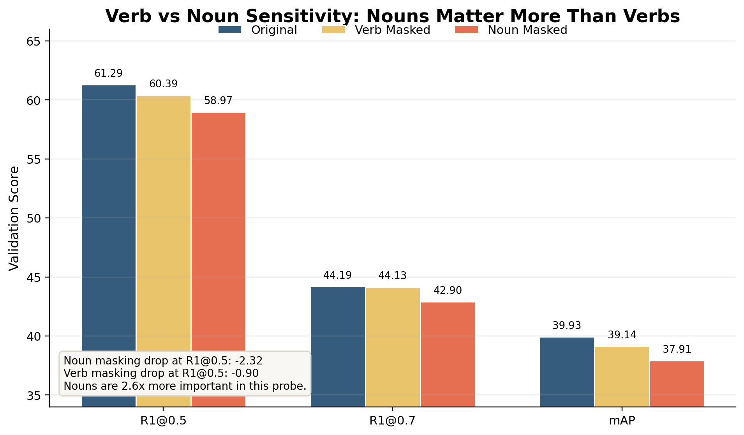
Verb vs. Noun — Ablation Result
Masking noun tokens hurts retrieval more than masking verb tokens, across every metric.
Key message: masking noun tokens hurts retrieval more than masking verb tokens, suggesting stronger reliance on object/entity cues.
CS585 · Image and Video Computing · Boston University
14 / 21

Slide 15
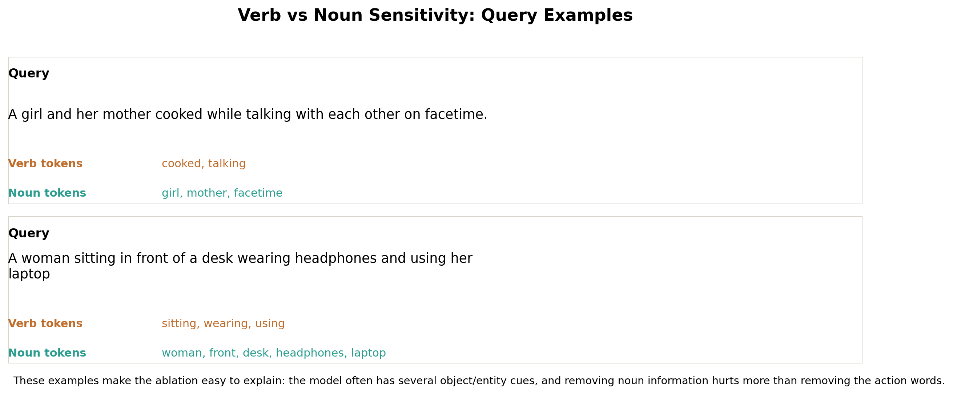
Verb vs. Noun — Tagged Query Examples
Concrete examples of what was masked in the CLIP text representation.
The query examples help explain what exactly was removed from the CLIP text representation.
CS585 · Image and Video Computing · Boston University
15 / 21

Slide 16
Head Ablation: Mechanistic Interpretability
Architecture
Most Impactful Heads
4 attention modules
2 text-to-video encoder layers
2 main encoder layers
8 heads each = 32 total heads
Head | Delta R1@0.5
encoder.layer0.head3 | -0.77
t2v_encoder.layer1.head2 | -0.39
encoder.layer0.head1 | -0.32
Method: Zero each head individually, measure R1@0.5 change
Key Finding
Largest single-head drop: only -0.77 points (baseline R1@0.5 = 61.29)
Boundary prediction is distributed across all heads — a distributed emergent property of the whole transformer, not localized in specific components. Early encoder layers (layer 0) are most sensitive.
CS585 · Image and Video Computing · Boston University
16 / 21

Slide 17
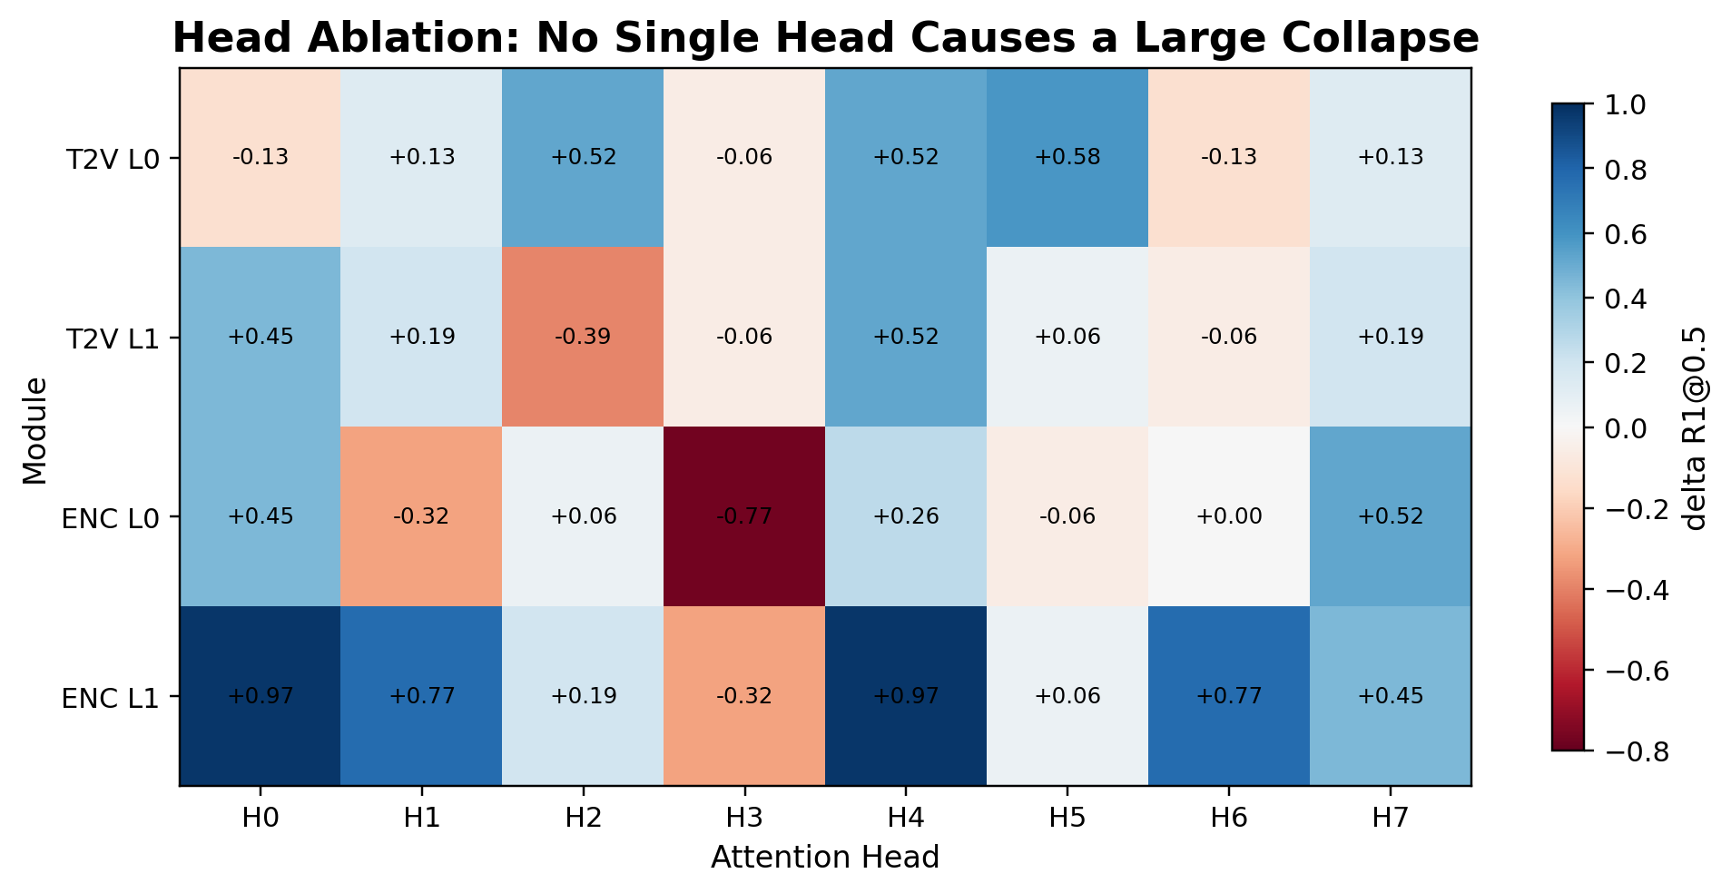
Head Ablation — All 32 Heads at a Glance
No single head dominates: the heatmap shows a distributed pattern across layers and modules.
Key message: there is no dramatic single-head failure. Boundary prediction is distributed across the transformer.
CS585 · Image and Video Computing · Boston University
17 / 21

Slide 18
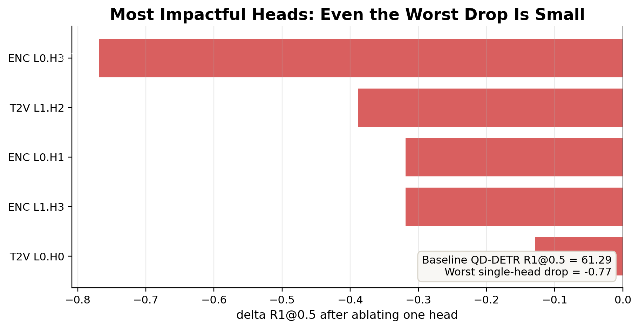
Head Ablation — Top Harmful Heads
Even the most impactful single-head removal barely dents overall accuracy.
Worst drop: only -0.77 R1@0.5
CS585 · Image and Video Computing · Boston University
18 / 21

Slide 19
Summary of Findings
1
QD-DETR and CG-DETR significantly outperform Moment-DETR (+8-9 R1@0.5 points)
2
Dominant failure mode: short moments (<10s), where R1@0.5 drops 13-15 points
3
Object nouns are 2.6x more important than action verbs for moment retrieval
4
No specialized boundary heads — temporal grounding is a distributed emergent property
5
Improving short-moment handling and action semantics are the most promising directions
CS585 · Image and Video Computing · Boston University
19 / 21

Slide 20
Next Steps
Multi-head ablation Test combinations of heads, not just individual ones
→
Activation patching Trace information flow to identify causal components
→
Short-moment augmentation Training strategies to improve short-moment retrieval
→
Cross-dataset analysis Test whether these biases differ on Charades-STA
→
Stronger verb representations Use action-specialized video-language models
→
CS585 · Image and Video Computing · Boston University
20 / 21

Slide 21
References
[1] Lei et al. (2021). QVHighlights: Detecting moments and highlights in videos via natural language queries. NeurIPS.
[2] Moon et al. (2023a). CG-DETR: Fine-grained moment retrieval with calibrated cross-modal grounding. arXiv.
[3] Moon et al. (2023b). QD-DETR: Query-dependent video representation for moment retrieval and highlight detection. CVPR.
[4] Nishimura et al. (2024). Lighthouse: A user-friendly library for reproducible video moment retrieval and highlight detection. EMNLP Demos.
[5] Li et al. (2023). A closer look at debiased temporal sentence grounding. IEEE TMM.
CS585 · Image and Video Computing · Boston University
21 / 21

