Slide 1
Portfolio Optimization: Deep Reinforcement Learning vs. Classical Methods
S&P Global-KASIT-UNIST-Kyung Hee University Quant Investment Model Competition
Tsoy Roman, Nguyen Minh Duc, Almas Dossay, Kim Artem

Slide 2
Introduction
Related Work
Methodology
Classical Methods
Deep Reinforcement Learning
Implementation
Evaluation and Results
Conclusion

Slide 3
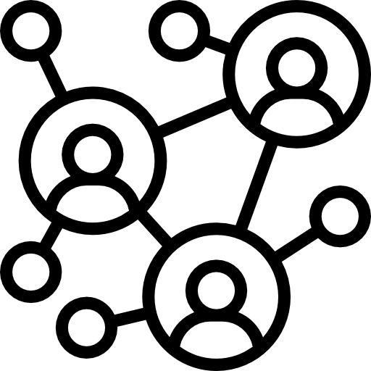




Introduction
Graph data are applied in a wide range of domains
Graph visualization has seen extensive study, particularly in data journalism due to social media growth.
Deriving graph data facts demands analysis skills and domain knowledge, posing challenges even for experienced analysts.
Calliope-Net is an automated framework for creating annotated visualizations from graph data facts.
Fact discovery module
Fact organization module
Visualization module

Slide 4
Related Work
1
Classic methods of optimization
Notes:
The cost of a derivation is simply the number of rules (in the derivation) that are not included in R𝑚𝑎𝑦. Note that cost(𝑑, R𝑚𝑎𝑦) = 0 iff every production used in 𝑑 lies in R𝑚𝑎𝑦.

Slide 5




Related Work
2
Deep Reinforcement Learning for Portfolio Optimization
Liu et al. (NerIPS 2018)
Propose the use of Actor-Critic Network for trading
Yang et al. (ICAI 2020)
Introduce a novel Ensemble Strategy for trading
Briola et al. (2021)
Propose DRL framework for high-frequency trading
Excellent tools for various trading tasks
FinRL-Meta (NerIPS 2022)
Multiprocessing simulation and training
Notes:
The cost of a derivation is simply the number of rules (in the derivation) that are not included in R𝑚𝑎𝑦. Note that cost(𝑑, R𝑚𝑎𝑦) = 0 iff every production used in 𝑑 lies in R𝑚𝑎𝑦.

Slide 6
Methodology – Classical Methods
1
Mean-Variance Optimization

Slide 7
Methodology – Classical Methods
2
Mean-Semivariance Optimization

Slide 8
Methodology – Classical Methods
3
Black-Litterman Allocation

Slide 9
Methodology – Classical Methods
4
Hierarchical Risk Parity

Slide 10


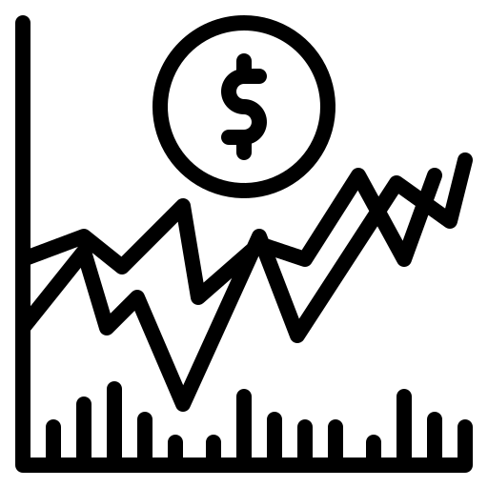
Methodology - Deep Reinforcement Learning
1
Problem Formulation
Stock Trading Environment
Random
Stochastic Optimal Control
(Markov Decision Process)
Interactive

Slide 11




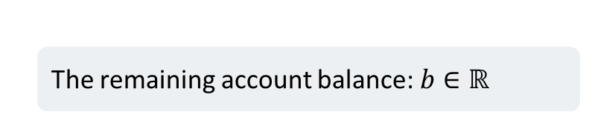
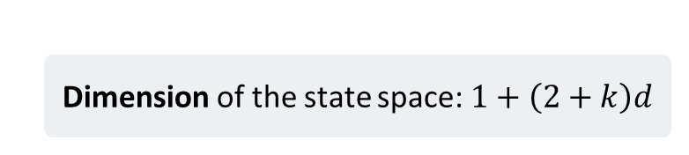
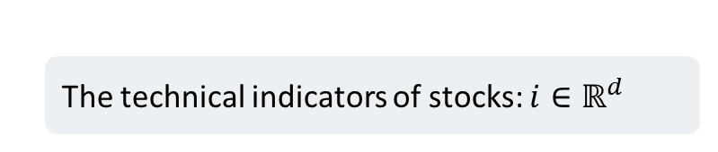
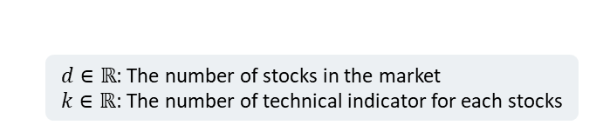
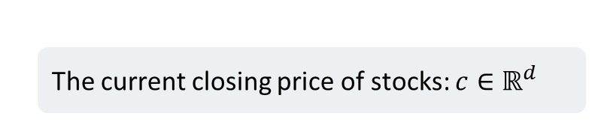
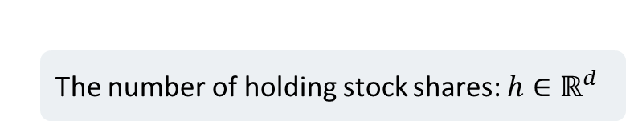
Methodology - Deep Reinforcement Learning
1
Problem Formulation
$d∈ℝ$: The number of stocks in the market
$k∈ℝ$: The number of technical indicator for each stocks
The remaining account balance: $b∈ℝ$
The number of holding stock shares: $h∈ℝ^{d}$
State Space
The current closing price of stocks: $c∈ℝ^{d}$
The technical indicators of stocks: $i∈ℝ^{d}$
Dimension of the state space: $1+\left(2+k\right)d$

Slide 12



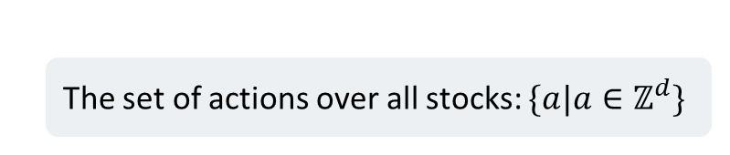


Methodology - Deep Reinforcement Learning
1
Problem Formulation
Control (action) space
The set of actions over all stocks: $\{a|a∈ℤ^{d}\}$
Sell
Hold
Buy
Selling $q$ stocks
$$\left\{\begin{aligned}h_{t+1}=h_{t}−q \\ b_{t+1}=b_{t}+c_{t}^{T}q\end{aligned}\right.$$
Note that $q≤h$
There is no change in the agent’s positions
Selling $q′$ stocks
Denote $q=−q′$
$$\left\{\begin{aligned}h_{t+1}=h_{t}−q \\ b_{t+1}=b_{t}+c_{t}^{T}q\end{aligned}\right.$$
Note that${−c}_{t}^{T}q≤b_{t}$

Slide 13
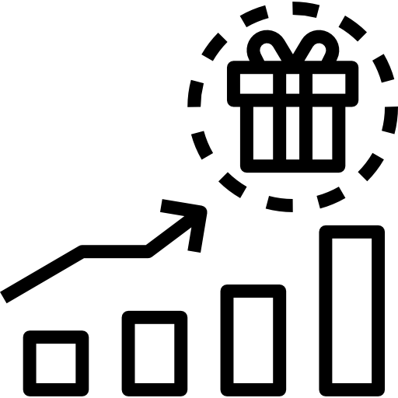
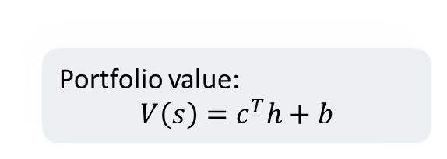
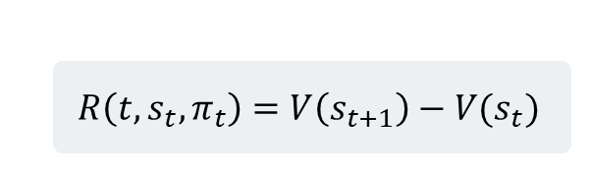
Methodology - Deep Reinforcement Learning
1
Problem Formulation
Reward Function
Portfolio value:
$$V\left(s\right)=c^{T}h+b$$
The change in portfolio value
$$R\left(t, s_{t},π_{t}\right)=V\left(s_{t+1}\right)−V(s_{t})$$

Slide 14
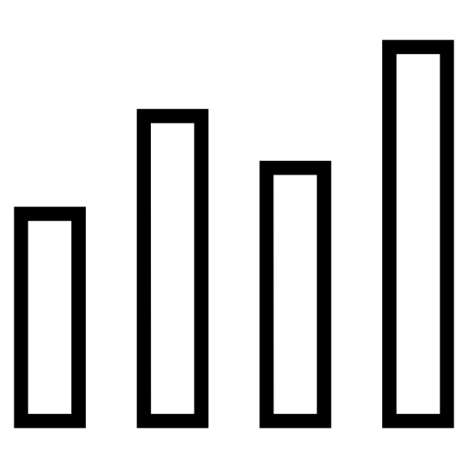
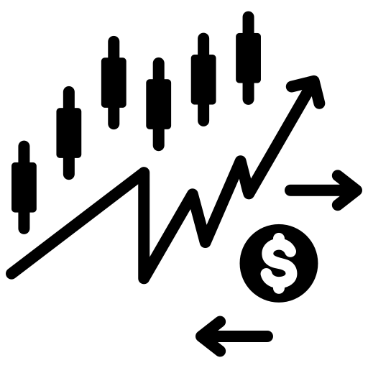
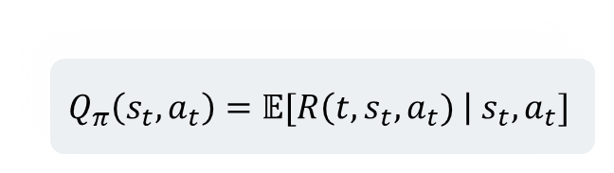
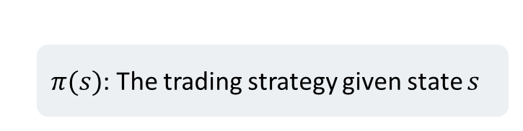
Methodology - Deep Reinforcement Learning
1
Problem Formulation
Action-Value function
Policy
$$Q_{π}\left(s_{t},a_{t}\right)=𝔼[R\left(t,s_{t},a_{t}) \right| s_{t},a_{t}]$$
$π(s)$: The trading strategy given state $s$

Slide 15

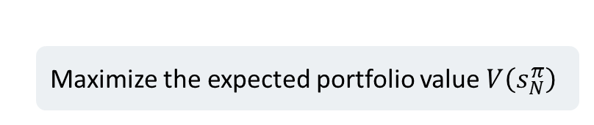
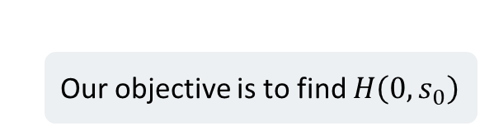
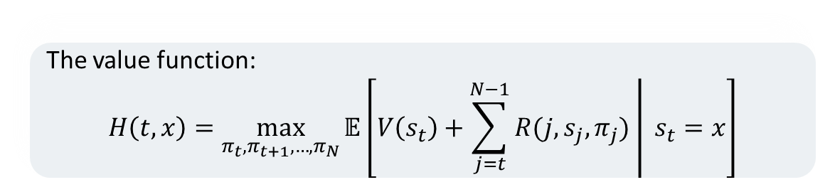
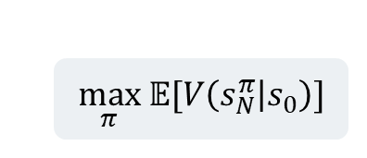
Methodology - Deep Reinforcement Learning
1
Problem Formulation
Trading Goal
Maximize the expected portfolio value $V\left(s_{N}^{π}\right)$
$$\max_{π} 𝔼[V\left(s_{N}^{π} | s_{0}\right)]$$
The value function:
$$H\left(t,x\right)=\max_{π_{t},π_{t+1},…,π_{N}}{𝔼\left[V\left(s_{t}\right)+\left.\sum_{j=t}^{N−1}{R(j,s_{j},π_{j})} \right| s_{t}=x\right]}$$
Our objective is to find $H\left(0,s_{0}\right)$

Slide 16
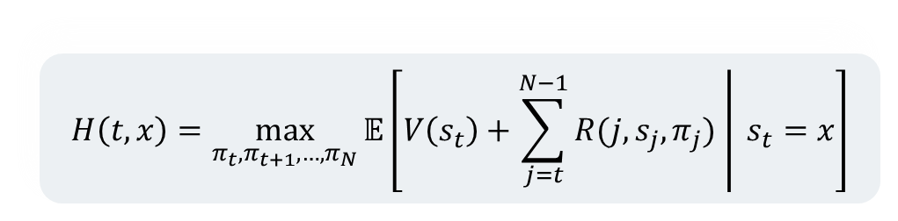
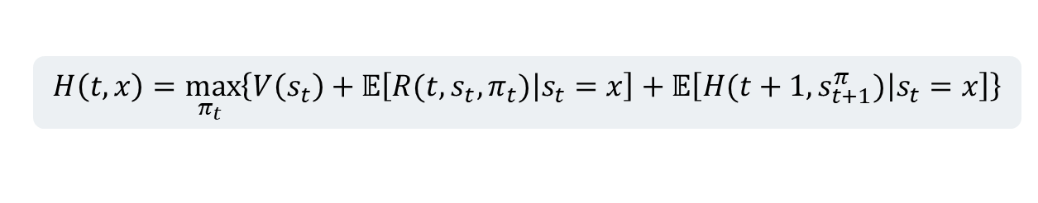
Methodology - Deep Reinforcement Learning
1
Problem Formulation
$$H\left(t,x\right)=\max_{π_{t},π_{t+1},…,π_{N}}{𝔼\left[V\left(s_{t}\right)+\left.\sum_{j=t}^{N−1}{R(j,s_{j},π_{j})} \right| s_{t}=x\right]}$$
How can we solve this optimization problem?
Dynamic Programming?
Dynamic Programming Principle:
$$H\left(t,x\right)=\max_{π_{t} }\left\{V\left(s_{t}\right)+𝔼\left[\left.R(t,s_{t},π_{t})\right|s_{t}=x\right]+𝔼\left[\left.H(t+1,s_{t+1}^{π})\right|s_{t}=x\right]\right\}$$
Very difficult!

Slide 17


Methodology - Deep Reinforcement Learning
2
Actor Critic Method
We utilize the Reinforcement Learning technique to solve the optimization problem
Good performance
Actor-Critic method is popular among RL algorithms
Reduce variance

Slide 18
Methodology - Deep Reinforcement Learning
2
Actor Critic Method
Actor (policy network)
Control how the agent behaves
The algorithm consists of two parts
Critic (value network)
Measure how good the action is
action
Actor network
Critic network
s
Q-value

Slide 19
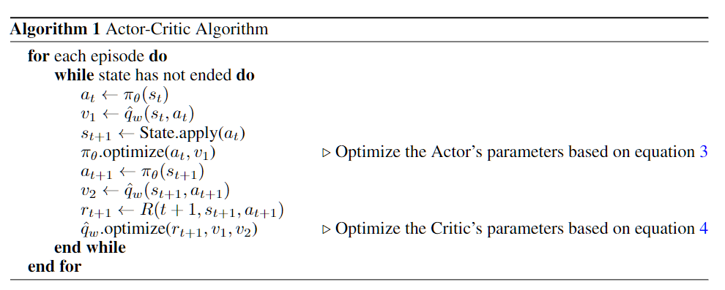
Methodology - Deep Reinforcement Learning
2
Actor Critic Method
Actor network
action
Critic network
s
Q-value

Slide 20
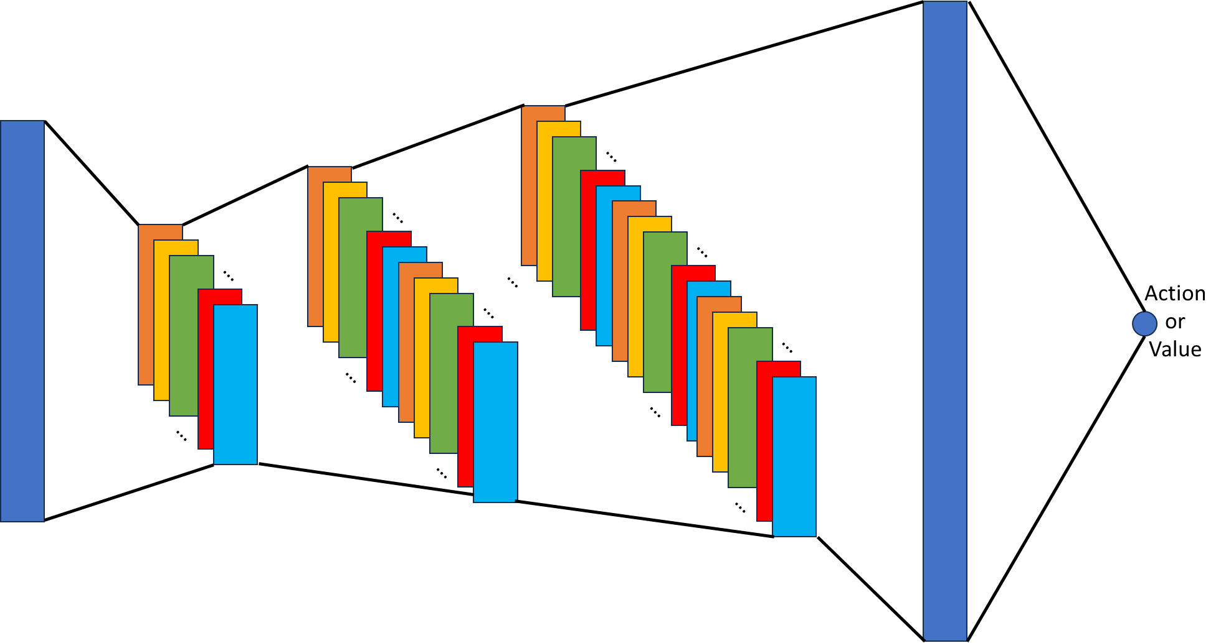
Methodology - Deep Reinforcement Learning
2
Actor Critic Method
The Actor and the Critic shares the same network architecture
We employ three 1D CNN layers and one linear layer to produce the action/value
CNN layers
Linear layer

Slide 21
Implementation
1
Mean-Variance Optimization
Notes:
For example, many data-driven news articles explore neighboring nodes of a single node

Slide 22
Implementation
2
Mean-Semivariance Optimization
Notes:
For example, many data-driven news articles explore neighboring nodes of a single node

Slide 23
Implementation
3
Black-Litterman Allocation
Notes:
For example, many data-driven news articles explore neighboring nodes of a single node

Slide 24
Implementation
4
Hierarchical Risk Parity
Notes:
For example, many data-driven news articles explore neighboring nodes of a single node

Slide 25


Implementation
5
Deep Reinforcement Learning
We utilize FinRL library to implement both the environment and the networks
Moving Average Convergence Divergence
Bollinger Bands
Relative Strength Index
Technical Indicators
Commodity Channel Index
Directional Movement Index
Close Smooth Moving Average
Notes:
For example, many data-driven news articles explore neighboring nodes of a single node

Slide 26
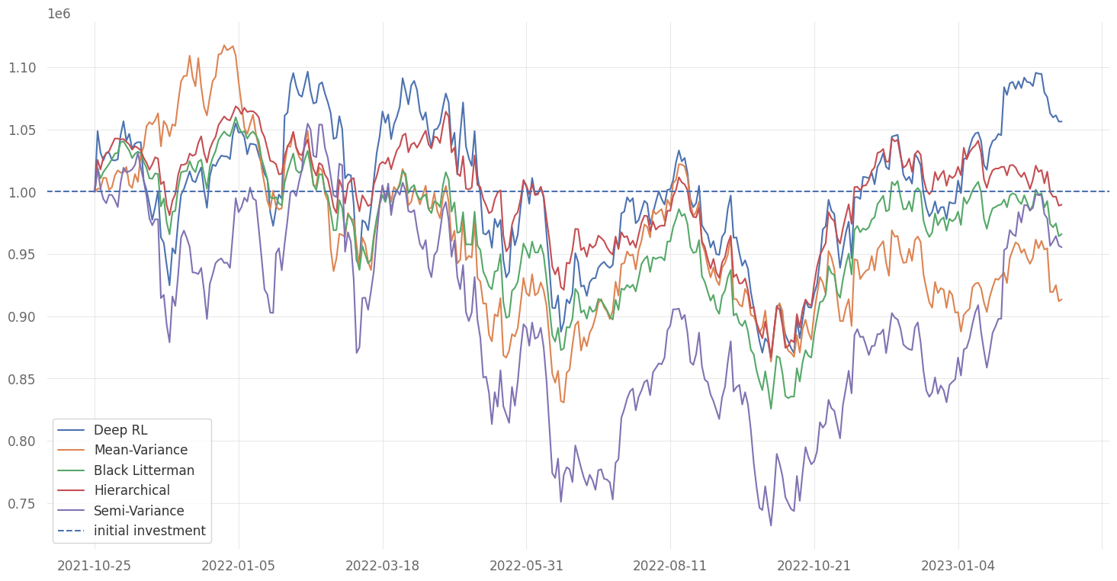
Evaluation
Investment Returns of five methods

Slide 27
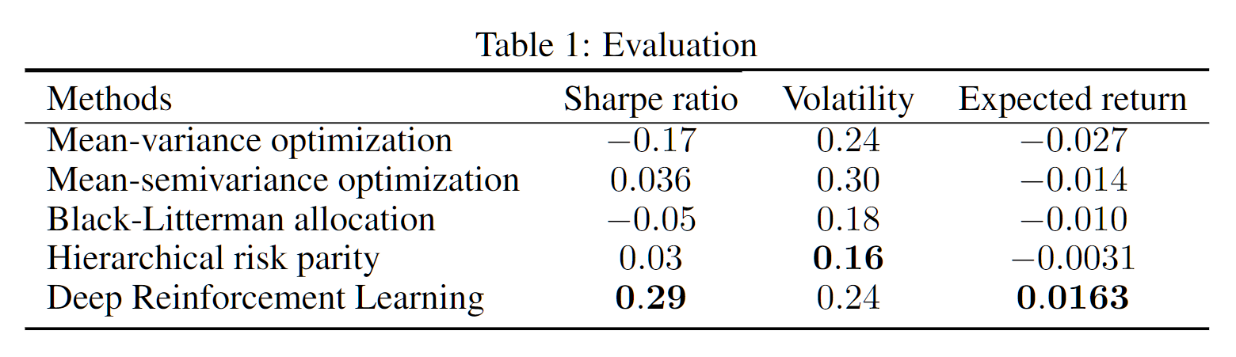
Evaluation

Slide 28
Conclusion
Deep Reinforcement Learning (DRL) outperforms classical methods.
Advanced classical techniques can be competitive with DRL in specific metrics.
Classical methods demonstrate strong performance in short-term periods.
DRL gains an advantage as the trading period becomes longer.
The strategy and method depends on the trader's objectives, trading period, and personal goals.
Notes:
For example, many data-driven news articles explore neighboring nodes of a single node

