Slide 1
Title Generation For Multilingual Session-Based
Recommendation Systems: Project Proposal
20202026 - Minh Duc Nguyen
20202027 - Thu Phuong Nguyen

Slide 2
Contents
01
03
Introduction
Dataset and Evaluation
02
04
Related Work
Project Plan

Slide 3
Introduction
E-commerce Platforms
Gradually expanded its popularity and slowly taken over traditional shopping
User Experience
Being constantly improved with advanced recommendation systems
Multilingual Problem
Few studies on session-based recommendations with multilingual scenarios
Engaging Title Generation
Personalize recommendations and advertisements

Slide 4
1. Introduction
Framework
EDA
Empirical study
A deep learning framework using Large Language Models to generate engaging product titles
Multilingual Shopping Session Dataset
Performance of different Large Language Models
Contributions

Slide 5
2. Related Work
Neural Collaborative Filtering
Gated Recurrent Units
Transformer
architectures
Literature Survey
Long Short Term Memory
Autoencoders with LSTM
Bidirectional RNN & Transfer Learning

Slide 6
2. Related Work
Keywords Generation
Product Names Generation
(Liu et al.)
(Bai et al.)
Use GRU to obtain product embeddings
Fine-tuned OpenNMT for keywords generation
Achieved state-of-the-art accuracy
The first to use generative approach
Concatenate title, Google Product Taxonomy, and ground truth as training data
Sequence to sequence objective
Outperform baseline models

Slide 7
2. Related Works
mGPT
Reproduced the GPT-3
architecture using GPT-2 source
Multilingual BERT
Variation of BERT that is multilingual
GPT & BERT
LLaMA
The first generation of Large Language Model
similar performance to GPT-3 but 10x smaller and faster
BLOOM
Open-source LLM with similar sizes and performance to
GPT-3

Slide 8
3. Dataset and Evaluation
Dataset
Evaluation Metrics
Multilingual Shopping Session Dataset
(Amazon)
Bilingual Evaluation Understudy (BLEU)

Slide 9
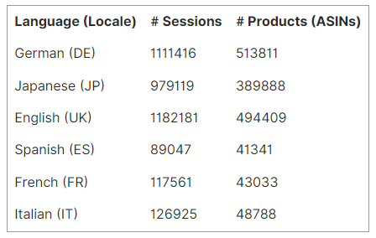
3.1 Dataset
Users session
Labeled data
Product Attributes
~ 1.55 million products
Figure 1: Dataset statistics

Slide 10
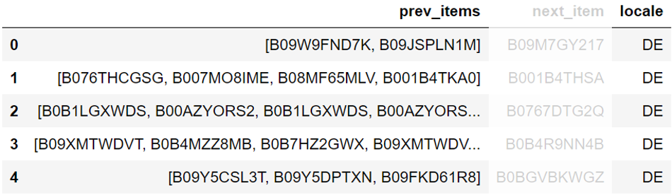
3.1 Dataset
Figure 2: Users session in the dataset

Slide 11
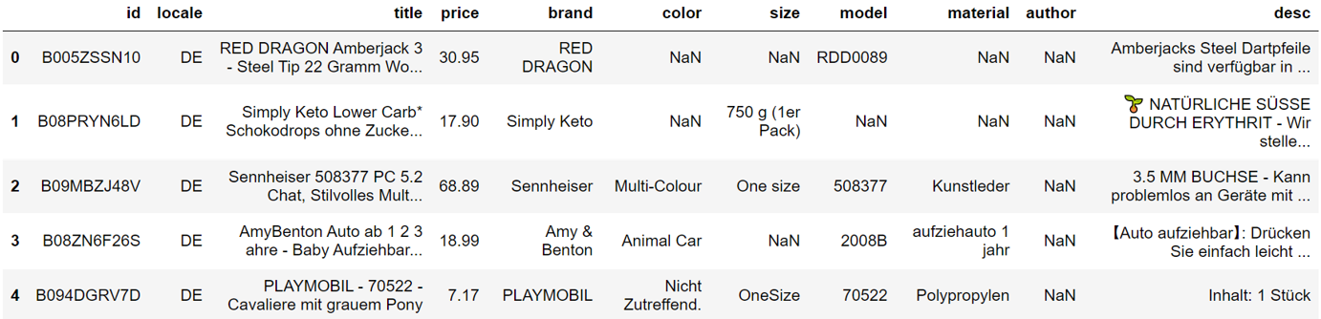
3.1 Dataset
Figure 3: Product attributes in the dataset
Most are unstructured data.
Same IDs but different price in different locales.
Texture data: the usage of space, bracket, capitalized, etc
→ Hard to tokenize and model

Slide 12
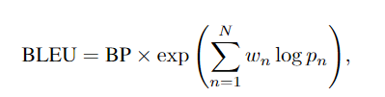
3.2 Evaluation Metrics
Standard metrics to evaluate machine generated text against human annotated reference
Mainly used for machine translation
In particular, we will use N = 4, i.e., BLEU-4.

Slide 13
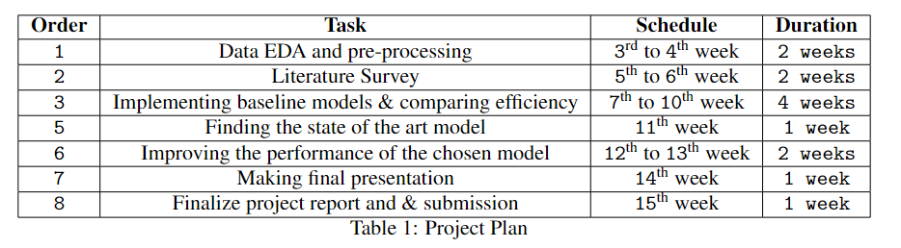
4. Tentative Project Plan

Slide 14
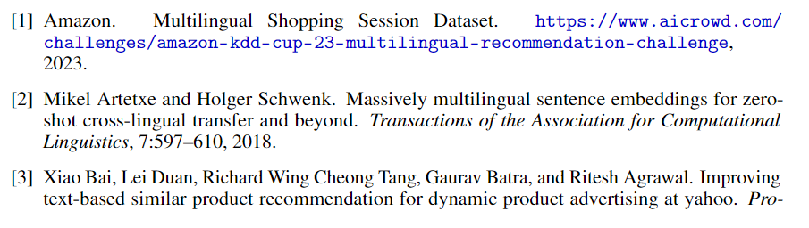
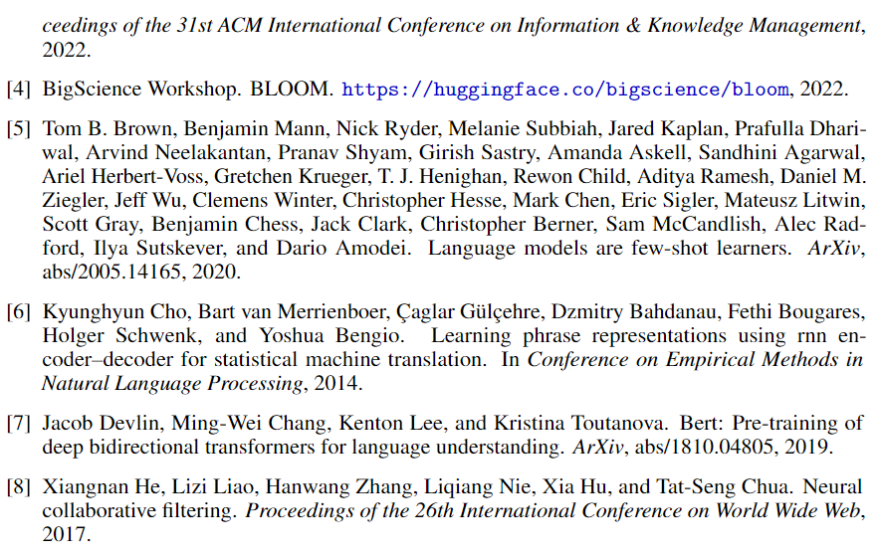
5. Reference

Slide 15
Thank you for listening

