Slide 1


Last update: 24 August 2007
Advanced databases –
Conceptual modelling
Bettina Berendt
– I thank my colleagues Henk Olivié and Erik Duval for holding the first lectures in my place! –
Katholieke Universiteit Leuven,
Department of Computer Science
http://www.cs.kuleuven.ac.be/~berendt/teaching/2007w/adb/

Slide 2
Agenda
Recap (Software Eng.): UML for data modelling
Logics-based formalisms for knowledge modelling
Knowledge modelling on the (Semantic) Web

Slide 3
Modelling static data relationships in EM and UML: in a nutshell
  Many design guidelines (e.g., what is an entity/class and what isn't) are identical, e.g. Ullman p. 52
  Key differences between ER and UML class diagrams (or OO/object oriented models in general)
    Some terminological differences (entity types → classes, etc.)
    UML classes have attributes, and in addition operations
    different graphical symbols for model constituents
    in UML (OO), objects are in one class only (see Ullman p. 34)
    OO: object identity ➔ no keys
    OO: object identity ➔ no notion of weak entity sets
    redundant attributes are bad in ERM (see Ullman p. 47), but wrong in UML

Slide 4
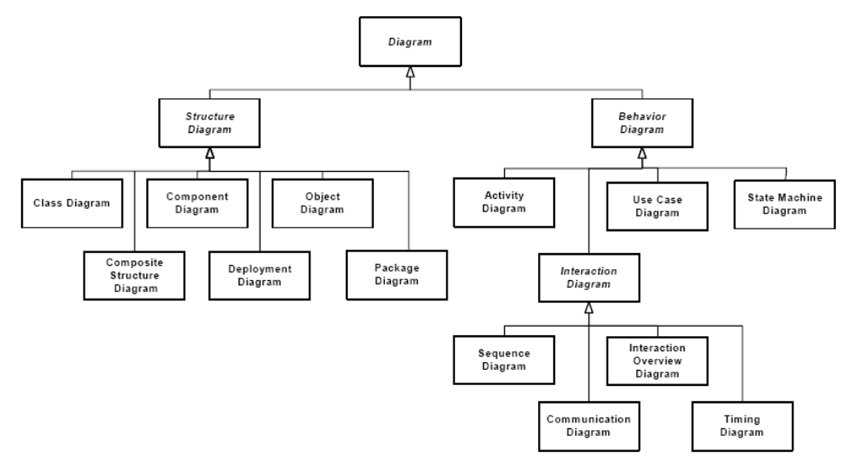
All diagram types in UML 2.0
(from the UML Superstructure specification,
http://www.omg.org/cgi-bin/doc?formal/05-07-04, p. 675)

Slide 5
UML reference: notation overview and glossary
Bernd Oestereich provides very helpful content on his UML Web site, http://www.oose.de/uml/ , including
The official documents are the OMG’s specifications:
  http://www.uml.org/#UML2.0
Notes:
http://www.informatik.uni-bonn.de/III/lehre/vorlesungen/SWT/SS96/Material/UML1.0/glossary.html

Slide 6
The specification of the system to be designed (1)
We have been asked to develop an automated Student Registration System (SRS) for the university. This system will enable students to register on-line for courses each semester, as well as tracking their progress toward completion of their degree.
When a student first enrolls at a university, he/she uses the SRS to set forth a plan of study as to which courses he/she plans on taking to satisfy a particular degree program, and chooses a faculty advisor. The SRS will verify whether or not the proposed plan of study satisfies the requirements of the degree that the student is seeking.
Once a plan of study has been established, then, during the registration period preceding each semester, students are able to view the schedule of classes online, and choose whichever classes they wish to attend, indicating the preferred section (day of the week and time of day) …

Slide 7
The specification of the system to be designed (2)
... if the class is offered by more than one professor. The SRS will verify whether or not the student has satisfied the necessary prerequisites for each requested course by referring to the student's on-line transcript of courses completed and grades received (the student may review his/her transcript on-line at any time).
Assuming that (a) the prerequisites for the requested course(s) are satisfied, (b) the course(s) meet(s) one of the student's plan of study requirements, and (c) there is room available in each of the class(es), the student is enrolled in the class(es). If (a) and (b) are satisfied, but (c) is not, the student is placed on a first-come, first-served wait list. If a class/section that he/she was previously wait-listed for becomes available (either because some other student has dropped the class or because the seating capacity for the class has been increased), the student is automatically enrolled in the waitlisted class, and an email message to that effect is sent to the student. It is his/her responsibility to drop the class if it is no longer desired; otherwise, he/she will be billed for the course.
Students may drop a class up to the end of the first week of the semester in which the class is being taught.

Slide 8
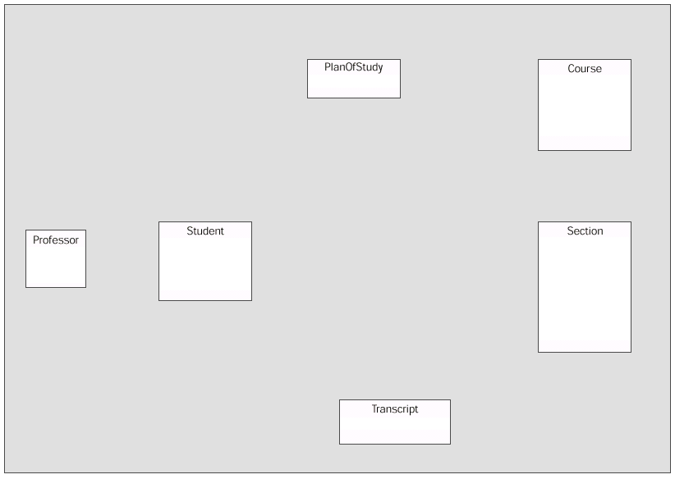
Class diagram (1): The classes

Slide 9
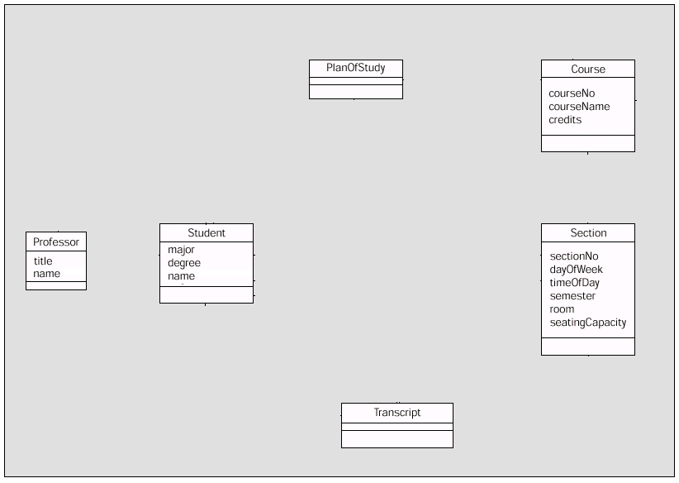
Class diagram (2): The classes and their attributes

Slide 10
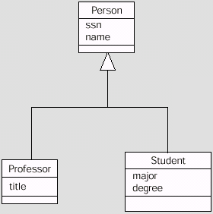
Class diagram (3): Inheritance (generalisation / specialisation)
  A Professor „is a“ (special kind of) Person
  A Student „is a“ (special kind of) Person
  All Persons have a social security number and a name; in addition,
  Students have a major (subject) and a degree (that they want)
  Professors have a title

Slide 11
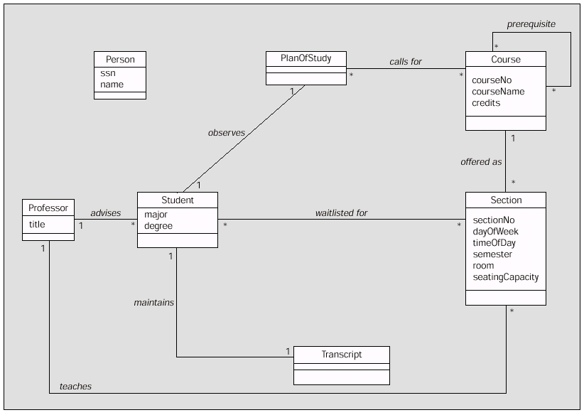
Class diagram (4): Associations

Slide 12
Class diagram (5): Association directionality
The standard direction is
left-to-right or
top-to-bottom
To indicate non-standard
reading direction, use
a little solid triangle
is taught by

Slide 13
Class diagram (6): Associations and their multiplicities
How many instances
of „Professor“ can
relate to a single
instance of „Student“?
How many instances
of „Student“ can
relate to a single
instance of „Professor“?
Between zero and many

Slide 14
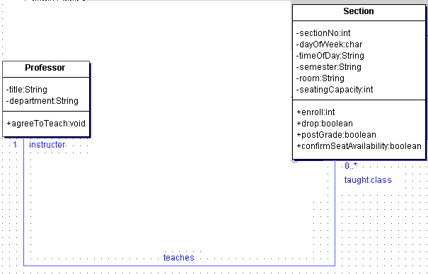
Roles in a structural relation
taughtClass

Slide 15
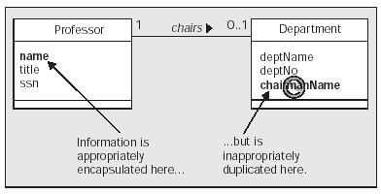
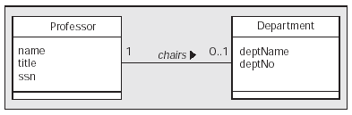
Class diagram (7): Associations and attributes
  “Information flows along the association pipeline“
  ➔ Don‘t duplicate the information contained in an association by an attribute
Incorrect
Correct

Slide 16
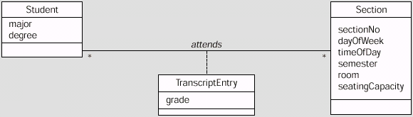
Class diagram (8): Association classes
  A Student who attends a Section will receive a TranscriptEntry to certify this
  The TranscriptEntry has its own attribute: a grade
  The TranscriptEntry and the grade belong neither to the Student nor to the Section, but to the relation between them
  ➔ Solution: make TranscriptEntry a class and treat it as a qualification of the attends association

Slide 17
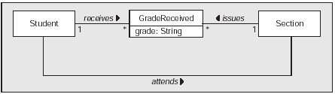
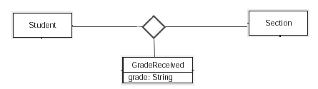
Class diagram (9): n-ary associations
  Alternative representations of the previous association:
  Several binary associations (take care of the multiplicities!)
  A ternary association (general: n-ary)

Slide 18
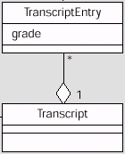
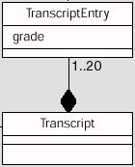
Class diagram (10): Aggregations and compositions
  A transcript consists of several transcript entries: It is an aggregation of transcript entries
  Each transcript entry is a part of the transcript
  Q: If there is no transcript, can there still be transcript entries?
  I.e., does the part depend, in its existence, on the existence of the whole?
  If yes, the part-of relation can be modelled as a composition

Slide 19
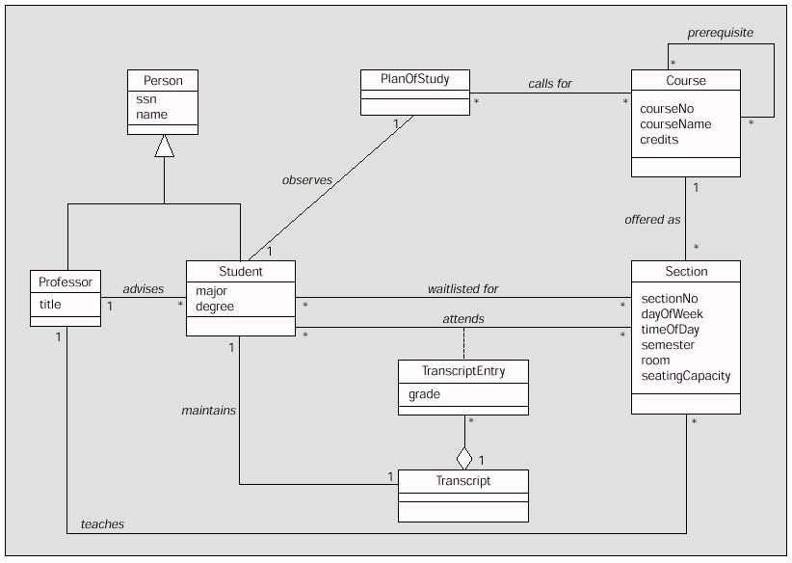
Class diagram (11): Putting it all together

Slide 20
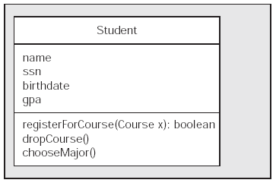
Class diagram (12): Description of classes containing their operations

Slide 21
Class diagrams: Full description of classes containing their attributes (2nd compartment) and operations (3rd c.)
Attribute –
detailed notation:
Attribute with
data type and visibility
-
: String
+registerForCourse (x : Course) : boolean
Operation –
detailed notation:
Operation with signature
and return type and visibility
Short notation:
Attribute or operation name only,
() indicates that it is an operation

Slide 22
More options in class diagrams: Operation parameter lists
+registerForCourse (in x : Course) : boolean
Detailed notation:
Operation with signature
and return type and
visibility
Note: The parameter list often also contains the
“direction“ of the parameter: in, out, inout

Slide 23
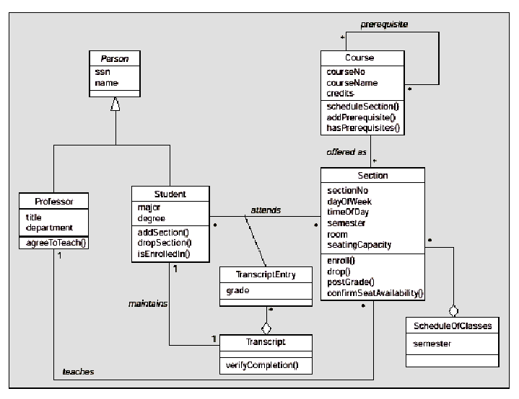
The UML class diagram of a Student Registration System (with attributes and operations)
(adapted from Barker, p. 377)
Notes:
Hier Anbindungen an andere Institute skizzieren!

Slide 24
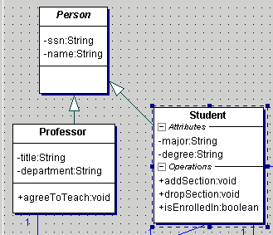
Abstract classes
  No-one is „just a person“. Everyone is either a student, or a professor, or ...
  An abstract class is one that cannot be instantiated.
  It only serves to define all attributes and behaviours that all subclasses (or their instances) have in common.
Class name
in italics!

Slide 25
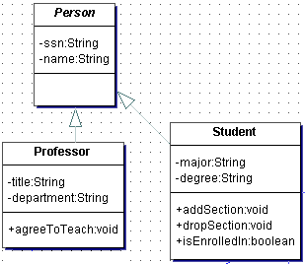
Generalization coverage: motivation
Are professors and students disjoint
sets of people (➔ of objects)?
{disjoint}
{overlapping}
Or can a person be both a lecturer
and a student (e.g., a PhD student)?

Slide 26
GENERALIZATION — COVERAGE
overlapping - a superclass object can be a member of more than one subclass
Player
Player
{overlapping}
Tennis
Soccer
Tennis
Soccer
disjoint - a superclass object is a member of at most one subclass
Person
Person
{disjoint}
Male
Female
Male
Female
(from http://course.cs.ust.hk/comp211/2002Spring/ Slides/02OOModeling.ppt)

Slide 27
GENERALIZATION — COVERAGE (cont’d)
complete - all superclass objects are also members of some subclass
University
Student
University
Student
{complete}
Undergrad
Postgrad
Undergrad
Postgrad
incomplete - some superclass object is not a member of any subclass
Tree
Elm
{incomplete}
Tree
Oak
Birch
Oak
Elm
Birch
(from http://course.cs.ust.hk/comp211/2002Spring/ Slides/02OOModeling.ppt)

Slide 28
GENERALIZATION — COVERAGE (cont’d)
overlapping, incomplete
Player
Player
{overlapping, incomplete}
Tennis
Soccer
Tennis
Soccer
overlapping, complete
Course
Course
{overlapping, complete}
UG
PG
UG
PG
(from http://course.cs.ust.hk/comp211/2002Spring/ Slides/02OOModeling.ppt)

Slide 29
GENERALIZATION — COVERAGE (cont’d)
disjoint, complete
University
Student
University
Student
{disjoint, complete}
Undergrad
Postgrad
Undergrad
Postgrad
disjoint, incomplete
Tree
Elm
{disjoint, incomplete}
Tree
Oak
Oak
Elm
Birch
Birch
(from http://course.cs.ust.hk/comp211/2002Spring/ Slides/02OOModeling.ppt)

Slide 30
Navigability
When the „maintains“ association is modelled like this, we can find, given a Student, his/her Transcript, and, given a Transcript, his/her owner:
<Class NAME=“Student“ ...> ...
<Association NAME=“maintains“ PEER=“Transcript“>
<AssocRole MULTIPLICITY=“1“>
<PeerAssocRole MULTIPLICITY=“1“>
</Association>
</Class>
When the association is modelled like this, we can only find the Transcript of a given Student (we cannot navigate back from a given Transcipt):
<PeerAssocRole MULTIPLICITY=“1“ NAVIGABILITY=“true“/>
Student
Transcript
Student
Transcript

Slide 31
Tool support for modelling: Examples
  Overview at
  http://www.oose.de/umltools.htm
  The (commercial) standard: Rational Rose
  A good free tool: ArgoUML

Slide 32
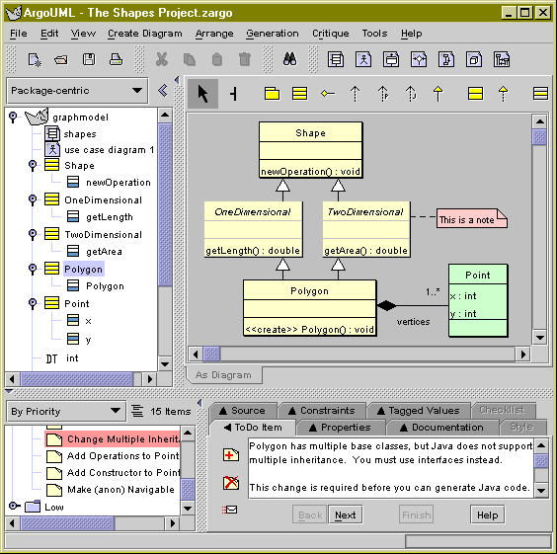
Example: ArgoUML screenshot
(http://argouml.tigris.org/images/welcome_screenshot.gif)
Notes:
http://argouml.tigris.org/images/welcome_screenshot.gif

Slide 33
Agenda
Recap (Software Eng.): UML for data modelling
Logics-based formalisms for knowledge modelling
Knowledge modelling on the (Semantic) Web

Slide 34
ERM/UML vs. AI knowledge representation: in a nutshell
  Many commonalities: e.g., represent instances, classes (“categories”), relations
  Main differences
    Generally richer expressiveness:
      Complex KR problems require the construction of an ontology to express categories, time, actions, belief, etc.
    Want to make inferences (“reason”)
      Recall: knowledge base vs. database
      A good KR system is general enough to represent the domain knowledge of the underlying problem, and specific enough to allow efficient computation.
➔ Build on logics

Slide 35
Categories and objects
KR requires the organisation of objects into categories
  Interaction at the level of the object
  Reasoning at the level of categories
Categories play a role in predictions about objects
  Based on perceived properties
Categories can be represented in two ways by FOL
  Predicates: apple(x)
  Reification of categories into objects: apples
Category = set of its members

Slide 36
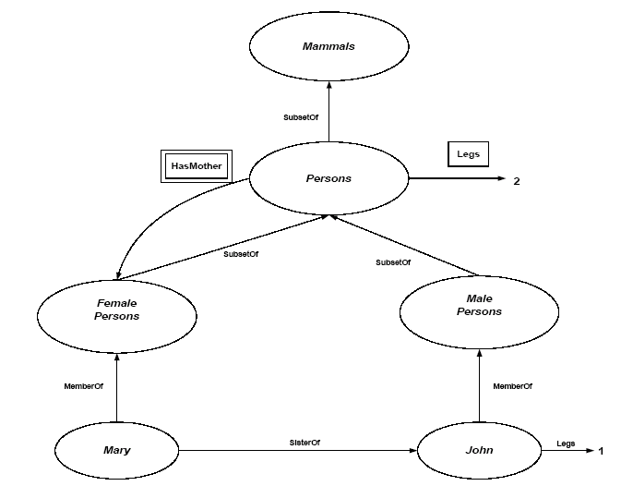
Category organization
Relation = inheritance:
  All instance of food are edible, fruit is a subclass of food and apples is a subclass of fruit then an apple is edible.
Defines a taxonomy

Slide 37
FOL and categories
An object is a member of a category
  MemberOf(BB₁₂,Basketballs)
A category is a subclass of another category
  SubsetOf(Basketballs,Balls)
All members of a category have some properties
  ∀ x (MemberOf(x,Basketballs) ⇒ Round(x))
All members of a category can be recognized by some properties
  ∀ x (Orange(x) ∧ Round(x) ∧ Diameter(x)=9.5in ∧ MemberOf(x,Balls) ⇒ MemberOf(x,BasketBalls))
A category as a whole has some properties
  MemberOf(Dogs,DomesticatedSpecies)

Slide 38
Relations between categories
Two or more categories are disjoint if they have no members in common:
  Disjoint(s)⇔(∀ c₁,c₂ c₁ ∈ s ∧ c₂ ∈ s ∧ c₁ ≠ c₂ ⇒ Intersection(c₁,c₂) ={})
  Example; Disjoint({animals, vegetables})
A set of categories s constitutes an exhaustive decomposition of a category c if all members of the set c are covered by categories in s:
  E.D.(s,c) ⇔ (∀ i i ∈ c ⇒ ∃ c₂ c₂ ∈ s ∧ i ∈ c₂)
  Example: ExhaustiveDecomposition({Americans, Canadian, Mexicans},NorthAmericans).

Slide 39
Relations between categories
A partition is a disjoint exhaustive decomposition:
  Partition(s,c) ⇔ Disjoint(s) ∧ E.D.(s,c)
  Example: Partition({Males,Females},Persons).
Is ({Americans,Canadian, Mexicans},NorthAmericans) a partition?
Categories can be defined by providing necessary and sufficient conditions for membership
  ∀ x Bachelor(x) ⇔ Male(x) ∧ Adult(x) ∧ Unmarried(x)

Slide 40
Reasoning systems for categories
How to organise and reason with categories?
  Semantic networks
    Visualize knowledge-base
    Efficient algorithms for category membership inference
  Description logics
    Formal language for constructing and combining category definitions
    Efficient algorithms to decide subset and superset relationships between categories.

Slide 41
Semantic Networks
Logic vs. semantic networks
Many variations
  All represent individual objects, categories of objects and relationships among objects.
Allows for inheritance reasoning
  Female persons inherit all properties from person.
  Cfr. OO programming.
Inference of inverse links
  SisterOf vs. HasSister

Slide 42
Semantic network example

Slide 43
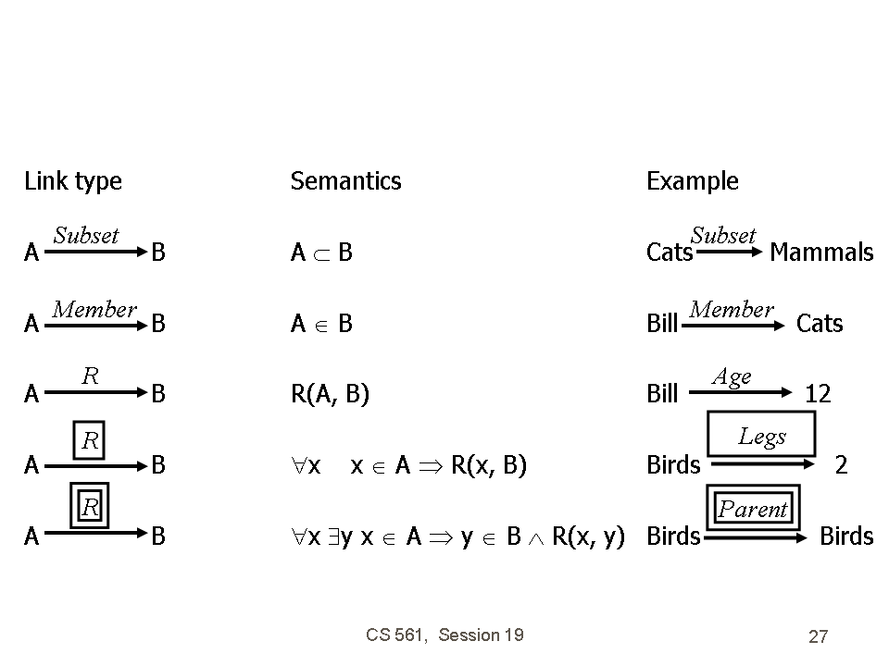
Semantic network link types

Slide 44
Semantic networks
Drawbacks
  Links can only assert binary relations
  Can be resolved by reification of the proposition as an event
Representation of default values
  Enforced by the inheritance mechanism.

Slide 45
Description logics
Are designed to describe defintions and properties about categories
  A formalization of semantic networks
Principal inference task is
  Subsumption: checking if one category is the subset of another by comparing their definitions
  Classification: checking whether an object belongs to a category.
  Consistency: whether the category membership criteria are logically satisfiable.

Slide 46
Agenda
Recap (Software Eng.): UML for data modelling
Logics-based formalisms for knowledge modelling
Knowledge modelling on the (Semantic) Web

Slide 47
Knowledge representation on the Semantic Web – closing the gap between conceptual modelling and implementation
What is an Ontology?
  „An ontology is a specification of a shared conceptualization.“
Tom Gruber, 1993
Ontologies are social contracts
  Agreed, explicit semantics
  Understandable to outsiders
  (Often) derived in a community process
  The term itself has no commonly agreed-upon definition (the one on p. XXX is one useful example) ➔ defined indirectly via the used languages:
Ontology markup and representation languages:
  RDF and RDF Schema (→ based on semantic networks)
  OWL (→ based on description logics)
  Other: DAML+OIL, EER, UML, Topic Maps, MOF, XML Schemas
Notes:
RDF alone is not enough – it just delivers a graph – but we need to provide some constraints, knowledge, etc
Ontologies are the key concept to do so
They are based on the social agreement
There are several ways to express ontologies

Slide 48
The Semantic Web – What is RDF ?
  RDF (Resource Description Framework)
    a data format for describing information and resources,
    the fundamental data model for the Semantic Web
  Using RDF, we can describe relationships between things like:
    A is a part of B or
    Y is a member of Z
    and their properties (size, weight, age, price…) in a machine-understandable format where each thing has a
  RDF graph-based model delivers straightforward machine processing
  Putting information into RDF files makes it possible for “scutters” or RDF crawlers to search, discover, pick up, collect, analyse and process information from the Web
  A W3C recommendation: http://www.w3.org/TR/rdf-primer/
Notes:
1)OK – first step to deliver semantic web – is to provide semantic descriptions
2)In order to do that – we can use widely addopted RDF
3)What is RDF? What are the properties?
4)RDF is not XML – as RDF is based on graph model
5)How machines can process it ?

Slide 49

The Semantic Web – What is RDF ?
A simple RDF example
  Statement:
  “Stefan Decker is the creator of the resource (web page) http://www.stefandecker.org”
  Structure:
    Resource (subject) http://www.stefandecker.org
    Property (predicate) http://purl.org/dc/elements/1.1/creator
    Value (object) “Stefan Decker”
  Directed graph:
http://www.stefandecker.org
dc:creator
Stefan Decker

Slide 50
The Semantic Web – RDF Schema
Defines small vocabulary for RDF:
  Class, subClassOf, type
  Property, subPropertyOf
  domain, range
Vocabulary can be used to define other vocabularies for your application domain
Person
subClassOf
subClassOf
Student
domain
range
Researcher
hasSuperVisor
type
type
Frank
hasSuperVisor
Jeen
Notes:
The simplest ontology we can define is with RDF Schema
RDFS defines a small vocabulary ...
It can be easily used to define other vocabularies
Like in our example ...

Slide 51
The Semantic Web – OWL
OWL – The Web Ontology Language
  provides a vocabulary for defining classes, their properties and their relationships among classes.
  A W3C recommendation: http://www.w3.org/TR/owl-ref/
Animal
s
s
Herbivore
Carnivore
owl:disjointWith
s
s
Omnivore
Notes:
Another example is OWL (motice that the name does not match the abbreviation – but we know why :D)
It is based on RDF/XML vocabulary
It allows us to be more explicite in what we define – see example ...
.. And DLs
OWL as W3C recommendation

Slide 52
Tool support for modelling: Examples
  Protégé (http://protege.stanford.edu)
    a free, open source ontology editor and knowledge-base framework.
    The Protégé platform supports two main ways of modeling ontologies via the Protégé-Frames and Protégé-OWL editors. Protégé ontologies can be exported into a variety of formats including RDF(S), OWL, and XML Schema.
    Protégé is based on Java, is extensible, and provides a plug-and-play environment that makes it a flexible base for rapid prototyping and application development.
  KAON (http://kaon.semanticweb.org/)
    an open-source ontology management infrastructure targeted for business applications.
    It includes a comprehensive tool suite allowing easy ontology creation and management and provides a framework for building ontology-based applications.
    An important focus of KAON is scalable and efficient reasoning with ontologies.

Slide 53
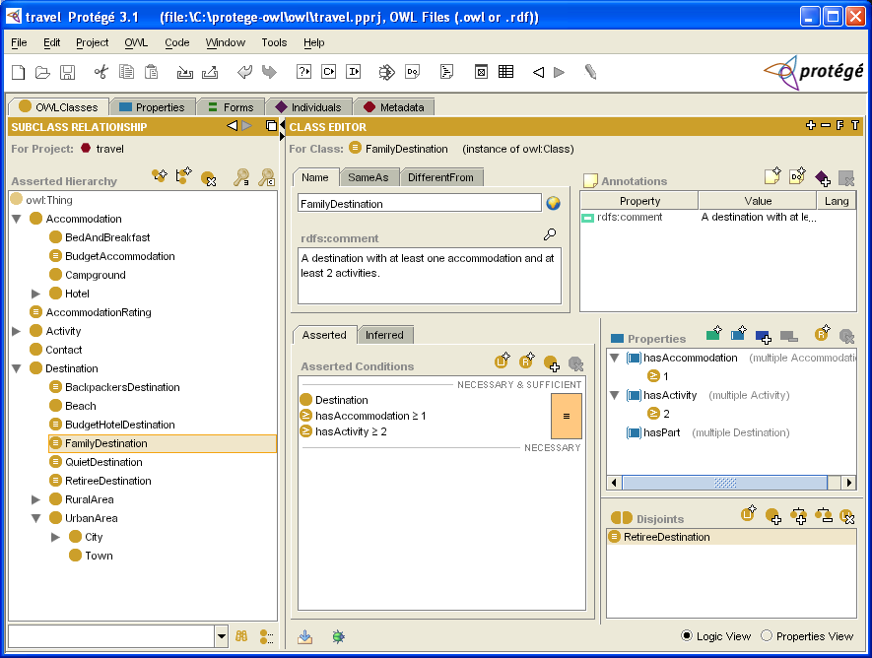
Protégé screenshots (1)

Slide 54
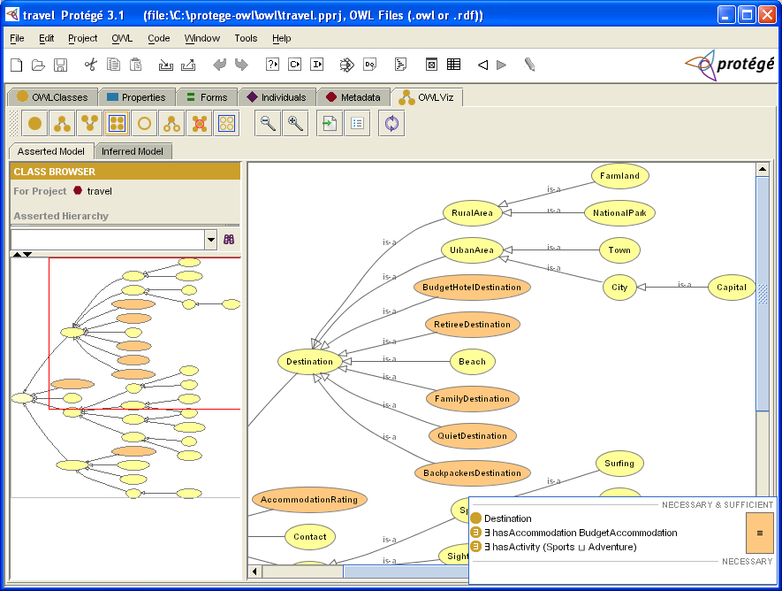
Protégé screenshots (2)

Slide 55
Note ...
  On the Semantic Web, knowledge representation is used to annotate resources (= often, but not always, Web pages)
  Recall the introduction to ontologies:

Slide 56
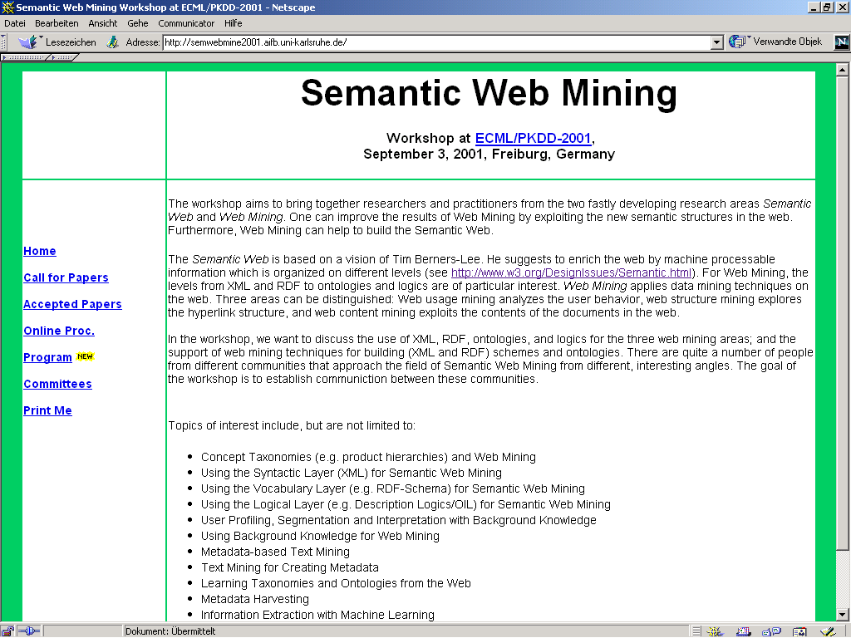
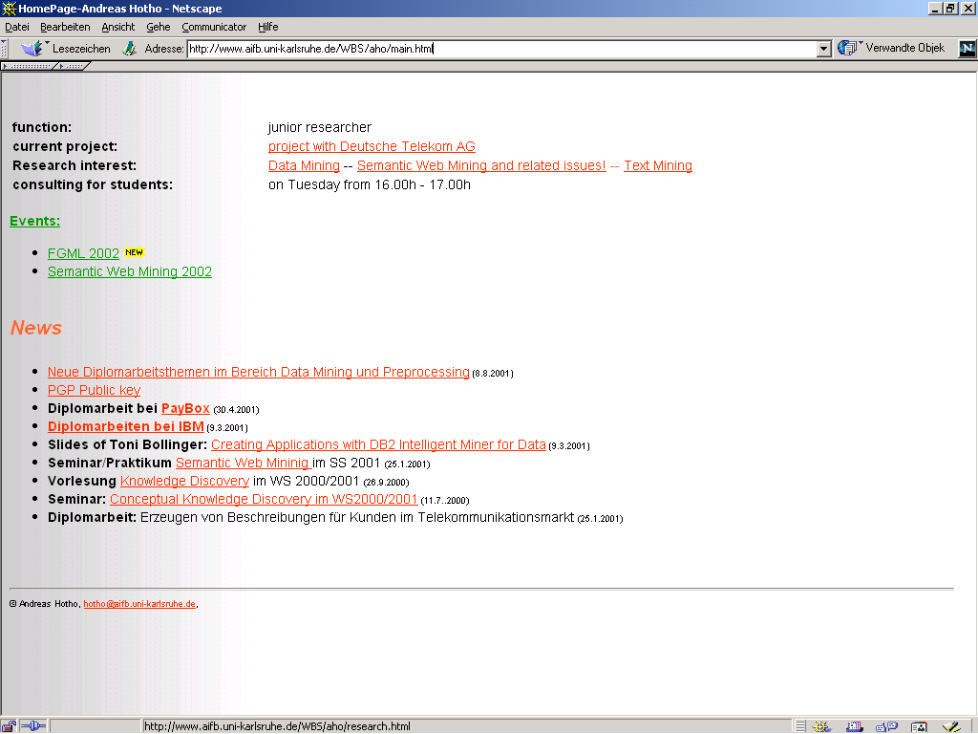
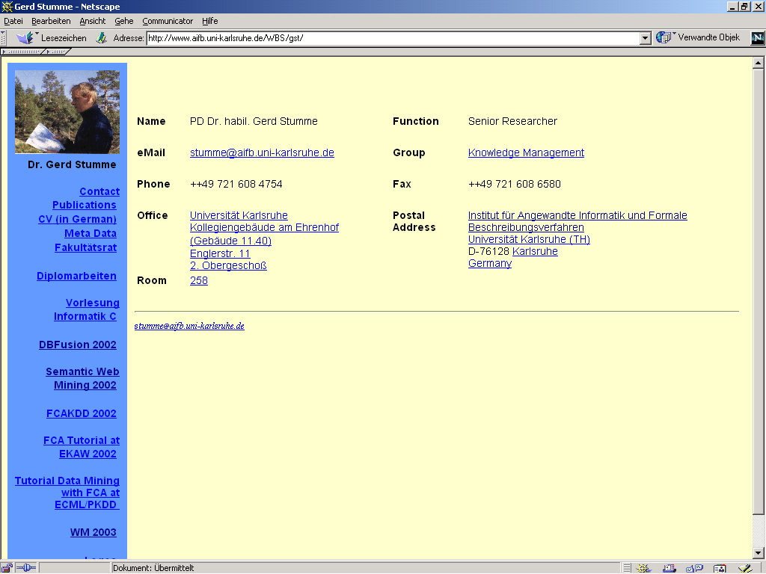
cooperateswith(X,Y)
cooperateswith(Y,X)
From database schema to ontology (3)
OBJECT
NAME
PERSON
TITLE
PERSON
PROJECT
COOPERATES
COOPERATES
--
--
WITH
WITH
Ontology
WORKS-IN
RESEARCHER
RESEARCHER
Semantic Web Mining
Andreas Hotho
WORKS-IN
DAMLPROJ
URI-SWMining
-
Relational
metadata
URI-AHO
WORKS-IN
COOPERATES
COOPERATES
-
-
WITH
WITH
URI-GST
WWW

Slide 57
Next lecture
Recap (Software Eng.): UML for data modelling
Logics-based formalisms for knowledge modelling
Knowledge modelling on the (Semantic) Web
Embracing heterogeneity: Temporal and spatial data

Slide 58
References / background reading; acknowledgements
UML for data modelling:
  Barker, J. (2000). Beginning Java Objects. From Concepts to Code. Birmingham, UK: Wrox Press.
  Description and sample chapters available at http://developer.java.sun.com/developer/Books/javaprogramming/begobjects/
Logics-based formalisms for knowledge modelling:
  Russell, S., & Norvig, P. (2003). Artificial Intelligence: A Modern Approach. 2nd edition. Prentice-Hall.
  Information and supplementary material available at http://aima.cs.berkeley.edu/
p. 35-42, 44-45: From Tom Lenaerts. Artificial Intelligence I: knowledge representation. Slides accompanying the textbook Artificial Intelligence: A Modern Approach
http://switch.vub.ac.be/~tlenaert/documents/teach/AIMA/krepresentation.ppt
p. 43: from Logical reasoning systems.
http://ilab.usc.edu/classes/2002cs561/notes/session19.ppt
p. 48-51: from or based on
S.R. Kruk, S. Decker, B. Haslhofer, P. Kneževic, S. Payette, D. Krafft. Tutorial at WWW 2007: Semantic Digital Libraries. http://wiki.corrib.org/images/1/12/01_intro_tutorial_semdl_www2007.ppt

