Slide 1
Stock movement as a Markov Process
Business Lab for Financial Engineering
Nguyen Minh Duc
20202026

Slide 2
Trading Strategy
Stock Movement as Markov Process
Experiment

Slide 3
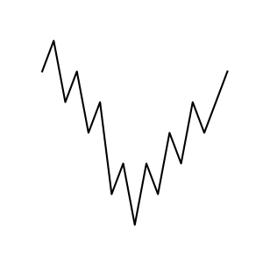
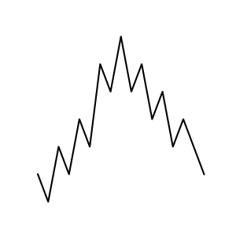
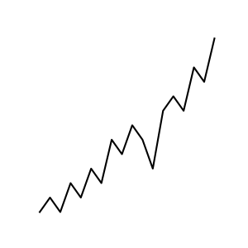
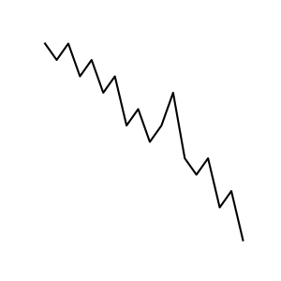
Trading Strategy
Just buy low and sell high, simple!
How?
Sell High
Sell High
Buy Low
Buy Low

Slide 4
Trading Strategy
Just buy low and sell high, simple!
Then, how to predict the future?
Sell High
Sell High
Buy Low
Buy Low

Slide 5
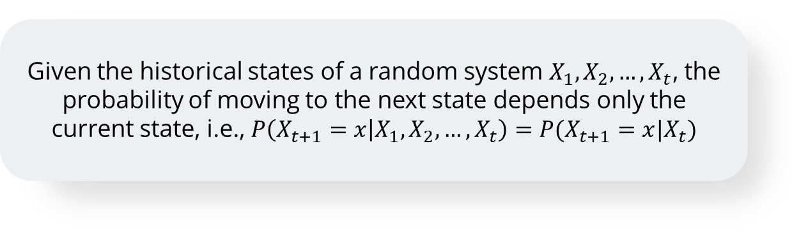
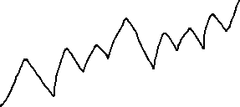
Stock Movement as a Markov Process
1
What is a Markov process?
Given the historical states of a random system $X_{1}, X_{2},…, X_{t}$, the probability of moving to the next state depends only the current state, i.e., $P\left(X_{t+1}=x | X_{1},X_{2}, …, X_{t}\right)=P(X_{t+1}=x|X_{t})$
Stock goes up
0.3
Stock Price
0.5
No change
We don’t care how we get to the current price
0.2
Stock goes down

Slide 6
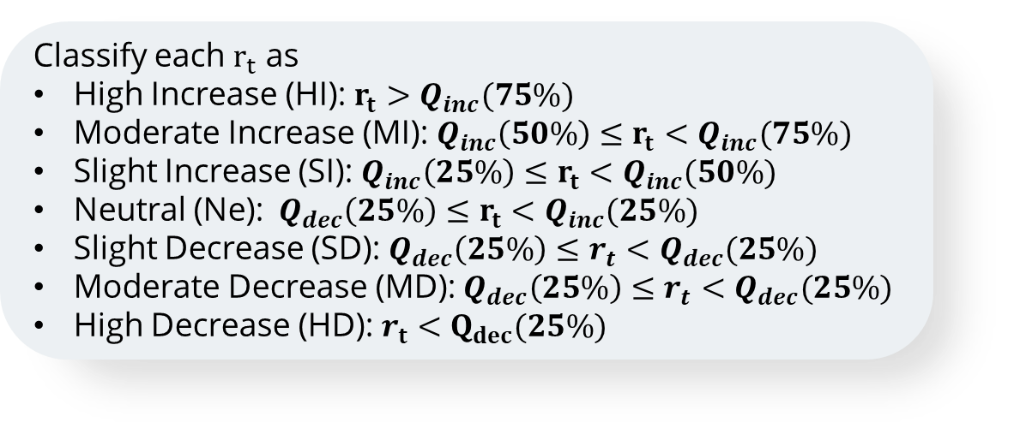
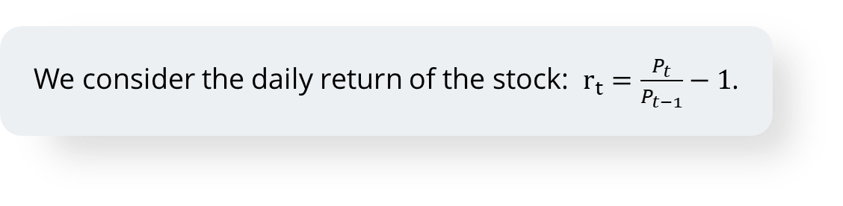
Stock Movement as a Markov Process
2
Stock Movement as a Markov process
We consider the daily return of the stock: $r_{t}=\frac{P_{t}}{P_{t−1}}−1$.
Classify each $r_{t}$ as
High Increase (HI): $r_{t}>Q_{inc}(75\%)$
Moderate Increase (MI): ${Q_{inc}\left(50\%\right)≤r}_{t}<Q_{inc}(75\%)$
Slight Increase (SI): ${Q_{inc}\left(25\%\right)≤r}_{t}<Q_{inc}(50\%)$
Neutral (Ne): ${Q_{dec}\left(25\%\right)≤r}_{t}<Q_{inc}(25\%)$
Slight Decrease (SD):${{ Q}_{dec}\left(25\%\right)≤r}_{t}<Q_{dec}(25\%)$
Moderate Decrease (MD):${{ Q}_{dec}\left(25\%\right)≤r}_{t}<Q_{dec}(25\%)$
High Decrease (HD): $r_{t}<Q_{dec}(25\%)$

Slide 7
Stock Movement as a Markov Process
2
Stock Movement as a Markov process
We define a hyperparameter: lookback – The number of prior prices to consider
The sequence of prices can be encoded as a tuple based on the daily return
Example: (HI, SD Ne, HD, MI)
Now, we can use the historical prices to estimate the probability distribution of the next price state
$$P\left(X_{t+1}=\left(x_{t+1}, x_{t+2}, …, x_{lookback}\right) | X_{t}=\left(x_{t−lookback+1}, x_{t−lookback+2}, …, x_{t}\right)\right)$$

Slide 8
Stock Movement as a Markov Process
3
Use prediction in the strategy
$$P[X_{t+1}=\left(x_{t+1}, x_{t+2}, …, x_{lookback}\right) \text{| }X_{t}=\left(x_{t−lookback+1}, x_{t−lookback+2}, …, x_{t}\right)]$$
The prediction of future trend is the price state with the highest probability
${\hat{X}}_{t+1}={argmax}_{x} \left(P[X_{t+1}=x \text{| }X_{t}=\left(x_{t−lookback+1}, x_{t−lookback+2}, …, x_{t}\right)] \right)$
Sell High
Sell High
Buy Low
Buy Low

Slide 9
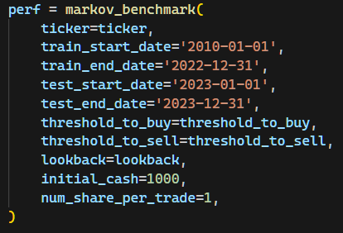
Experiment
1
Experimental setup

Slide 10
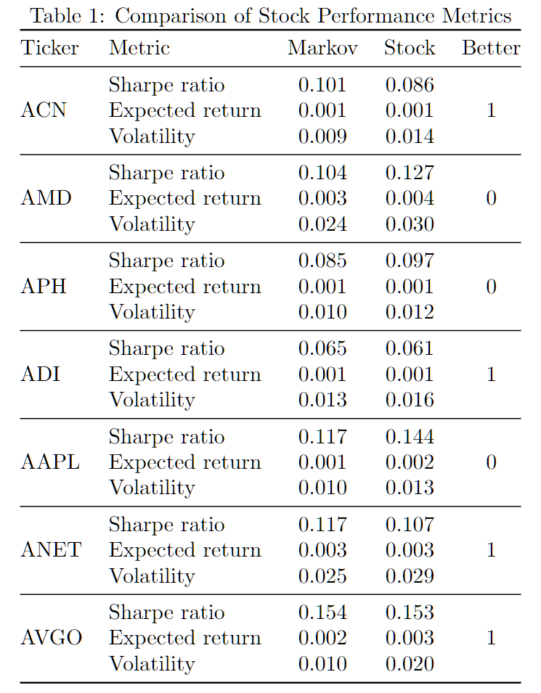
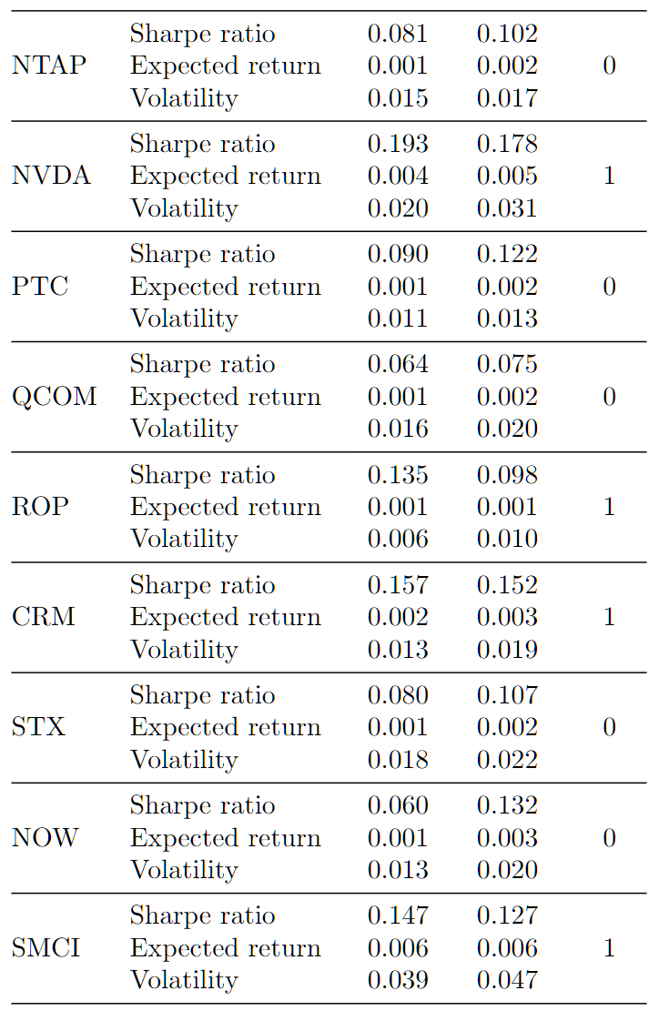
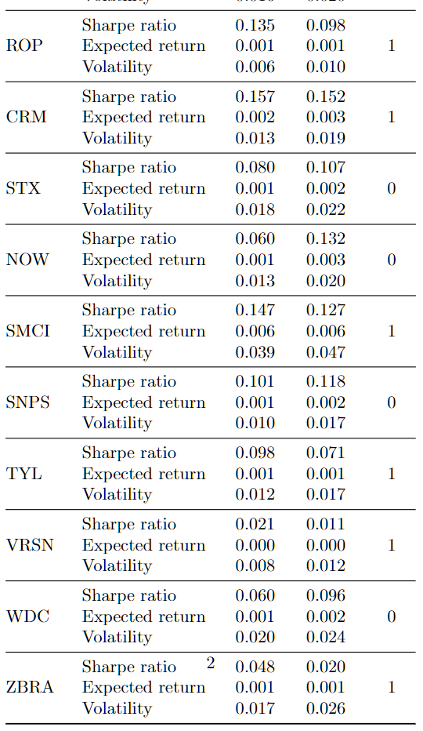
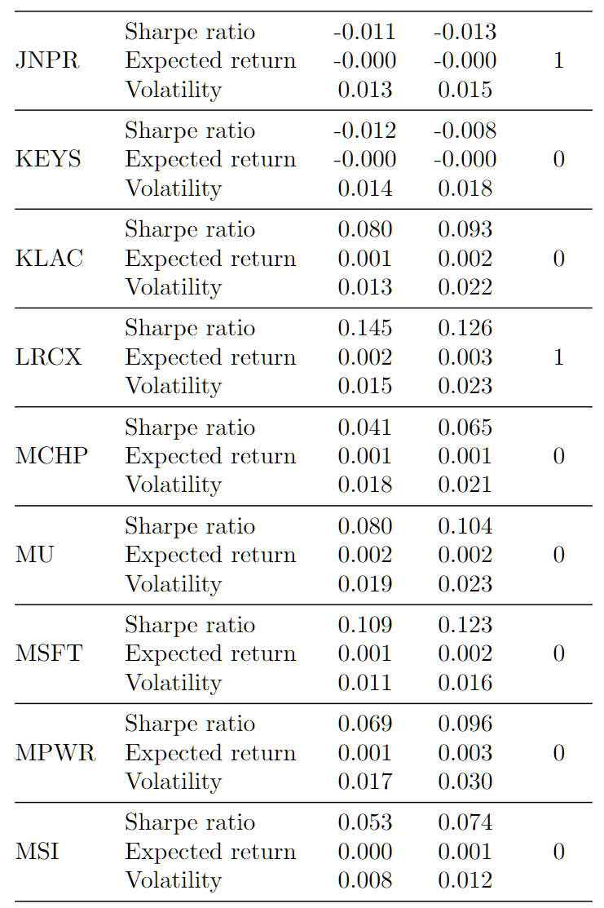
Experiment
2
Experimental results

Slide 11
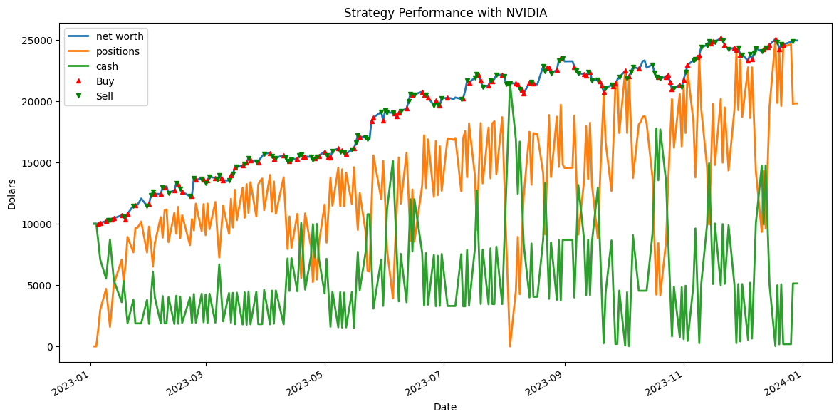
Experiment
3
Case study with NVIDIA

