Slide 1
Portfolio Optimization: Deep Reinforcement Learning vs. Classical Methods
S&P Global-KASIT-UNIST-Kyung Hee University Quant Investment Model Competition
Tsoy Roman, Nguyen Minh Duc, Almas Dossay, Kim Artem

Slide 2
Introduction
Related Work
Methodology
Classical Methods
Deep Reinforcement Learning
Implementation
Evaluation and Results
Conclusion

Slide 3

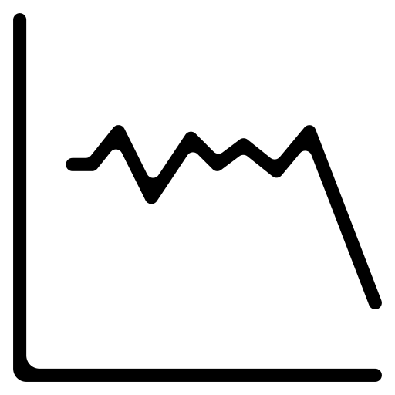


Introduction
Financial markets are complex
Motivation
Traditional methods may struggle to adapt
DRL can learn from sequential data, adapting to dynamic markets.
Objective
Compare traditional methods with Deep Reinforcement Learning method for Portfolio Optimization

Slide 4

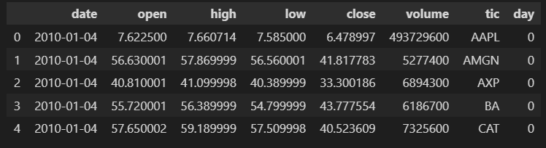
Introduction
Dataset
Historical data from Dow Jones Industrial Average
Data range
2010-01-01
2023-03-01

Slide 5




Related Work
Deep Reinforcement Learning for Portfolio Optimization
Liu et al. (NerIPS 2018)
Propose the use of Actor-Critic Network for trading
Yang et al. (ICAI 2020)
Introduce a novel Ensemble Strategy for trading
Briola et al. (2021)
Propose DRL framework for high-frequency trading
Excellent tools for various trading tasks
FinRL-Meta (NerIPS 2022)
Multiprocessing simulation and training

Slide 6
Methodology – Classical Methods
1. Mean-Variance Optimization:
Balances risk and return using diversification and efficient frontier analysis.
2. Mean-Semivariance Optimization:
Focuses on minimizing the downside risk, measuring only negative returns.
3. Black-Litterman Allocation:
Blends market expectations with individual investor views for tailored portfolios.
4. Hierarchical Risk Parity:
Uses asset class correlations to allocate risk evenly across the portfolio.

Slide 7
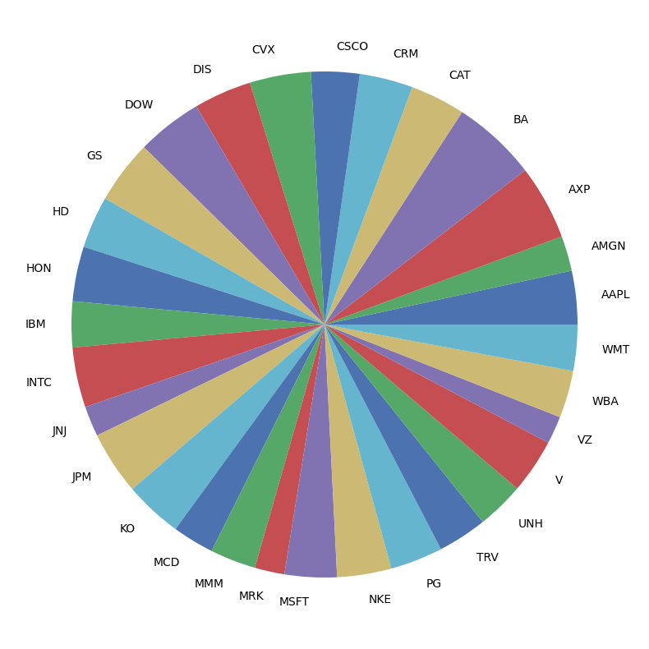
Methodology – Classical Methods
1
Mean-Variance Optimization
Balancing expected returns with risk
Concept of Efficient Frontier
Optimal diversification shown on the right

Slide 8
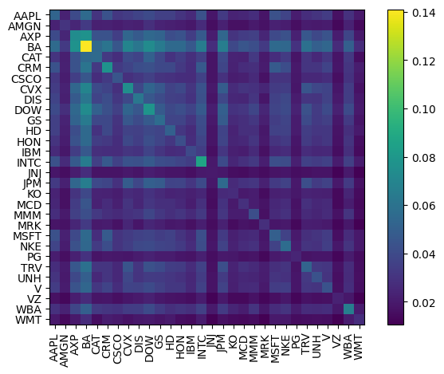
Methodology – Classical Methods
2
Mean-Semivariance Optimization
Focus on downside risk
Use of semi-variance for risk assessment
Suitable for conservative strategies

Slide 9
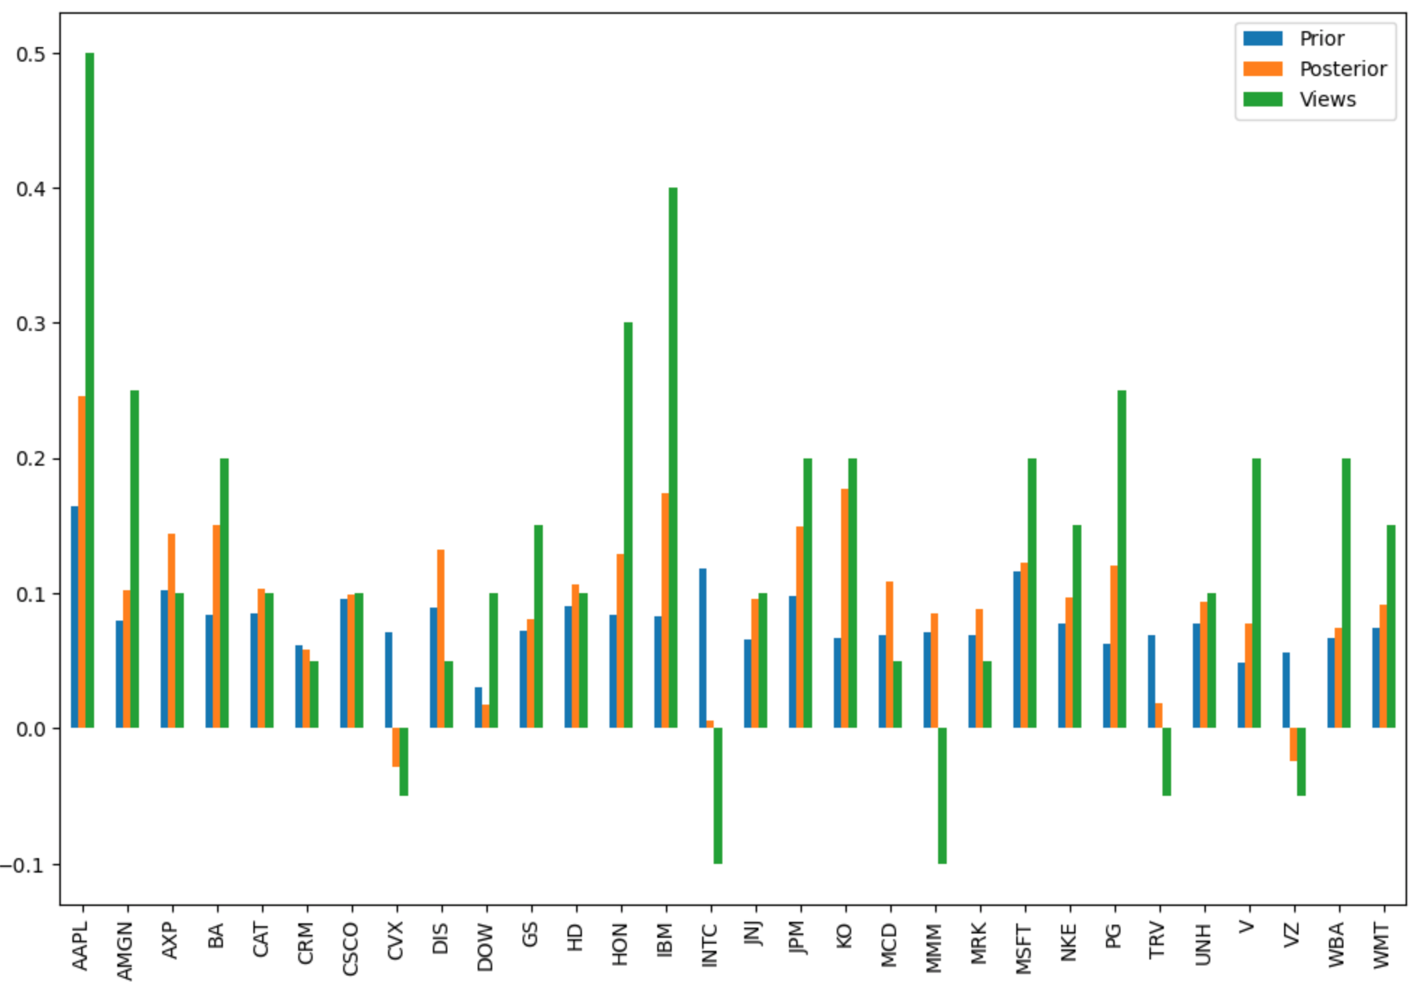
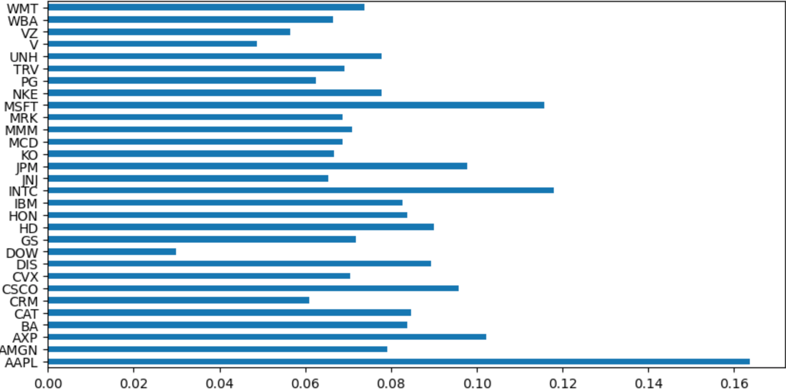
Methodology – Classical Methods
3
Black-Litterman Allocation
First return allocation based on covariance matrix
By combining views and confidence scores, we get posterior estimates

Slide 10
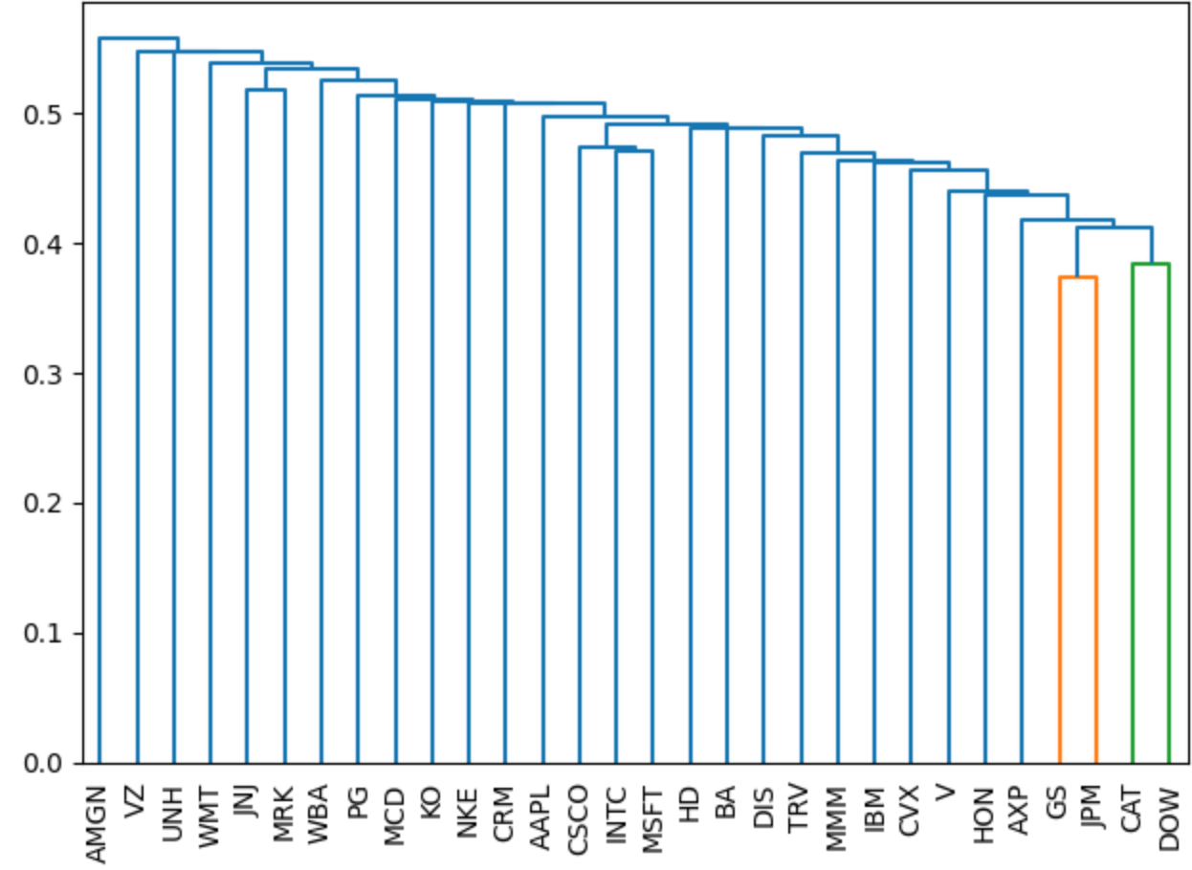
Methodology – Classical Methods
4
Hierarchical Risk Parity
Calculation of pairwise correlation matrix of asset returns
Distribution of assets in hierarchy with single linkage
Weights were allocated based on the risk contributions

Slide 11


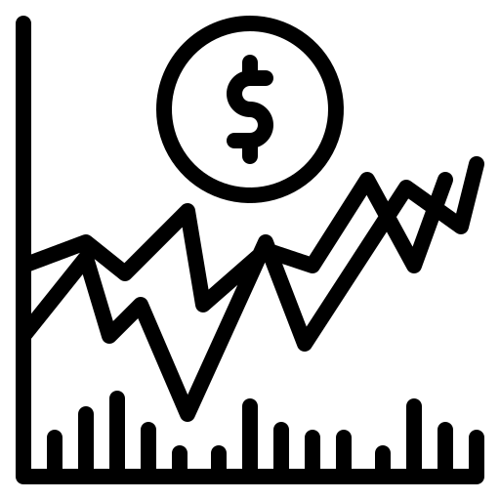
Methodology - Deep Reinforcement Learning
1
Problem Formulation
Stock Trading Environment
Random
Stochastic Optimal Control
(Markov Decision Process)
Interactive

Slide 12




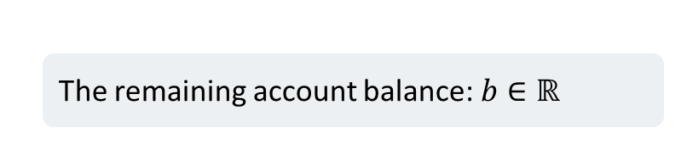
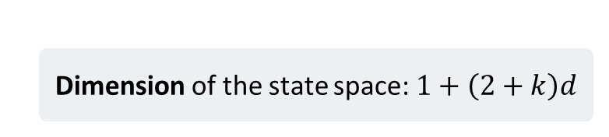
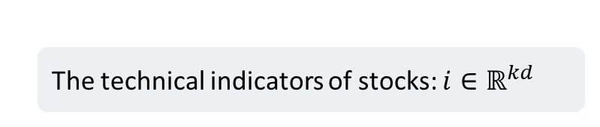
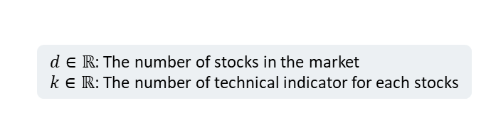
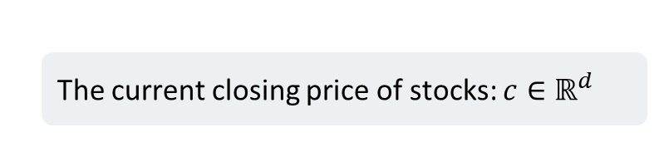
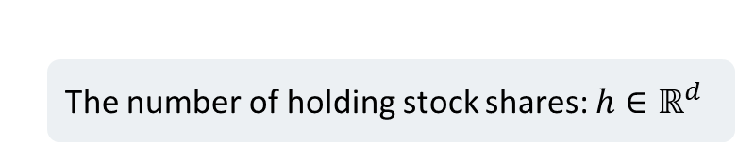
Methodology - Deep Reinforcement Learning
1
Problem Formulation
$d∈ℝ$: The number of stocks in the market
$k∈ℝ$: The number of technical indicator for each stocks
The remaining account balance: $b∈ℝ$
The number of holding stock shares: $h∈ℝ^{d}$
State Space
The current closing price of stocks: $c∈ℝ^{d}$
The technical indicators of stocks: $i∈ℝ^{kd}$
Dimension of the state space: $1+\left(2+k\right)d$

Slide 13



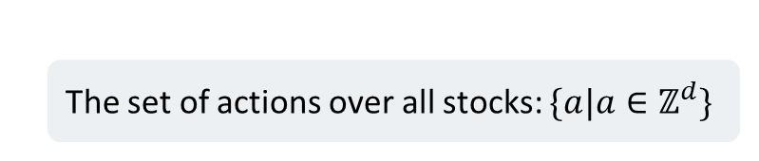


Methodology - Deep Reinforcement Learning
1
Problem Formulation
Control (action) space
The set of actions over all stocks: $\{a|a∈ℤ^{d}\}$
Sell
Hold
Buy
Selling $q$ stocks
$$\left\{\begin{aligned}h_{t+1}=h_{t}−q \\ b_{t+1}=b_{t}+c_{t}^{T}q\end{aligned}\right.$$
Constraint: $q≤h$
There is no change in the agent’s positions
Selling $q′$ stocks
Denote $q=−q′$
$$\left\{\begin{aligned}h_{t+1}=h_{t}−q \\ b_{t+1}=b_{t}+c_{t}^{T}q\end{aligned}\right.$$
Constraint:${−c}_{t}^{T}q≤b_{t}$

Slide 14
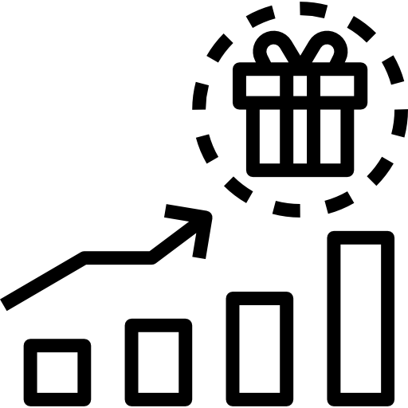
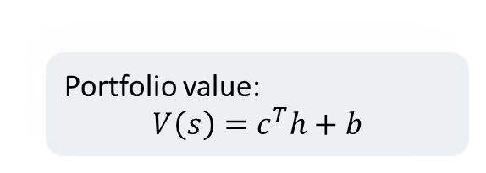
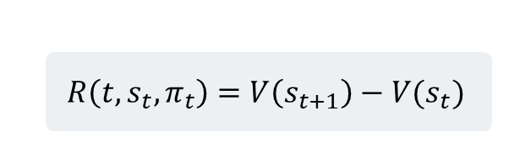
Methodology - Deep Reinforcement Learning
1
Problem Formulation
Reward Function
Portfolio value:
$$V\left(s\right)=c^{T}h+b$$
The change in portfolio value
$$R\left(t, s_{t},π_{t}\right)=V\left(s_{t+1}\right)−V(s_{t})$$

Slide 15
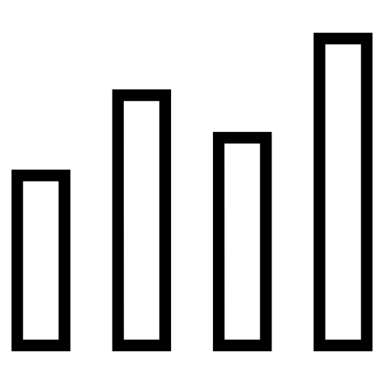
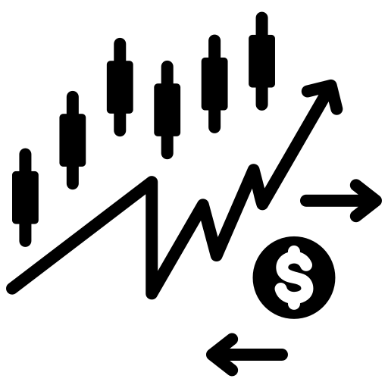
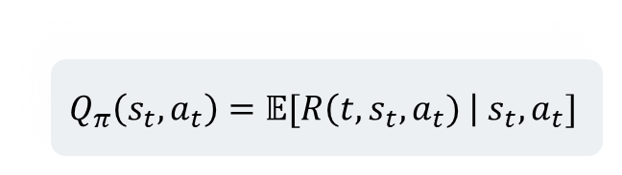
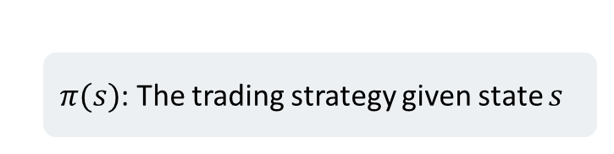
Methodology - Deep Reinforcement Learning
1
Problem Formulation
Action-Value function
Policy
$$Q_{π}\left(s_{t},a_{t}\right)=𝔼[R\left(t,s_{t},a_{t}) \right| s_{t},a_{t}]$$
$π(s)$: The trading strategy given state $s$

Slide 16

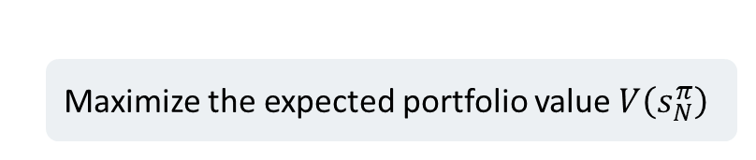
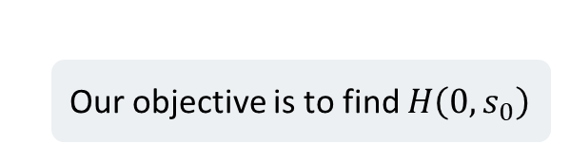
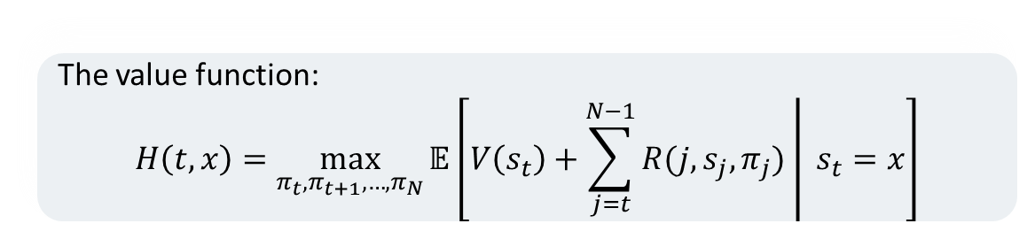
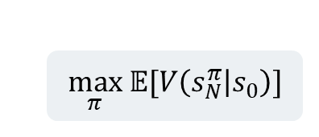
Methodology - Deep Reinforcement Learning
1
Problem Formulation
Trading Goal
Maximize the expected portfolio value $V\left(s_{N}^{π}\right)$
$$\max_{π} 𝔼[V\left(s_{N}^{π} | s_{0}\right)]$$
The value function:
$$H\left(t,x\right)=\max_{π_{t},π_{t+1},…,π_{N}}{𝔼\left[V\left(s_{t}\right)+\left.\sum_{j=t}^{N−1}{R(j,s_{j},π_{j})} \right| s_{t}=x\right]}$$
Our objective is to find $H\left(0,s_{0}\right)$

Slide 17
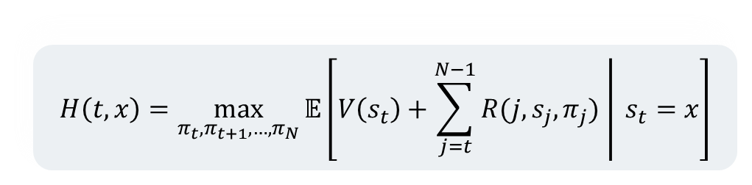
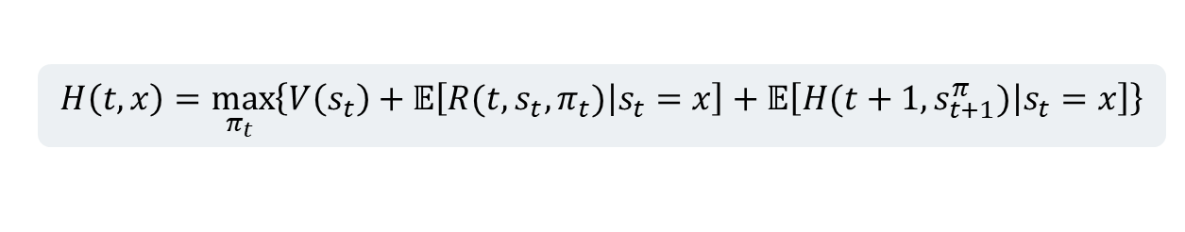
Methodology - Deep Reinforcement Learning
1
Problem Formulation
$$H\left(t,x\right)=\max_{π_{t},π_{t+1},…,π_{N}}{𝔼\left[V\left(s_{t}\right)+\left.\sum_{j=t}^{N−1}{R(j,s_{j},π_{j})} \right| s_{t}=x\right]}$$
How can we solve this optimization problem?
Dynamic Programming?
Dynamic Programming Principle:
$$H\left(t,x\right)=\max_{π_{t} }\left\{V\left(s_{t}\right)+𝔼\left[\left.R(t,s_{t},π_{t})\right|s_{t}=x\right]+𝔼\left[\left.H(t+1,s_{t+1}^{π})\right|s_{t}=x\right]\right\}$$
Very difficult!

Slide 18


Methodology - Deep Reinforcement Learning
2
Actor Critic Method
We utilize the Reinforcement Learning technique to solve the optimization problem
Good performance
Actor-Critic method is popular among RL algorithms
Reduce variance

Slide 19
Methodology - Deep Reinforcement Learning
2
Actor Critic Method
Actor (policy network)
Control how the agent behaves
The algorithm consists of two parts
Critic (value network)
Measure how good the action is
action
Actor network
Critic network
s
Q-value

Slide 20
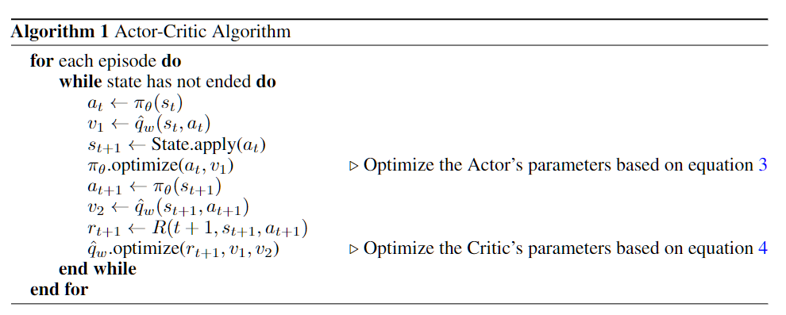
Methodology - Deep Reinforcement Learning
2
Actor Critic Method
Actor network
action
Critic network
s
Q-value

Slide 21
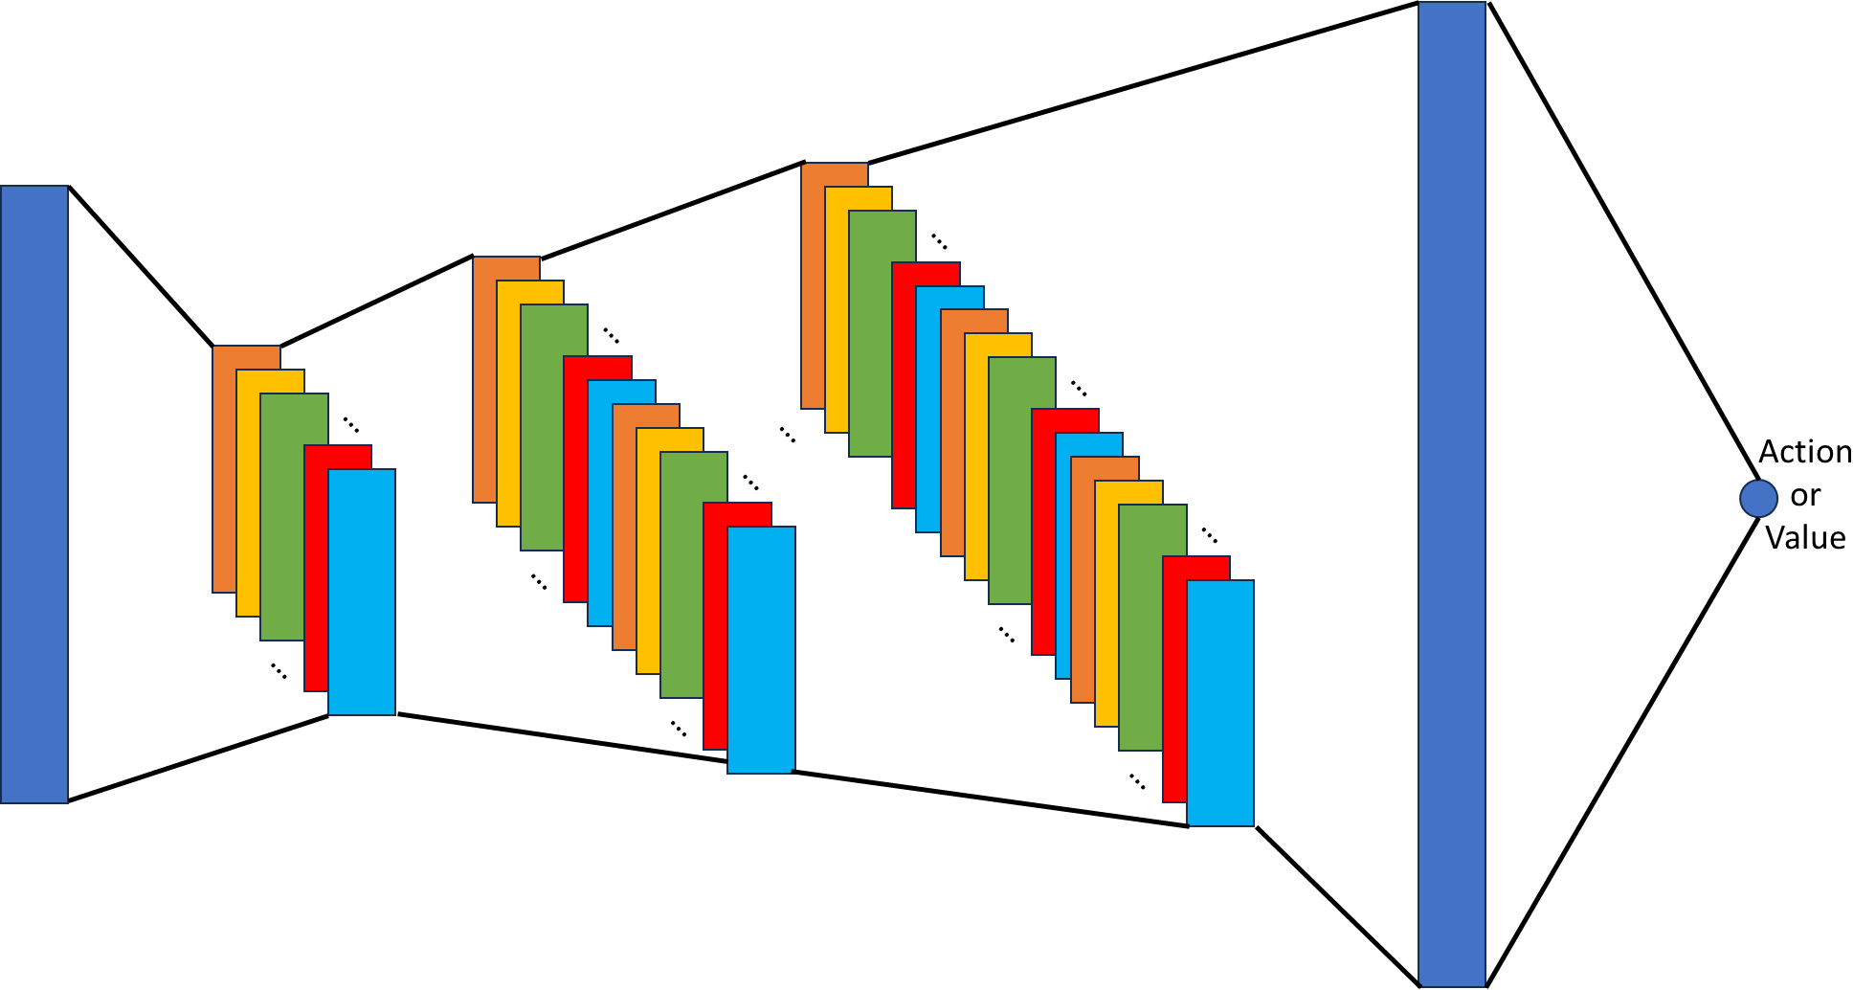
Methodology - Deep Reinforcement Learning
2
Actor Critic Method
The Actor and the Critic shares the same network architecture
We employ three 1D CNN layers and one linear layer to produce the action/value
CNN layers
Linear layer

Slide 22


Implementation
Deep Reinforcement Learning
We utilize FinRL library to implement both the environment and the networks
Moving Average Convergence Divergence
Bollinger Bands
Relative Strength Index
Technical Indicators
Commodity Channel Index
Directional Movement Index
Close Smooth Moving Average

Slide 23
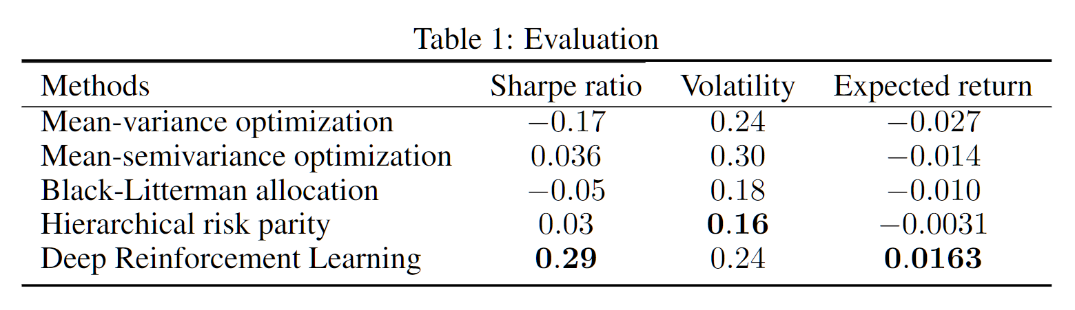
Evaluation
For evaluation, we split the data into 2 parts:
In-sample data from 2010 to 2021
out-sample data from 2021 to 2023
By running all methods, following results are obtained:

Slide 24
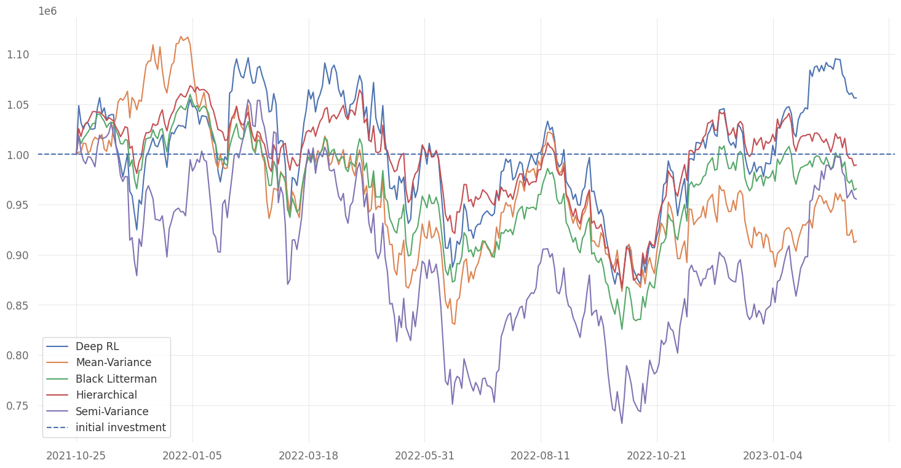
Evaluation
Investment Returns of five methods

Slide 25
Conclusion
Deep Reinforcement Learning (DRL) outperforms classical methods.
Advanced classical techniques can be competitive with DRL in specific metrics.
Classical methods demonstrate strong performance in short-term periods.
DRL gains an advantage as the trading period becomes longer.
The strategy and method depends on the trader's objectives, trading period, and personal goals.

