Slide 1
Stock movement as a Markov Process using Machine Learning predictor
Business Lab for Financial Engineering
Nguyen Minh Duc
20202026

Slide 2
Trading Strategy
Stock Movement as Markov Process
Experiment

Slide 3
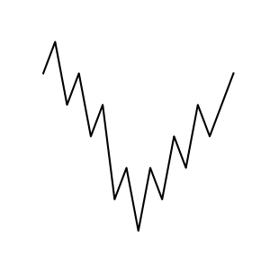
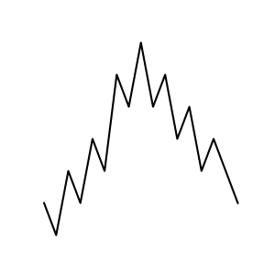
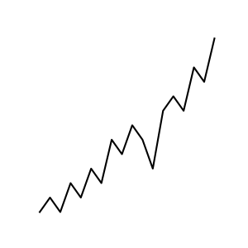
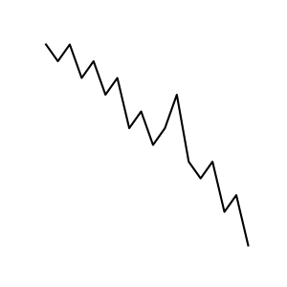
Trading Strategy
Just buy low and sell high, simple!
How?
Sell High
Sell High
Buy Low
Buy Low

Slide 4
Trading Strategy
Just buy low and sell high, simple!
Then, how to predict the future?
Sell High
Sell High
Buy Low
Buy Low

Slide 5
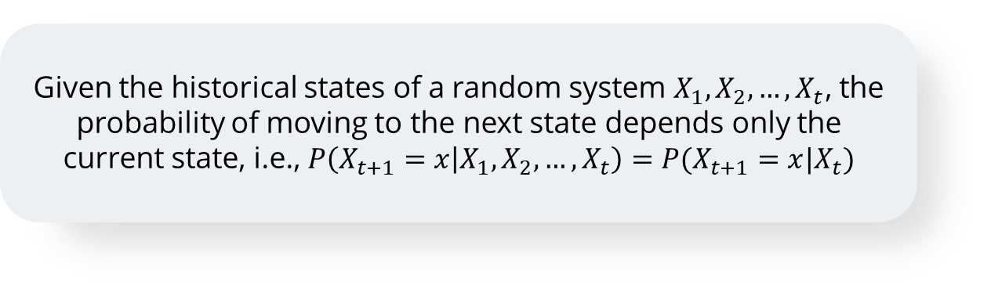
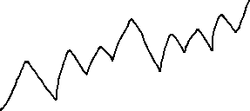
Stock Movement as a Markov Process
1
What is a Markov process?
Given the historical states of a random system $X_{1}, X_{2},…, X_{t}$, the probability of moving to the next state depends only the current state, i.e., $P\left(X_{t+1}=x | X_{1},X_{2}, …, X_{t}\right)=P(X_{t+1}=x|X_{t})$
Stock goes up
0.3
Stock Price
0.5
No change
We don’t care how we get to the current price
0.2
Stock goes down

Slide 6
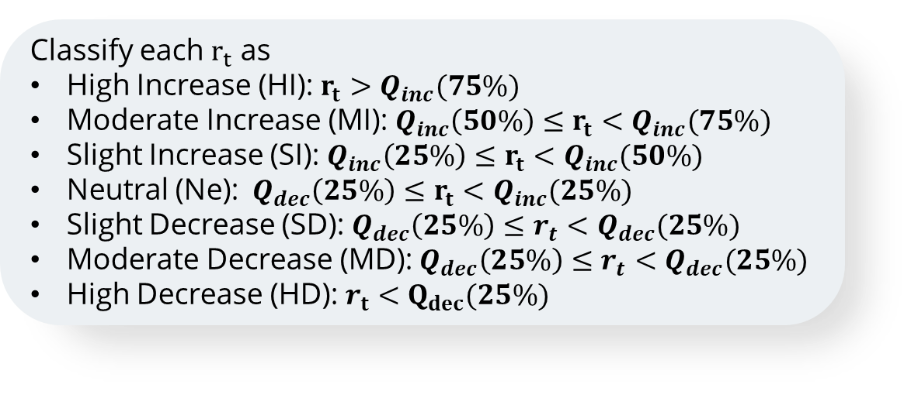
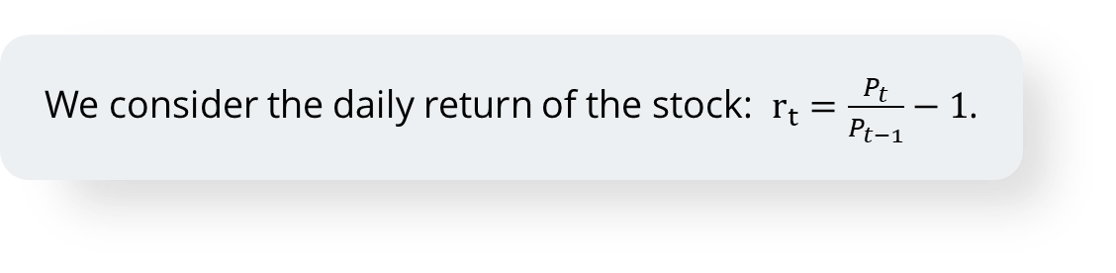
Stock Movement as a Markov Process
2
Stock Movement as a Markov process
We consider the daily return of the stock: $r_{t}=\frac{P_{t}}{P_{t−1}}−1$.
Classify each $r_{t}$ as
High Increase (HI): $r_{t}>Q_{inc}(75\%)$
Moderate Increase (MI): ${Q_{inc}\left(50\%\right)≤r}_{t}<Q_{inc}(75\%)$
Slight Increase (SI): ${Q_{inc}\left(25\%\right)≤r}_{t}<Q_{inc}(50\%)$
Neutral (Ne): ${Q_{dec}\left(25\%\right)≤r}_{t}<Q_{inc}(25\%)$
Slight Decrease (SD):${{ Q}_{dec}\left(25\%\right)≤r}_{t}<Q_{dec}(25\%)$
Moderate Decrease (MD):${{ Q}_{dec}\left(25\%\right)≤r}_{t}<Q_{dec}(25\%)$
High Decrease (HD): $r_{t}<Q_{dec}(25\%)$

Slide 7
Stock Movement as a Markov Process
2
Stock Movement as a Markov process
We define a hyperparameter: lookback – The number of prior prices to consider
forward – The number of future days to predict
The sequence of prices can be encoded as a tuple based on the daily return
Example: (HI, SD Ne, HD, MI)
Now, we can use the historical prices to estimate the probability distribution of the next price state
$$P\left(X_{t+1}=\left(x_{t+1}, x_{t+2}, …, x_{t+forward}\right) | X_{t}=\left(x_{t−lookback+1}, x_{t−lookback+2}, …, x_{t}\right)\right)$$

Slide 8
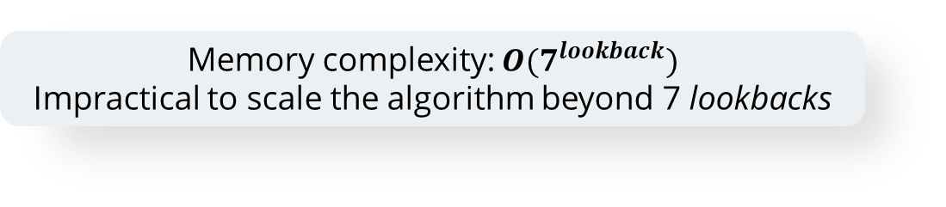
Stock Movement as a Markov Process
2
Stock Movement as a Markov process
How can we approximate this probability with the sample stock data?
$$P\left(X_{t+1}=\left(x_{t+1}, x_{t+2}, …, x_{t+forward}\right) | X_{t}=\left(x_{t−lookback+1}, x_{t−lookback+2}, …, x_{t}\right)\right)$$
Previous approach was to use a table to count the frequency of every possible combination of price movements
Memory complexity: $O(7^{lookback})$
Impractical to scale the algorithm beyond 7 lookbacks
How to improve memory efficiency for longer sequences?

Slide 9












Stock Movement as a Markov Process
3
ML-based predictor
Recurrent Neural Network
$$h_{0}$$
$$h_{1}$$
$$h_{2}$$
$$h_{n}$$
$$A$$
$$A$$
$$A$$
…
$$A$$
$$x_{0}$$
$$x_{1}$$
$$x_{2}$$
$$x_{n}$$

Slide 10












Stock Movement as a Markov Process
3
ML-based predictor
Model Architecture
Future trends
Feed Forward & Softmax
…
Concatenate & Flatten
…
$$h_{0}$$
$$h_{1}$$
$$h_{2}$$
$$h_{n}$$
$$A$$
$$A$$
$$A$$
…
$$A$$
$$x_{0}$$
$$x_{1}$$
$$x_{2}$$
$$x_{n}$$

Slide 11
Stock Movement as a Markov Process
4
Use prediction in the strategy
$$P[X_{t+1}=\left(x_{t+1}, x_{t+2}, …, x_{t+forward}\right) \text{| }X_{t}=\left(x_{t−lookback+1}, x_{t−lookback+2}, …, x_{t}\right)]$$
The prediction of future trend is the price state with the highest probability
${\hat{X}}_{t+1}={argmax}_{x} \left(P[X_{t+1}=x \text{| }X_{t}=\left(x_{t−lookback+1}, x_{t−lookback+2}, …, x_{t}\right)] \right)$
Sell High
Sell High
Buy Low
Buy Low

Slide 12
Experiment
1
Experimental setup
The historical price of stocks in S&P500 were collected
Total number of obtained stocks: 496
2013
2022
2023
Training period
Validation period
Backtest
The stocks’ prices are categorized into 7 categories
Each data point is then one-hot encoded

Slide 13
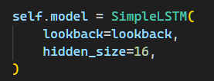
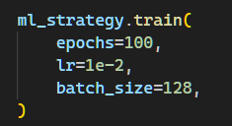

Experiment
2
Model hyperparameters
$$Loss\left(y, \hat{y}\right)=−\sum_{x ∈ \{up, side, down\}}{y_{i}log({\hat{y}}_{i})}$$
The model’s parameters are optimized by AdamW optimizer

Slide 14
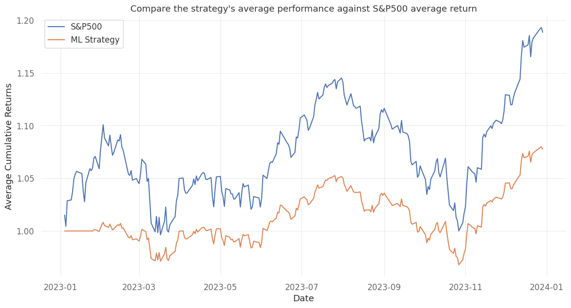
Experiment
3
Experimental results
S&P500 Performance
Monthly Expected Return: 0.010
Monthly Volatility: 0.045
Sharpe ratio: 0.222
Strategy Performance
Monthly Expected Return: 0.006
Monthly Volatility: 0.025
Sharpe ratio: 0.226
Can it beat the market?
The strategy beats 243 stocks
→Yes, but only 49% of the time
The strategy generates higher returns than 196 stocks
→Actually beat the market 49.52% of the time

Slide 15
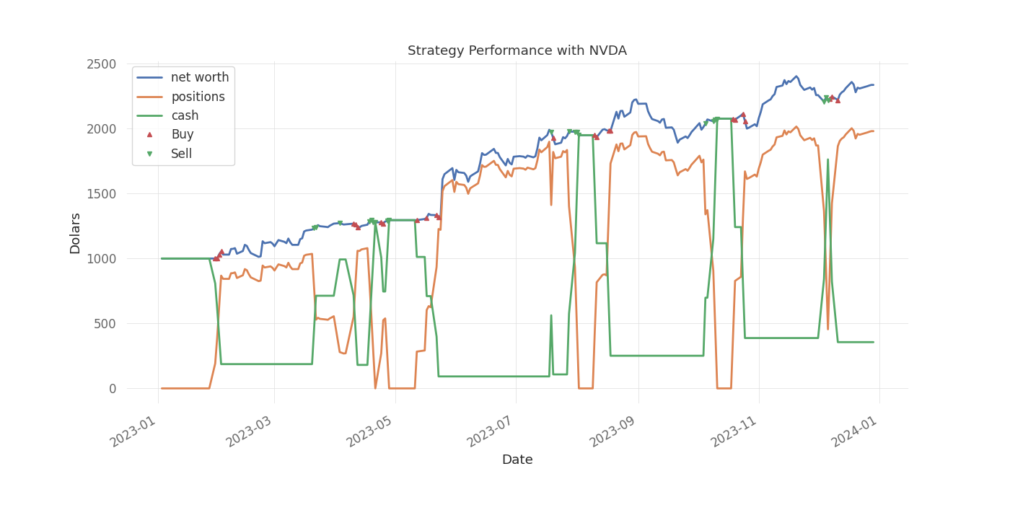
Experiment
4
Case study - NVDA
Monthly Expected Return: 0.082
Monthly Volatility: 0.094
Sharpe ratio: 0.874

Slide 16
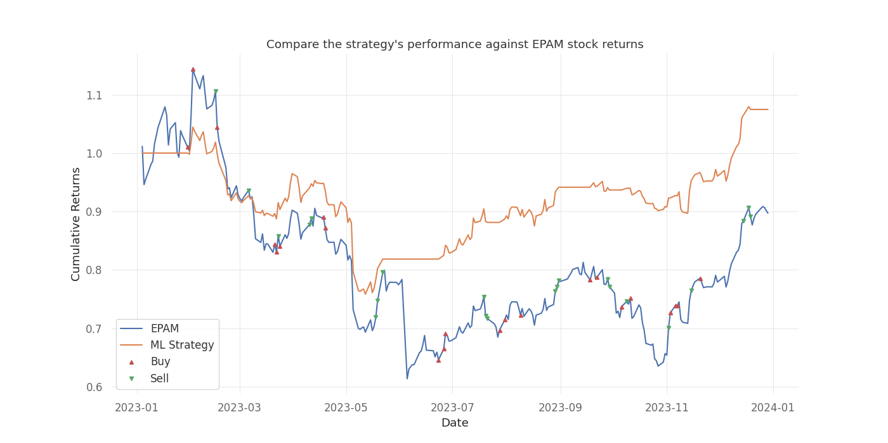
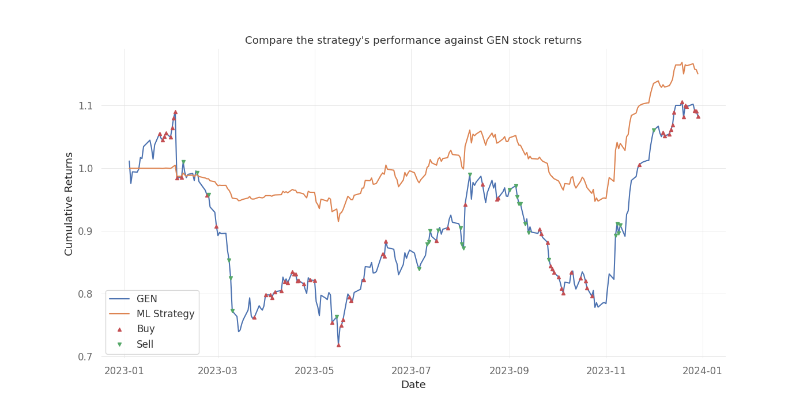
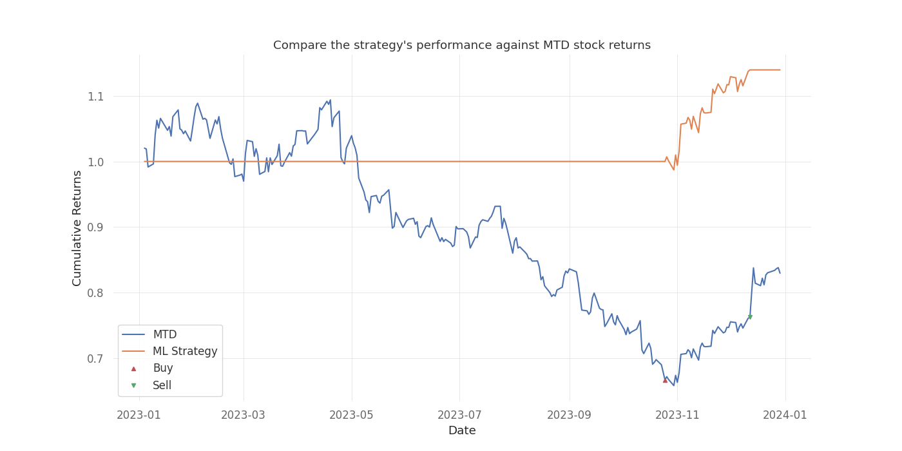
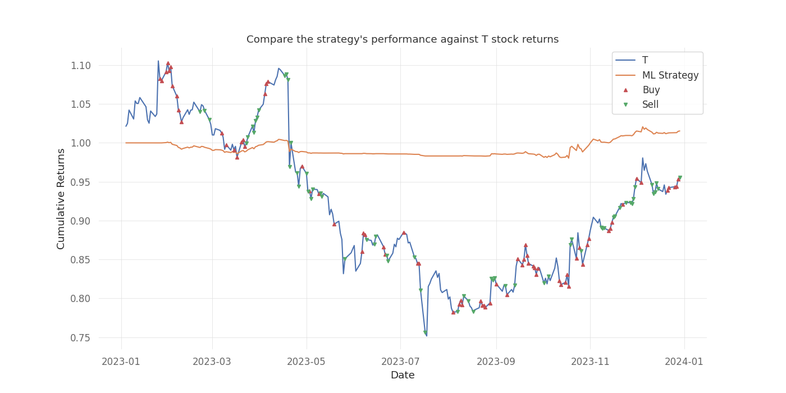
Experiment
4
Case study – Bearish Markets

Slide 17
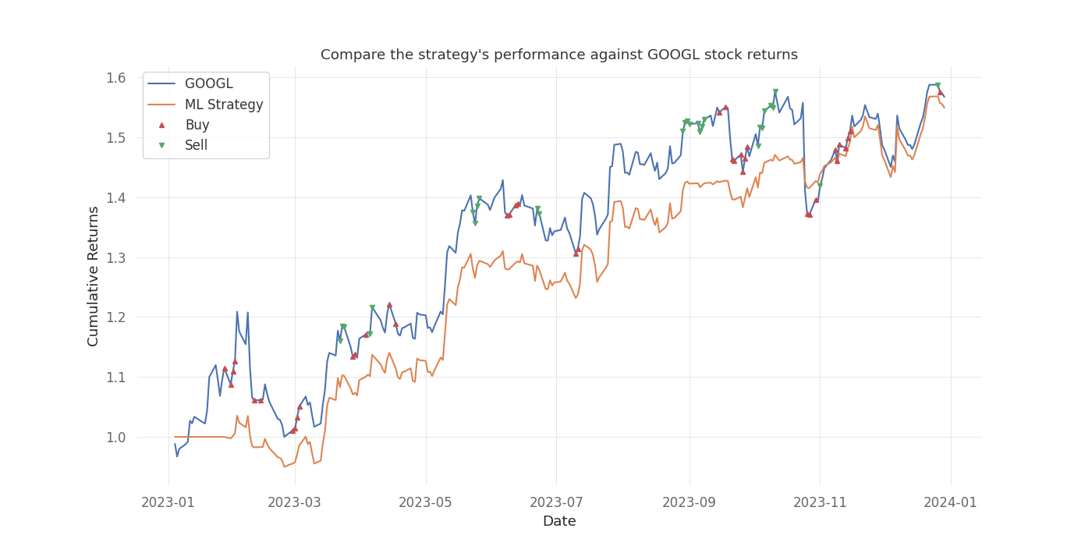
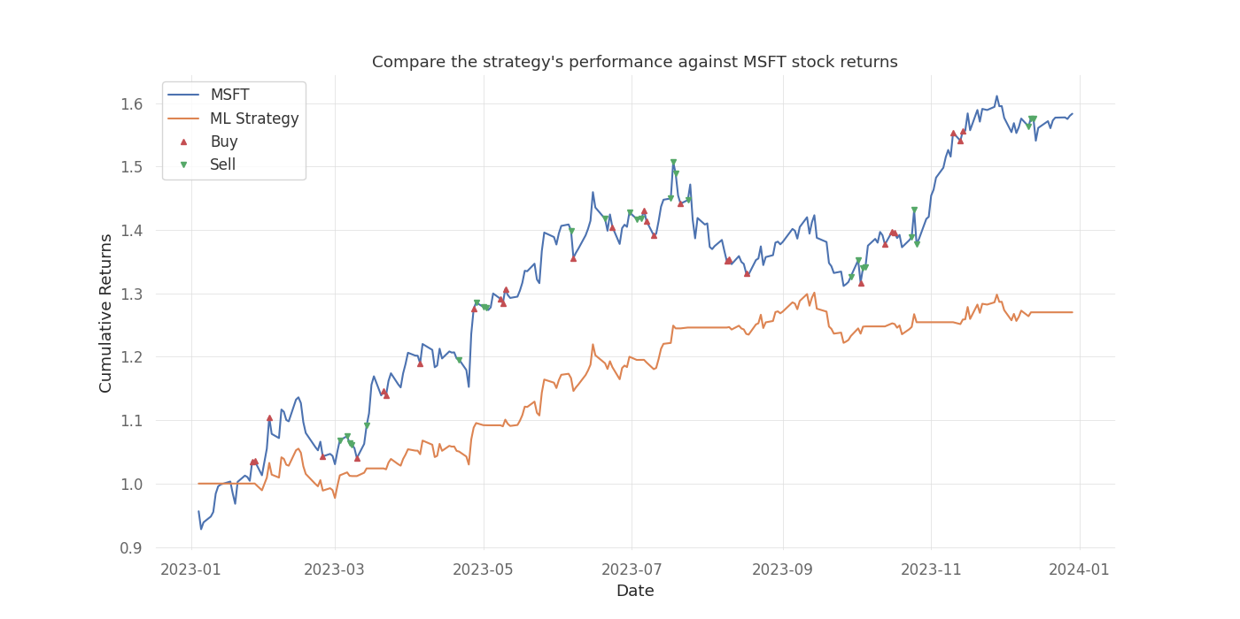
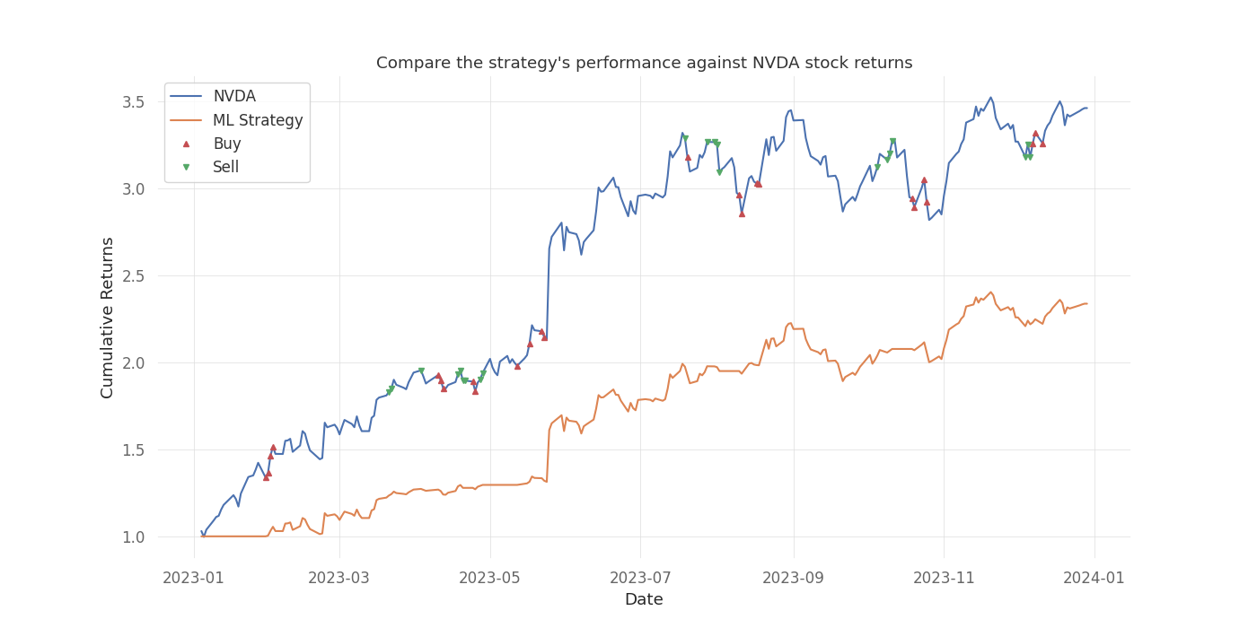
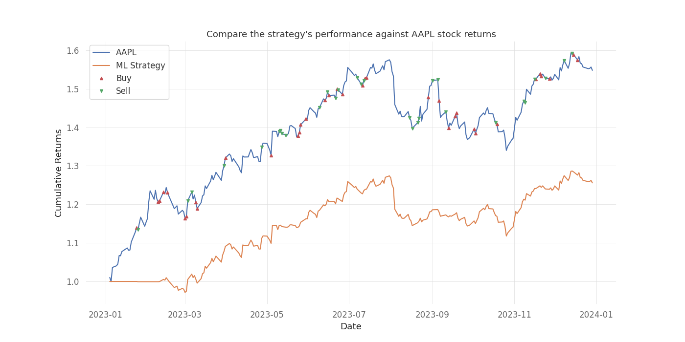
Experiment
4
Case study – Bullish Markets

