Slide 1
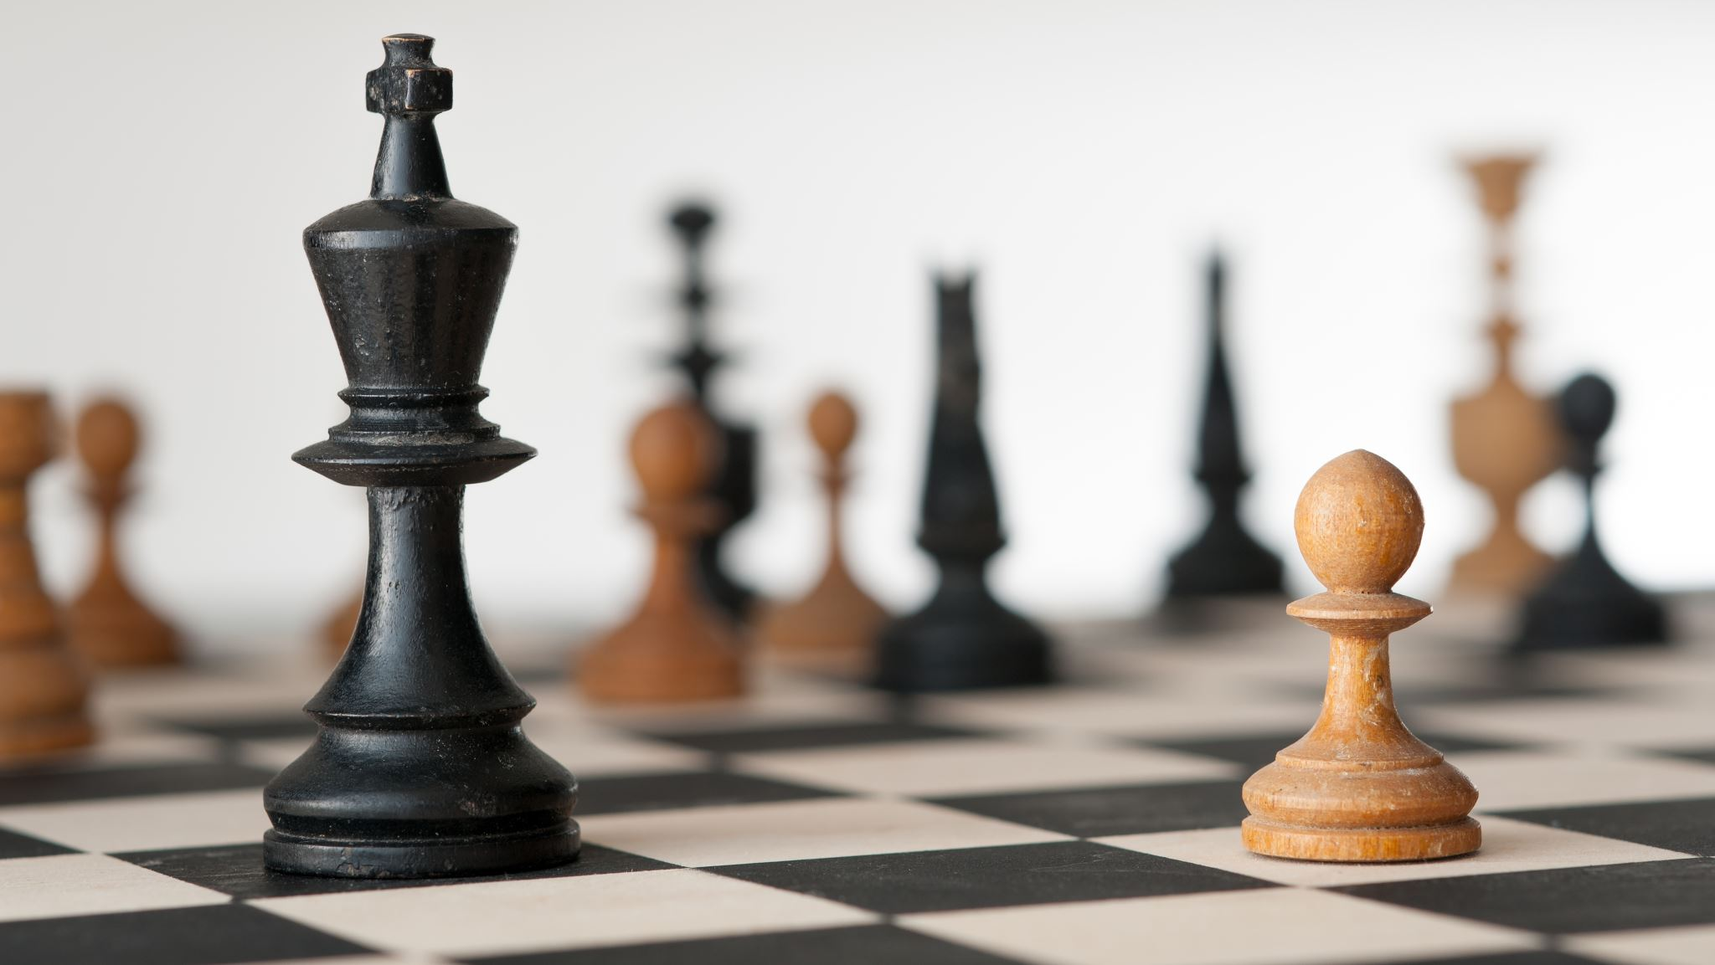
RANDOM CHESS
Team HI
Nguyen Minh Duc
Nguyen Thu Phuong
Truong Nhat Nguyen Bao

Slide 2
RULES
Still have 2 players black and white.
Each player starts with 1 king and 15 pawns.
Player can pay 7 points to roll a random major piece (bishop, knight, rook, queen)
Each turn, player gain 1 point.
Player can gain points by taking opponent’s piece.
All other normal chess rules still apply.

Slide 3
WHY
Classical chess is boring
Classical chess is slowpace
Variations
Randomness

Slide 4
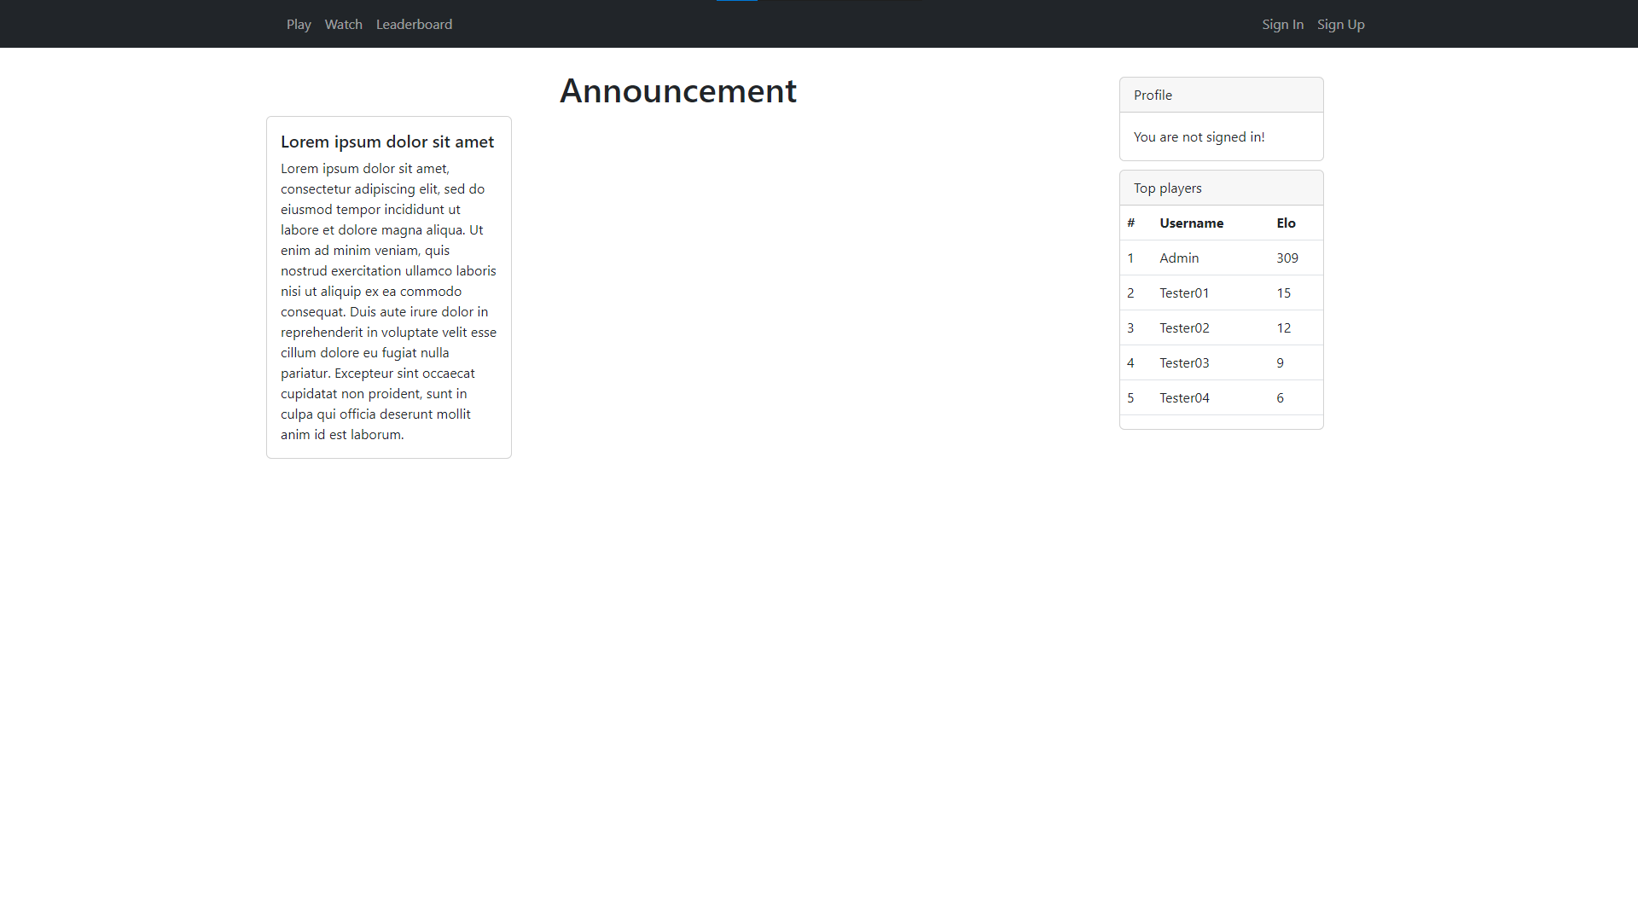
DEMO

Slide 5
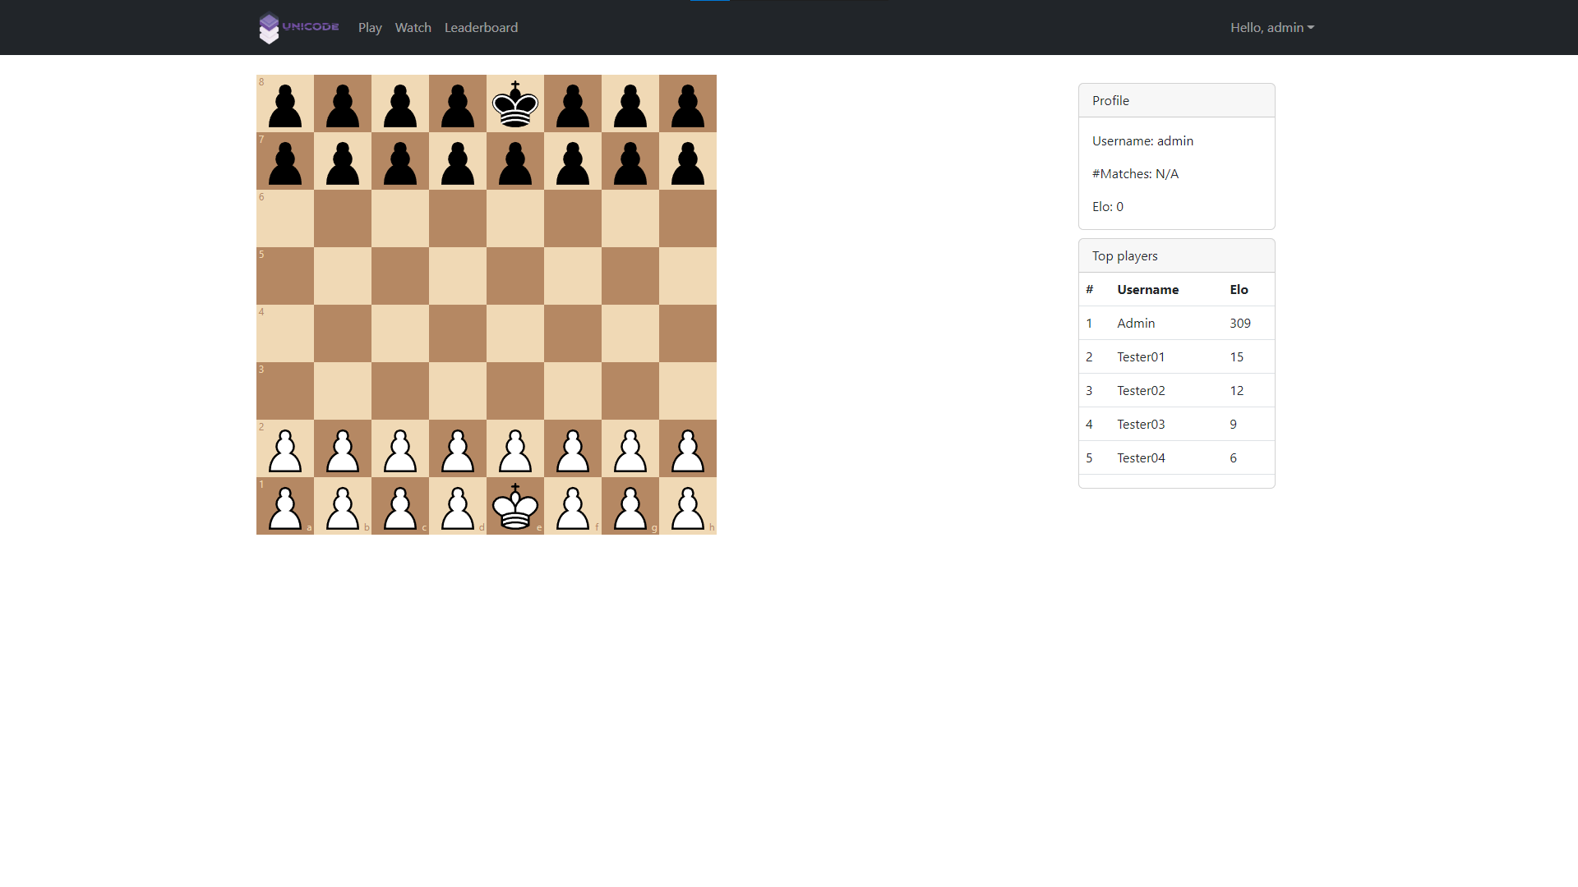
DEMO

Slide 6
THIS SLIDE IS NOT FINISHED

