Slide 1



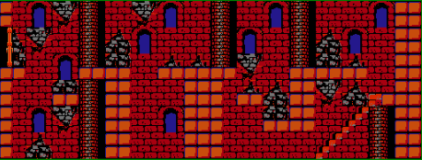
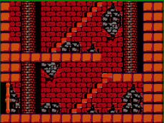

Scene 4
Scene 3
Start
Scene 1
Scene 2

