Slide 1
Clothes Classification Based on CNN
Nie Yi
STAT. 6289 Midterm
https://github.com/kurononyan/My6103Work/blob/main/Midterm6289/Midterm_Nie_Yi.ipynb
Notes:
In this project, three models are trained to build the clothes classifier. In addition, The accuracy of prediction on test set of three models are also compared. Finally, pictures from Amazon goods are used for testing the CNN model.

Slide 2


Introduce the Dataset
Classes in the data:
Try to print the first element in the data:
Here are 10 classes in our data.
The image size is 28*28, and it's of the 9th class
Notes:
Before transforming the data, we need to know some basic information about the dataset. Here are 10 classes in our data.
Print the first element of trainset, the image size is 28*28, and it's of the 9th class. The image is stored as 0, let us print it.

Slide 3
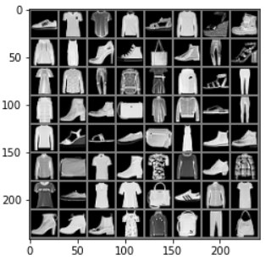
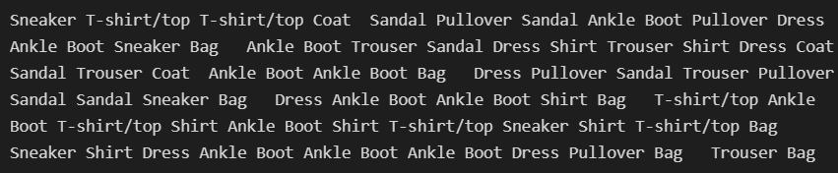
Data pre-processing
Transfer the type into Tensor
The range becomes -1 to 1
The shape from (H,W,C) to (C,H,W).
Then normalized.
Using DataLoader( ) here, we defined train set and test set. And shuffled the data.
Transform:
Using DataLoader( ) function
Show images in one batch size:
Notes:
Then composing these two transform steps here. The first step transfer the type into Tensor, and the range becomes -1 to 1. Also the shape from (H,W,C) to (C,H,W). The second step is normalized. Since our images in data is just black and white, there is only one channel.
Using DataLoader( ) here, we defined train set and test set. And shuffled the data.
Let's just print one batch size of data here.

Slide 4
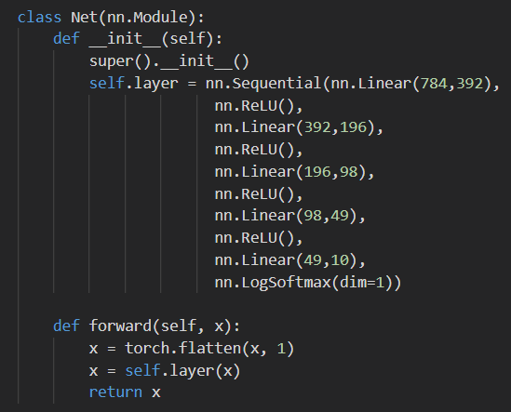
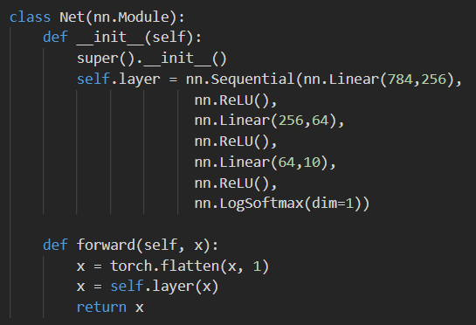
Define the neural networks
Fully connected neural network
（Linear layers = 5）
Fully connected neural network
（Linear layers = 3）
Why not the Softmax function?
Notes:
Then define our neural networks. In this projects, we difined 3 neural networks for comparison. Here are two fully connected neural networks with different number of hidden layers. The single image size is 28*28, thus we have 784 pixels here. And we take ReLu function as activation function which helps us train the network faster. Since there is only 10 classes, we have to compress the output to 10. Maybe you have noticed that here is a LogSoftmax function. So why not the softmax function?

Slide 5
Define the neural networks
Advantages of ReLu function:
1. can make the network training faster.
2. Increase the nonlinearity of network.
3. Prevent the gradient from disappearing.
4. Make the grid sparse.
Advantages of LogSoftmax function:
1. Transfer the output into a probability distribution. (The same as Softmax function)
2. Prevent overflow and underflow. (The shortage of Softmax function)
Notes:
When training the networks using softmax, I found when the input is negative and the absolute value is large, the numerator and denominator will become very small, and may be rounded to 0, resulting in overflow. In some class the accuracy of prediction bacame very low. Thus I used Logsoftmax instead, which is essential the same thing.

Slide 6
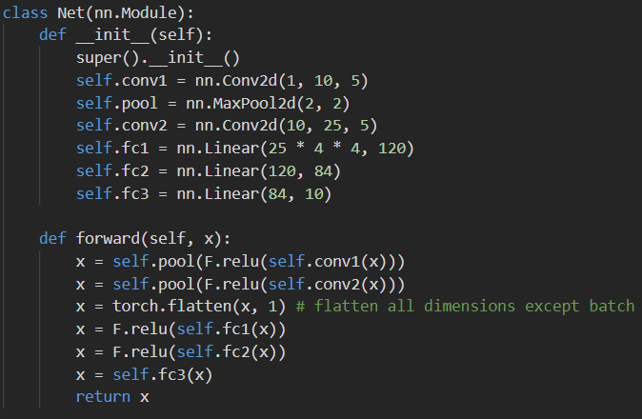
Define the neural networks
Convolutional neural network
1*28*28
↓
10*24*24
↓
10*12*12
↓
25*8*8
↓
25*4*4
Convolution
MaxPool
Convolution
MaxPool
Notes:
Then define the convolutional neural networks. Here we have two convolutional layers followed by Relu function and max pool function. Then we use 3 linear function compress the output into 10.

Slide 7
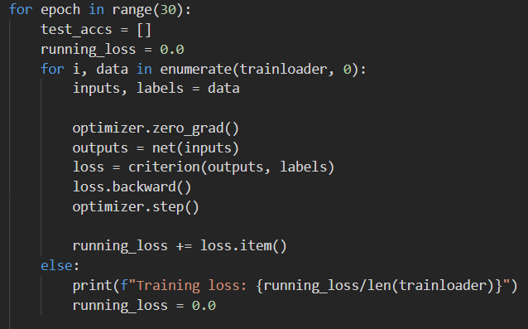
Training the networks on trainset
Define a Loss function and optimizer
Print the loss when training
Let’s use a Classification Cross-Entropy loss and SGD with momentum.
Learning rate = 0.1
Epoch = 30
Notes:
Let’s use a Classification Cross-Entropy loss and SGD with momentum. The learning rate here is 0.1. Here we set the epoch as 30, in other word, we will use the whole trainset 30 times. Here is the result for training loss.

Slide 8
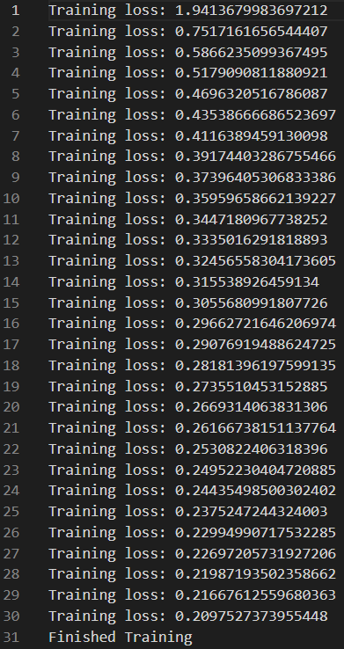
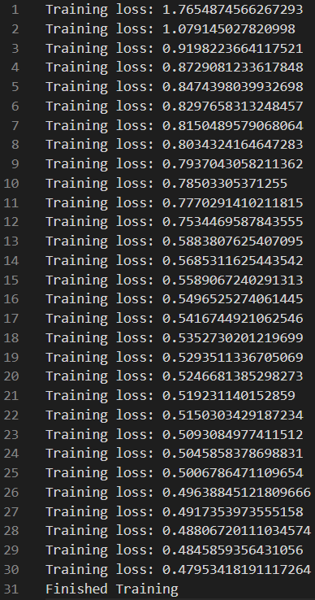
Training Loss Comparison
Fully connected neural network
（Linear layers = 5）
Fully connected neural network
（Linear layers = 3）
As the epoch increasing, the loss becomes lower. It shows that the fully connected network with 5 layers has a faster rate of convergence.
Notes:
As the epoch increasing, the loss becomes lower. It shows that the fully connected network with 5 layers has a faster rate of convergence. And the final loss is also lower than the net work with 3 layers.

Slide 9
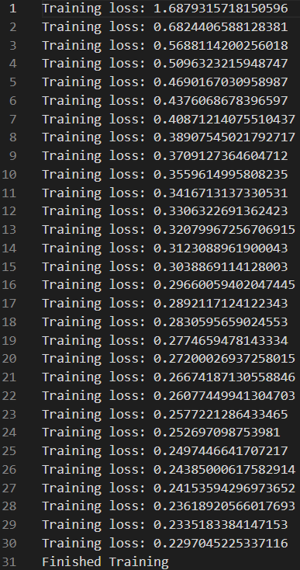
Training Loss Comparison
Convolutional neural network
The CNN has the lowest loss in the first.
Notes:
The CNN has lower loss in the first. And the final loss is also very low.

Slide 10
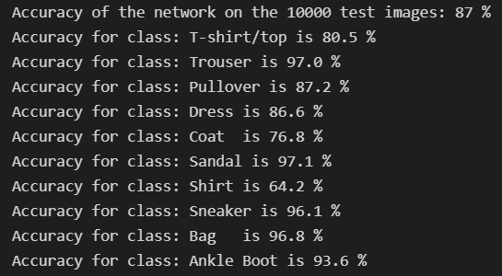
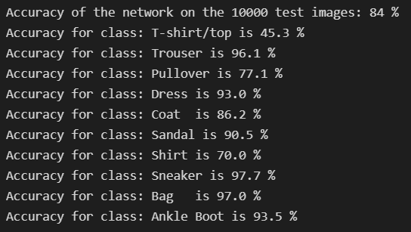
Prediction Accuracy on Testset
Fully connected neural network
（Linear layers = 5）
Fully connected neural network
（Linear layers = 3）
Notes:
After training the networks, we want to test if it really learned anything. Thus we used trained networks for predicting the data in test set. The accuracy in each class is here.

Slide 11
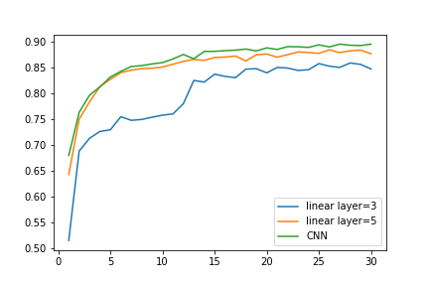
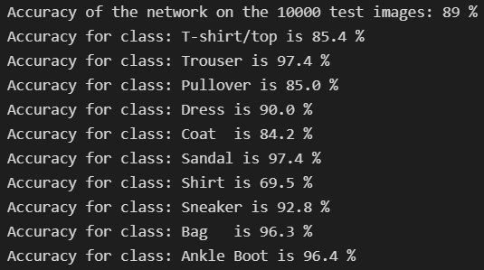
Prediction Accuracy on Testset
Convolutional neural network
Plot the accuracy
The CNN has the best accuracy.
The fully connected model with 5 layers is slightly worse than CNN.
Notes:
The CNN has the best accuracy. The fully connected model with 5 layers is slightly worse than CNN. Then the 3-layer network is the worst, and it has a slow rate of convergence.

Slide 12


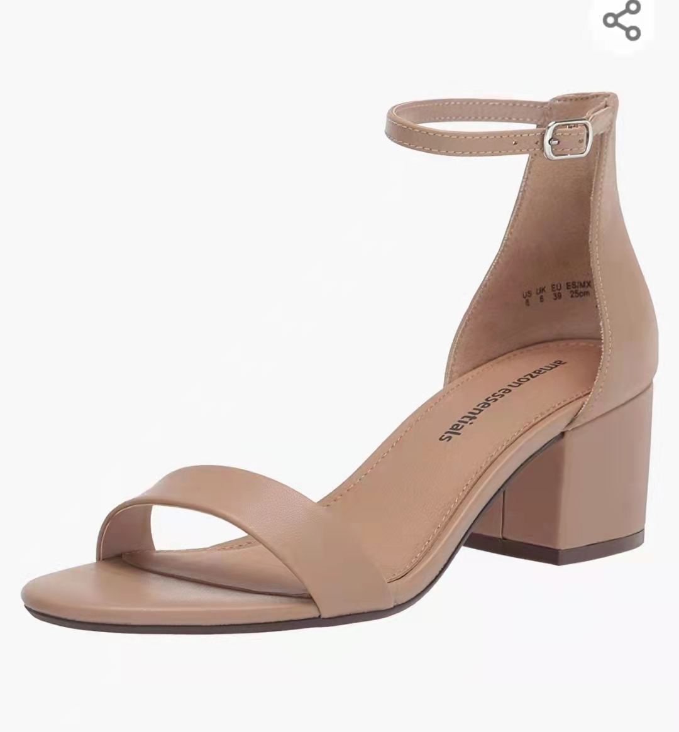
CNN prediction on Amazon Goods
Images of three Amazon goods are selected to be tested.
T-Shirt/top
Trouser
Sandal
Notes:
Only using the prepared dataset is a little bit boring, so I found three images from Amazons.

Slide 13
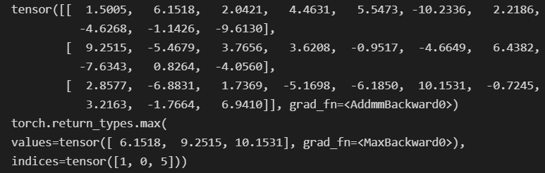
CNN prediction on Amazon Goods
After pre-processing:
Prediction Output:
Classification Result:
T-Shirt/top
Trouser
Sandal
[T-Shirt/top,
Trouser,
Sandal]
Notes:
After pre-processing we got images like this. And the prediction output shows the first item is the mostly to be T-shirt/top, then the coat. The second item is mostly to be trouser, then shirt. The third item is mostly to be sandal, then ankle boots. Fortunately, it made the right classification!

Slide 14

Thank your for watching!

