Slide 1
NUI Using Microsoft’s Kinect Sensor

Slide 2
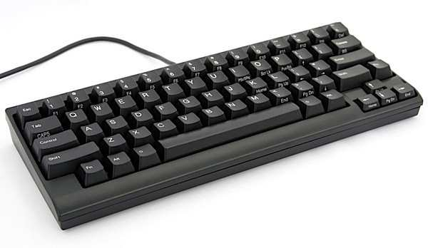
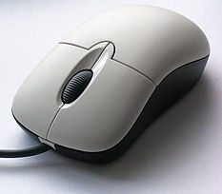
Famous input devices

Slide 3
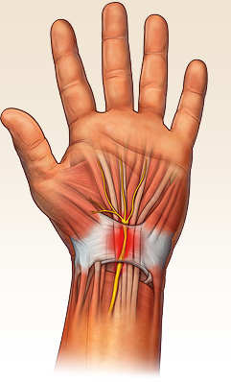
Carpal Tunnel Syndrome

Slide 4
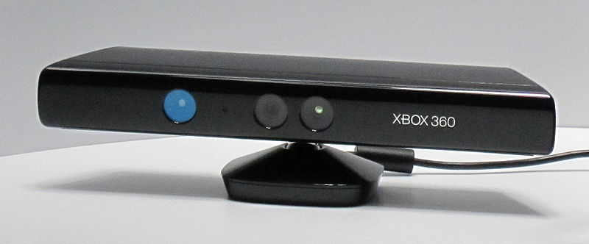
Kinect

Slide 5
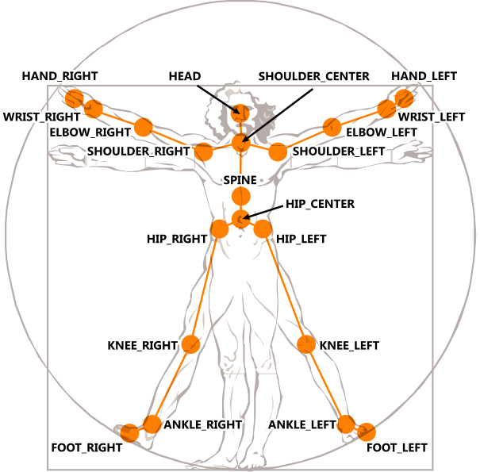

Slide 6
Sources
http://www.geekstuff4u.com/happy-hacking-keyboard-lite-2.html#.UFx_6bLiZcQ
http://www.mycarpaltunnel.org/
http://en.wikipedia.org/wiki/File:3-Tastenmaus_Microsoft.jpg
http://www.digitaltrends.com/gaming/kinect-price-and-bundle-officially-announced/

