Slide 1
Plant A
Maintenance
Agent
An ontology-backed AI agent for field engineers in Japanese manufacturing
Every answer comes with evidence you can trace on a graph.
Gemini 3.8 Flash · Agent Development Kit · Vertex AI · Cloud Run · Neo4j AuraDB
AI Builder Cup 2026 · Manufacturing · October 2026
Kakeru Kurosawa · Junichi Fujioka · Kotaro Fukuo
All data in this deck is synthetic (“Plant A”). No real company, product or person is referenced.

Slide 2

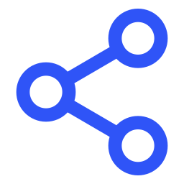


Maintenance know-how that lives in four systems and in retiring veterans can become an AI agent that answers with traceable evidence, on the data a plant already has
Executive summary
Problem
When a machine fails at night, the facts needed to decide are scattered across the equipment register, work orders, the parts inventory and manuals, and the veteran who connects them is off duty or retiring. Document search cannot connect them.
Solution
We model the plant as an ontology (equipment, components, failure modes, symptoms, work orders, procedures, parts, people) in a knowledge graph. A Gemini agent built with ADK walks it through read-only tools and cites work-order IDs and manual pages.
Proof
Deployed on Cloud Run with Neo4j AuraDB. In rehearsal, 45 of 45 reference answers were correct across diagnosis, cross-line comparison, parts and people, aggregation and “no record” questions. ADK hallucination score 1.0; median answer about 20 seconds.
Impact
Shorter diagnosis on every unplanned stop, cross-line patterns that registers alone hide, and know-how that survives retirements. The same pipeline runs on a plant's own registers, work orders and manuals, in Japanese or English, in four weeks.

Slide 3
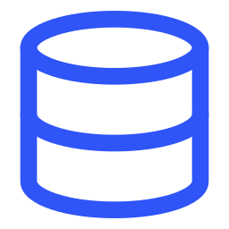



Field engineers lose hours on every unplanned stop because the facts needed to decide live in four places, and in one veteran's head
1. The problem
Equipment register & BOM
Work orders
Manuals
Veteran experience
Models, install years and component structure in a CMMS or Excel
Finding “the same model on another line” means searching across registers
“What happened, when, what we did” in a CMMS, daily reports or paper
Similar past cases are found from memory, if at all
Vendor PDFs with judgement thresholds and procedures
Someone has to remember which page
Which cause to suspect from a symptom; what to check on a repeat failure
Not on the night shift; lost at retirement
Plant A (our synthetic demo plant) Three press procedures (slide-guide, clutch-brake and flywheel-bearing replacement) can only be performed by one technician who holds the press-operation certificate and retires at the end of FY2026. The register, the work orders and the skills ledger each know one piece of this; nobody sees it until the three are connected.

Slide 4
Document search (RAG alone) cannot answer the questions that matter most on the floor: cross-line similarity, counts, and “who can do this”
1. The problem
Document search only
Knowledge graph + agent (ours)
Retrieves text chunks that look similar. The P-301 manual and P-301 reports are found
Reports from the same model on another line never say “P-301”, so they are missed
Cannot count: “which machines had the most bearing-related stops this year?”
Evidence is a text fragment; a person must work out which machine and which report
May infer a part number or lead time from context and state it as fact
Stores equipment, components, failure modes and work orders as things and relationships
Crosses lines through the model node: P-301 → CP-200 ← P-101
Aggregates by failure-mode category and date in one query
Evidence is work-order IDs, procedure IDs and manual pages, drawn as a sub-graph
Answers “no record” when the graph has nothing; never invents an ID

Slide 5



Vector search over the manuals finds where to start; the knowledge graph supplies the ranked answer, the next action and the evidence
2. The solution
A plant's existing data
Equipment register & BOM
Transform & load
Normalise names, build the failure-mode dictionary, chunk manuals, embed with Gemini
Work orders (CMMS)
Ontology graph
Neo4j AuraDB
Equipment · components · failure modes · symptoms · work orders · procedures · parts · people · manual chunks with a vector index
Gemini agent (ADK)
Three read-only tools: semantic manual search, keyword search, Cypher
Answers in a fixed format: conclusion · ranked causes · action · evidence IDs
Manuals (PDF)
Skills ledger · purchasing
Three mechanisms 1 Vector search picks the entry point (a manual passage linked to failure modes). 2 The graph walk delivers the answer: causes ranked by history, procedure, parts in stock, certified people. 3 Every ID in the answer is a node the user can inspect on screen.

Slide 6
Twelve node types and seventeen relationships, with the failure mode as the hub, cover diagnosis, history, the procedure, parts and people in one walk
2. The solution
Model
CP-200
HAS_COMPONENT
Component
main shaft bearing
Work order
WO-2026-020 · 6 cases
PERFORMED_BY
Technician
cert: rotating machinery
HAS_FAILURE_MODE
DIAGNOSED
Symptom
vibration ↑
Failure mode
bearing inner ring wear
OF_MODEL
HAS_SYMPTOM
ON_EQUIPMENT
PERFORMED
MENTIONS
RESOLVES
Equipment
P-301 · line 3
Manual chunk
CP-200 manual p.1
Procedure
PR-001 · 240 min
REQUIRES_PART
Part
6306ZZ · stock 4 · 3 days
SUPPLIED_BY
Supplier
lead time
HAS_EQUIPMENT
Line
Line 3 · cooling utility
Why an ontology, not tables The same question (“has this happened before?”) is one path, whatever the plant. New data sources attach as new nodes; the agent's tools do not change. Plant A 295 nodes · 901 relationships · 43 manual chunks (768-dim Gemini embeddings).

Slide 7
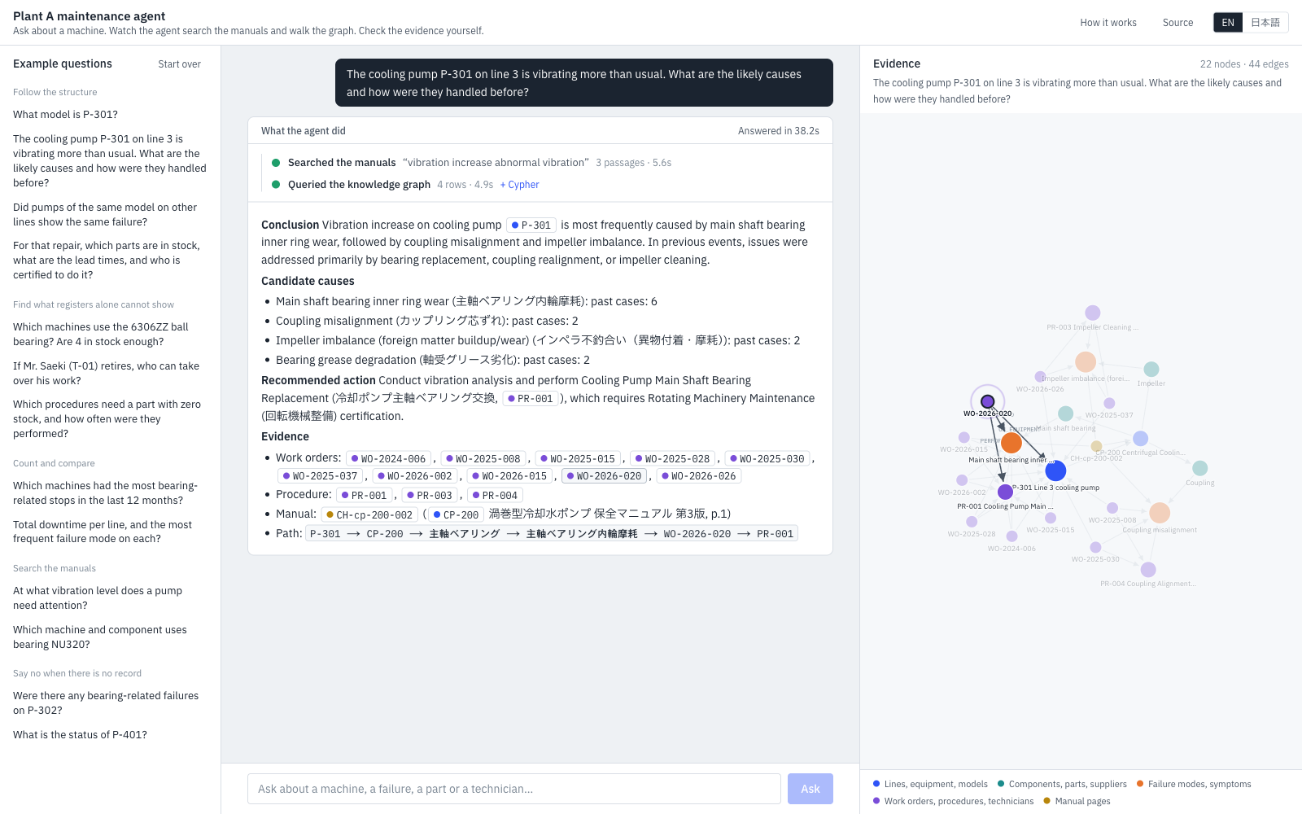
In the live app every cited ID is a clickable node: the engineer sees what the agent did, reads the answer, and checks the evidence on the graph
3. The product
1
What the agent did
Semantic manual search, then one Cypher query. Each step shows the search text or the Cypher, row counts and seconds.
2
Answer in a fixed format
Conclusion · candidate causes with past-case counts · recommended action with the required certification · evidence IDs.
3
Evidence graph
Shortest paths between the cited nodes. Clicking WO-2026-020 in the answer highlights it on the graph.
4
Bilingual over Japanese records
Ask in English or Japanese; the graph values stay in Japanese with English names, IDs never change.

Slide 8
An ADK agent with three read-only tools, Gemini for reasoning and embeddings, two Cloud Run services, and guardrails that reject writes and invented IDs
4. Technical merit
Vertex AI
Gemini 3.8 Flash · gemini-embedding-001 (768-dim)
Cloud Run · kg-agent
Google ADK · Gemini 3.8 Flash · 3 read-only tools · SSE streaming
Cloud Run · kg-web
Next.js 16: chat, tool timeline, evidence graph
Browser
field engineer
Neo4j AuraDB (on Google Cloud)
ontology graph · vector index · full-text index
Secret Manager · Cloud Scheduler · Cloud Logging · Cloud Build · Artifact Registry
Read-only by construction
Write clauses are rejected before execution; transactions open in READ mode; 20-second query timeout. Covered by unit tests.
Evidence is mandatory
Fixed answer format with an Evidence section. IDs become chips and are resolved against the graph, so an unknown ID cannot appear as a node.
Private agent, public UI
kg-agent accepts only ID tokens from the web service account and Cloud Scheduler. Neo4j credentials come from Secret Manager.
Evaluated, not assumed
ADK eval set with LLM-judged response match and hallucination metrics, plus a rehearsal harness with fact checkers (next slide).

Slide 9
Rehearsal and ADK evaluation: 45 of 45 reference answers correct, hallucination score 1.0, median answer about 20 seconds with two to three tool calls
4. Technical merit
45 / 45
1.0
≈ 20 s
0
reference answers correct
(9 cases × 5 runs, fact-checked)
ADK hallucinations_v1
(7 / 7 eval cases pass)
median answer time
2–3 tool calls
invented work-order IDs,
parts or people
Case | Question | Correct | Median (min–max) | Tool calls
Q1 | P-301 vibrating: causes and past fixes (JA / EN) | 10 / 10 | 23 s (18–32) | 2.4
Q2 | Same model on other lines (follow-up) | 5 / 5 | 32 s (22–42) | 2.0
Q3 | Parts in stock, lead times, certified technicians | 5 / 5 | 24 s (22–30) | 2.2
Q4 | Most bearing-related stops in the last 12 months | 5 / 5 | 26 s (20–37) | 2.6
B2 | Who can take over when T-01 retires | 5 / 5 | 35 s (19–44) | 3.2
D2 | Which machine uses bearing NU320 (keyword) | 5 / 5 | 20 s (18–44) | 3.0
E1 / E2 | Bearing failures on P-302 · unknown machine → “no record” | 10 / 10 | 19–23 s | 2.4–3.4
Rehearsal on the deployed AuraDB graph with gemini-3.8-flash, 2026-10-06 (agent/rehearse.py, log in docs/eval). ADK eval: final_response_match_v2 = 1.00 on all 7 cases, hallucinations_v1 = 1.00 on 6 cases and 0.86 on the three-turn conversation (judge gemini-3.5-flash, 3 samples).

Slide 10
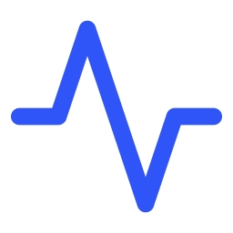

For a plant the value is hours of downtime avoided on every incident, patterns that registers hide, and know-how that survives retirements
5. Impact and innovation
80
935 min
1
≈ 20 s
unplanned stops in two years at Plant A
bearing-related downtime on one pump in 12 months
technician holding the only press certification, retiring FY2026
from question to ranked causes, parts and people
Faster diagnosis on every stop
Patterns registers hide
Know-how that survives
Plant A: 80 unplanned stops in two years, 9 bearing-related in the last 12 months alone (P-301: 3 stops, 935 minutes).
The agent returns ranked causes, the procedure, parts and people in about 20 seconds instead of a search across four systems.
Illustrative: one hour saved per incident × 40 incidents a year × ¥500k per hour of line stop (assumption) ≈ ¥20M a year per plant.
Same-model failures across lines (P-101 ×4, P-201 ×1) surface in one answer.
A part shared by 8 machines with stock for two replacements; procedures that depend on a zero-stock part.
Bearing-related downtime concentrated on the CP-200 pumps: a maintenance-plan decision, not a repair.
One technician holds the only press certification and retires in FY2026; the graph shows which procedures have no successor.
Work orders become searchable history; manual pages become cited evidence.
New engineers and night shifts get the veteran's path, with the IDs to verify it.
Cost figures are illustrative assumptions for a mid-size plant; the team's manufacturing CFO is validating them against industry benchmarks for the final pitch.

Slide 11


What is new: answers grounded in an ontology with graph evidence, bilingual access to Japanese floor documents, and an agent that is read-only and says “no record”
5. Impact and innovation
Ontology-grounded GraphRAG
Built for Japanese plants
Honest and safe by design
Vector search only chooses where to start; the content of the answer comes from graph structure, so every claim maps to a node and a path.
Cross-line, aggregation and “who can do it” questions that document RAG cannot answer become one Cypher query.
Registers, work orders and manuals stay in Japanese; the master data carries Gemini-generated English names.
An engineer asks in either language and gets the same IDs. JAPAC plants with mixed teams get one assistant.
The agent cannot write to the graph and rejects write clauses before execution.
When there is no record it says so and lists only the IDs it checked. Verified in rehearsal and ADK eval.
Why Gemini + ADK made this possible in days
Gemini 3.8 Flash writes correct Cypher against a schema it is shown once and keeps a fixed answer format across languages; gemini-embedding-001 indexes Japanese manuals without a local model; ADK gives the tool loop, SSE streaming to the UI, Cloud Run deployment and an evaluation harness. The whole build, from synthetic plant to deployed app, took one week.

Slide 12
Four weeks from a plant's own registers to a working assistant; next: sensor time series, approved write-back, and a mobile UI for the floor
6. Roadmap and team
Week 1
Data inventory, ontology fit, load the equipment register, parts and people
Week 2
Work orders: normalise names, build the failure-mode dictionary, load history
Week 3
Manuals: chunk, embed, link to components and failure modes; define reference questions
Week 4
Agent prompts, evaluation with floor engineers, evidence graph, hand-over
After the first four weeks
Sensor time series
Attach vibration and temperature trends to equipment nodes; predict the failure mode and propose the procedure before the stop.
Approved write-back
Draft the work order from the conversation; a person approves before anything is written to the graph.
Mobile UI for the floor
Voice and camera input on a phone, offline manual pages, the same evidence graph.
Team
Kakeru Kurosawa
Product & engineering lead
Built the agent, the graph pipeline and the web app. COO at AIdeaLab; previously PwC consulting and new-business development for edge AI at Sony.
Junichi Fujioka
Manufacturing & impact
Manufacturing CFO. About 30 years in a global electronics group across plants, finance and operations. Validates the problem and quantifies the value.
Kotaro Fukuo
Software engineering
Software engineer with 8+ years in mobile and backend (React Native, TypeScript, Ruby on Rails, AWS). B.E. Mechanical Engineering Informatics, Meiji University.

Slide 13
Try it, read the code, ask it a question.
Live app kg-web-7ikzkb2evq-an.a.run.app
Source github.com/kurorooooo/kg-maintenance-agent
Kakeru Kurosawa · Junichi Fujioka · Kotaro Fukuo

