Slide 1
Agent-Driven Data Curation for Multi-lingual Fine-tuning
Yixian

Slide 2
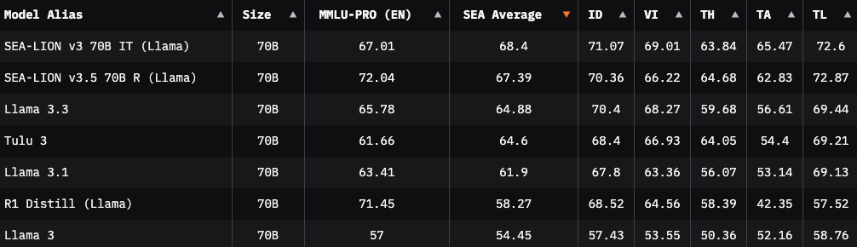
Prior Work 1 (SEA-LION)
Off-the-shelf LLMs excel in English (MMLU-PRO) but may not be as proficient in other languages
Through fine-tuning with multi-lingual data, models improve in non-English tasks for the same size
SEA-LION: Southeast Asian Languages in One Network (R. Ng et al.)
SEA-LION excels in Indonesian (ID), Vietnamese (VI), Thai (TH), Tamil (TA), Tagalog (TL) tasks
Current fine-tuning efforts involve manual effort, and not all data may be beneficial (e.g., train data dist. similar to existing knowledge, noisy data, etc)
Can we guide the model using an agentic framework to select data it is bad at, or even suggest what kind of data it may need from future data collection exercises?

Slide 3
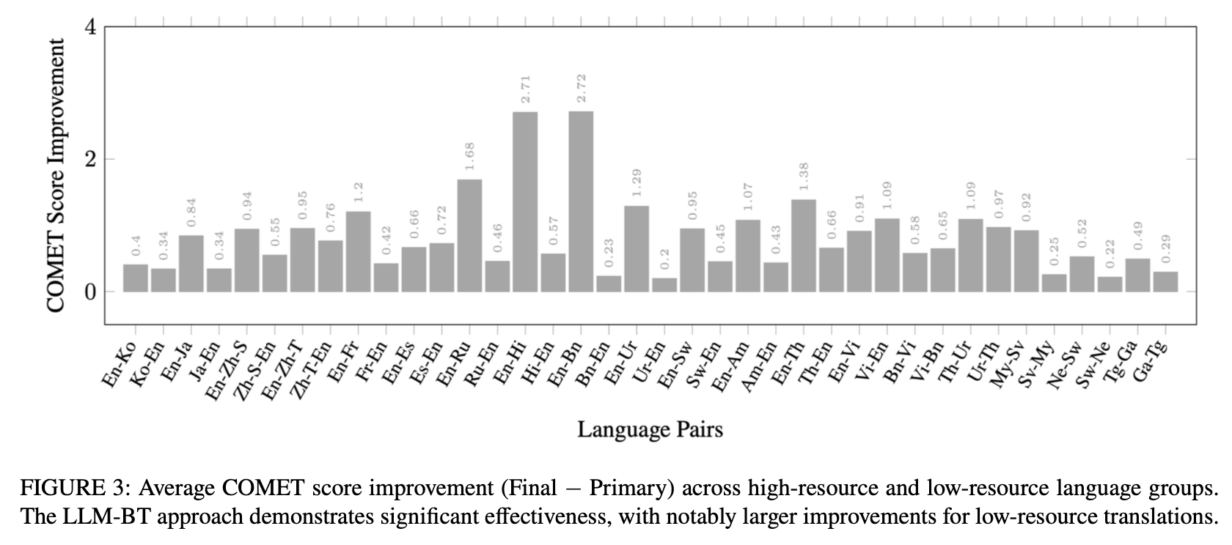
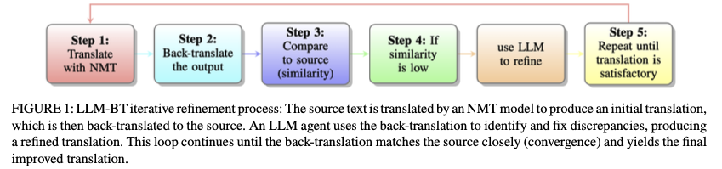
Prior Work 2 (LLM-BT)
Back-translation (source lang –> target lang –> source lang) can help improve translations
LLM-BT: Enhancing Multilingual Translation Utilizing Agents for Back-Translation (James J. Yoon et al.)
Doing multiple iterations of the above may result in better translations
Similarity matrix of the original text and the back-translated text serves as a scoring metric for translation
LLM can refine the translation prompt to get a better translation
We can extend this solution to guide fine-tuning of LLMs

Slide 4
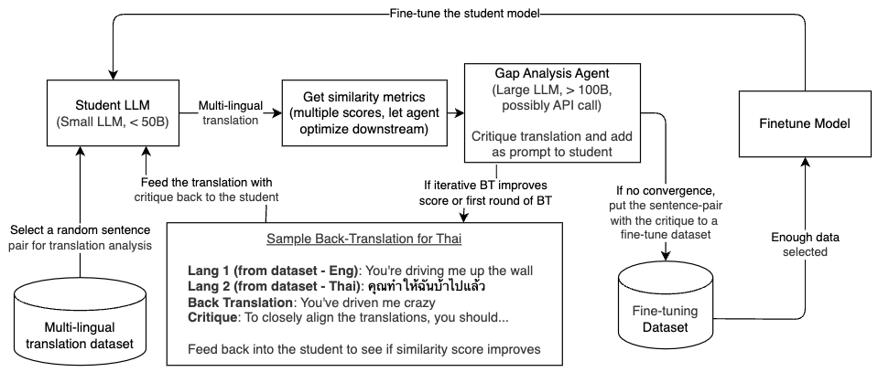
How can we fine-tune effectively?
Using back-translation, ask a large model (teacher) to critique the small model’s (student) output
Add the critique as a prompt, seeing if the new translation improves scores
If repeated rounds fail to converge or diverge, select this pair + critique into a fine-tune dataset
The fine-tune dataset contains the pair from the original dataset, and the critique as part of the prompt
Only do this for sentence pairs below a certain threshold score
Once enough data chosen, finetune the student model and repeat the process

Slide 5
Considerations
How to have the agent sample the dataset efficiently?
Static metrics for dataset selection
Ask the agent for what the current model’s gaps for a language through prompting
Possibly include websearch results to augment data
Can we introduce a few metrics, and let the agent decide which one is most significant for a certain sample?
When to trigger finetuning of data?
After n samples, use a static number for initial experiments
Stop if the model is not improving or converges
How to measure uncertainty and improvements in finetuning?
LLM-BT is promising as it involves the model in measuring uncertainty (similarity score)
BLEU/chr-F/COMET as additional metrics
Compare to same multi-lingual tasks as SEA-LION
How to effectively select the multi-lingual data?
Look at low-resource languages first (e.g., Southeast Asian languages)
Multi-lingual datasets exist but may not cover the same topic domain (Eng -> Thai vs. Eng -> Indonesian)
Can we use highly available translations across languages (e.g., translated religious texts, regional news, etc)

Slide 6
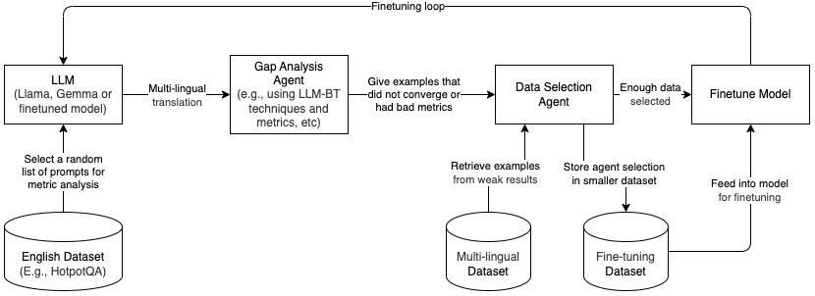
Proposal #1 (Select similar topics)
One agent to critique model responses by comparing same prompt across multiple languages
Done using some similarity matrix through multiple translations or relevant techniques
From “bad” responses, have another agent to select from raw dataset that may fill gaps
After a few rounds, finetune the model and run the loop (especially for previously bad prompts)
Compare with random selection/static metric selection

