Slide 1

Python final project
SE2008 Yeerhan Aheti

Slide 2
Agenda
1.Run program
2.Login section
3.Coin section

Slide 3
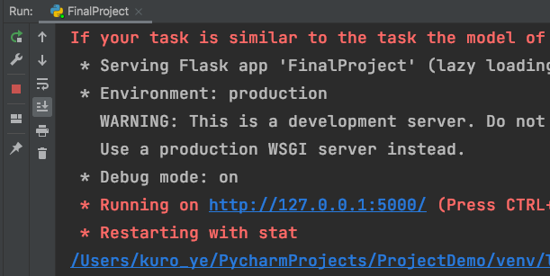
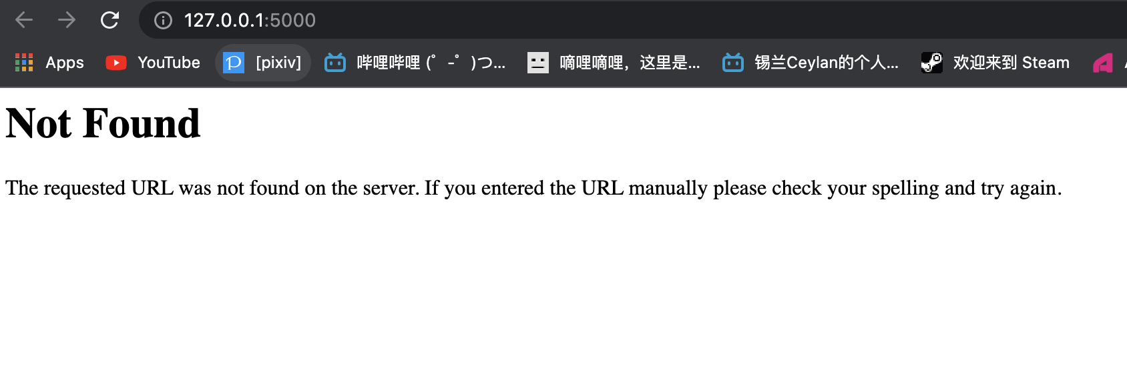
Run program
Run FinalProject.py
Provide a localhost link
Open in browser

Slide 4
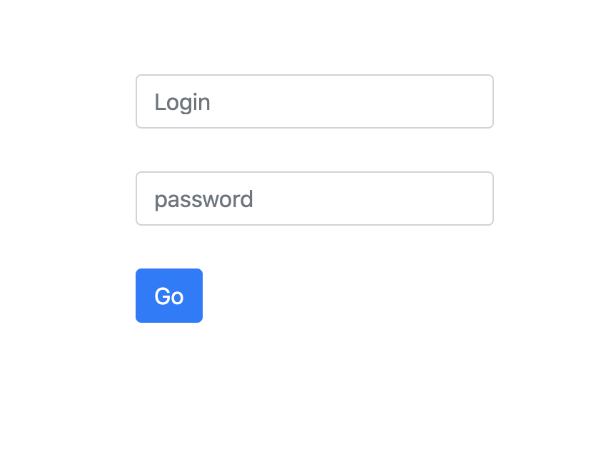

Login page

Slide 5
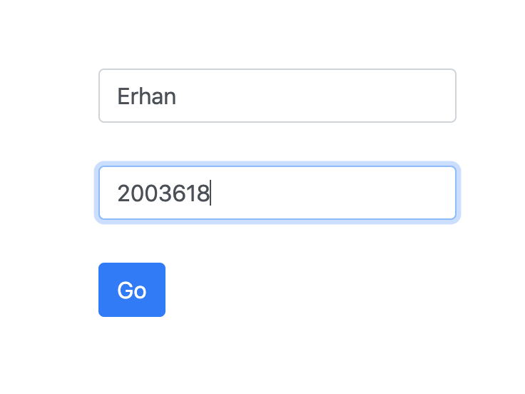
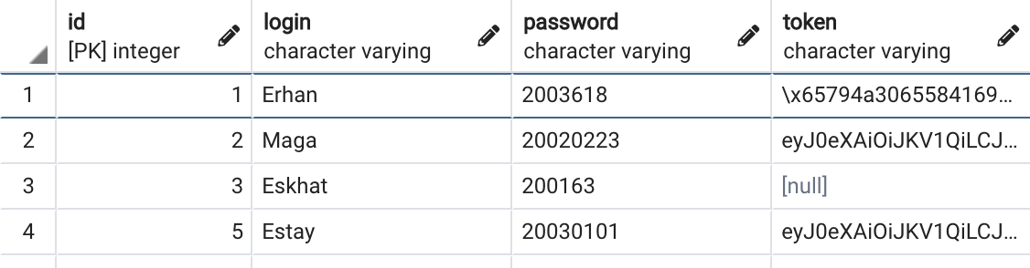
Login
User list

Slide 6
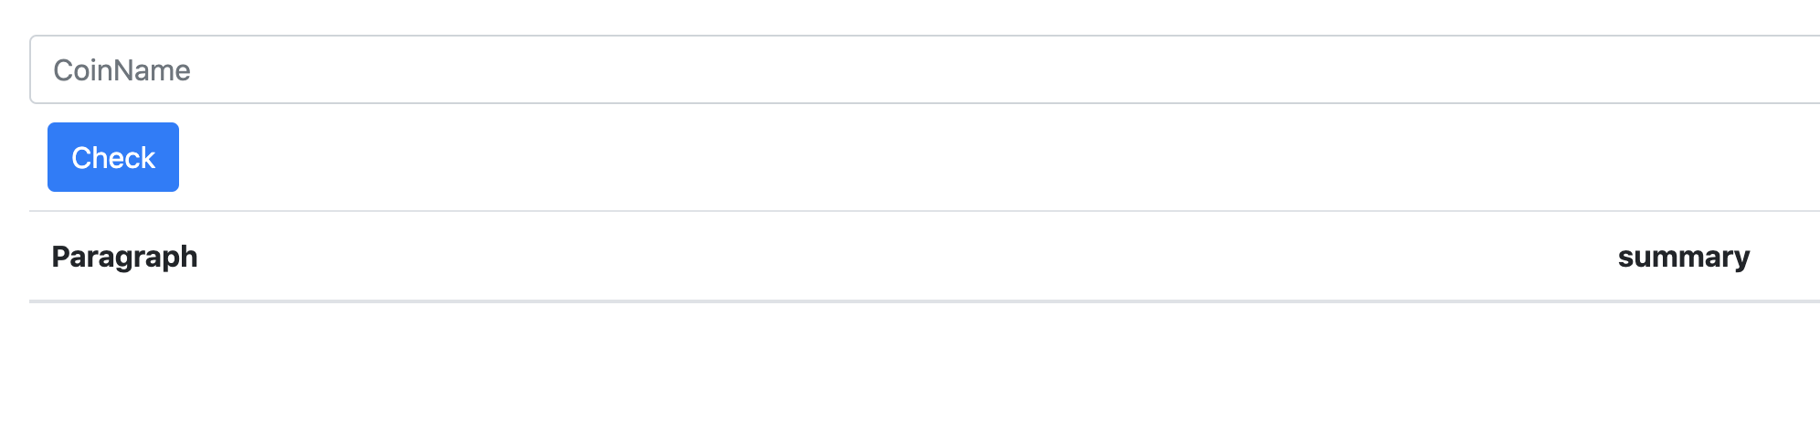
Coin page

Slide 7
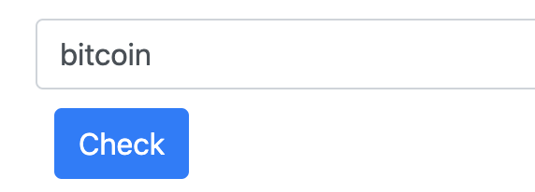
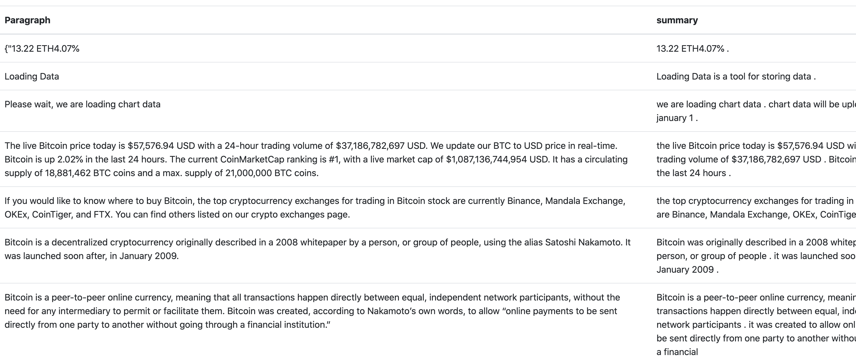
Check

Slide 8
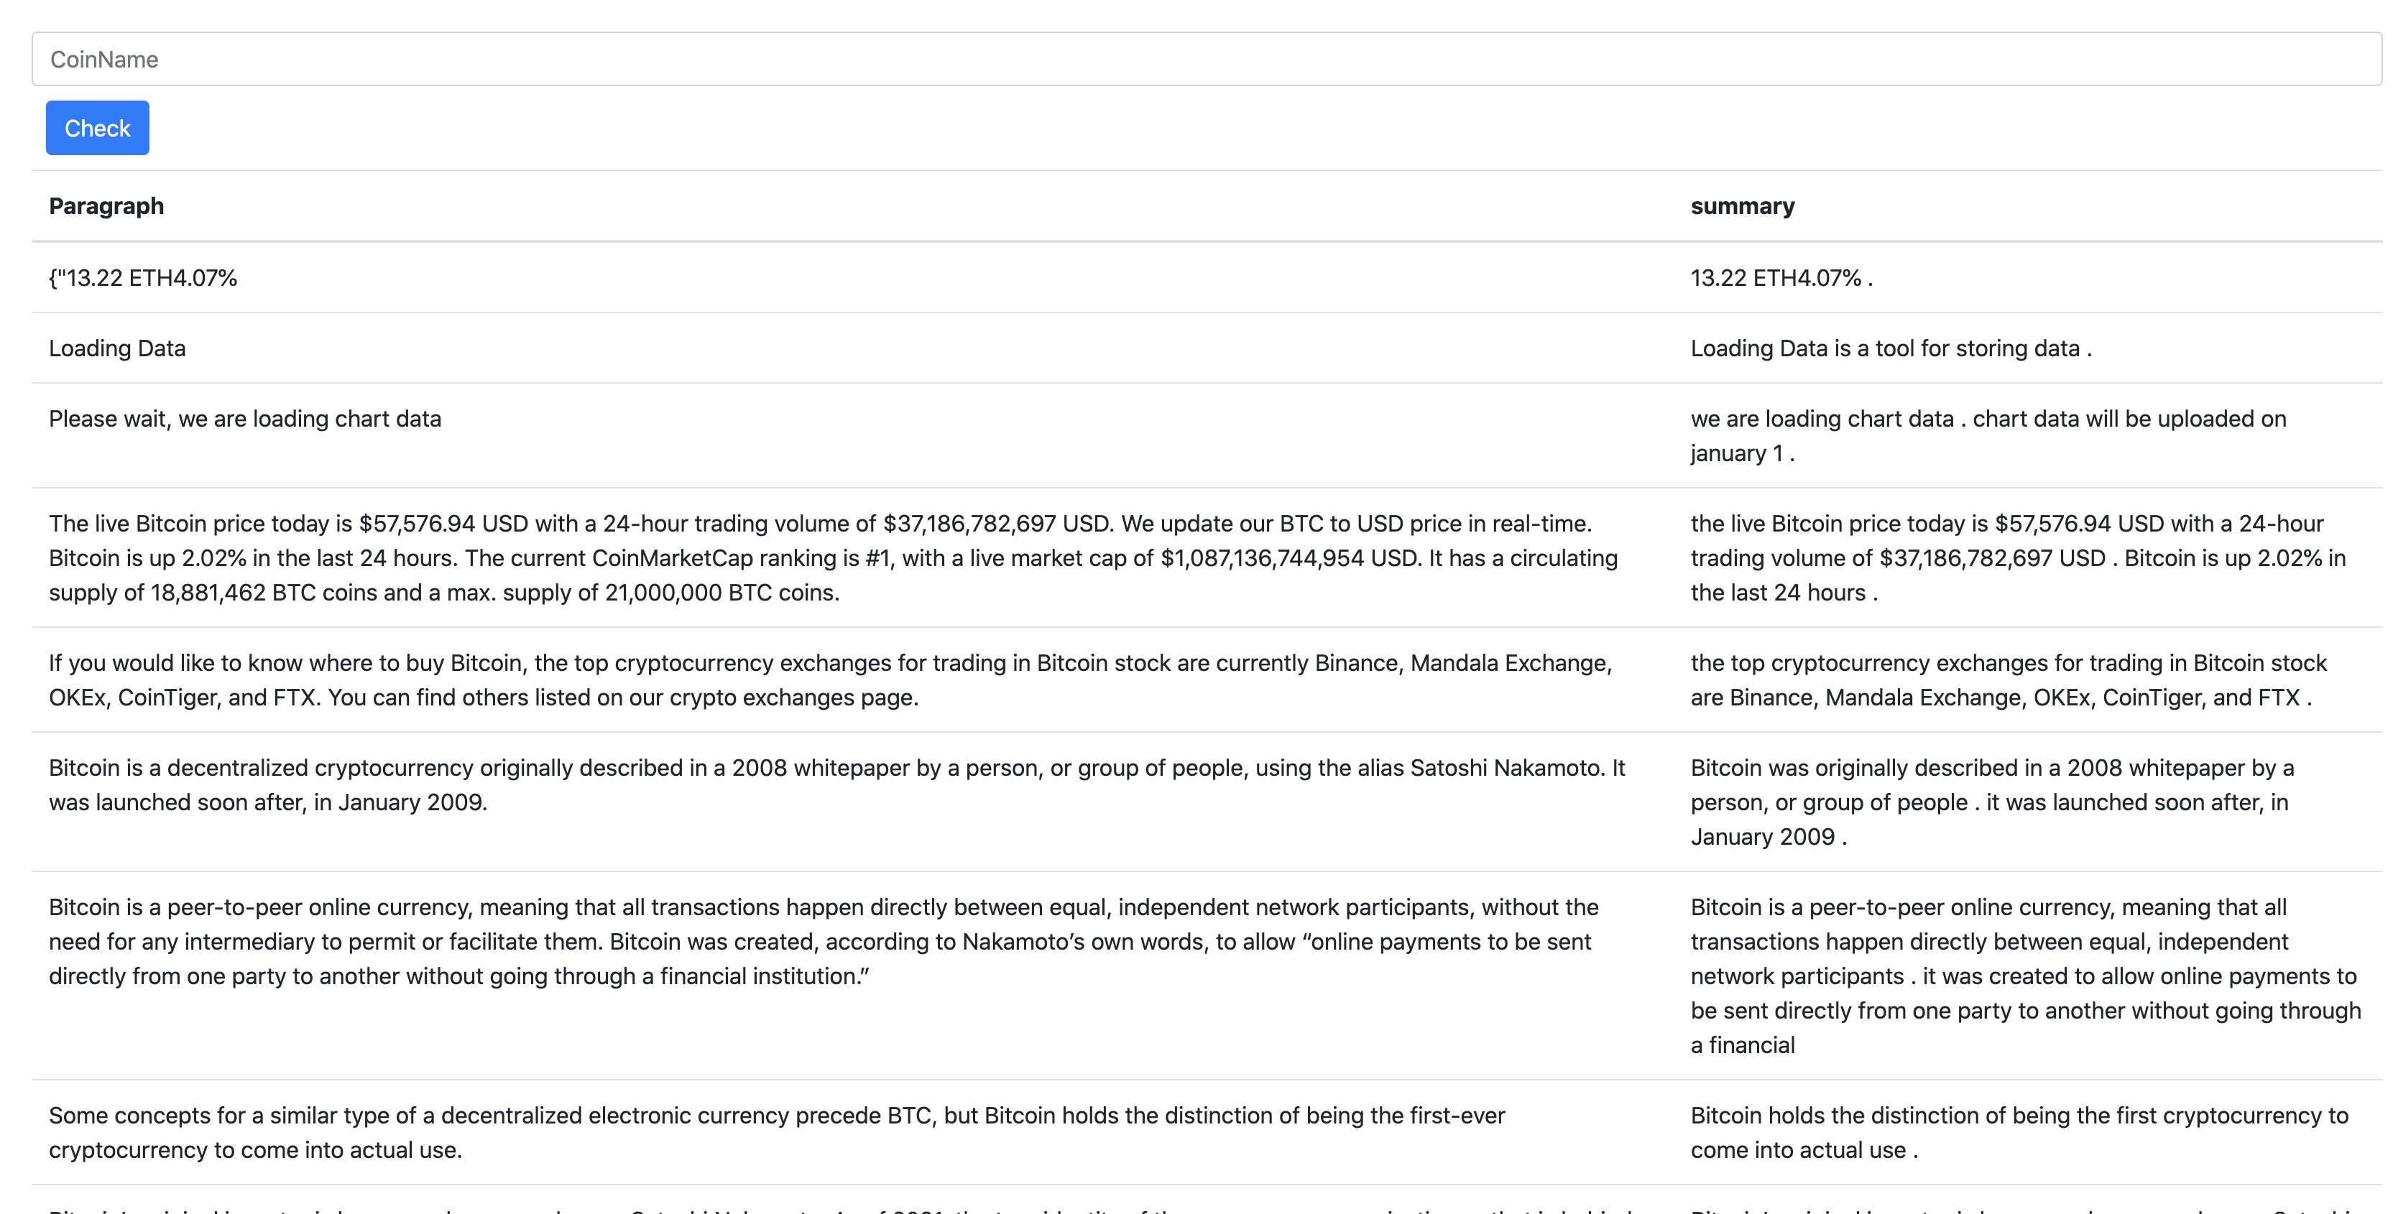

Slide 9
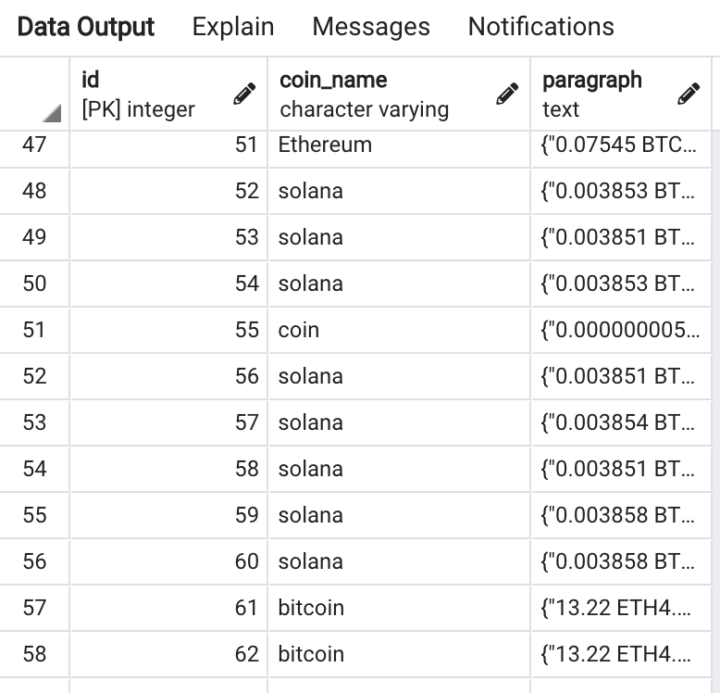
Store the data in database

Slide 10
Github link:
https://github.com/kuroye/Python_FinalProject

Slide 11

Thanks for attention

