Slide 1

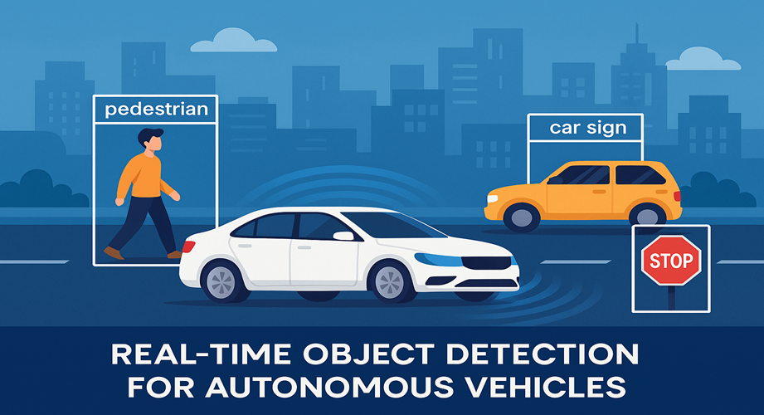
Name : Kurra Shiva Rama Krishna
Student ID: W9638957
Date of Presentation: 09/05/2025
Notes:
Welcome everyone. Today, I’ll present my research on real-time object detection for autonomous vehicles using deep learning, specifically YOLO and CNN models. The study focuses on improving accuracy and speed in vehicle and pedestrian detection, which are critical for safe self-driving operations. Let’s explore the objectives, methodology, findings, and future potential of this work.

Slide 2
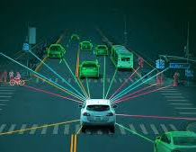
Introduction to Object Detection in Autonomous Vehicles
Object detection is vital for safety and decision-making in autonomous cars.
It allows the vehicle to recognize pedestrians, vehicles, road signs, and obstacles (Alahdal et al., 2024).
Real-time performance is crucial for responding to dynamic driving environments.
Traditional models face latency and accuracy issues.
Deep learning offers promising solutions to enhance object recognition capabilities.
Notes:
Object detection helps self-driving vehicles recognize and respond to their surroundings in real-time. Without accurate detection of pedestrians, road signs, and obstacles, safe navigation is impossible. However, traditional models often fail under poor lighting or weather. Hence, deep learning offers a faster and more accurate alternative, capable of improving road safety and autonomous decision-making.

Slide 3
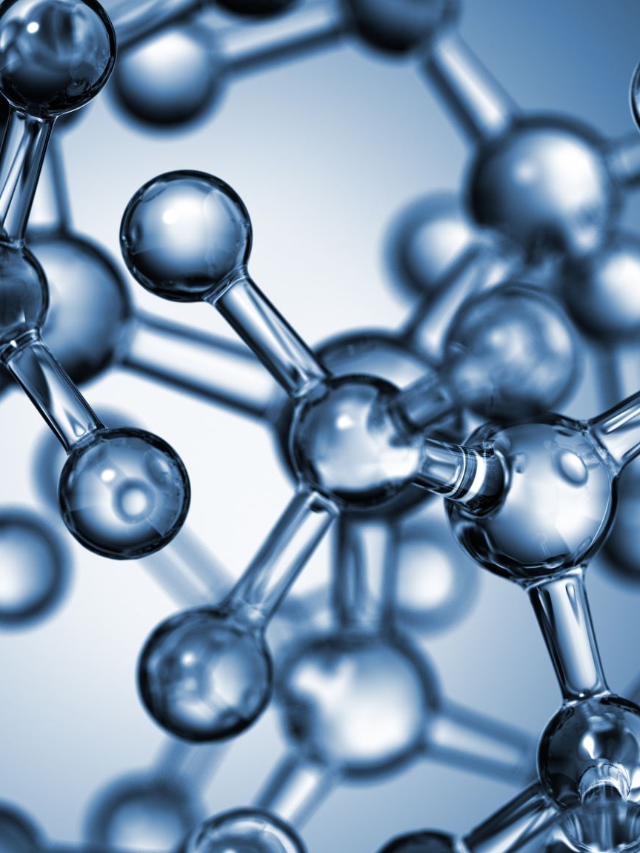
Aim and Research Objectives
Aim
Aim: Implement real-time object detection using YOLO and CNN.
Design
Design vehicle and pedestrian detection system.
Reduce
Reduce latency while maintaining high accuracy.
Evaluate
Evaluate performance using mAP, precision, and recall.
Integrate
Integrate detection with autonomous vehicle navigation.
Notes:
The aim of this project is to implement a real-time object detection system using YOLO and CNN on embedded systems. Key objectives include designing a hybrid detection model, minimizing latency, ensuring accuracy with key performance metrics, and integrating this system into autonomous vehicles for intelligent decision-making. Together, these goals support improved navigation and collision avoidance.

Slide 4
Research Problem and Question
Current models have high latency and low reliability.
Poor performance in bad lighting or weather conditions (Koehrsen, 2023).
Leads to false positives and safety risks.
Research Question: How to balance adaptability, speed, and accuracy?
Notes:
The core issue is balancing real-time performance with precision. Many models either lag in speed or lose accuracy in adverse conditions. They often fail to generalize to new environments, leading to dangerous errors. Our central question explores how to build a real-time detection system that maintains accuracy, adaptability, and speed for autonomous vehicles across various driving conditions.

Slide 5

Methodology Overview
Used Kaggle’s traffic dataset with labeled images (cars, buses, trucks, etc.).
Implemented YOLOv8 and conceptual YOLOv11 models using Python.
Dataset split into training, validation, and testing.
Performance measured using mAP, precision, recall, and FPS (Liang et al., 2022).
Applied CRISP-DM framework to structure data analysis and model evaluation.
Notes:
This study uses Kaggle’s annotated vehicle dataset. We applied supervised learning using YOLOv8 and a conceptual YOLOv11. The CRISP-DM approach guided the workflow: data preparation, modeling, evaluation, and deployment. Models were trained and validated on split datasets. Metrics like mAP, precision, and recall helped assess performance under real-time constraints in a simulated driving environment.

Slide 6
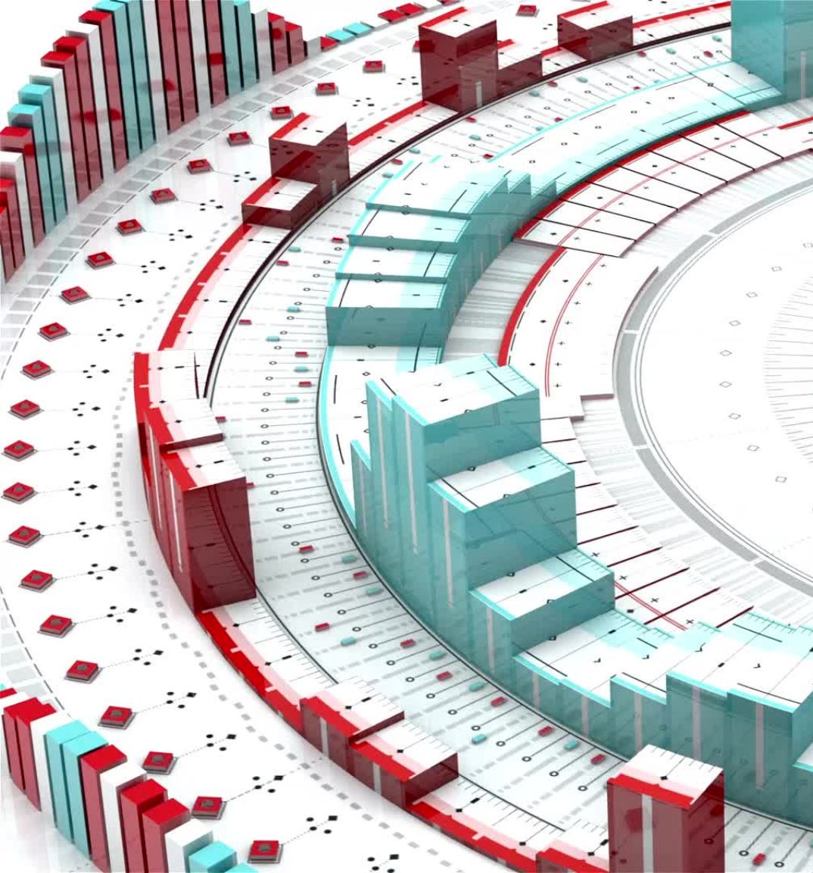
YOLOv8: Efficient Real-Time Detection
YOLOv8 is anchor-free, lightweight, and optimized for edge devices.
Uses CSPDarknet backbone and SPPF for multi-scale detection.
High speed with near real-time performance (7.8 ms per image).
Achieved mAP@0.5 = 0.56 in 10 training epochs.
Best suited for applications with limited computational resources.
Notes:
YOLOv8 offers an anchor-free design, efficient backbone, and excellent speed, ideal for real-time use. With an inference time under 8 milliseconds and mAP@0.5 around 0.56, it performs well on low-resource systems. YOLOv8 also includes built-in augmentation learning and flexible deployment, making it a top choice for applications like smart traffic monitoring and autonomous vehicles.

Slide 7
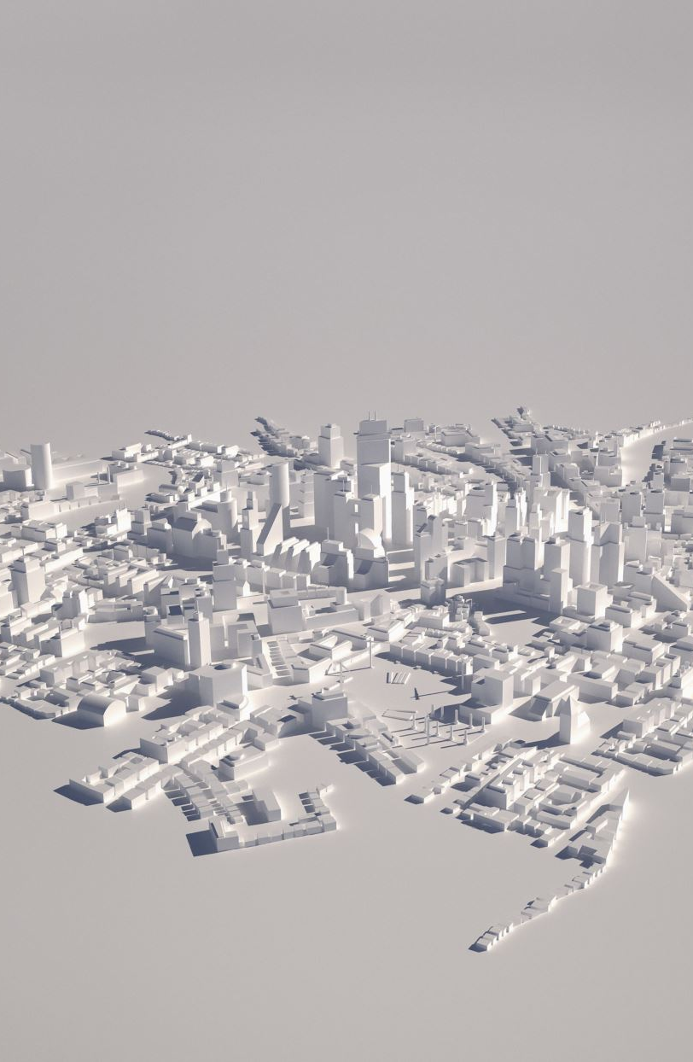
YOLOv11: Future-Ready Object Detection
Hybrid CNN + Transformer architecture (Qian, Lai, and Li, 2022).
Features dynamic attention and self-distillation.
Improved detection of small and occluded objects.
mAP@0.5 around 0.27 in early tests.
Still in conceptual development phase.
Notes:
Some enhancements included in the structure of YOLOv11 are HybridCNN-transformer architecture, Dynamic Optional Attention, and Self-distillation. They are expected to improve the identification of small objects, handling of context, and improvements in generality of the network. However, this only works within a limited set of possibilities, but it is a good beginning for its use in more complicated surroundings in the future. With more training and data, YOLOv11 could outperform previous models in challenging scenarios.

Slide 8
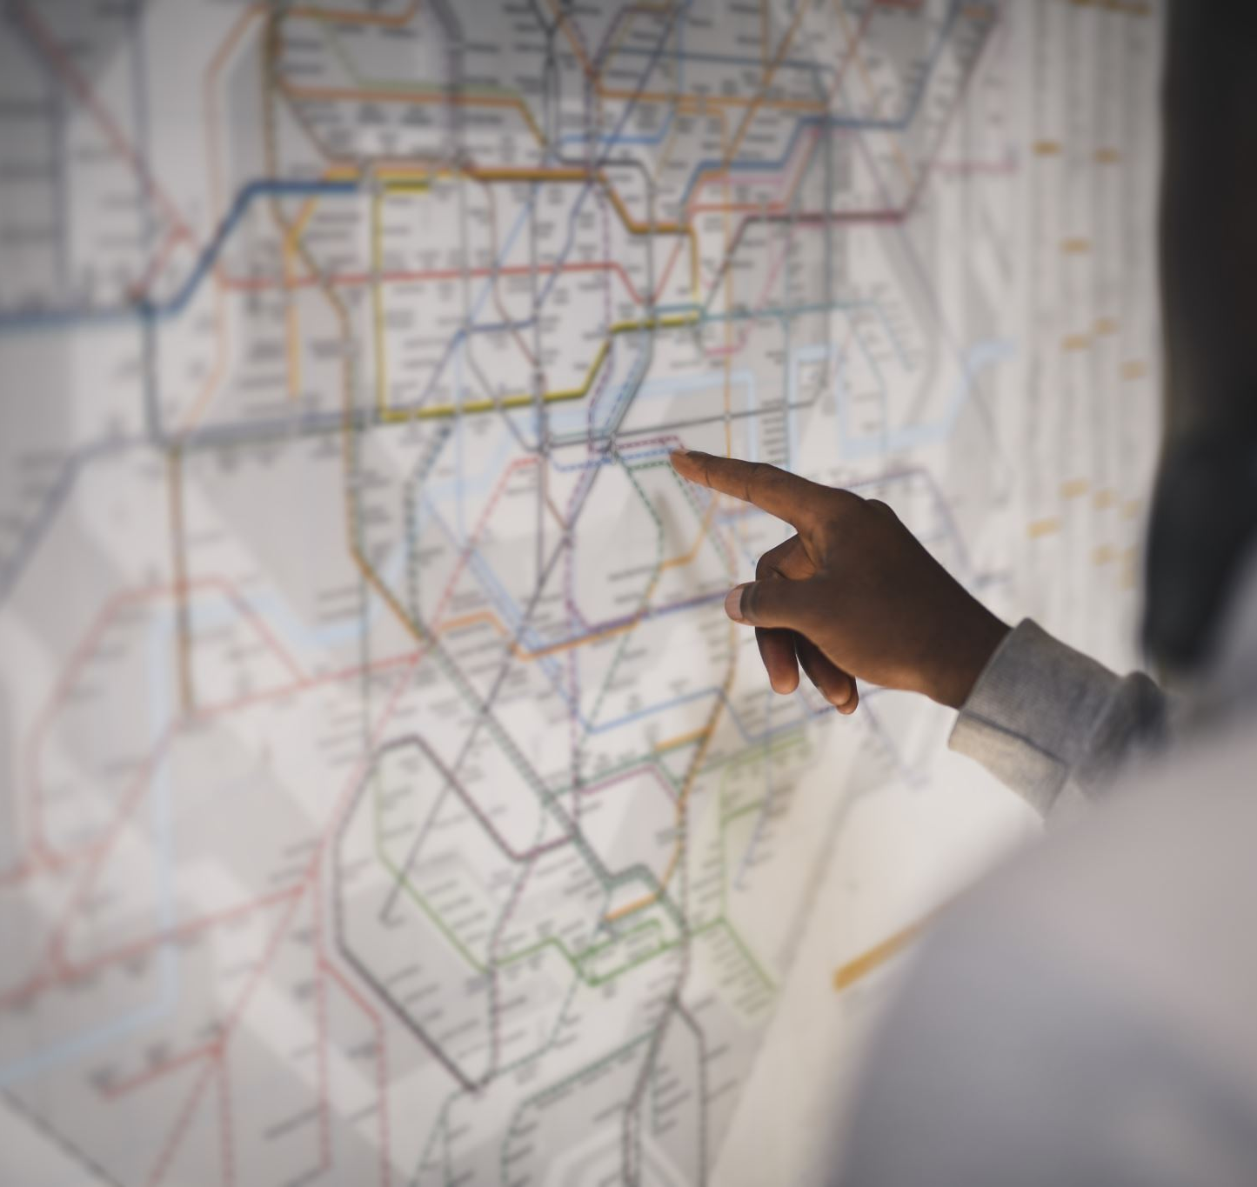
YOLOv8 vs YOLOv11: Performance Comparison
YOLOv8: mAP@0.5 = 0.56 | Faster inference.
YOLOv11: mAP@0.5 = 0.27 | Slower inference.
YOLOv8 better for real-time deployment (Vaithianathan, 2024).
YOLOv11 has potential with further training.
Notes:
By comparing YOLOv8 and YOLOv11. YOLOv8 had better mAP@0.5 and higher speed in comparison to the other models, that made YOLOv8 more suitable for real-time use. YOLOv11, though, was developed relatively more advanced due to the lack of proper training. This proves that sufficient training and adequate dataset is critical when deploying such systems in real practical, real-time environments such as self-driving.

Slide 9
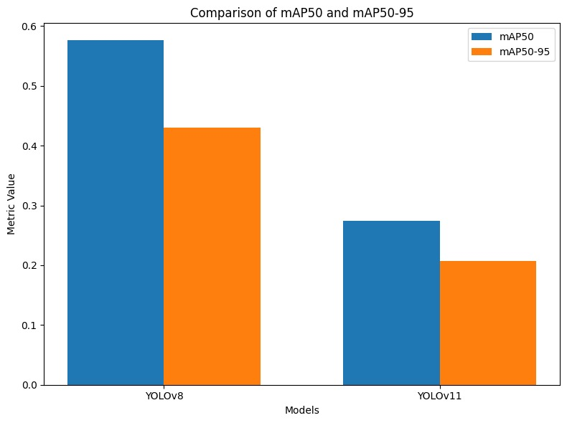
YOLOv8 vs YOLOv11 Performance Comparison
Notes:
By comparing YOLOv8 and YOLOv11. YOLOv8 had better mAP@0.5 and higher speed in comparison to the other models, that made YOLOv8 more suitable for real-time use. YOLOv11, though, was developed relatively more advanced due to the lack of proper training. This proves that sufficient training and adequate dataset is critical when deploying such systems in real practical, real-time environments such as self-driving.

Slide 10
Results
High Accuracy with Low Training Time
Achieved strong mAP@0.5:0.95 after just 10 epochs
Accurate and reliable detection across all vehicle classes
Optimized Architecture for Real-Time Use
Incorporates C2f block and SPPF for efficient multi-scale detection
Lightweight design ideal for real-time and embedded systems
Efficient Training & Monitoring
Used AdamW optimizer with auto hyperparameter tuning
Enabled fast, memory-efficient training with AMP and real-time tracking via TensorBoard
Notes:
"YOLOv8 achieved strong accuracy quickly with just 10 epochs, showing great potential for real-time vehicle detection.“
"Its optimized architecture and training setup made it both fast and reliable, with efficient monitoring through TensorBoard”.

Slide 11
Challenges Encountered
Dataset annotation inconsistencies.
Limited GPU access slowed training.
Balancing accuracy vs. speed was difficult (Yusuf, Muhammad Hanzla and Jalal, 2024).
Hyperparameter tuning was time-consuming.
Deployment on edge devices required optimization.
Notes:
Several challenges emerged. There was a poor and uneven quality of the dataset, which needed to be cleaned by hand. This was due to lack of hardware resources hence delaying the training processes of the models. Maintaining high speed and maintaining accuracy was a problem for the solution when it was implemented on edge devices. Hyperparameter tuning was time-consuming. YOLOv11’s complexity made deployment harder. These issues highlight some of the realities in real-time object detection projects where one has to deal with possible performance gains while at the same time contemplating on feasibility and efficiency.

Slide 12

Conclusion and Future Scope
YOLOv8 is practical and accurate for real-time use.
YOLOv11 needs more data and tuning.
Future: diverse datasets, edge computing integration.
Combine detection with full AV decision systems.
Explore ethical AI and deployment at scale.
Notes:
In conclusion, YOLOv8 is feasible for real-time detection and it works with a comparatively good efficiency and high speed. Also, for YOLOv11, it is to note that it has a great potential, yet, for the outputs to be optimized, it requires more training. For the future wort, improvement of the used dataset, rising the robustness of the models, and the integration of the detectors into full autonomous control systems should be potential fields. There are more opportunities for improvement regarding edge computing and ethical practices of using artificial intelligence applications.

Slide 13
References
Alahdal, N.M., Abukhodair, F., Meftah, L.H. and Cherif, A., 2024. Real-time Object Detection in Autonomous Vehicles with YOLO. Procedia Computer Science, 246, pp.2792-2801.
Koehrsen, W. 2023. When Accuracy Isn’t Enough, Use Precision and Recall to Evaluate Your Classification Model. [Online]. Available at: https://builtin.com/data-science/precision-and-recall.
Liang, S., Wu, H., Zhen, L., Hua, Q., Garg, S., Kaddoum, G., Hassan, M.M. and Yu, K., 2022. Edge YOLO: Real-time intelligent object detection system based on edge-cloud cooperation in autonomous vehicles. IEEE Transactions on Intelligent Transportation Systems, 23(12), pp.25345-25360.
Qian, R., Lai, X. and Li, X., 2022. 3D object detection for autonomous driving: A survey. Pattern Recognition, 130, p.108796.
Vaithianathan, M., 2024. Real-Time Object Detection and Recognition in FPGA-Based Autonomous Driving Systems. International Journal of Computer Trends and Technology, 72(4), pp.145-152.
Yusuf, M.O., Muhammad Hanzla and Jalal, A. 2024. Vehicle Detection and Classification via YOLOv4 and CNN over Aerial Images. [Online] Available at: https://www.researchgate.net/publication/380426102_Vehicle_Detection_and_Classification_via_YOLOv4_and_CNN_over_Aerial_Images.

