Slide 1
DronePort
Case Programming Tasks & Case Study
10.2025

Slide 2
Programming Tasks
1. Take a look at cpp_task.cpp
  What is the code doing, are there any issues, and if so how to fix them?
2. Take a look at python_task.py
  The code tries to rotate a matrix 90° but it fails, fix it.

Slide 3
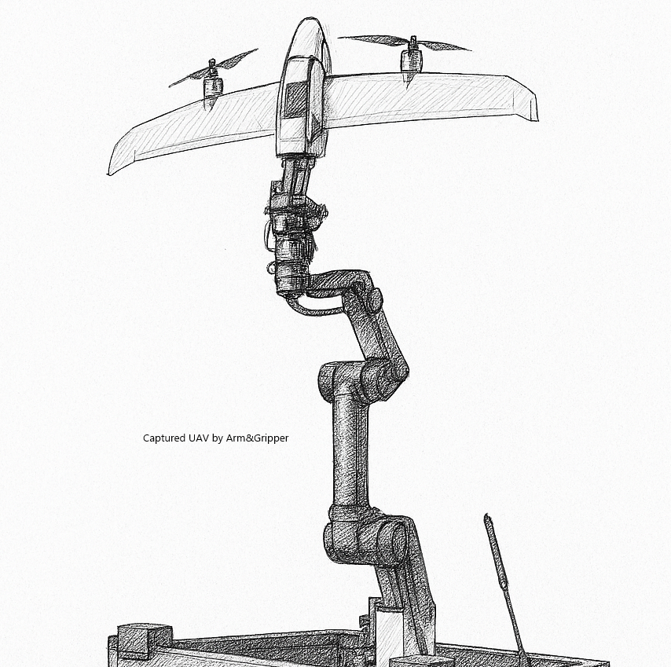
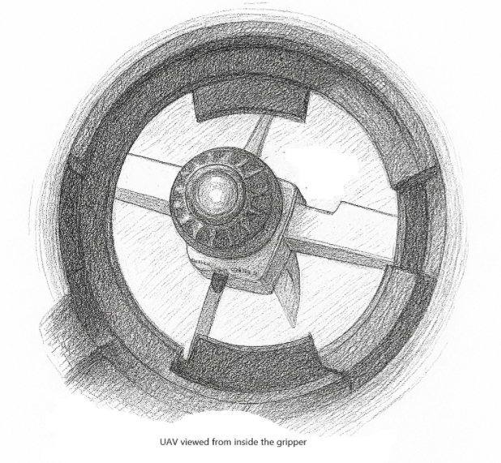
Case Study
Catch an UAV
  Available HW
    Robot Arm (for example UR10)
    Gripper system(capable to hold an UAV)
      Gripper has integrated full HD camera
      (FOV like in the scatches)
  Challenge
  * no ready sw solution is required only technical path how to achive it
    What kind of algorithm could be used to track ( 3d. i.e. XYZ Achses) and capture the drone?
    What are the challanges to use a single camera as sensor and how to resolve them?
    What other approaches (sensors, etc) then a single camera would you use?

