Slide 1
Quarterly Review
Product team, Q4

Slide 2
Highlights
Launched the new onboarding flow
  Activation up 18%
  Support tickets down 12%
Shipped 3 major integrations
Notes:
Mention the onboarding experiment results.

Slide 3
Roadmap
Quarter | Focus | Status
Q1 | Mobile app | Planned
Q2 | Offline mode | Planned
Q3 | API v2 | Idea

Slide 4
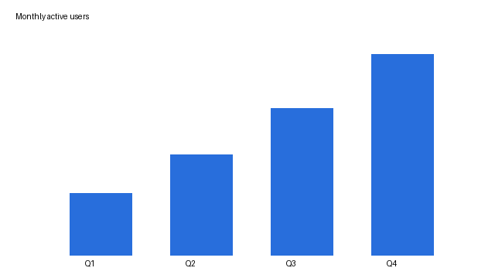
Growth

